Slide 1
HIVE

Slide 2
Agenda
What is Hive?
Why use Hive?
Hive features
Hive architecture
Demo

Slide 3
Hive
Data warehouse system for Hadoop
Enables Extract/Load/Transform (ETL)
Associate structure with a variety of data formats
Stored in Hive metastore
Access to files in HDFS, Hbase etc.
Query execution in Mapreduce

Slide 4
Why Hive?
MapReduce is catered towards developers
Run SQL-like queries that get compiled and run as MapReduce jobs
Data in Hadoop even through generally unstructured has some vague structure associated with it
Benefits of MapReduce
Fault tolerant
Robust
Scalable

Slide 5
Hive Features
Create table, create view, create index –DDL
Select, where clause, group by, order by and joins
Pluggable:
User Defined Functions - UDFs
User Defined Aggregate Functions - UDAF
User Defined Table Functions – UDTF
Pluggable custom Input/output formats
Pluggable Serialization Deserialization libraries (SerDes)

Slide 6
Hive Features
Pluggable custom map/reduce scripts
Partitioning
Sampling
Bucketing
Various kinds of optimized joins
Views
Complex data types- structs, arrays, maps
Integration with Hbase and other storage handlers

Slide 7
What Hive does not support
OLTP workloads- low latency
Correlated subqueries
Not super performance with small amounts of data

Slide 8
Connecting to Hive
Hive Shell
JDBC Driver
ODBC Driver
Thrift Client

Slide 9
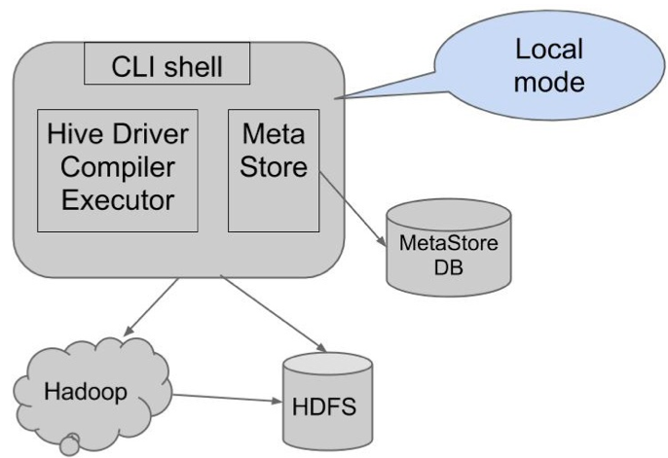
Hive Architecture

Slide 10
Hive Metastore
Persists Schema
Default embedded is Derby
Not recommended for anything but POC
3 different modes of configurations:
Embedded Derby (Default)
Local
Remote

Slide 11
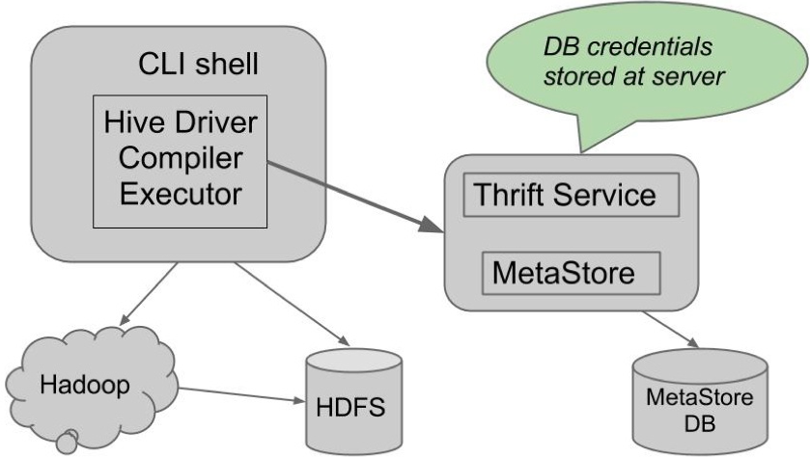
Hive Remote Mode

Slide 12
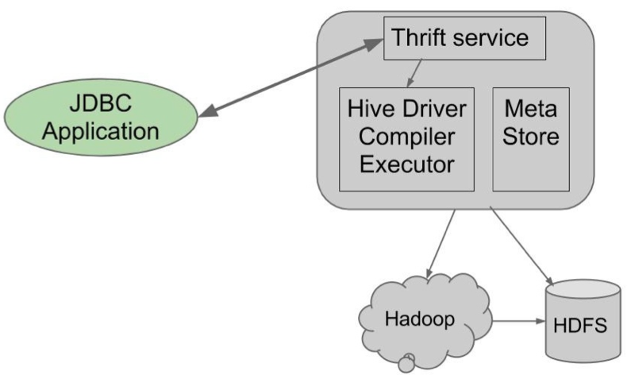
Hive Server

Slide 13
Problems with Hive Server
No sessions/concurrency
Essentially need one server per client

Slide 14
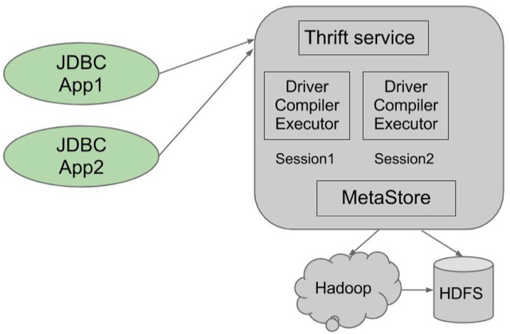
Hive Server 2

Slide 15
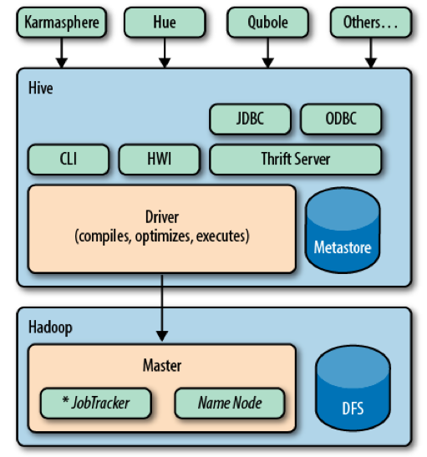
Hive Architecture

Slide 16
Hive Architecture
Compiler
Parser
Type Checking
Semantic Analyzer
Plan generation
Task generation

Slide 17
Hive Architecture
Execution Engine
Plan
Operators
SerDes
UDFs/UDAFs/UDTFs
Metastore
Stores schema of data
HCatalog

Slide 18
Architecture Summary
Use remote metastore service for sharing the metastore with Hcatalog and other tools
Use Hive Server 2 for concurrent queries

Slide 19
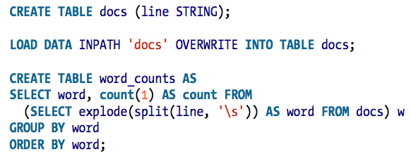
Word Count-HIVE

Slide 20
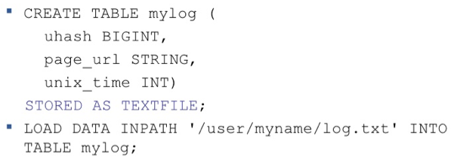
Storage Formats

Slide 21
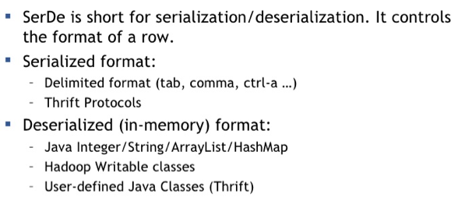
Serialization Formats

Slide 22
Sorting the rows returned
SORT BY
May use Multiple reducers for final output
Sorts the data per reducer
Only guarantees ordering of rows within a reducer
May give partially ordered final results
ORDER BY
Uses a single reducer to guarantee total order in input
Single reducer will take a long time to sort very large outputs
Use the LIMIT clause to reduce sort time

Slide 23
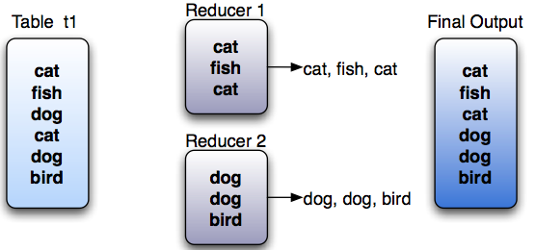
DISTRIBUTE BY
DISTRIBUTE BY:
Distributes the rows among reducers
Useful if there is a need to partition and sort the output of a query
Example:
SELECT pets FROM t1 DISTRIBUTE BY pets;

Slide 24
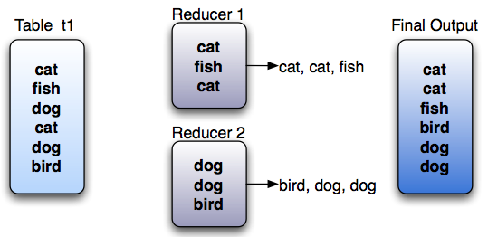
CLUSTER BY
Combination of DISTRIBUTE BY and SORT BY
Rows with same keys are distributed to same reducer
Clustered in adjacent positions and sorted per reducer
Example: SELECT pets FROM t1 CLUSTER BY pets;

Slide 25
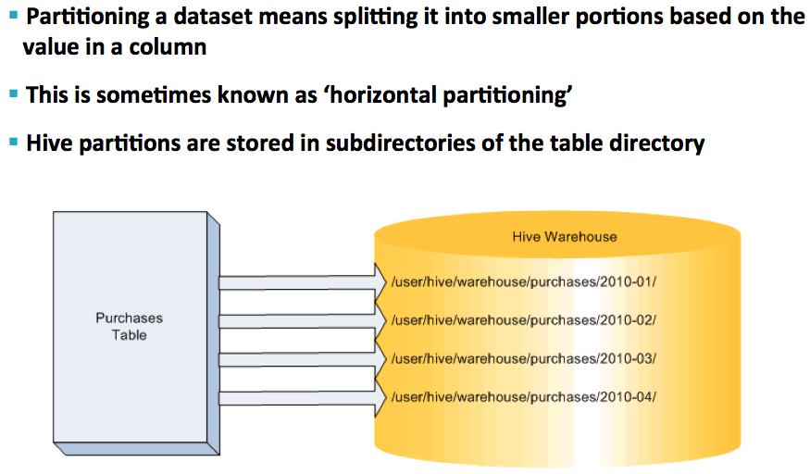
What is Partitioning?

Slide 26
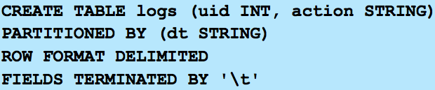

Why Parititioning
Partitioning allows to filter at input path level itself.

Slide 27

What is Bucketing?
Data is split into buckets based on the hash key of a column of the incoming data
Intended to produce an even distribution of rows across n buckets
Useful for jobs which just work on a ‘random’ portion of the data

Slide 28
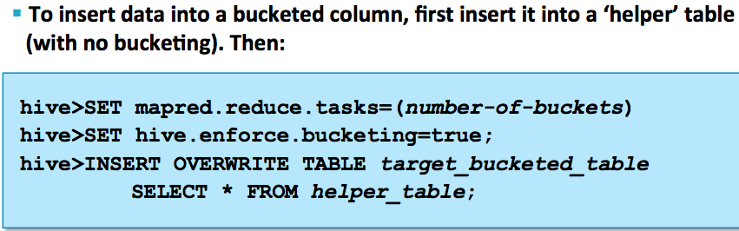
Inserting Data Into A Bucketed Table

Slide 29
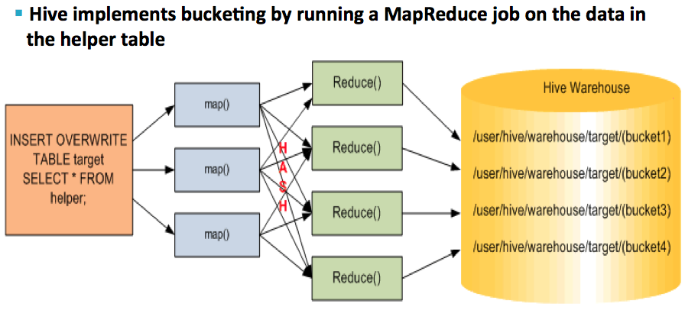
Inserting Data Into A Bucketed Table

Slide 30
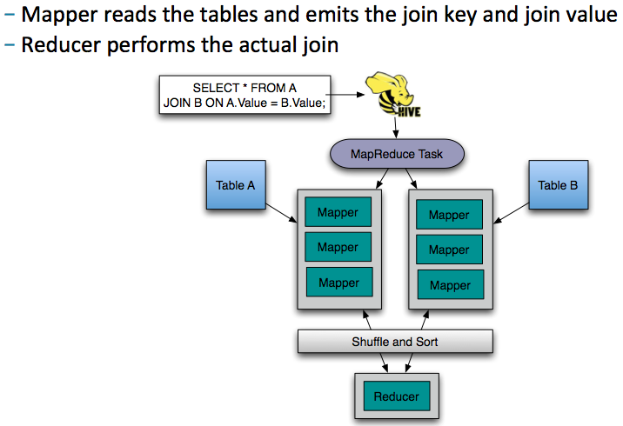
Reduce Side Join

Slide 31
Map Side Join
Reads the smaller table in memory hashtable
Each mapper gets its own copy of the hashtable
This join is performed in the map
No reduce or sort or shuffle phases are required!

Slide 32
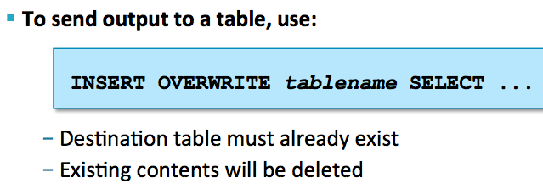
Writing Output To A Table

Slide 33

Multitable Insert

Slide 34
Using ThriftSerDe
CREATE EXTERNAL TABLE IPFix
PARTITIONED BY (binInterval INT)
ROW FORMAT SERDE 'org.apache.hadoop.hive.serde2.thrift.ThriftDeserializer'
With serdeproperties(
"serialization.format"="org.apache.thrift.protocol.TBinaryProtocol",
"serialization.class"="collector.adapters.IpfixFlowRecordIdl”
)
STORED AS SEQUENCEFILE;

Slide 35
Add Partition
ALTER TABLE ipfix
ADD IF NOT EXISTS PARTITION (bininterval=1358208000)
LOCATION 'hdfs://192.168.0.224:9000/user/hive/warehouse/ipfix';
ALTER TABLE ipfix PARTITION
(bininterval=1358208000)
SET LOCATION
'hdfs://192.168.0.224:9000/data/jk/ipfix/15/00/00/Naperville.IPFIX.1358208000.0';

Slide 36
SQL- Add Partition
hadoop dfs -du /data/jk/ipfix/15/*/* |
egrep "0$" | sed 's/^.*hdfs/hdfs/g' |
awk -F. '{print "ALTER TABLE ipfix
ADD IF NOT EXISTS PARTITION (bininterval="$6") location '\''hdfs:// 192.168.0.224:9000/user/hive/warehouse/ ipfix'\'';
ALTER TABLE ipfix PARTITION(bininterval="$6") set location '\''" $_"'\'';"}'

Slide 37
Hive
https://confluence.guavus.com/display/OAM/Hive+IOG
https://confluence.guavus.com/display/CRUX/Hive+with+PostGreSQL

Slide 38
Subqueries
Hive supports subqueries in the FROM clause
It does not support correlated subqueries

Slide 39
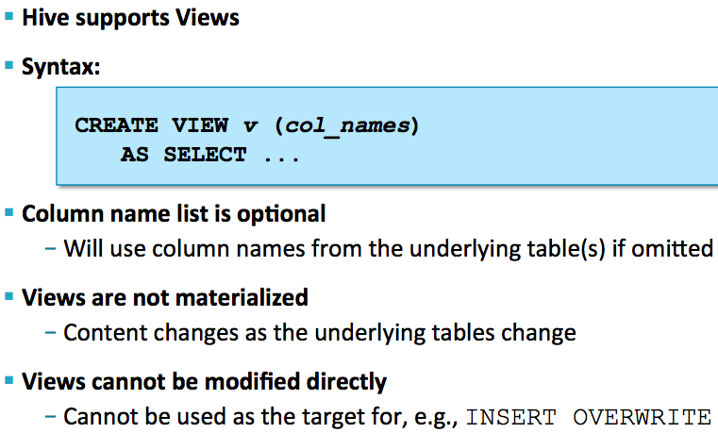
Views

Slide 40
Others
Hive Variables
Hive CLI
Hive with Thrift
TRANSFORM
Custom SerDe
Custom UDF
Custom UDAF
Custom UDTF

Slide 41
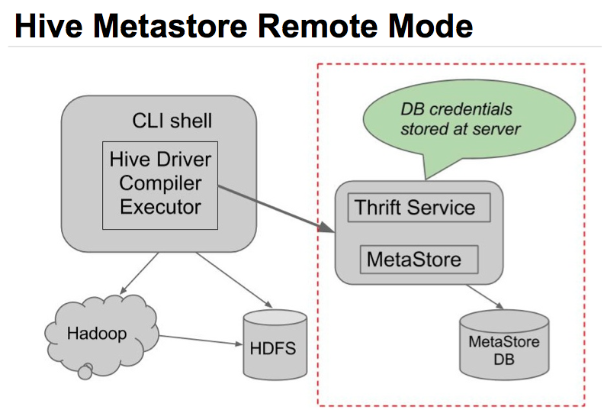
HCatalog

Slide 42
HCatalog
Table and storage management service
Metastore contains information of interest to other tools like pig
Expose that information as REST api
WebHCat: Web Server for engaging with the Hive metastore

Slide 43
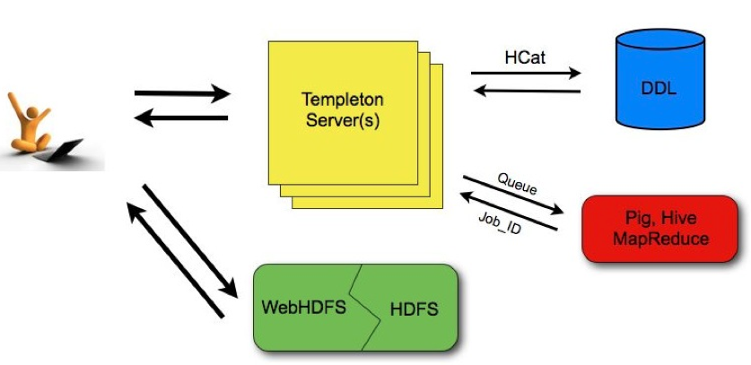
WebHCat

Slide 44
Applications of Hive
Web Analytics
Retail
Healthcare
Spam detection
Data mining
Ad optimization

