Slide 1
Apache Kafka 0.8 basic training

Slide 2
Kafka?
Part 1: Introducing Kafka
Part 2: Kafka core concepts
Topics, partitions, replicas, producers, consumers, brokers
Part 3: Operating Kafka
Architecture, hardware specs, deploying, monitoring, P&S tuning
Part 4: Developing Kafka apps
Writing to Kafka, reading from Kafka, testing, serialization, compression, example apps
Wrapping up

Slide 3
Part 1: Introducing Kafka

Slide 4
Overview of Part 1: Introducing Kafka
Kafka?
Kafka adoption and use cases in the wild
At LinkedIn
At other companies
How fast is Kafka, and why?
Kafka + X for processing
Storm, Samza, Spark Streaming, custom apps

Slide 5
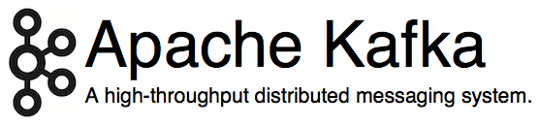
Kafka?
http://kafka.apache.org/
Originated at LinkedIn, open sourced in early 2011
Implemented in Scala, some Java
9 core committers, plus ~ 20 contributors
https://kafka.apache.org/committers.html
https://github.com/apache/kafka/graphs/contributors

Slide 6
Kafka?
LinkedIn’s motivation for Kafka was:
“A unified platform for handling all the real-time data feeds a large company might have.”
Must haves
High throughput to support high volume event feeds.
Support real-time processing of these feeds to create new, derived feeds.
Support large data backlogs to handle periodic ingestion from offline systems.
Support low-latency delivery to handle more traditional messaging use cases.
Guarantee fault-tolerance in the presence of machine failures.
http://kafka.apache.org/documentation.html#majordesignelements
Notes:
Kafka is designed to be able to act as a unified platform for handling all the real-time data feeds a large company might have. To do this kafka had to think through a fairly broad set of use cases.
It would have to have high-throughput to support high volume event streams such as real-time log aggregation.
It would need to deal gracefully with large data backlogs to be able to support periodic data loads from offline systems.
It also meant the system would have to handle low-latency delivery to handle more traditional messaging use-cases.
We wanted to support partitioned, distributed, real-time processing of these feeds to create new, derived feeds. This motivated our partitioning and consumer model.
Finally in cases where the stream is fed into other data systems for serving we new the system would have to be able to guarantee fault-tolerance in the presence of machine failures.
Supporting these uses led use to a design with a number of unique elements, more akin to a database log then a traditional messaging system. Some of which will be covered in the following slides.

Slide 7
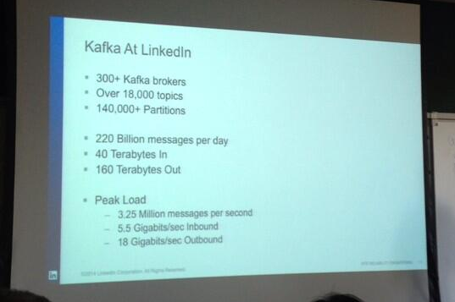
Kafka @ LinkedIn, 2014
(Numbers have increased since.)
https://twitter.com/SalesforceEng/status/466033231800713216/photo/
http://www.hakkalabs.co/articles/site-reliability-engineering-linkedin-kafka-service
1

Slide 8
Kafka @ LinkedIn, 2014
Multiple data centers, multiple clusters
Mirroring between clusters / data centers
What type of data is being transported through Kafka?
Metrics: operational telemetry data
Tracking: everything a LinkedIn.com user does
Queuing: between LinkedIn apps, e.g. for sending emails
To transport data from LinkedIn’s apps to Hadoop, and back
In total ~ 200 billion events/day via Kafka
Tens of thousands of data producers, thousands of consumers
7 million events/sec (write), 35 million events/sec (read) <<< may include replicated events
But: LinkedIn is not even the largest Kafka user anymore as of 2014
http://www.hakkalabs.co/articles/site-reliability-engineering-linkedin-kafka-service
http://www.slideshare.net/JayKreps1/i-32858698
http://search-hadoop.com/m/4TaT4qAFQW1
Notes:
Telemetry is the highly automated communications process by which measurements are made and other data collected at remote or inaccessible points and transmitted to receiving equipment for monitoring.
LinkedIn apps:
Reading List by Amazon
WordPress
SlideShare Presentations
Events
Company Buzz

Slide 9
Staffing: Kafka team @ LinkedIn
Team of 8+ engineers
Site reliability engineers (Ops): at least 3
Developers: at least 5
SRE’s as well as DEV’s are on call 24x7
https://kafka.apache.org/committers.html
http://www.hakkalabs.co/articles/site-reliability-engineering-linkedin-kafka-service

Slide 10
Kafka adoption and use cases
LinkedIn: activity streams, operational metrics, data bus
400 nodes, 18k topics, 220B msg/day (peak 3.2M msg/s), May 2014
Netflix: real-time monitoring and event processing
Twitter: as part of their Storm real-time data pipelines
Spotify: log delivery (from 4h down to 10s), Hadoop
Loggly: log collection and processing
Mozilla: telemetry data
Airbnb, Cisco, Gnip, InfoChimps, Ooyala, Square, Uber, …
https://cwiki.apache.org/confluence/display/KAFKA/Powered+By

Slide 11
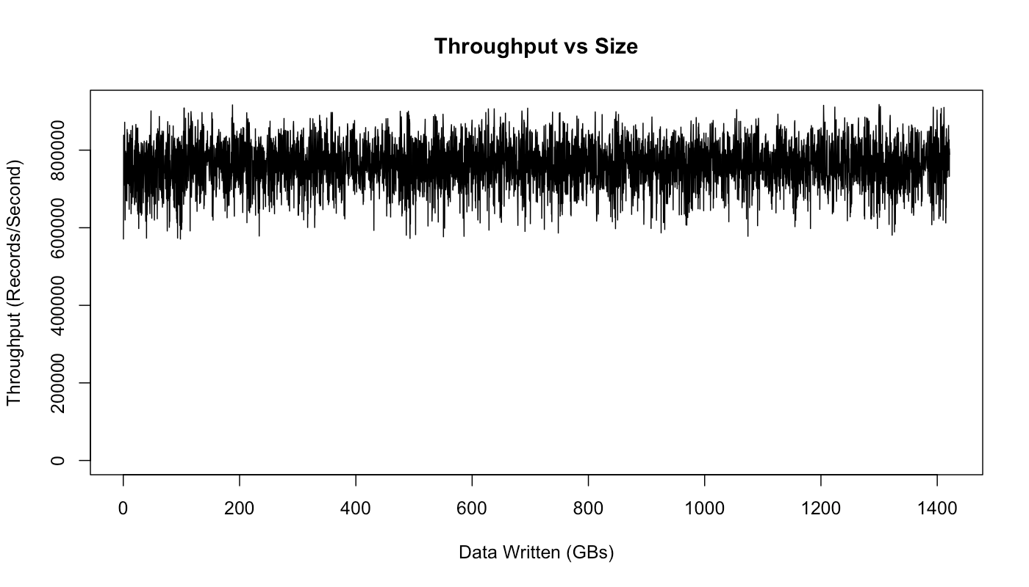
How fast is Kafka?
“Up to 2 million writes/sec on 3 cheap machines”
Using 3 producers on 3 different machines, 3x async replication
Only 1 producer/machine because NIC already saturated
Sustained throughput as stored data grows
Slightly different test config than 2M writes/sec above.
Test setup
Kafka trunk as of April 2013, but 0.8.1+ should be similar.
3 machines: 6-core Intel Xeon 2.5 GHz, 32GB RAM, 6x 7200rpm SATA, 1GigE
http://engineering.linkedin.com/kafka/benchmarking-apache-kafka-2-million-writes-second-three-cheap-machines

Slide 12
Why is Kafka so fast?
Fast writes:
While Kafka persists all data to disk, essentially all writes go to the page cache of OS, i.e. RAM.
Cf. hardware specs and OS tuning (we cover this later)
Fast reads:
Very efficient to transfer data from page cache to a network socket
Linux: sendfile() system call
Combination of the two = fast Kafka!
Example (Operations): On a Kafka cluster where the consumers are mostly caught up you will see no read activity on the disks as they will be serving data entirely from cache.
http://kafka.apache.org/documentation.html#persistence

Slide 13
Kafka + X for processing the data?
Kafka + Storm often used in combination, e.g. Twitter
Kafka + custom
“Normal” Java multi-threaded setups
Akka actors with Scala or Java, e.g. Ooyala
Recent additions:
Samza (since Aug ’13) – also by LinkedIn
Spark Streaming, part of Spark (since Feb ’13)
Kafka + Camus for Kafka->Hadoop ingestion
https://cwiki.apache.org/confluence/display/KAFKA/Powered+By

Slide 14
Part 2: Kafka core concepts

Slide 15
Overview of Part 2: Kafka core concepts
A first look
Topics, partitions, replicas, offsets
Producers, brokers, consumers
Putting it all together

Slide 16
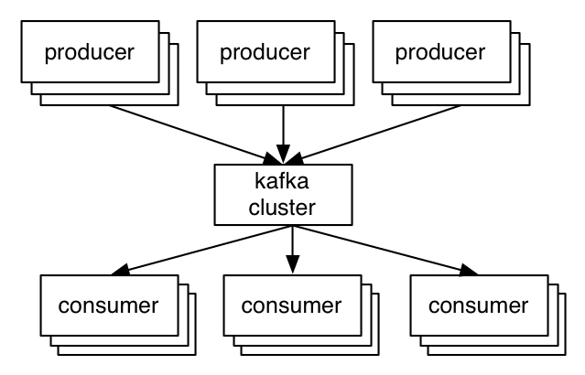
A first look
The who is who
Producers write data to brokers.
Consumers read data from brokers.
All this is distributed.
The data
Data is stored in topics.
Topics are split into partitions, which are replicated.

Slide 17
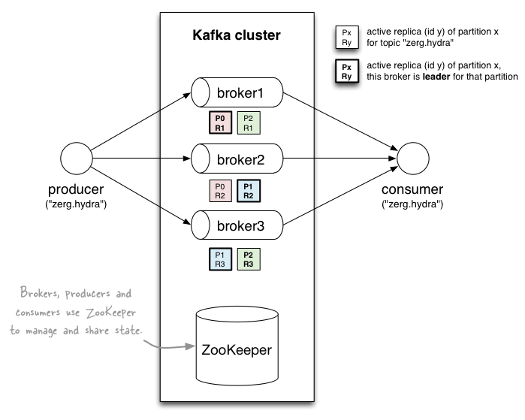
A first look
http://www.michael-noll.com/blog/2013/03/13/running-a-multi-broker-apache-kafka-cluster-on-a-single-node/

Slide 18
Topics
Topic: feed name to which messages are published
Example: “zerg.hydra”
Kafka prunes “head” based on age or max size or “key”
Producer A1
Kafka topic
Producer A2
…
…
new
Producer An
Older msgs
Newer msgs
Producers always append to “tail”
(think: append to a file)
Broker(s)

Slide 19
Topics
Consumer group C1
Consumers use an “offset pointer” to
track/control their read progress
(and decide the pace of consumption)
Consumer group C2
Producer A1
Producer A2
…
…
new
Producer An
Older msgs
Newer msgs
Producers always append to “tail”
(think: append to a file)
Broker(s)

Slide 20
Topics
Creating a topic
CLI
$ kafka-topics.sh --zookeeper zookeeper1:2181 --create --topic zerg.hydra \ --partitions 3 --replication-factor 2 \ --config x=y

Slide 21
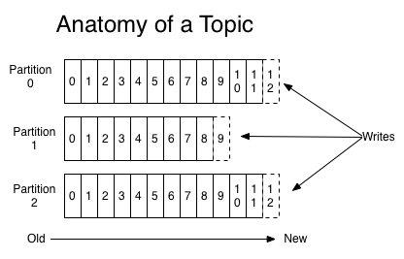
Partitions
A topic consists of partitions.
Partition: ordered + immutable sequence of messages that is continually appended to

Slide 22
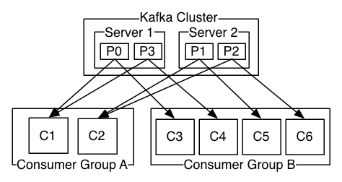
Partitions
#partitions of a topic is configurable
#partitions determines max consumer (group) parallelism
Cf. parallelism of Storm’s KafkaSpout via builder.setSpout(,,N)
Consumer group A, with 2 consumers, reads from a 4-partition topic
Consumer group B, with 4 consumers, reads from the same topic

Slide 23
Partition offsets
Offset: messages in the partitions are each assigned a unique (per partition) and sequential id called the offset
Consumers track their pointers via (offset, partition, topic) tuples
Consumer group C1

Slide 24
Replicas of a partition
Replicas: “backups” of a partition
They exist solely to prevent data loss.
Replicas are never read from, never written to.
They do NOT help to increase producer or consumer parallelism!
Kafka tolerates (numReplicas - 1) dead brokers before losing data
LinkedIn: numReplicas == 2 → 1 broker can die

Slide 25
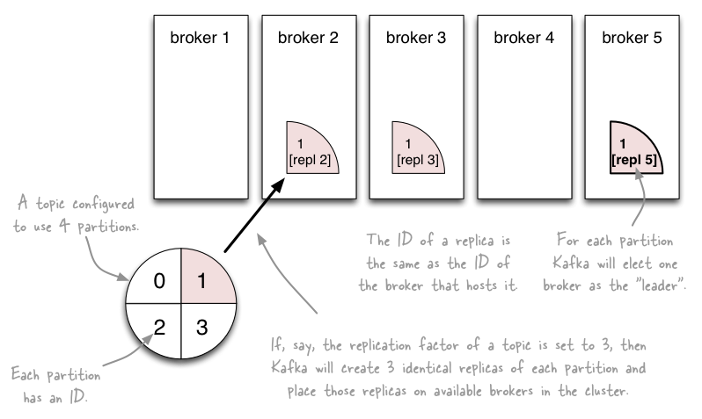
Topics vs. Partitions vs. Replicas
http://www.michael-noll.com/blog/2013/03/13/running-a-multi-broker-apache-kafka-cluster-on-a-single-node/

Slide 26
Inspecting the current state of a topic
--describe the topic
Leader: brokerID of the currently elected leader broker
Replica ID’s = broker ID’s
ISR = “in-sync replica”, replicas that are in sync with the leader
In this example:
Broker 0 is leader for partition 1.
Broker 1 is leader for partitions 0 and 2.
All replicas are in-sync with their respective leader partitions.
$ kafka-topics.sh --zookeeper zookeeper1:2181 --describe --topic zerg.hydra Topic:zerg2.hydra PartitionCount:3 ReplicationFactor:2 Configs:
Topic: zerg2.hydra Partition: 0 Leader: 1 Replicas: 1,0 Isr: 1,0
Topic: zerg2.hydra Partition: 1 Leader: 0 Replicas: 0,1 Isr: 0,1
Topic: zerg2.hydra Partition: 2 Leader: 1 Replicas: 1,0 Isr: 1,0

Slide 27
Let’s recap
The who is who
Producers write data to brokers.
Consumers read data from brokers.
All this is distributed.
The data
Data is stored in topics.
Topics are split into partitions which are replicated.

Slide 28
Putting it all together
http://www.michael-noll.com/blog/2013/03/13/running-a-multi-broker-apache-kafka-cluster-on-a-single-node/

Slide 29
Part 3: Operating Kafka

Slide 30
Overview of Part 3: Operating Kafka
Kafka architecture
Kafka hardware specs
Deploying Kafka
Monitoring Kafka
Kafka apps
Kafka itself
ZooKeeper
"Auditing" Kafka (not: security audit)
P&S tuning
Ops-related Kafka references

Slide 31
Kafka architecture
Kafka brokers
You can run clusters with 1+ brokers.
Each broker in a cluster must have a unique broker.id.

Slide 32
Kafka architecture
Kafka requires ZooKeeper
LinkedIn runs (old) ZK 3.3.4, but latest 3.4.5 works, too.
ZooKeeper
v0.8: used by brokers and consumers, but not by producers.
Brokers: general state information, leader election, etc.
Consumers: primarily for tracking message offsets (cf. later)
v0.9: used by brokers only
Consumers will use special Kafka topics instead of ZooKeeper
Will substantially reduce the load on ZooKeeper for large deployments

Slide 33
Kafka broker hardware specs @ LinkedIn
Solely dedicated to running Kafka, run nothing else.
1 Kafka broker instance per machine
2x 4-core Intel Xeon (info outdated?)
64 GB RAM (up from 24 GB)
Only 4 GB used for Kafka broker, remaining 60 GB for page cache
Page cache is what makes Kafka fast
RAID10 with 14 spindles
More spindles = higher disk throughput
Cache on RAID, with battery backup
Before H/W upgrade: 8x SATA drives (7200rpm), not sure about RAID
1 GigE (?) NICs
EC2 example: m2.2xlarge @ $0.34/hour, with provisioned IOPS

Slide 34
ZooKeeper hardware specs @ LinkedIn
ZooKeeper servers
Solely dedicated to running ZooKeeper, run nothing else.
1 ZooKeeper instance per machine
SSD’s dramatically improve performance
In v0.8.x, brokers and consumers must talk to ZK. In large-scale environments (many consumers, many topics and partitions) this means ZK can become a bottleneck because it processes requests serially. And this processing depends primarily on I/O performance.
1 GigE (?) NICs
ZooKeeper in LinkedIn’s architecture
5-node ZK ensembles = tolerates 2 dead nodes
1 ZK ensemble for all Kafka clusters within a data center
LinkedIn runs multiple data centers, with multiple Kafka clusters

Slide 35
Monitoring Kafka

Slide 36
Kafka performance tuning

Slide 37
OS tuning
Kernel tuning
Don’t swap! vm.swappiness = 0 (RHEL 6.5 onwards: 1)
Allow more dirty pages but less dirty cache.
LinkedIn have lots of RAM in servers, most of it is for page cache (60 of 64 GB). They let dirty pages built up, but cache should be available as Kafka does lots of disk and network I/O.
See vm.dirty_*_ratio & friends
Disk throughput
Longer commit interval on mount points. (ext3 or ext4?)
Normal interval for ext3 mount point is 30s (?) between flushes; LinkedIn: 120s. They can tolerate losing 2mins worth of data (because of partition replicas) so they rather prefer higher throughput here.
More spindles (RAID10 w/ 14 disks)

Slide 38
Java/JVM tuning
Biggest issue: garbage collection
And, most of the time, the only issue
Goal is to minimize GC pause times
Aka “stop-the-world” events – apps are halted until GC finishes

Slide 39
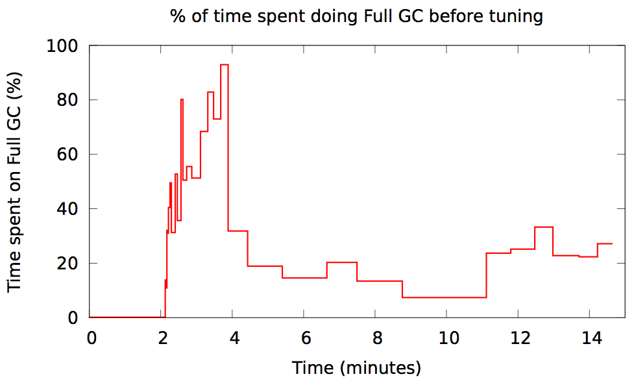
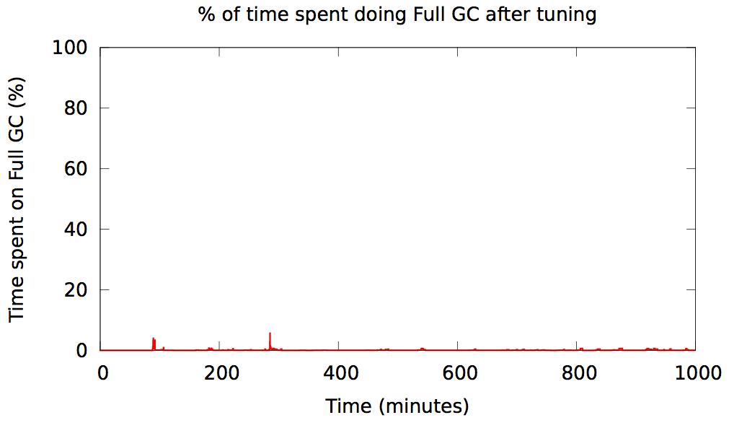
Java garbage collection in Kafka @ Spotify
Before tuning
After tuning
https://www.jfokus.se/jfokus14/preso/Reliable-real-time-processing-with-Kafka-and-Storm.pdf

Slide 40
Java/JVM tuning
Good news: use JDK7u51 or later and have a quiet life!
LinkedIn: Oracle JDK, not OpenJDK
Silver bullet is new G1 “garbage-first” garbage collector
Available since JDK7u4.
Substantial improvement over all previous GC’s, at least for Kafka.
$ java -Xms4g -Xmx4g -XX:PermSize=48m -XX:MaxPermSize=48m
-XX:+UseG1GC
-XX:MaxGCPauseMillis=20
-XX:InitiatingHeapOccupancyPercent=35

Slide 41
Kafka configuration tuning
Often not much to do beyond using the defaults, yay. ☺
Key candidates for tuning:
num.io.threads | should be >= #disks (start testing with == #disks)
num.network.threads | adjust it based on (concurrent) #producers, #consumers, and replication factor

Slide 42
Kafka usage tuning – lessons learned from others
Don't break things up into separate topics unless the data in them is truly independent.
Consumer behavior can (and will) be extremely variable, don’t assume you will always be consuming as fast as you are producing.
Keep time related messages in the same partition.
Consumer behavior can extremely variable, don't assume the lag on all your partitions will be similar.
Design a partitioning scheme, so that the owner of one partition can stop consuming for a long period of time and your application will be minimally impacted (for example, partition by transaction id)
http://grokbase.com/t/kafka/users/145qtx4z1c/topic-partitioning-strategy-for-large-data

Slide 43
Ops-related references
Kafka FAQ
https://cwiki.apache.org/confluence/display/KAFKA/FAQ
Kafka operations
https://kafka.apache.org/documentation.html#operations
Kafka system tools
https://cwiki.apache.org/confluence/display/KAFKA/System+Tools
Consumer offset checker, get offsets for a topic, print metrics via JMX to console, read from topic A and write to topic B, verify consumer rebalance
Kafka replication tools
https://cwiki.apache.org/confluence/display/KAFKA/Replication+tools
Caveat: Some sections of this document are slightly outdated.
Controlled shutdown, preferred leader election tool, reassign partitions tool
Kafka tutorial
http://www.michael-noll.com/blog/2013/03/13/running-a-multi-broker-apache-kafka-cluster-on-a-single-node/

Slide 44
Part 4: Developing Kafka apps

Slide 45
Overview of Part 4: Developing Kafka apps
Writing data to Kafka with producers
Example producer
Producer types (async, sync)
Message acking and batching of messages
Write operations behind the scenes – caveats ahead!
Reading data from Kafka with consumers
High-level consumer API and simple consumer API
Consumer groups
Rebalancing
Example Kafka applications
Dev-related Kafka references

Slide 46
Writing data to Kafka

Slide 47
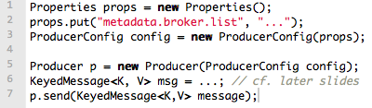
Writing data to Kafka
You use Kafka “producers” to write data to Kafka brokers.
Available for JVM (Java, Scala), C/C++, Python, Ruby, etc.
The Kafka project only provides the JVM implementation.
Has risk that a new Kafka release will break non-JVM clients.
A simple example producer:
Full details at:
https://cwiki.apache.org/confluence/display/KAFKA/0.8.0+Producer+Example

Slide 48
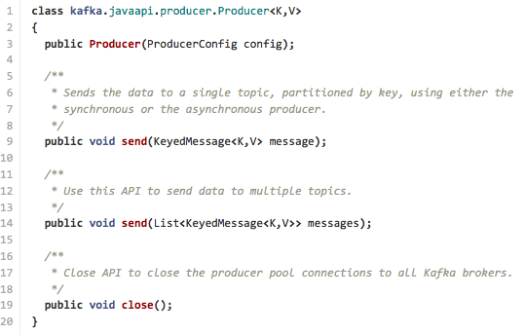
Producers
The Java producer API is very simple.
We’ll talk about the slightly confusing details next. ☺

Slide 49

Producers
Two types of producers: “async” and “sync”
Same API and configuration, but slightly different semantics.
What applies to a sync producer almost always applies to async, too.
Async producer is preferred when you want higher throughput.
Important configuration settings for either producer type:
client.id | identifies producer app, e.g. in system logs
producer.type | async or sync
request.required.acks | acking semantics, cf. next slides
serializer.class | configure encoder, cf. slides on Avro usage
metadata.broker.list | cf. slides on bootstrapping list of brokers

Slide 50
Sync producers
Straight-forward so I won’t cover sync producers here
Please go to https://kafka.apache.org/documentation.html
Most important thing to remember: producer.send() will block!

Slide 51
Async producer
Sends messages in background = no blocking in client.
Provides more powerful batching of messages (see later).
Wraps a sync producer, or rather a pool of them.
Communication from async->sync producer happens via a queue.
Which explains why you may see kafka.producer.async.QueueFullException
Each sync producer gets a copy of the original async producer config, including the request.required.acks setting (see later).
Implementation details: Producer, async.AsyncProducer, async.ProducerSendThread, ProducerPool, async.DefaultEventHandler#send()

Slide 52
Async producer
Caveats
Async producer may drop messages if its queue is full.
Solution 1: Don’t push data to producer faster than it is able to send to brokers.
Solution 2: Queue full == need more brokers, add them now! Use this solution in favor of solution 3 particularly if your producer cannot block (async producers).
Solution 3: Set queue.enqueue.timeout.ms to -1 (default). Now the producer will block indefinitely and will never willingly drop a message.
Solution 4: Increase queue.buffering.max.messages (default: 10,000).
In 0.8 an async producer does not have a callback for send() to register error handlers. Callbacks will be available in 0.9.

Slide 53
Producers
Two aspects worth mentioning because they significantly influence Kafka performance:
Message acking
Batching of messages

Slide 54
1) Message acking
Background:
In Kafka, a message is considered committed when “any required” ISR (in-sync replicas) for that partition have applied it to their data log.
Message acking is about conveying this “Yes, committed!” information back from the brokers to the producer client.
Exact meaning of “any required” is defined by request.required.acks.
Only producers must configure acking
Exact behavior is configured via request.required.acks, which determines when a produce request is considered completed.
Allows you to trade latency (speed) <-> durability (data safety).
Consumers: Acking and how you configured it on the side of producers do not matter to consumers because only committed messages are ever given out to consumers. They don’t need to worry about potentially seeing a message that could be lost if the leader fails.

Slide 55
1) Message acking
Typical values of request.required.acks
0: producer never waits for an ack from the broker.
Gives the lowest latency but the weakest durability guarantees.
1: producer gets an ack after the leader replica has received the data.
Gives better durability as the we wait until the lead broker acks the request. Only msgs that were written to the now-dead leader but not yet replicated will be lost.
-1: producer gets an ack after all ISR have received the data.
Gives the best durability as Kafka guarantees that no data will be lost as long as at least one ISR remains.
Beware of interplay with request.timeout.ms!
"The amount of time the broker will wait trying to meet the `request.required.acks` requirement before sending back an error to the client.”
Caveat: Message may be committed even when broker sends timeout error to client (e.g. because not all ISR ack’ed in time). One reason for this is that the producer acknowledgement is independent of the leader-follower replication, and ISR’s send their acks to the leader, the latter of which will reply to the client.
better
latency
better
durability

Slide 56
2) Batching of messages
Batching improves throughput
Tradeoff is data loss if client dies before pending messages have been sent.
You have two options to “batch” messages in 0.8:
Use send(listOfMessages).
Sync producer: will send this list (“batch”) of messages right now. Blocks!
Async producer: will send this list of messages in background “as usual”, i.e. according to batch-related configuration settings. Does not block!
Use send(singleMessage) with async producer.
For async the behavior is the same as send(listOfMessages).

Slide 57
2) Batching of messages
Option 1: How send(listOfMessages) works behind the scenes
The original list of messages is partitioned (randomly if the default partitioner is used) based on their destination partitions/topics, i.e. split into smaller batches.
Each post-split batch is sent to the respective leader broker/ISR (the individual send()’s happen sequentially), and each is acked by its respective leader broker according to request.required.acks.
p4
p4
partitioner.class
p6
p1
p4
p4
p6
p6
p6
p1
p4
p4
send()
Current leader ISR (broker) for partition 4
p6
p6
send()
Current leader ISR (broker) for partition 6
p1
…and so on…

Slide 58
2) Batching of messages
Option 2: Async producer
Standard behavior is to batch messages
Semantics are controlled via producer configuration settings
batch.num.messages
queue.buffering.max.ms + queue.buffering.max.messages
queue.enqueue.timeout.ms
And more, see producer configuration docs.
Remember: Async producer simply wraps sync producer!
But the batch-related config settings above have no effect on “true” sync producers, i.e. when used without a wrapping async producer.

Slide 59
FYI: upcoming producer configuration changes
Kafka 0.8 | Kafka 0.9 (unreleased)
metadata.broker.list | bootstrap.servers
request.required.acks | acks
batch.num.messages | batch.size
message.send.max.retries | retries
(This list is not complete, see Kafka docs for details.)

Slide 60
Write operations behind the scenes
When writing to a topic in Kafka, producers write directly to the partition leaders (brokers) of that topic
Remember: Writes always go to the leader ISR of a partition!
This raises two questions:
How to know the “right” partition for a given topic?
How to know the current leader broker/replica of a partition?

Slide 61
1) How to know the “right” partition when sending?
In Kafka, a producer – i.e. the client – decides to which target partition a message will be sent.
Can be random ~ load balancing across receiving brokers.
Can be semantic based on message “key”, e.g. by user ID or domain name.
Here, Kafka guarantees that all data for the same key will go to the same partition, so consumers can make locality assumptions.
But there’s one catch with line 2 (i.e. no key) in Kafka 0.8.

Slide 62
Keyed vs. non-keyed messages in Kafka 0.8
If a key is not specified:
Producer will ignore any configured partitioner.
It will pick a random partition from the list of available partitions and stick to it for some time before switching to another one = NOT round robin or similar!
Why? To reduce number of open sockets in large Kafka deployments (KAFKA-1017).
Default: 10mins, cf. topic.metadata.refresh.interval.ms
See implementation in DefaultEventHandler#getPartition()
If there are fewer producers than partitions at a given point of time, some partitions may not receive any data. How to fix if needed?
Try to reduce the metadata refresh interval topic.metadata.refresh.interval.ms
Specify a message key and a customized random partitioner.
In practice it is not trivial to implement a correct “random” partitioner in Kafka 0.8.
Partitioner interface in Kafka 0.8 lacks sufficient information to let a partitioner select a random and available partition. Same issue with DefaultPartitioner.
Notes:
Apparently implementing a custom random partitioner correctly is tricky as of 0.8.0 because the Partitioner interface lacks sufficient information to let a partitioner select a random and AVAILABLE partition (see discussion at http://bit.ly/1fekbAd). That being said Kafka's DefaultPartitioner seems to suffer from the same problem, i.e. the information it has available to make partitioning decisions lacks information about AVAILABLE partitions.

Slide 63
Keyed vs. non-keyed messages in Kafka 0.8
If a key is specified:
Key is retained as part of the msg, will be stored in the broker.
One can design a partition function to route the msg based on key.
The default partitioner assigns messages to a partition based on their key hashes, via key.hashCode % numPartitions.
Caveat:
If you specify a key for a message but do not explicitly wire in a custom partitioner via partitioner.class, your producer will use the default partitioner.
So without a custom partitioner, messages with the same key will still end up in the same partition! (cf. default partitioner’s behavior above)

Slide 64
2) How to know the current leader of a partition?
Producers: broker discovery aka bootstrapping
Producers don’t talk to ZooKeeper, so it’s not through ZK.
Broker discovery is achieved by providing producers with a “bootstrapping” broker list, cf. metadata.broker.list
These brokers inform the producer about all alive brokers and where to find current partition leaders. The bootstrap brokers do use ZK for that.
Impacts on failure handling
In Kafka 0.8 the bootstrap list is static/immutable during producer run-time. This has limitations and problems as shown in next slide.
The current bootstrap approach will improve in Kafka 0.9. This change will make the life of Ops easier.

Slide 65

Bootstrapping in Kafka 0.8
Scenario: N=5 brokers total, 2 of which are for bootstrap
Do’s:
Take down one bootstrap broker (e.g. broker2), repair it, and bring it back.
In terms of impacts on broker discovery, you can do whatever you want to brokers 3-5.
Don’ts:
Stop all bootstrap brokers 1+2. If you do, the producer stops working!
To improve operational flexibility, use VIP’s or similar for values in metadata.broker.list.
broker1
broker2
broker3
broker4
broker5

Slide 66
Reading data from Kafka

Slide 67
Reading data from Kafka
You use Kafka “consumers” to write data to Kafka brokers.
Available for JVM (Java, Scala), C/C++, Python, Ruby, etc.
The Kafka project only provides the JVM implementation.
Has risk that a new Kafka release will break non-JVM clients.
Examples will be shown later in the “Example Kafka apps” section.
Three API options for JVM users:
High-level consumer API <<< in most cases you want to use this one!
Simple consumer API
Hadoop consumer API
Most noteworthy: The “simple” API is anything but simple. ☺
Prefer to use the high-level consumer API if it meets your needs (it should).
Counter-example: Kafka spout in Storm 0.9.2 uses simple consumer API to integrate well with Storm’s model of guaranteed message processing.

Slide 68
Reading data from Kafka
Consumers pull from Kafka (there’s no push)
Allows consumers to control their pace of consumption.
Allows to design downstream apps for average load, not peak load (cf. Loggly talk)
Consumers are responsible to track their read positions aka “offsets”
High-level consumer API: takes care of this for you, stores offsets in ZooKeeper
Simple consumer API: nothing provided, it’s totally up to you
What does this offset management allow you to do?
Consumers can deliberately rewind “in time” (up to the point where Kafka prunes), e.g. to replay older messages.
Cf. Kafka spout in Storm 0.9.2.
Consumers can decide to only read a specific subset of partitions for a given topic.
Cf. Loggly’s setup of (down)sampling a production Kafka topic to a manageable volume for testing
Run offline, batch ingestion tools that write (say) from Kafka to Hadoop HDFS every hour.
Cf. LinkedIn Camus, Pinterest Secor

Slide 69
Reading data from Kafka
Important consumer configuration settings
group.id | assigns an individual consumer to a “group”
zookeeper.connect | to discover brokers/topics/etc., and to store consumer state (e.g. when using the high-level consumer API)
fetch.message.max.bytes | number of message bytes to (attempt to) fetch for each partition; must be >= broker’s message.max.bytes

Slide 70
Reading data from Kafka
Consumer “groups”
Allows multi-threaded and/or multi-machine consumption from Kafka topics.
Consumers “join” a group by using the same group.id
Kafka guarantees a message is only ever read by a single consumer in a group.
Kafka assigns the partitions of a topic to the consumers in a group so that each partition is consumed by exactly one consumer in the group.
Maximum parallelism of a consumer group: #consumers (in the group) <= #partitions

Slide 71
Guarantees when reading data from Kafka
A message is only ever read by a single consumer in a group.
A consumer sees messages in the order they were stored in the log.
The order of messages is only guaranteed within a partition.
No order guarantee across partitions, which includes no order guarantee per-topic.
If total order (per topic) is required you can consider, for instance:
Use #partition = 1. Good: total order. Bad: Only 1 consumer process at a time.
“Add” total ordering in your consumer application, e.g. a Storm topology.
Some gotchas:
If you have multiple partitions per thread there is NO guarantee about the order you receive messages, other than that within the partition the offsets will be sequential.
Example: You may receive 5 messages from partition 10 and 6 from partition 11, then 5 more from partition 10 followed by 5 more from partition 10, even if partition 11 has data available.
Adding more processes/threads will cause Kafka to rebalance, possibly changing the assignment of a partition to a thread (whoops).

Slide 72
Rebalancing: how consumers meet brokers
Remember?
The assignment of brokers – via the partitions of a topic – to consumers is quite important, and it is dynamic at run-time.

Slide 73
Rebalancing: how consumers meet brokers
Why “dynamic at run-time”?
Machines can die, be added, …
Consumer apps may die, be re-configured, added, …
Whenever this happens a rebalancing occurs.
Rebalancing is a normal and expected lifecycle event in Kafka.
But it’s also a nice way to shoot yourself or Ops in the foot.
Why is this important?
Most Ops issues are due to 1) rebalancing and 2) consumer lag.
So Dev + Ops must understand what goes on.

Slide 74
Rebalancing: how consumers meet brokers
Rebalancing?
Consumers in a group come into consensus on which consumer is consuming which partitions → required for distributed consumption
Divides broker partitions evenly across consumers, tries to reduce the number of broker nodes each consumer has to connect to
When does it happen? Each time:
a consumer joins or leaves a consumer group, OR
a broker joins or leaves, OR
a topic “joins/leaves” via a filter, cf. createMessageStreamsByFilter()
Examples:
If a consumer or broker fails to heartbeat to ZK → rebalance!
createMessageStreams() registers consumers for a topic, which results in a rebalance of the consumer-broker assignment.

Slide 75
Testing Kafka apps

Slide 76
Testing Kafka apps
Won’t have the time to cover testing in this workshop.
Some hints:
Unit-test your individual classes like usual
When integration testing, use in-memory instances of Kafka and ZK
Test-drive your producers/consumers in virtual Kafka clusters via Wirbelsturm
Starting points:
Kafka’s own test suite
0.8.1: https://github.com/apache/kafka/tree/0.8.1/core/src/test
trunk: https://github.com/apache/kafka/tree/trunk/core/src/test/
Kafka tests in kafka-storm-starter
https://github.com/miguno/kafka-storm-starter/

Slide 77
Serialization in Kafka

Slide 78
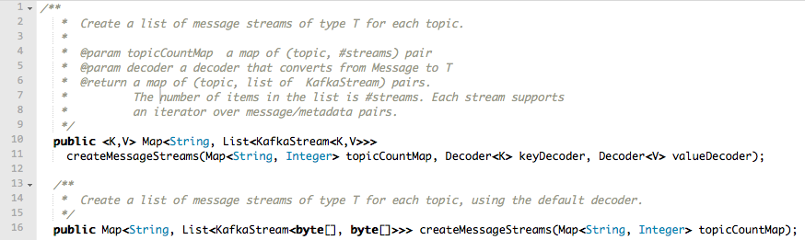
Serialization in Kafka
Kafka does not care about data format of msg payload
Up to developer (= you) to handle serialization/deserialization
Common choices in practice: Avro, JSON
(Code above is from the High Level Consumer API)

Slide 79
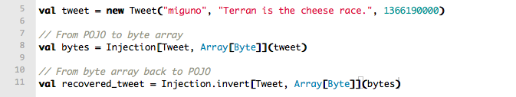
Serialization in Kafka: using Avro
One way to use Avro in Kafka is via Twitter Bijection.
https://github.com/twitter/bijection
Approach: Convert pojo to byte[], then send byte[] to Kafka.
Bijection in Scala:
Bijection in Java: https://github.com/twitter/bijection/wiki/Using-bijection-from-java
Full Kafka/Bijection example:
KafkaSpec in kafka-storm-starter
Alternatives to Bijection:
e.g. https://github.com/miguno/kafka-avro-codec

Slide 80
Data compression in Kafka

Slide 81
Data compression in Kafka
Again, no time to cover compression in this training.
But worth looking into!
Interplay with batching of messages, e.g. larger batches typically achieve better compression ratios.
Details about compression in Kafka:
https://cwiki.apache.org/confluence/display/KAFKA/Compression
Blog post by Neha Narkhede, Kafka committer @ LinkedIn: http://geekmantra.wordpress.com/2013/03/28/compression-in-kafka-gzip-or-snappy/

Slide 82
Example Kafka applications

Slide 83
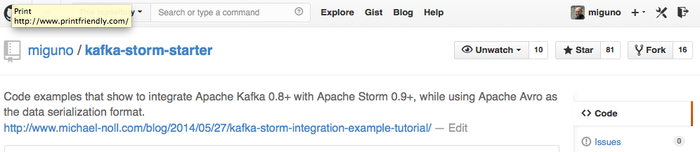
kafka-storm-starter
Written by yours truly
https://github.com/miguno/kafka-storm-starter
$ git clone https://github.com/miguno/kafka-storm-starter
$ cd kafka-storm-starter
# Now ready for mayhem!
(Must have JDK 6 installed.)

Slide 84
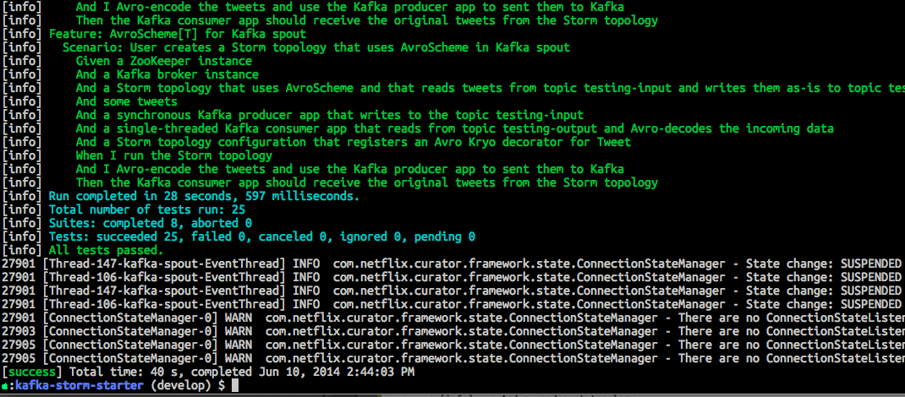
kafka-storm-starter: run the test suite
$ ./sbt test
Will run unit tests plus end-to-end tests of Kafka, Storm, and Kafka-Storm integration.

Slide 85
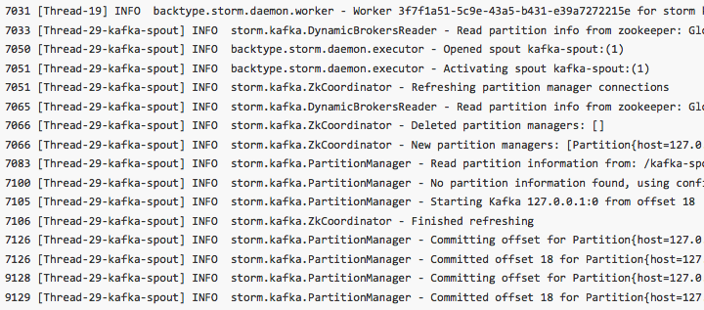
kafka-storm-starter: run the KafkaStormDemo app
$ ./sbt run
Starts in-memory instances of ZooKeeper, Kafka, and Storm. Then runs a Storm topology that reads from Kafka.

Slide 86
Kafka related code in kafka-storm-starter
KafkaProducerApp
https://github.com/miguno/kafka-storm-starter/blob/develop/src/main/scala/com/miguno/kafkastorm/kafka/KafkaProducerApp.scala
KafkaConsumerApp
https://github.com/miguno/kafka-storm-starter/blob/develop/src/main/scala/com/miguno/kafkastorm/kafka/KafkaConsumerApp.scala
KafkaSpec: test-drives producer and consumer above
https://github.com/miguno/kafka-storm-starter/blob/develop/src/test/scala/com/miguno/kafkastorm/integration/KafkaSpec.scala

Slide 87
Dev-related references
Kafka documentation
Kafka FAQ
Kafka tutorials
http://www.michael-noll.com/blog/2013/03/13/running-a-multi-broker-apache-kafka-cluster-on-a-single-node/
Code examples
https://github.com/miguno/kafka-storm-starter/

Slide 88
Part 5: Playing with Kafka using Wirbelsturm
1-click Kafka deployments

Slide 89
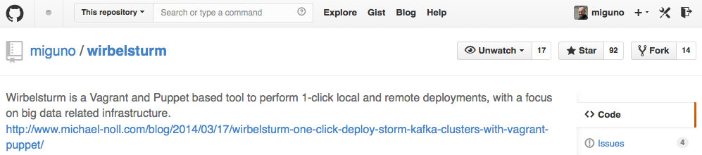
Deploying Kafka via Wirbelsturm
Written by yours truly
https://github.com/miguno/wirbelsturm
$ git clone https://github.com/miguno/wirbelsturm.git
$ cd wirbelsturm
$ ./bootstrap
$ vi wirbelsturm.yaml # uncomment Kafka section
$ vagrant up zookeeper1 kafka1
(Must have Vagrant 1.6.1+ and VirtualBox 4.3+ installed.)

Slide 90
What can I do with Wirbelsturm?
Get a first impression of Kafka
Test-drive your producer apps and consumer apps
Test failure handling
Stop/kill brokers, check what happens to producers or consumers.
Stop/kill ZooKeeper instances, check what happens to brokers.
Use as sandbox environment to test/validate deployments
“What will actually happen when I run this reassign partition tool?”
"What will actually happen when I delete a topic?"
“Will my Hiera changes actually work?”
Reproduce production issues, share results with Dev
Also helpful when reporting back to Kafka project and mailing lists.
Any further cool ideas? ☺

Slide 91
Wrapping up

Slide 92
Where to find help
No (good) Kafka book available yet.
Kafka documentation
http://kafka.apache.org/documentation.html
https://cwiki.apache.org/confluence/display/KAFKA/Index
Kafka ecosystem, e.g. Storm integration, Puppet
https://cwiki.apache.org/confluence/display/KAFKA/Ecosystem
Mailing lists
http://kafka.apache.org/contact.html
Code examples
examples/ directory in Kafka, https://github.com/apache/kafka/
https://github.com/miguno/kafka-storm-starter/

