Slide 1
Spark Performance Techniques
Notes:
- Added date

Slide 2
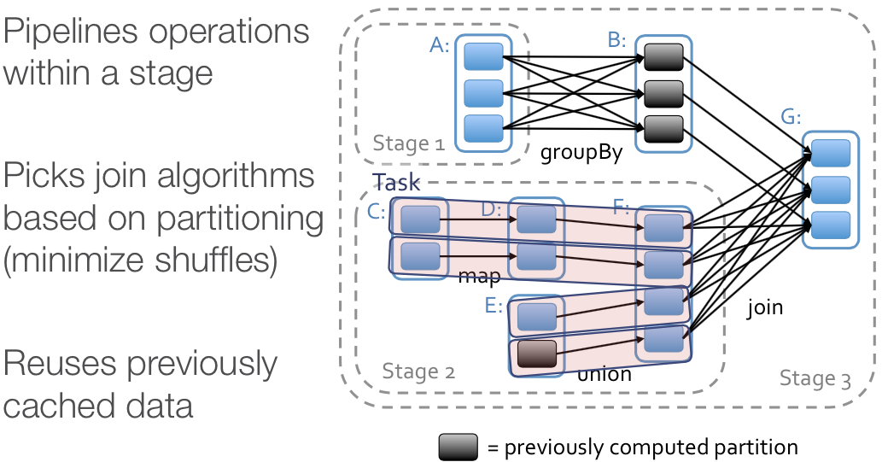
Scheduler Optimizations

Slide 3
Task
Unit of work to execute on in an executor thread
Unlike MR, there is no “map” vs “reduce” task
Each task either partitions its output for “shuffle”, or send the output back to the driver

Slide 4
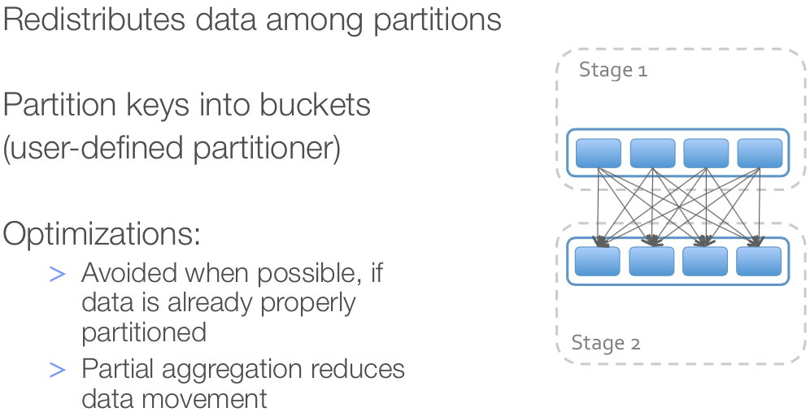
Shuffle

Slide 5
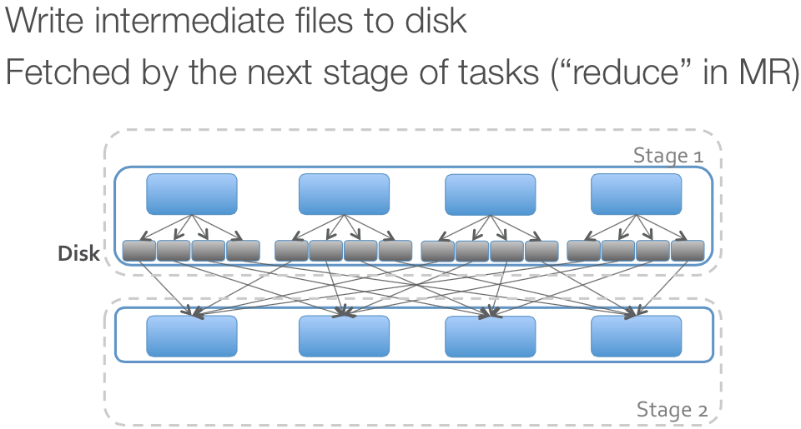
Shuffle

Slide 6
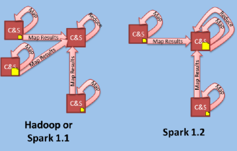
Shuffle
Shuffle happens on node with largest shuffle file (but shuffle files still written to disk).

Slide 7
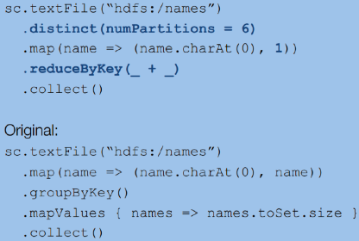
Prefer reduceByKey over groupByKey

Slide 8
Controllable Partitioning

Slide 9
Motivation
Network bandwidth is ~100× as expensive as memory bandwidth
One way Spark avoids using it is through locality-aware scheduling for RAM and disk
Another important tool is controlling the partitioning of RDD contents across nodes

Slide 10
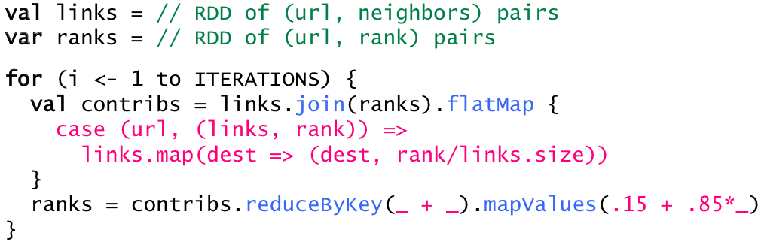
Example: PageRank
Start each page at a rank of 1
On each iteration, have page p contribute rank_{p} / |neighbors_{p}| to its neighbors
Set each page’s rank to 0.15 + 0.85 × contribs

Slide 11
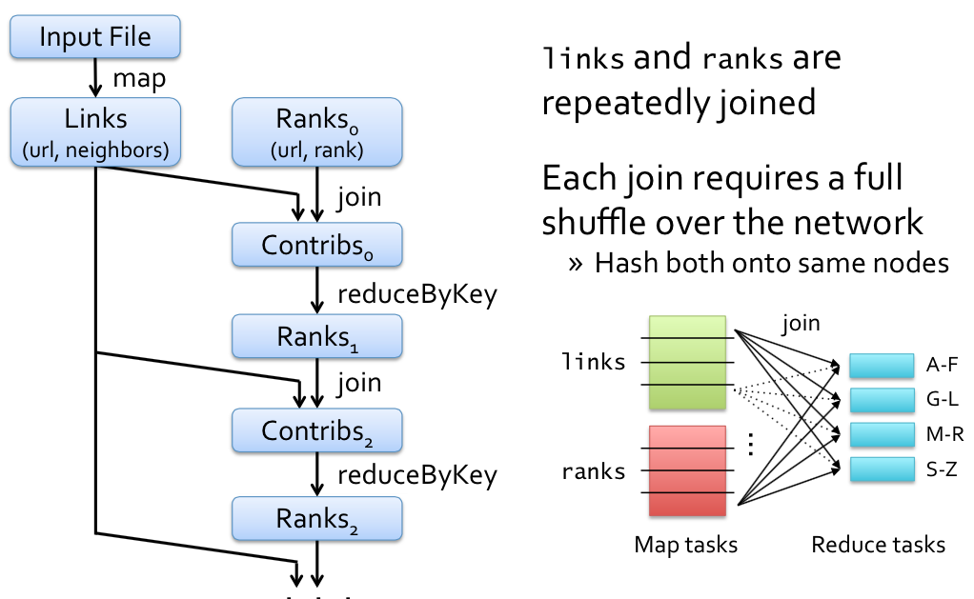
PageRank Execution

Slide 12
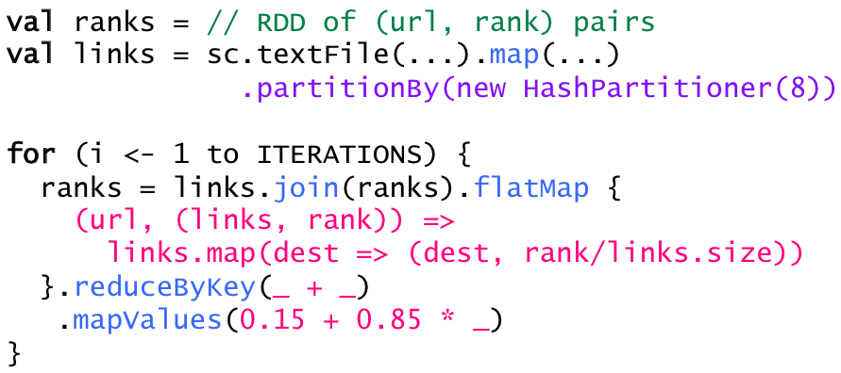
Solution
Pre-partition the links RDD so that links for URLs with the same hash code are on the same node

Slide 13
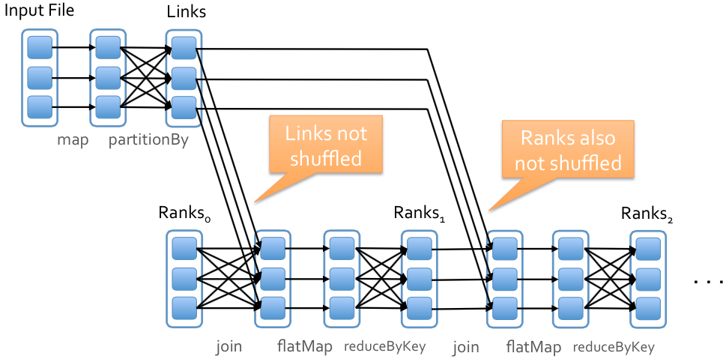
New Execution

Slide 14
How It Works
Each RDD has an optional Partitioner object
Any shuffle operation on an RDD with a Partitioner will respect that Partitioner
Any shuffle operation on two RDDs will take on the Partitioner of one of them, if one is set
Otherwise, by default use HashPartitioner

Slide 15
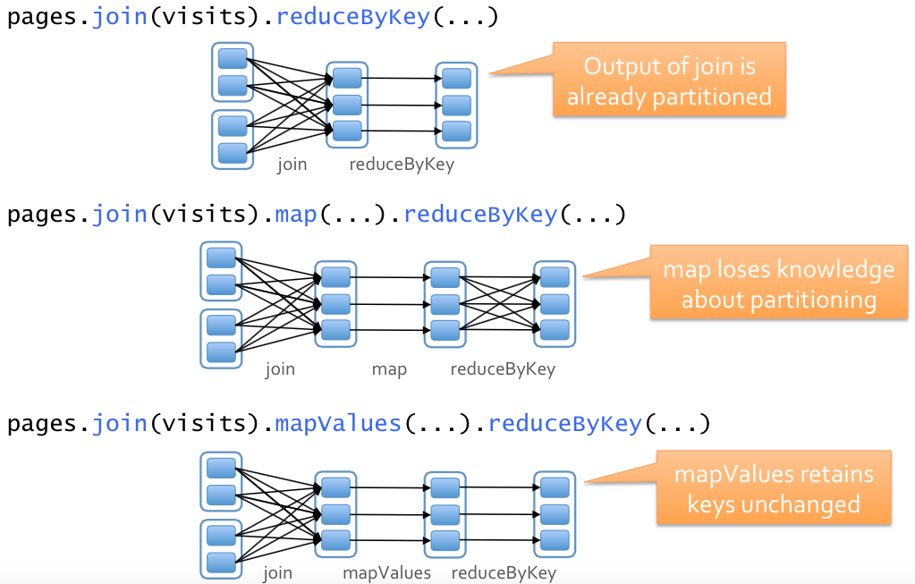
Examples

Slide 16
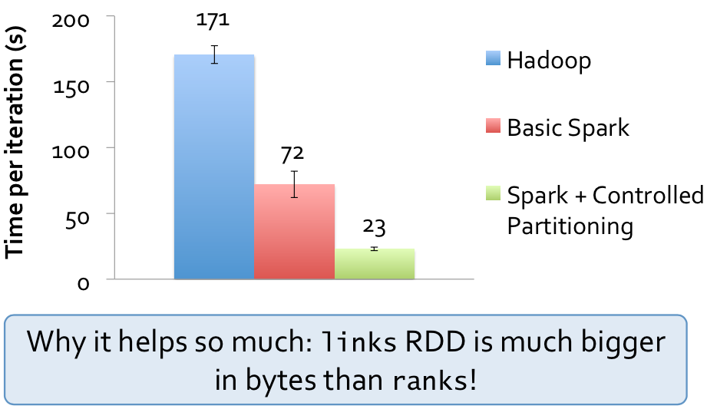
PageRank Performance

Slide 17
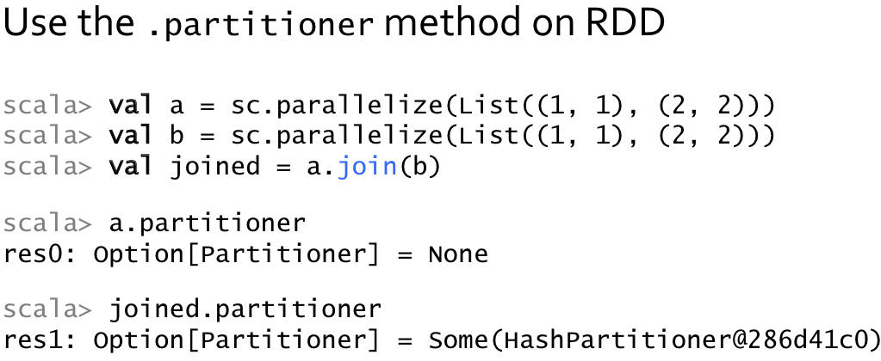
Telling How an RDD is Partitioned

Slide 18
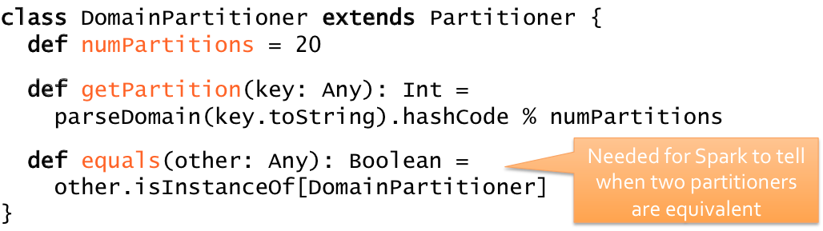
Custom Partitioning
Can define your own subclass of Partitioner to leverage domain-specific knowledge
Example: in PageRank, hash URLs by domain name, because many links are internal

Slide 19
Data Serialization
Store RDD’s in serialized form.
Impacts
Data over network
Memory usage

Slide 20
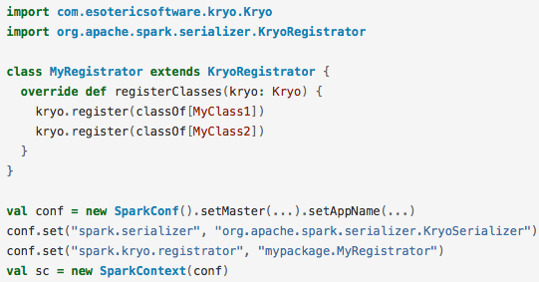
To Use Kryo: Example
Notes:
If your objects are large, you may also need to increase the spark.kryoserializer.buffer.mb config property. The default is 2, but this value needs to be large enough to hold the largest object you will serialize.
Finally, if you don’t register your custom classes, Kryo will still work, but it will have to store the full class name with each object, which is wasteful.

Slide 21
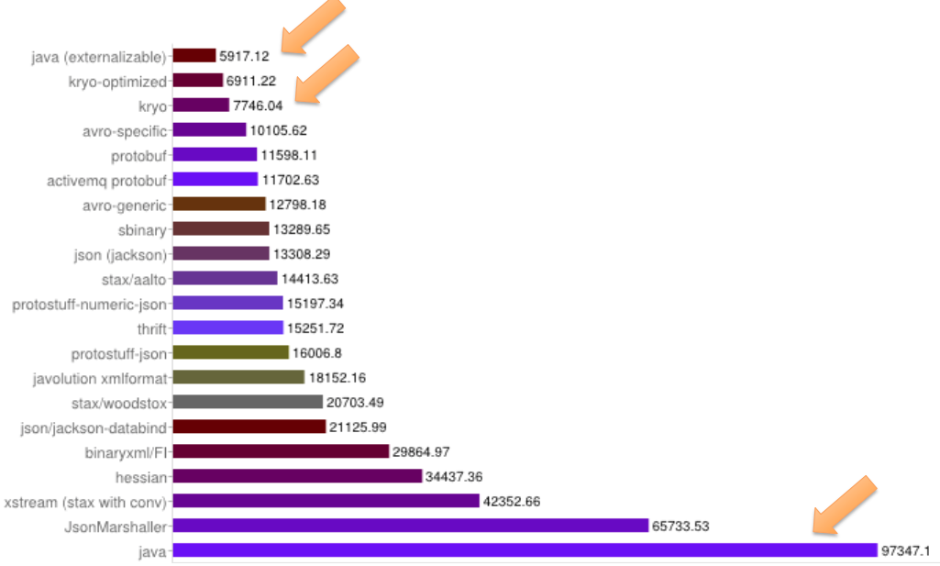
Serializer Benchmark: Time

Slide 22
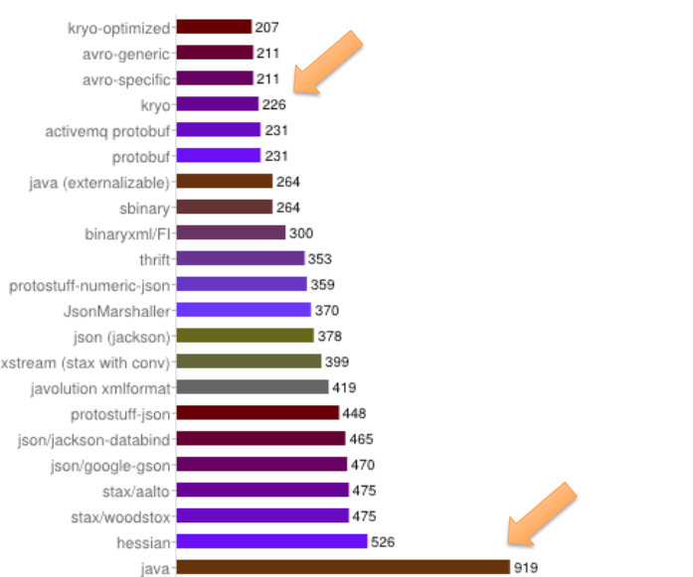
Serializer Benchmark: Space

Slide 23
https://code.google.com/p/thrift-protobuf-compare/wiki/Benchmarking

Slide 24
Memory Tuning

Slide 25
There are 3 considerations:
Amount of memory used by objects
Cost of accessing these objects
Overhead of GC
By default, java objects are fast to access
But can consume 2-5x more space then the raw data inside the fields.
We will see how to improve memory usage
Either by changing Data Structure
Or storing data as Serialized
Notes:
Each distinct Java object has an “object header”, which is about 16 bytes and contains information such as a pointer to its class. For an object with very little data in it (say one Int field), this can be bigger than the data.
Java Strings have about 40 bytes of overhead over the raw string data (since they store it in an array of Chars and keep extra data such as the length), and store each character as two bytes due to String’s internal usage of UTF-16 encoding. Thus a 10-character string can easily consume 60 bytes.
Common collection classes, such as HashMap and LinkedList, use linked data structures, where there is a “wrapper” object for each entry (e.g. Map.Entry). This object not only has a header, but also pointers (typically 8 bytes each) to the next object in the list.
Collections of primitive types often store them as “boxed” objects such as java.lang.Integer.

Slide 26
Determining Memory Consumption
This means that partition 1 of RDD 0 consumed 717.5 KB.

Slide 27
Tuning Data Structures
Design your data structures to prefer arrays, instead of standard Java or Scala collection classes
Fastutil library: http://fastutil.di.unimi.it/
Provides collection classes for primitives.
Avoid nested structures when possible.
Consider using numeric IDs or enumeration objects instead of strings for keys.
If you have less than 32 GB of RAM,
set the JVM flag -XX:+UseCompressedOops
to make pointers be 4 bytes instead of 8.

Slide 28
Garbage Collection Tuning
Measuring the Impact of GC
SPARK_JAVA_OPTS
GC logs in clusters worker nodes, not in driver

Slide 29
Garbage Collection Tuning
Cache Size Tuning
By default, 60% of spark.executor.memory to cache RDDs
40% is available for objects created during task execution.
If GC kicks in frequently or OOM, you might want to lower this value to 50%
Notes:
Combined with the use of serialized caching, using a smaller cache should be sufficient to mitigate most of the garbage collection problems. In case you are interested in further tuning the Java GC, continue reading below.

Slide 30
Advanced GC Tuning
The Goal of tuning in spark is:
That only long-lived RDDs are stored in the Old generation
That the Young generation is sufficiently sized to store short-lived objects.
From GC stats, check if there are too many GC before a task completes .
If yes, it means that there isn’t enough memory available for executing tasks.
More on Java GC tuning
Notes:
To further tune garbage collection, we first need to understand some basic information about memory management in the JVM:
Java Heap space is divided in to two regions Young and Old. The Young generation is meant to hold short-lived objects while the Old generation is intended for objects with longer lifetimes.
The Young generation is further divided into three regions [Eden, Survivor1, Survivor2].
A simplified description of the garbage collection procedure: When Eden is full, a minor GC is run on Eden and objects that are alive from Eden and Survivor1 are copied to Survivor2. The Survivor regions are swapped. If an object is old enough or Survivor2 is full, it is moved to Old. Finally when Old is close to full, a full GC is invoked.
The goal of GC tuning in Spark is to ensure that only long-lived RDDs are stored in the Old generation and that the Young generation is sufficiently sized to store short-lived objects. This will help avoid full GCs to collect temporary objects created during task execution. Some steps which may be useful are:
Check if there are too many garbage collections by collecting GC stats. If a full GC is invoked multiple times for before a task completes, it means that there isn’t enough memory available for executing tasks.
In the GC stats that are printed, if the OldGen is close to being full, reduce the amount of memory used for caching. This can be done using the spark.storage.memoryFraction property. It is better to cache fewer objects than to slow down task execution!
If there are too many minor collections but not many major GCs, allocating more memory for Eden would help. You can set the size of the Eden to be an over-estimate of how much memory each task will need. If the size of Eden is determined to be E, then you can set the size of the Young generation using the option -Xmn=4/3*E. (The scaling up by 4/3 is to account for space used by survivor regions as well.)
As an example, if your task is reading data from HDFS, the amount of memory used by the task can be estimated using the size of the data block read from HDFS. Note that the size of a decompressed block is often 2 or 3 times the size of the block. So if we wish to have 3 or 4 tasks worth of working space, and the HDFS block size is 64 MB, we can estimate size of Eden to be 4*3*64MB.
Monitor how the frequency and time taken by garbage collection changes with the new settings.
Our experience suggests that the effect of GC tuning depends on your application and the amount of memory available. There are many more tuning options described online, but at a high level, managing how frequently full GC takes place can help in reducing the overhead.

Slide 31
Advanced GC Tuning
If there are too many minor GCs but not many major GCs
Allocating more memory for Eden would help.
Example:
Task reading from HDFS
Estimate amount of task memory based on block size being read
Decompressed blocks typically becomes 2-3x
For 4 tasks, memory required is 4 x 3 x 64MB.

Slide 32
Other Considerations
Level of parallelism
Result better resource utilization
2-3 tasks per cpu core
spark.default.parallelism
Memory usage of reduce tasks
Sometimes OOM is not because of RDD cache
Your tasks working set may be too large
Most shuffle operations, build a hashtable within task to perform grouping, which can be large.
Simple fix is increasing the level of parallelism
In Spark, its ok to have parallelism > cores
Notes:
Broadcasting Large Variables
Using the broadcast functionality available in SparkContext can greatly reduce the size of each serialized task, and the cost of launching a job over a cluster. If your tasks use any large object from the driver program inside of them (e.g. a static lookup table), consider turning it into a broadcast variable. Spark prints the serialized size of each task on the master, so you can look at that to decide whether your tasks are too large; in general tasks larger than about 20 KB are probably worth optimizing.

Slide 33
Performance Debugging
2 Useful Tools
Application Web UI (Default Port 4040)
Executer Logs

Slide 34
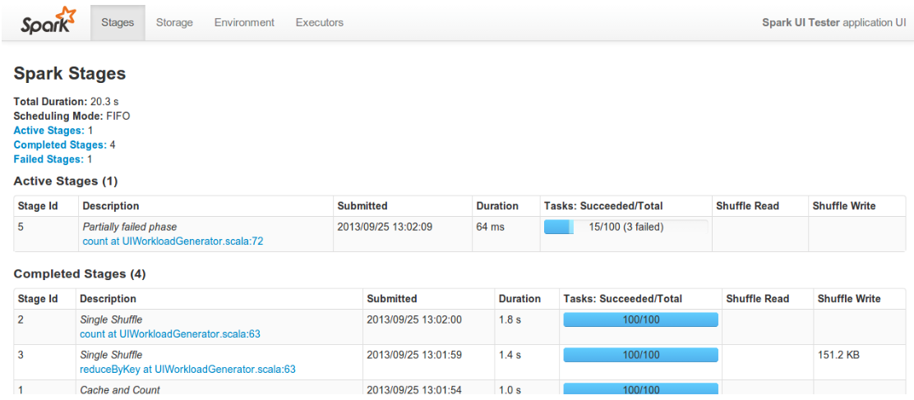
Find Slow Stages

Slide 35
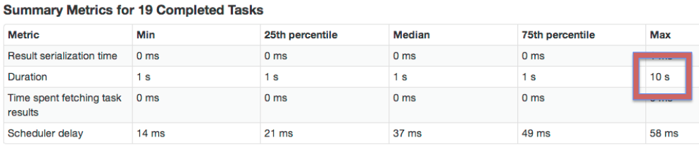
Stragglers?
Some tasks are just slower than others.
Easy to identify from summary metrics:

Slide 36
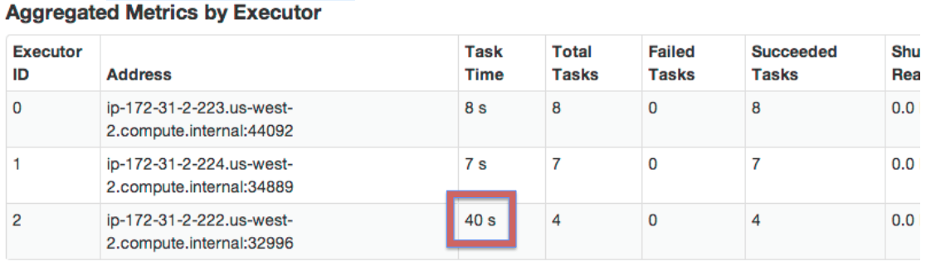
Stragglers due to slow nodes
sc.parallelize(1 to 15, 15).map { index =>
val host = java.net.InetAddress.getLocalHost.getHostName
if (host == "ip-172-31-2-222") {
Thread.sleep(10000)
} else {
Thread.sleep(1000) }

Slide 37
Stragglers due to slow nodes
Turn speculation on to mitigates this problem.
Speculation: Spark identifies slow tasks (by looking at runtime distribution), and re-launches those tasks on other nodes.
spark.speculation true

Slide 38
Demo Time: slow node

Slide 39
Stragglers due to data skew
sc.parallelize(1 to 15, 15)
.flatMap { i => 1 to i }
.map { i => Thread.sleep(1000) }
.count()
Speculation is not going to help because the problem is inherent in the algorithm/data.
Pick a different algorithm or restructure the data.

Slide 40
Demo:

Slide 41
Tasks are just slow
GC
Serialization
Performance of code running in each task

Slide 42
Garbage Collection
To discover whether GC is the problem:
Look at the “GC Time” column in the web UI
Set spark.executor.extraJavaOptions to include: “-XX:-PrintGCDetails -XX:+PrintGCTimeStamps”
Look at spark/work/app.../[n]/stdout on executors
Short GC times are OK. Long ones are bad.

Slide 43
jmap: heap analysis
jmap -histo [pid] Gets a histogram of objects in the JVM heap
jmap -histo:live [pid]
Gets a histogram of objects in the heap after GC (thus “live”)

Slide 44
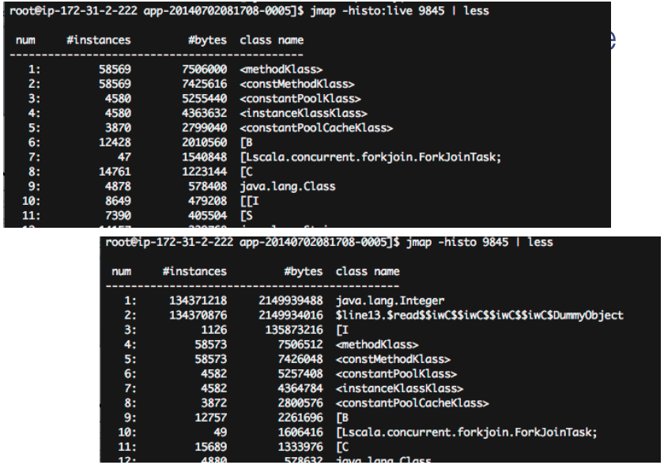

Slide 45
Demo: GC log & jmap

Slide 46
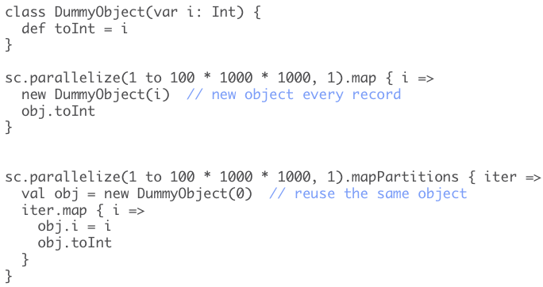
Reduce GC impact

Slide 47
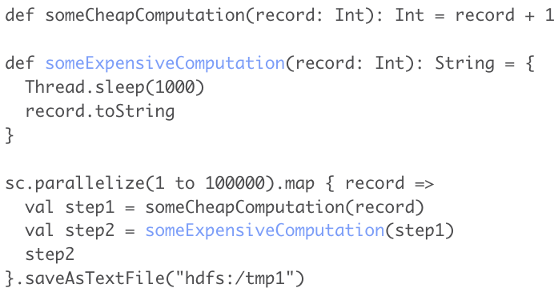
Example: identify expensive comp.

Slide 48
Demo Time

Slide 49
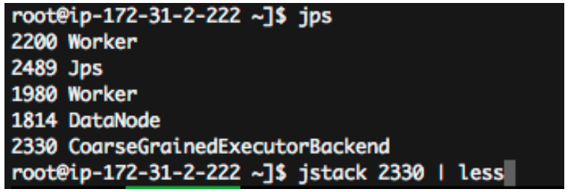
JStack

Slide 50
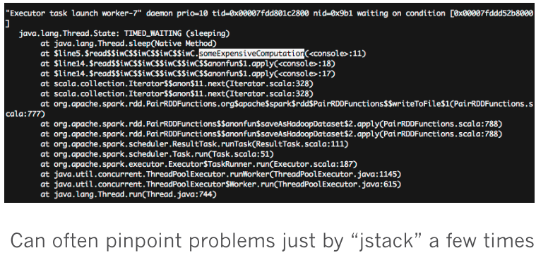
JStack

Slide 51
Thank you.

