Slide 1
Resilient Distributed Datasets
A Fault-Tolerant Abstraction for In-Memory Cluster Computing

Slide 2
Motivation
MapReduce greatly simplified “big data” analysis on large, unreliable clusters
But as soon as it got popular, users wanted more:
More complex, multi-stage applications (e.g. iterative machine learning & graph processing)
More interactive ad-hoc queries
Response: specialized frameworks for some of these apps (e.g. Pregel for graph processing)
Notes:
We all know that MapReduce and related models had huge adoption for data mining
But as soon as people started putting data into them, they wanted to do more

Slide 3
Big Data Systems Today
Giraph
Pregel
Dremel
Drill
Tez
MapReduce
Impala
GraphLab
Storm
…
S4
General batch processing
Specialized systems
(iterative, interactive and streaming apps)

Slide 4
Motivation
Complex apps and interactive queries both need one thing that MapReduce lacks:
Efficient primitives for data sharing
In MapReduce, the only way to share data across jobs is stable storage ➔ slow!

Slide 5
Examples
HDFS read
HDFS write
HDFS read
HDFS write
iter. 1
iter. 2
. . .
Input
HDFS read
query 1
result 1
query 2
result 2
query 3
result 3
Input
. . .
Slow due to replication and disk I/O, but necessary for fault tolerance
Notes:
Emphasize that the overhead of replication and disk IO from HDFS comes from FT

Slide 6
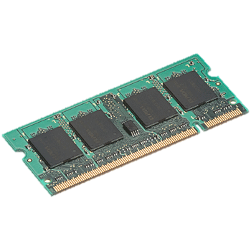
Goal: In-Memory Data Sharing
iter. 1
iter. 2
. . .
Input
query 1
one-time processing
query 2
query 3
Input
. . .
10-100× faster than network/disk, but how to get FT?

Slide 7
Challenge
How to design a distributed memory abstraction that is both fault-tolerant and efficient?

Slide 8
Challenge
Existing storage abstractions have interfaces based on fine-grained updates to mutable state
RAMCloud, databases, distributed mem, Piccolo
Requires replicating data or logs across nodes for fault tolerance
Costly for data-intensive apps
10-100x slower than memory write
Notes:
Say it’s expensive for data-intensive apps in particular
Data-intensive vs transactional -> show spectrum with update granularity and write throughput

Slide 9
Solution: Resilient Distributed Datasets (RDDs)
Restricted form of distributed shared memory
Immutable, partitioned collections of records
Can only be built through coarse-grained deterministic transformations (map, filter, join, …)
Efficient fault recovery using lineage
Log one operation to apply to many elements
Recompute lost partitions on failure
No cost if nothing fails
Notes:
Define RDDs more precisely here!

Slide 10
RDD Recovery
iter. 1
iter. 2
. . .
Input
query 1
one-time processing
query 2
query 3
Input
. . .

Slide 11
Generality of RDDs
Despite their restrictions, RDDs can express surprisingly many parallel algorithms
These naturally apply the same operation to many items
Unify many current programming models
Data flow models: MapReduce, Dryad, SQL, …
Specialized models for iterative apps: BSP (Pregel), iterative MapReduce (Haloop), bulk incremental, …
Support new apps that these models don’t
Notes:
Similarity to GFS/HDFS: large blocks, append only.

Slide 12
Tradeoff Space
Fine
K-V stores,
databases,
RAMCloud
Best for
transactional
workloads
Granularity
of Updates
Best for batch
workloads
HDFS
RDDs
Coarse
Low
High
Write Throughput

Slide 13
Spark Programming Interface
Usable interactively from Scala interpreter
Provides:
Resilient distributed datasets (RDDs)
Operations on RDDs: transformations (build new RDDs), actions (compute and output results)
Control of each RDD’s partitioning (layout across nodes) and persistence (storage in RAM, on disk, etc)
Notes:
Mention that Scala is a JVM language

Slide 14
Working With RDDs
textFile = sc.textFile(”SomeFile.txt”)
RDD
RDD
Action
RDD
Transformations
RDD
Value
linesWithSpark.count()
74
linesWithSpark.first()
# Apache Spark
linesWithSpark = textFile.filter(lambda line: "Spark” in line)
Notes:
Let me illustrate this with some bad powerpoint diagrams and animations
This diagram is LOGICAL,

Slide 15

Example: Log Mining
Load error messages from a log into memory, then interactively search for various patterns
Base RDD
Msgs. 1
lines = spark.textFile(“hdfs://...”)
errors = lines.filter(_.startsWith(“ERROR”))
messages = errors.map(_.split(‘\t’)(2))
Messages.cache
Transformed RDD
Worker
results
tasks
Block 1
Master
Action
messages.filter(_.contains(“foo”)).count
messages.filter(_.contains(“bar”)).count
Msgs. 2
Worker
Msgs. 3
Result: full-text search of Wikipedia in <1 sec (vs 20 sec for on-disk data)
Worker
Block 2
Result: scaled to 1 TB data in 5-7 sec (vs 170 sec for on-disk data)
Block 3
Notes:
Key idea: add “variables” to the “functions” in functional programming

Slide 16
Fault Recovery
RDDs track the graph of transformations that built them (their lineage) to rebuild lost data
E.g.:
messages = textFile(...).filter(_.contains(“error”))
.map(_.split(‘\t’)(2))
HadoopRDD
FilteredRDD
MappedRDD
HadoopRDD
path = hdfs://…
FilteredRDD
func = _.contains(...)
MappedRDD
func = _.split(…)

Slide 17
Fault Recovery Results
Failure happens
Notes:
These are for K-means

Slide 18
Example: PageRank
1. Start each page with a rank of 1
2. On each iteration, update each page’s rank to
Σ_{i∈neighbors} rank_{i} / |neighbors_{i}|
links = // RDD of (url, neighbors) pairs
ranks = // RDD of (url, rank) pairs
for (i <- 1 to ITERATIONS) {
ranks = links.join(ranks).flatMap {
(url, (links, rank)) =>
links.map(dest => (dest, rank/links.size))
}.reduceByKey(_ + _)
}

Slide 19
Optimizing Placement
Links
(url, neighbors)
Ranks₀
(url, rank)
links & ranks repeatedly joined
Can co-partition them (e.g. hash both on URL) to avoid shuffles
Can also use app knowledge, e.g., hash on DNS name
links = links.partitionBy( new URLPartitioner())
join
Contribs₀
reduce
Ranks₁
join
Contribs₂
reduce
Ranks₂
. . .

Slide 20
PageRank Performance

Slide 21
Implementation
Runs on Mesos [NSDI 11] to share clusters w/ Hadoop
Can read from any Hadoop input source (HDFS, S3, …)
Spark
Hadoop
MPI
…
Mesos
Node
Node
Node
Node
No changes to Scala language or compiler
Reflection + bytecode analysis to correctly ship code
www.spark-project.org

Slide 22
Programming Models Implemented on Spark
RDDs can express many existing parallel models
MapReduce, DryadLINQ
Pregel graph processing [200 LOC]
Iterative MapReduce [200 LOC]
SQL: Hive on Spark (Shark) [in progress]
Enables apps to efficiently intermix these models
All are based on coarse-grained operations
Notes:
Emphasize Shark

Slide 23
Conclusion
RDDs offer a simple and efficient programming model for a broad range of applications
Leverage the coarse-grained nature of many parallel algorithms for low-overhead recovery
Try it out at www.spark-project.org

Slide 24
Behavior with Insufficient RAM

Slide 25
Scalability
Logistic Regression
K-Means

Slide 26
Components
Spark client (app master)
Spark worker
Your program
RDD graph
Cluster manager
sc = new SparkContext
f = sc.textFile(“…”) f.filter(…) .count() ...
Task threads
Scheduler
Block tracker
Block manager
Shuffle tracker
HDFS, HBase, …

Slide 27
Example Job
Resilient distributed
datasets (RDDs)
val sc = new SparkContext( “spark://...”, “MyJob”, home, jars) val file = sc.textFile(“hdfs://...”) val errors = file.filter(_.contains(“ERROR”)) errors.cache() errors.count()
Action

Slide 28
RDD Graph
Dataset-level view:
Partition-level view:
file:
HadoopRDD path = hdfs://...
errors:
FilteredRDD func = _.contains(…) shouldCache = true
Task 1
Task 2
...

Slide 29
Data Locality
First run: data not in cache, so use HadoopRDD’s locality prefs (from HDFS)
Second run: FilteredRDD is in cache, so use its locations
If something falls out of cache, go back to HDFS

Slide 30
In More Detail: Life of a Job

Slide 31
Scheduling Process
RDD Objects
DAGScheduler
TaskScheduler
Worker
Cluster manager
Threads
DAG
TaskSet
Task
Block manager
rdd1.join(rdd2) .groupBy(…)
.filter(…)
split graph into stages of tasks
launch tasks via cluster manager
execute tasks
submit each stage as ready
retry failed or straggling tasks
store and serve blocks
build operator DAG
agnostic to operators!
stage failed
doesn’t know about stages

Slide 32
RDD Abstraction
Goal: wanted to support wide array of operators and let users compose them arbitrarily
Don’t want to modify scheduler for each one
How to capture dependencies generically?

Slide 33
RDD Interface
Set of partitions (“splits”)
List of dependencies on parent RDDs
Function to compute a partition given parents
Optional preferred locations
Optional partitioning info (Partitioner)
Captures all current Spark operations!

Slide 34
Example: HadoopRDD
partitions = one per HDFS block
dependencies = none
compute(partition) = read corresponding block
preferredLocations(part) = HDFS block location
partitioner = none

Slide 35
Example: FilteredRDD
partitions = same as parent RDD
dependencies = “one-to-one” on parent
compute(partition) = compute parent and filter it
preferredLocations(part) = none (ask parent)
partitioner = none

Slide 36
Example: JoinedRDD
partitions = one per reduce task
dependencies = “shuffle” on each parent
compute(partition) = read and join shuffled data
preferredLocations(part) = none
partitioner = HashPartitioner(numTasks)
Spark will now know this data is hashed!

Slide 37
Spark Operations
Transformations (define a new RDD) | map Filter groupByKey reduceByKey sortByKey | flatMap union join Cogroup mapPartition
Actions (return a result to driver program) | collect reduce count saveAsTextFile lookupKey

Slide 38
Task Scheduler
DAGs
Pipelines functions within a stage
Locality & data reuse aware
Partitioning-aware to avoid shuffles
A:
B:
G:
Stage 1
groupBy
C:
D:
F:
map
E:
join
Stage 2
union
Stage 3
= cached data partition
Notes:
NOT a modified version of Hadoop

Slide 39
Task Details
Stage boundaries are only at input RDDs or “shuffle” operations
So, each task looks like this:
(Note: we write shuffle outputs to RAM/disk to allow retries)
external storage
Task
f₁ ➔ f₂ ➔ …
map output file or master
and/or
fetch map
outputs

Slide 40
Task Details
Each Task object is self-contained
Contains all transformation code up to input boundary (e.g. HadoopRDD => filter => map)
Allows Tasks on cached data to even if they fall out of cache
Design goal: any Task can run on any node
Only way a Task can fail is lost map output files

Slide 41
Event Flow
graph of stages
RDD partitioning
pipelining
runJob(targetRDD, partitions, func, listener)
DAGScheduler
task finish & stage failure events
submitTasks(taskSet)
TaskScheduler
task placement
retries on failure
speculation
inter-job policy
Task objects
Cluster or local runner

Slide 42
TaskScheduler
Interface:
Given a TaskSet (set of Tasks), run it and report results
Report “fetch failed” errors when shuffle output lost
Two main implementations:
LocalScheduler (runs locally)
ClusterScheduler (connects to a cluster manager using a pluggable “SchedulerBackend” API)

Slide 43
TaskScheduler Details
Can run multiple concurrent TaskSets, but currently does so in FIFO order
Would be really easy to plug in other policies!
If someone wants to suggest a plugin API, please do
Maintains one TaskSetManager per TaskSet that tracks its locality and failure info
Polls these for tasks in order (FIFO)

Slide 44
Worker
Implemented by the Executor class
Receives self-contained Task objects and calls run() on them in a thread pool
Reports results or exceptions to master
Special case: FetchFailedException for shuffle
Pluggable ExecutorBackend for cluster

Slide 45
Other Components
BlockManager
“Write-once” key-value store on each worker
Serves shuffle data as well as cached RDDs
Tracks a StorageLevel for each block (e.g. disk, RAM)
Can drop data to disk if running low on RAM
Can replicate data across nodes

Slide 46
Other Components
CommunicationManager
Asynchronous IO based networking library
Allows fetching blocks from BlockManagers
Allows prioritization / chunking across connections (would be nice to make this pluggable!)
Fetch logic tries to optimize for block sizes

Slide 47
Other Components
MapOutputTracker
Tracks where each “map” task in a shuffle ran
Tells reduce tasks the map locations
Each worker caches the locations to avoid re-fetching
A “generation ID” passed with each Task allows invalidating the cache when map outputs are lost

Slide 48
Extension Points
Spark provides several places to customize functionality:
Extending RDD: add new input sources or transformations
SchedulerBackend: add new cluster managers
spark.serializer: customize object storage

Slide 49
What People Have Done
New RDD transformations (sample, glom, mapPartitions, leftOuterJoin, rightOuterJoin)
New input sources (DynamoDB)
Custom serialization for memory and bandwidth efficiency
New language bindings (Java, Python)

Slide 50
Possible Future Extensions
Pluggable inter-job scheduler
Pluggable cache eviction policy (ideally with priority flags on StorageLevel)
Pluggable instrumentation / event listeners
Let us know if you want to contribute these!

Slide 51
As an Exercise
Try writing your own input RDD from the local filesystem (say one partition per file)
Try writing your own transformation RDD (pick a Scala collection method not in Spark)
Try writing your own action (e.g. product())

Slide 52
How to Run It
Local multicore: just a library in your program
EC2: scripts for launching a Spark cluster
Private cluster:
YARN
Standalone Mode
Mesos

Slide 53
Languages
APIs in Java, Scala, Python and R
Interactive shells in Scala and Python

Slide 54
Operations
Transformations (e.g. map, filter, groupBy, join)
Lazy operations to build RDDs from other RDDs
Actions (e.g. count, collect, save)
Return a result or write it to storage
Notes:
You write a single program → similar to DryadLINQ
Distributed data sets with parallel operations on them are pretty standard; the new thing is that they can be reused across ops
Variables in the driver program can be used in parallel ops; accumulators useful for sending information back, cached vars are an optimization
Mention cached vars useful for some workloads that won’t be shown here
Mention it’s all designed to be easy to distribute in a fault-tolerant fashion

Slide 55
Spark in Java and Scala
Java API:
JavaRDD<String> lines = spark.textFile(…); errors = lines.filter( new Function<String, Boolean>() { public Boolean call(String s) { return s.contains(“ERROR”); } }); errors.count()
Scala API:
val lines = spark.textFile(…) errors = lines.filter(s => s.contains(“ERROR”)) // can also write filter(_.contains(“ERROR”)) errors.count

Slide 56
Scala Cheat Sheet
Variables:
var x: Int = 7 var x = 7 // type inferred
val y = “hi” // read-only
Collections and closures:
val nums = Array(1, 2, 3)
nums.map((x: Int) => x + 2) // => Array(3, 4, 5)
nums.map(x => x + 2) // => same nums.map(_ + 2) // => same
nums.reduce((x, y) => x + y) // => 6 nums.reduce(_ + _) // => 6
Functions:
def square(x: Int): Int = x*x
def square(x: Int): Int = { x*x // last line returned }
Java interop:
import java.net.URL
new URL(“http://cnn.com”).openStream()
More details:
scala-lang.org

Slide 57
Learning Spark
Easiest way: Spark interpreter (spark-shell or pyspark)
Special Scala and Python consoles for cluster use
Runs in local mode on 1 thread by default, but can control with MASTER environment var:
MASTER=local ./spark-shell # local, 1 thread MASTER=local[2] ./spark-shell # local, 2 threads MASTER=spark://host:port ./spark-shell # Spark standalone cluster

Slide 58
First Stop: SparkContext
Main entry point to Spark functionality
Created for you in Spark shells as variable sc
In standalone programs, you’d make your own (see later for details)

Slide 59
Creating RDDs
# Turn a local collection into an RDD
sc.parallelize([1, 2, 3])
# Load text file from local FS, HDFS, or S3
sc.textFile(“file.txt”)
sc.textFile(“directory/*.txt”)
sc.textFile(“hdfs://namenode:9000/path/file”)
# Reading from a SequenceFile
sc.sequenceFile(path,keyClass,valClass)
# Use any existing Hadoop InputFormat
sc.hadoopFile[keyClass, valClass, inputFmt](path)

Slide 60
Basic Transformations
nums = sc.parallelize([1, 2, 3])
# Pass each element through a function
squares = nums.map(lambda x: x*x) # => {1, 4, 9}
# Keep elements passing a predicate
even = squares.filter(lambda x: x % 2 == 0) # => {4}
# Map each element to zero or more others
nums.flatMap(lambda x: range(0, x)) # => {0, 0, 1, 0, 1, 2}
Range object (sequence of numbers 0, 1, …, x-1)
Notes:
All lazy

Slide 61
Basic Actions
nums = sc.parallelize([1, 2, 3])
# Retrieve RDD contents as a local collection nums.collect() # => [1, 2, 3]
# Return first K elements nums.take(2) # => [1, 2]
# Count number of elements nums.count() # => 3
# Merge elements with an associative function nums.reduce(lambda x, y: x + y) # => 6
# Write elements to a text file nums.saveAsTextFile(“hdfs://file.txt”)
Notes:
Launch computations

Slide 62
Working with Key-Value Pairs
Spark’s “distributed reduce” transformations act on RDDs of key-value pairs
Python: pair = (a, b)
pair[0] # => a
pair[1] # => b
Scala: val pair = (a, b)
pair._1 // => a
pair._2 // => b
Java: Tuple2 pair = new Tuple2(a, b); // class scala.Tuple2
pair._1 // => a
pair._2 // => b

Slide 63
Some Key-Value Operations
pets = sc.parallelize([(“cat”, 1), (“dog”, 1), (“cat”, 2)])
pets.reduceByKey(lambda x, y: x + y) # => {(cat, 3), (dog, 1)}
pets.groupByKey() # => {(cat, Seq(1, 2)), (dog, Seq(1)}
pets.sortByKey() # => {(cat, 1), (cat, 2), (dog, 1)}
Note: reduceByKey also automatically implements combiners on the map side
Notes:
val pets=sc.parallelize(List(("cat",1),("dog",1),("cat",2)))

Slide 64
Example: Word Count
lines = sc.textFile(“hamlet.txt”)
counts = lines.flatMap(lambda line: line.split(“ ”)) \ .map(lambda word: (word, 1)) \ .reduceByKey(lambda x, y: x + y)
“to” “be” “or”
(to, 1) (be, 1) (or, 1)
(be, 2) (not, 1)
“to be or”
“not” “to” “be”
(not, 1) (to, 1) (be, 1)
(or, 1)
(to, 2)
“not to be”

Slide 65
Multiple Datasets
visits = sc.parallelize([(“index.html”, “1.2.3.4”), (“about.html”, “3.4.5.6”), (“index.html”, “1.3.3.1”)])
pageNames = sc.parallelize([(“index.html”, “Home”), (“about.html”, “About”)])
visits.join(pageNames) # (“index.html”, (“1.2.3.4”, “Home”)) # (“index.html”, (“1.3.3.1”, “Home”)) # (“about.html”, (“3.4.5.6”, “About”))
visits.cogroup(pageNames) # (“index.html”, (Seq(“1.2.3.4”, “1.3.3.1”), Seq(“Home”))) # (“about.html”, (Seq(“3.4.5.6”), Seq(“About”)))

Slide 66
Controlling the Level of Parallelism
All the pair RDD operations take an optional second parameter for number of tasks
words.reduceByKey(lambda x, y: x + y, 5)
words.groupByKey(5)
visits.join(pageViews, 5)

Slide 67
Using Local Variables
External variables you use in a closure will automatically be shipped to the cluster:
query = raw_input(“Enter a query:”)
pages.filter(lambda x: x.startswith(query)).count()
Some caveats:
Each task gets a new copy (updates aren’t sent back)
Variable must be Serializable (Java/Scala) or Pickle-able (Python)
Don’t use fields of an outer object (ships all of it!)

Slide 68
Closure Mishap Example
class MyCoolRddApp { val param = 3.14 val log = new Log(...) ... def work(rdd: RDD[Int]) { rdd.map(x => x + param) .reduce(...) } }
How to get around it:
class MyCoolRddApp { ... def work(rdd: RDD[Int]) { val param_ = param rdd.map(x => x + param_) .reduce(...) } }
NotSerializableException: MyCoolRddApp (or Log)
References only local variable instead of this.param

Slide 69
More Details
Spark supports lots of other operations!
Full programming guide: spark-project.org/documentation

Slide 70
Software Components
Spark runs as a library in your program (one instance per app)
Runs tasks locally or on a cluster
Standalone deploy cluster, Mesos or YARN
Accesses storage via Hadoop InputFormat API
Can use HBase, HDFS, S3, …
Your application
SparkContext
Cluster manager
Local threads
Worker
Worker
Spark executor
Spark executor
HDFS or other storage

Slide 71
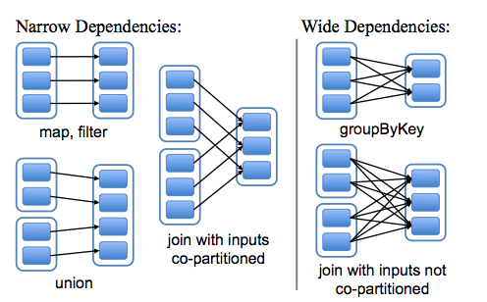
RDD Representations

Slide 72
Task Scheduler
Supports general task graphs
Pipelines functions where possible
Cache-aware data reuse & locality
Partitioning-aware to avoid shuffles
A:
B:
F:
Stage 1
groupBy
C:
D:
E:
join
Stage 2
map
filter
Stage 3
= RDD
= cached partition
Notes:
NOT a modified version of Hadoop

Slide 73
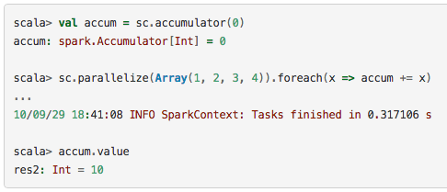
Accumulator Variables
Variables that are only “added” to through an associative operation in parallel

Slide 74
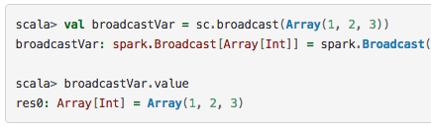
Broadcast Variables
Read-only variable cached on each machine instead of shipping it with every task

Slide 75
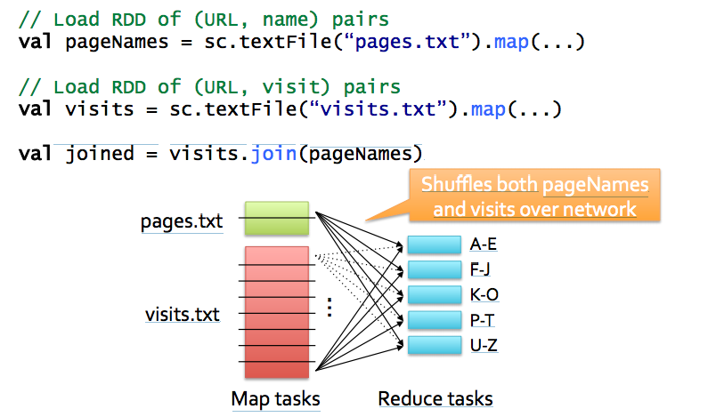
Example: Join

Slide 76
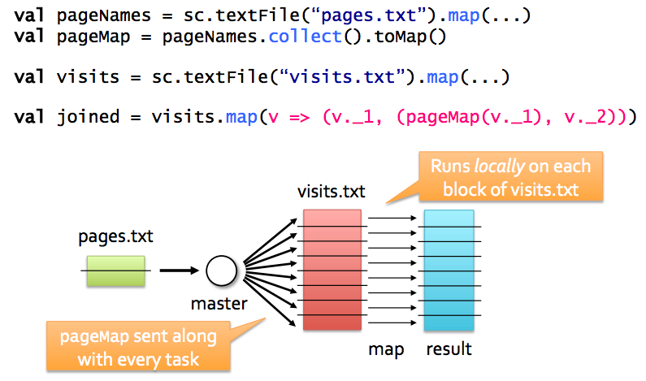
Alternative if One Table is Small

Slide 77
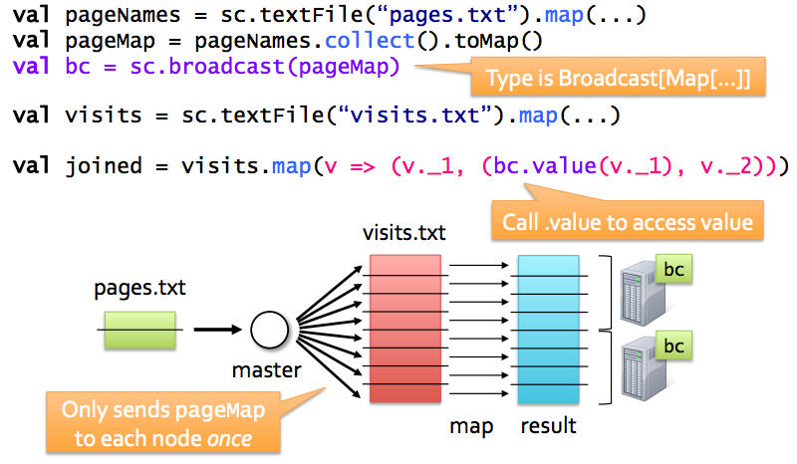
Better Version with Broadcast

Slide 78
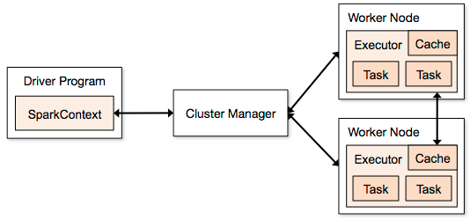
Spark Components
Spark Context
DAG Scheduler
Task Scheduler
Block Manager
Defines and tracks RDDS
Allocates resources across applications
Standalone
Mesos
Yarn
Runs computations
Stores data

Slide 79
Spark Config
Environment variables (conf/spark-env.sh)
Spark Properties
Set by passing a SparkConf object to SparkContext

Slide 80
Spark Tuning CPU <–> Network Bandwidth <-> Memory
Data Serialization
Java/Kryo Serialization
Memory Tuning
Tuning Data Structures
Avoid Strings, use primitive types instead of collections
Serialized RDD Storage
MEMORY_ONLY_SER
Level of Parallelism
Memory Usage of Reduce Tasks
Broadcasting Large Variables

Slide 81
Hadoop Compatibility
Spark can read/write to any storage system / format that has a plugin for Hadoop!
Examples: HDFS, S3, HBase, Cassandra, Avro, SequenceFile
Reuses Hadoop’s InputFormat and OutputFormat APIs
APIs like SparkContext.textFile support filesystems, while SparkContext.hadoopRDD allows passing any Hadoop JobConf to configure an input source

Slide 82
Build Spark
Requires Java 6+, Scala 2.9.2
git clone git://github.com/mesos/spark cd spark sbt/sbt package
# Optional: publish to local Maven cache sbt/sbt publish-local

Slide 83
Add Spark to Your Project
Scala and Java: add a Maven dependency on
groupId: org.spark-project artifactId: spark-core_2.9.1 version: 0.7.0-SNAPSHOT
Python: run program with our pyspark script

Slide 84
Create a SparkContext
import spark.SparkContext
import spark.SparkContext._
val sc = new SparkContext(“masterUrl”, “name”, “sparkHome”, Seq(“app.jar”))
Scala
Cluster URL, or local / local[N]
App name
Spark install path on cluster
List of JARs with app code (to ship)
import spark.api.java.JavaSparkContext;
JavaSparkContext sc = new JavaSparkContext(
“masterUrl”, “name”, “sparkHome”, new String[] {“app.jar”}));
Java
from pyspark import SparkContext
sc = SparkContext(“masterUrl”, “name”, “sparkHome”, [“library.py”]))
Python
Notes:
Mention assembly JAR in Maven etc
Use the shell with your own JAR`

Slide 85
Complete App: Scala
import spark.SparkContext
import spark.SparkContext._
object WordCount { def main(args: Array[String]) {
val sc = new SparkContext(“local”, “WordCount”, args(0), Seq(args(1))) val lines = sc.textFile(args(2)) lines.flatMap(_.split(“ ”)) .map(word => (word, 1)) .reduceByKey(_ + _) .saveAsTextFile(args(3)) } }

Slide 86
Complete App: Python
import sys
from pyspark import SparkContext
if __name__ == "__main__":
sc = SparkContext( “local”, “WordCount”, sys.argv[0], None) lines = sc.textFile(sys.argv[1])
lines.flatMap(lambda s: s.split(“ ”)) \ .map(lambda word: (word, 1)) \ .reduceByKey(lambda x, y: x + y) \ .saveAsTextFile(sys.argv[2])

Slide 87
Example: PageRank

Slide 88
Why PageRank?
Good example of a more complex algorithm
Multiple stages of map & reduce
Benefits from Spark’s in-memory caching
Multiple iterations over the same data

Slide 89
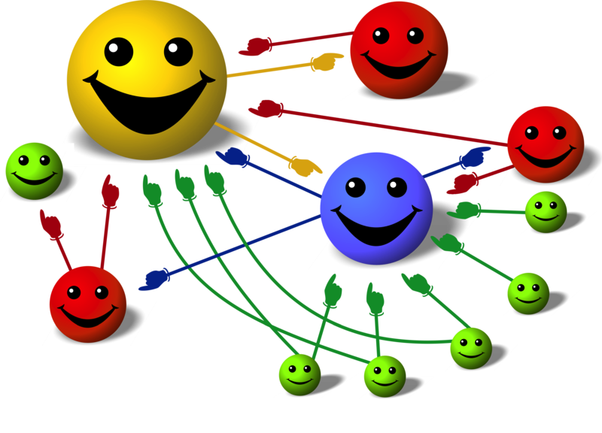
Basic Idea
Give pages ranks (scores) based on links to them
Links from many pages ➔ high rank
Link from a high-rank page ➔ high rank
Image: en.wikipedia.org/wiki/File:PageRank-hi-res-2.png

Slide 90
Algorithm
Start each page at a rank of 1
On each iteration, have page p contribute rank_{p} / |neighbors_{p}| to its neighbors
Set each page’s rank to 0.15 + 0.85 × contribs
1.0
1.0
1.0
1.0

Slide 91
Algorithm
Start each page at a rank of 1
On each iteration, have page p contribute rank_{p} / |neighbors_{p}| to its neighbors
Set each page’s rank to 0.15 + 0.85 × contribs
1.0
1
0.5
1
1.0
0.5
1.0
0.5
0.5
1.0

Slide 92
Algorithm
Start each page at a rank of 1
On each iteration, have page p contribute rank_{p} / |neighbors_{p}| to its neighbors
Set each page’s rank to 0.15 + 0.85 × contribs
1.85
0.58
1.0
0.58

Slide 93
Algorithm
Start each page at a rank of 1
On each iteration, have page p contribute rank_{p} / |neighbors_{p}| to its neighbors
Set each page’s rank to 0.15 + 0.85 × contribs
1.85
0.58
0.5
1.85
0.58
0.29
1.0
0.5
0.29
0.58

Slide 94
Algorithm
Start each page at a rank of 1
On each iteration, have page p contribute rank_{p} / |neighbors_{p}| to its neighbors
Set each page’s rank to 0.15 + 0.85 × contribs
1.31
0.39
. . .
1.72
0.58

Slide 95
Algorithm
Start each page at a rank of 1
On each iteration, have page p contribute rank_{p} / |neighbors_{p}| to its neighbors
Set each page’s rank to 0.15 + 0.85 × contribs
Final state:
1.44
0.46
1.37
0.73

Slide 96
Scala Implementation
val links = // RDD of (url, neighbors) pairs
var ranks = // RDD of (url, rank) pairs
for (i <- 1 to ITERATIONS) {
val contribs = links.join(ranks).flatMap {
case (url, (links, rank)) =>
links.map(dest => (dest, rank/links.size))
} ranks = contribs.reduceByKey(_ + _) .mapValues(0.15 + 0.85 * _)
} ranks.saveAsTextFile(...)

Slide 97
Python Implementation
links = # RDD of (url, neighbors) pairs
ranks = # RDD of (url, rank) pairs
for i in range(NUM_ITERATIONS):
def compute_contribs(pair): [url, [links, rank]] = pair # split key-value pair
return [(dest, rank/len(links)) for dest in links]
contribs = links.join(ranks).flatMap(compute_contribs)
ranks = contribs.reduceByKey(lambda x, y: x + y) \ .mapValues(lambda x: 0.15 + 0.85 * x) ranks.saveAsTextFile(...)

Slide 98
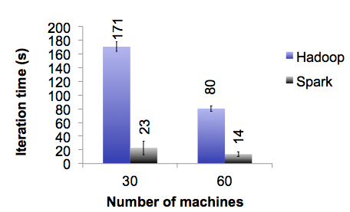
PageRank Performance
Notes:
54 GB Wikipedia dataset

Slide 99
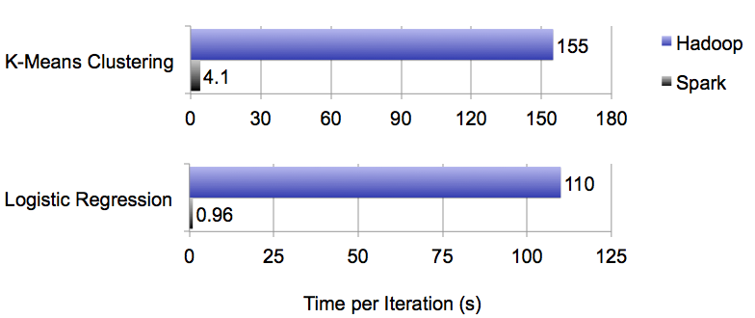
Other Iterative Algorithms
Notes:
100 GB datasets

Slide 100
Thank You!!

