Slide 1

Open Source Software Engineering
SEZG587
Assignment 2- Working with GitHub Pages
Mahua Sarkar
2021MT93071

Slide 2
Assignment Task
Assignment Task:
• Navigate to GitHub.com
• Create an account – it is linked to your email id
• Example –username is ritubits
• Create a repository in your login with the same name as your username – ritubits.github.io
• You may NOT choose any license for the same
• Create a file index.html
• Use HTML to write content - create your profile page
• View your profile: https://ritubits.github.io/
Expected Deliverables:
• Submit

Slide 3

Navigate to GitHub.com

Slide 4
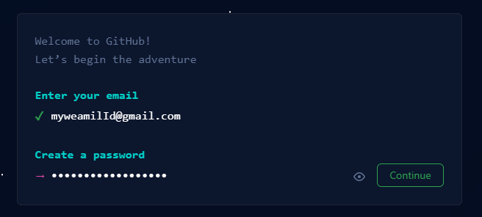
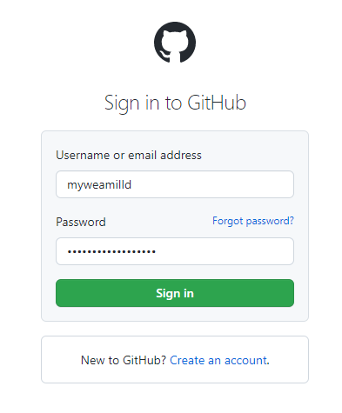
Create an account – It is linked to your email id

Slide 5
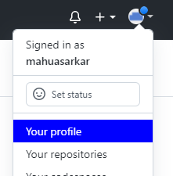
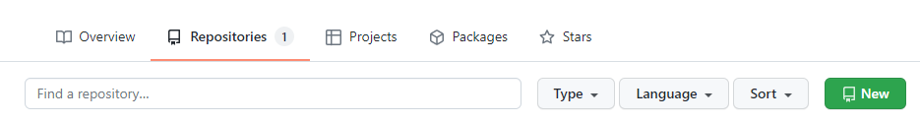
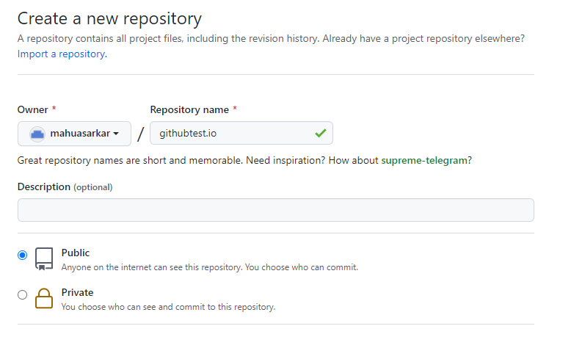

Create a repository in your login with the same name as your username

Slide 6
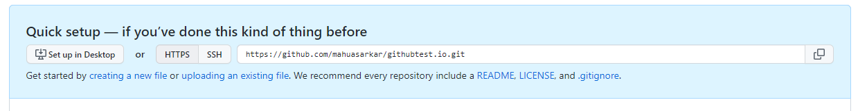


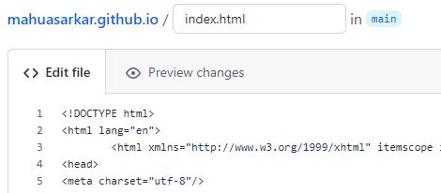
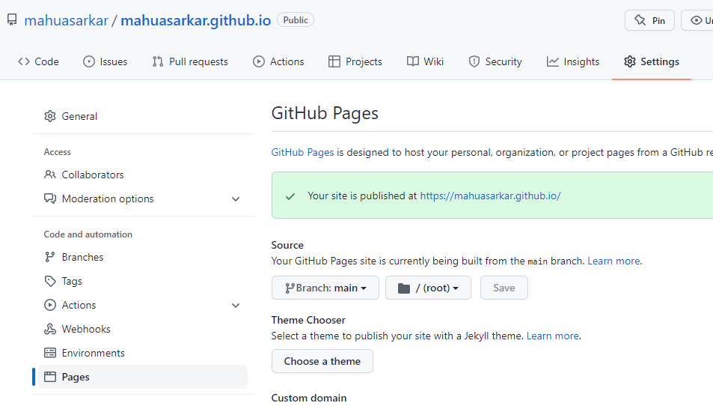

Create a repository in your login with the same name as your username

Slide 7
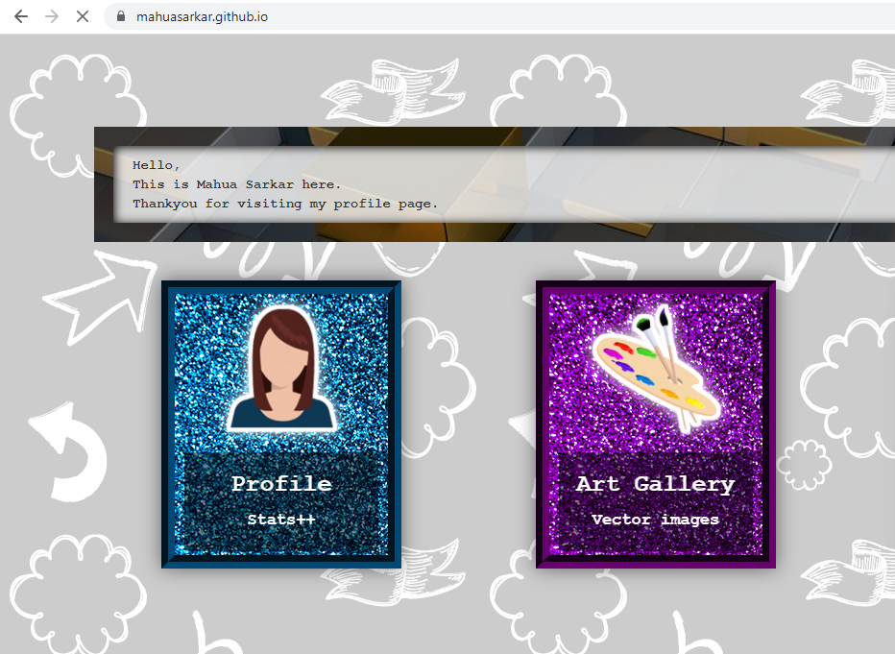
Mahuasarkar.github.io

Slide 8
Open Source Software Engineering
SEZG587
Thank You
Assignment #2
Mahua Sarkar
2021MT93071

