Slide 1
Conceptual Architecture
of WezTerm
CISC 322
Group 20 - https://youtu.be/g_ZeLQwuBT0
Notes:
~15 s. Introduce the topic: the conceptual architecture of WezTerm, an open-source, cross-platform terminal emulator and multiplexer written in Rust. We are Group 20 in CISC 322.

Slide 2
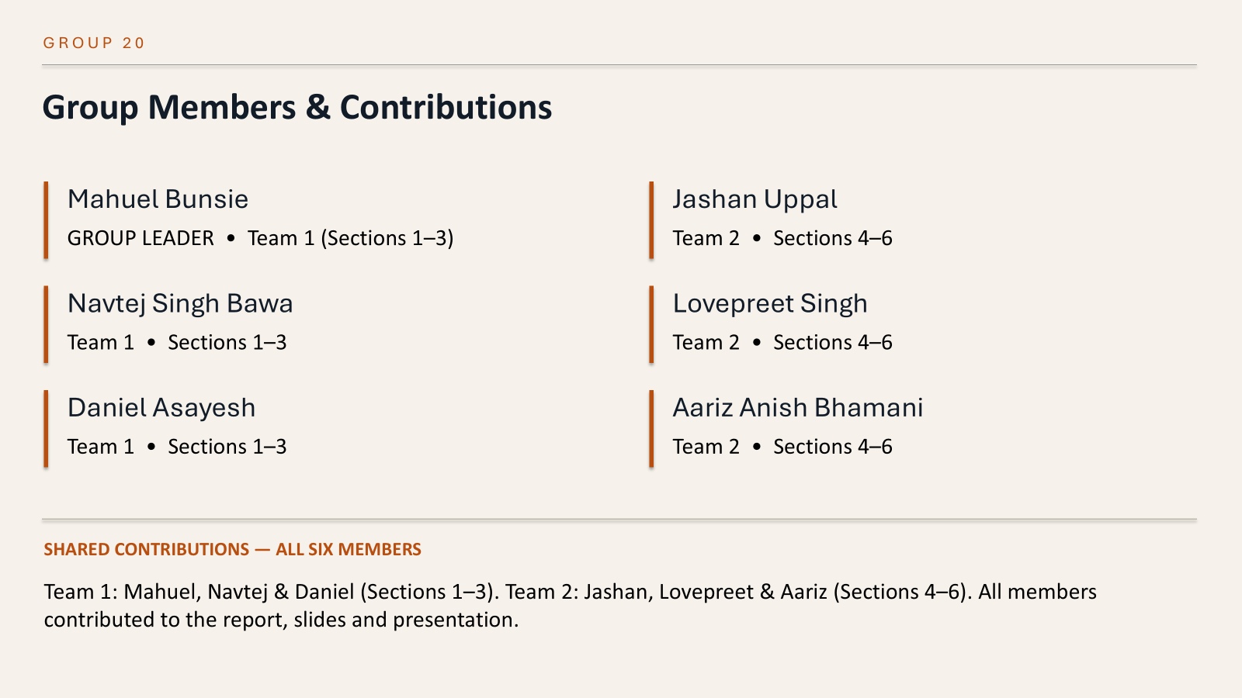

Slide 3
What is WezTerm?
INTRODUCTION
An open-source, cross-platform terminal emulator and multiplexer.
• Windows, tabs and split panes
• Searchable scrollback
• Built-in SSH client
• Local and remote multiplexing
Notes:
~35 s. GUI and mux are separate because the mux can run without a GUI, so sessions survive and can be remote. The mux routes input to the active pane, and each pane is its own session, so programs run side by side. The PTY hides OS differences such as ConPTY on Windows. Lua config hooks into the GUI and mux without changing WezTerm's code.

Slide 4

Architecture Development
DERIVATION PROCESS
1
2
3
4
Read the documentation
Check source and history
Trace use cases
Draw and cross-check
Followed a keystroke and a pane split from end to end to see which part does what.
What is a Terminal, Multiplexing, Pane object, wezterm.mux, Keyboard Concepts.
Repository layout, mux/src/lib.rs, release notes 2019–2024, maintainer discussions.
Checked the box-and-arrow and sequence diagrams against each other and against the docs.
Notes:
~30 s. We worked in four steps. We read the official docs, then the repository layout, the mux source and the release history. We traced two use cases, running a command and splitting a pane, to see who does what. Finally we drew the diagrams and checked them against each other and the sources. Component names come straight from the docs.

Slide 5








Conceptual Architecture
BOX-AND-ARROW DIAGRAM
User
types input, reads the screen
Input handling
Renderer
Lua configuration
GUI
key bindings · encoding
draws screen state
settings · events · scripts
Multiplexer (mux)
Remote mux server
SESSION
windows · tabs · panes · workspaces · domains
Unix socket · SSH · TLS
Pane + terminal emulation
LEGEND
TERMINAL
escape-sequence parser · screen state · scrollback
input / control (down)
output / data (up)
PTY layer
Shell and apps
configuration
OS / PROCESS
pseudo-terminal · ConPTY
bash · zsh · vim
session link (both ways)
Notes:
~50 s. Four layers. The GUI has input handling, which checks key bindings and encodes keys, and the renderer, which draws the screen. The mux owns windows, tabs, panes and domains, and can reach a remote mux server over a Unix socket, SSH or TLS. Each pane holds one session: it parses escape sequences and keeps screen state. The PTY connects it to the shell and apps. Lua configuration reaches into the GUI and the mux. Orange is input going down, blue is output coming up, and each layer only talks to its neighbours.

Slide 6
How Subsystems Interact
INTERACTIONS AND RATIONALE
GUI ↔ Mux
Mux ↔ Pane
Input goes down; change notices come up.
The mux sends input to the active pane.
Why: Managing sessions separately from displaying them supports both local and remote connections
Why: Input must reach the correct pane and each pane must keep its own terminal state
Pane ↔ PTY ↔ Shell
Lua config → GUI and Mux
Bytes travel in both directions.
Settings and event callbacks.
Why: The PTY provides the terminal connection between WezTerm and local shells
Why: Users can change behaviour without changing WezTerm's code.
Notes:
~35 s. GUI and mux are separate because the mux can run without a GUI, so sessions survive and can be remote. The mux routes input to the active pane, and each pane is its own session, so programs run side by side. The PTY hides OS differences such as ConPTY on Windows. Lua config hooks into the GUI and mux without changing WezTerm's code.

Slide 7
Description of WezTerm’s architecture
ARCHITECTURAL STYLE
Layered
Event-driven
Client–server (remote)
GUI → Mux → Pane → PTY → OS. Each layer talks only to its neighbours.
Key presses, program output and config reloads start the work.
The GUI is a client of a local or remote mux.
Evidence: key bindings decide what an event means; reader threads notify panes of new output.
Evidence: wezterm-mux-server became its own program in October 2020.
Evidence: the same chain appears in the docs, our box diagram and both sequence diagrams.
These styles describe different aspects of WezTerm. Together, they explain its responsibilities, behaviour and remote connections
Notes:
~35 s. The style is a hybrid. Mainly layered: GUI to mux to pane to PTY, each depending only on the layer below. Event-driven: key presses, program output and config reloads start the work. And client–server for remote sessions, since the mux server became its own program in 2020. That is why sessions outlive windows and remote works like local.

Slide 8
Alternative views we considered
CONSIDERED ALTERNATIVES
View | What it gets right | Why it is not our main view
Pipe-and-filter | Output really is a pipeline: PTY → parser → screen state → renderer | Leaves out user events, key bindings and session management
GUI owns sessions | Simple: each window holds its own terminals | Docs say the mux runs without a GUI; remote domains need that split
Client–server | Matches remote domains and wezterm-mux-server | Local panes don't need a server; too narrow for the whole system
Layered and event-driven | Shows separate responsibilities and the events that trigger their work | Our main view, with client-server added for separate mux connections
Notes:
~35 s. Pipe-and-filter fits the output path but ignores user events and session management. Letting the GUI own its sessions is simpler but contradicts the docs, since the mux runs without a GUI. Pure client–server fits remote sessions only. So we chose layered plus event-driven, with client–server as a sub-style.

Slide 9
Evolution of Features
SYSTEM EVOLUTION
2018
2019
2020
2022
2024
Repository created on February 7.
First tagged releases. November: tab bar, wezterm ssh, config hot-reload, software rendering fallback. December: Wayland, split font pipeline.
October: Lua event callbacks; mux server moved into its own wezterm-mux-server program.
June: wezterm.mux Lua module. November: WebGpu added as a third renderer.
WebGpu default for one day, then back to OpenGL. Feb 3: latest stable; nightly builds since.
The boundaries held: a new renderer or a separate server didn't require rewriting the other parts.
Notes:
~30 s. WezTerm started in 2018. In 2019 it gained a tab bar, SSH multiplexing and config hot-reload. In 2020 the mux server became its own program. In 2022 the mux was exposed to Lua and WebGpu was added as a third renderer. New features were added beside old ones, and the boundaries meant one change didn't require rewriting the rest.

Slide 10
Events Decide What Happens Next
CONTROL FLOW
User
GUI input
Mux
Pane
PTY
Shell / app
Key bindings branch the flow
The mux is not the GUI
A shortcut such as new tab or split pane is a WezTerm action. Any other key is passed on as input to the program.
The mux manages windows, tabs, panes and workspaces, and can exist with no GUI attached.
Notes:
~25 s. Control flow is event-driven. When a key is pressed, WezTerm first decides what it means. A key binding like split pane is handled by WezTerm itself; anything else becomes input for the program. The mux manages sessions and can exist without a GUI.

Slide 11

Input goes Down, Output comes Up
DATA FLOW
Input path — e.g. typing ls
Keyboard
WezTerm
Pane
PTY
Shell / app
Output path — the result coming back
Shell / app
PTY
Parser
Screen state
Renderer
User
Not just text: output carries escape sequences that change colours, move the cursor or set formatting, so WezTerm interprets it before drawing.
Shell integration: the shell can report the working directory and prompt positions, used to open panes in place and jump through output.
Notes:
~30 s. Data moves both ways. Typed keys go through the pane and PTY to the program. Output comes back the other way, but it includes escape sequences for colour and cursor movement, so WezTerm parses it into screen state before drawing. Shell integration also sends extras like the current directory.

Slide 12
Parallel Output Processing
CONCURRENCY
PTY
Reader thread
Parser thread
Pane state
Notify GUI
Many sessions
Separate processes
Lua states
Python in one pane, git in another. Each stream stays with its own pane and in order; shared mux data is synchronised.
The GUI and a mux server can be different processes, even on different machines, linked by Unix socket, SSH or TLS.
Callbacks may run in different Lua states, so globals aren't shared. Config can be evaluated more than once.
A slow program waiting to print doesn't block the user in another pane. This helps responsiveness but doesn't guarantee it.
Notes:
~35 s. Reading from a PTY can block, so WezTerm reads in background threads and hands the bytes to parser threads, which update the pane and notify the GUI. Each stream stays with its own pane, in order, and shared mux data is synchronised. The GUI and a mux server can also be separate processes. In Lua, callbacks may run in different states, so globals aren't shared.

Slide 13
Running a Command: ls
SEQUENCE DIAGRAM 1
━ input ━ output
User
GUI
Mux
Pane
PTY
Shell
ls
1. ls + Enter
2. no binding
3. key input
4. route input
5. write bytes
6. read line
7. start ls
8. output
9. read
10. parse
11. new output
12. notify
13. draw
GUI includes input handling and rendering. Pane includes terminal emulation, as shown in our architecture diagram
Notes:
~45 s. Same components as the box diagram. The user types ls. No key binding matches, so the GUI encodes the keys and the mux routes them to the active pane. The pane writes to the PTY, the shell reads the line and starts ls. Note that ls writes its output straight to the PTY, not through the shell. A reader thread picks it up, the pane parses it, the mux notifies the GUI, and the result is drawn.

Slide 14
Splitting a Pane and Starting a Shell
SEQUENCE DIAGRAM 2
━ request ━ result
User
GUI
Mux
New pane
New PTY
New shell
1. shortcut
2. SplitPane
3. split pane
4. create pane
5. open PTY
6. spawn shell
7. prompt
8. read + parse
9. add to tab
10. new layout
11. draw panes
Notes:
~35 s. Here the key is a shortcut, so the GUI runs the SplitPane action instead of sending input. The mux creates a new pane with its own PTY and starts the default shell. Its prompt is read and parsed, the mux adds the pane to the tab, and the GUI draws the new layout. Splitting creates a whole new session, not just a visual change.

Slide 15

ChatGPT as a Teammate, Not a Source
AI TEAMMATE · SELECTION AND CONTROLS
Why we chose ChatGPT
Prompting & quality checks
Estimated AI contribution
GPT-5.6 Sol (October 2026)
Clear explanations
Familiar to our group
Agree on a question and research it
Give context and clear limits
Review and refine AI responses
Verify claims against WezTerm docs
Group reviews accuracy and diagrams
Concepts 10%
Organisation 8%
How we used it
Organised report sections
Explained mux, pane and PTY
Improved wording and clarity
Brainstormed sequence steps
Wording 8%
Diagrams 5%
Clarity 4%

Slide 16
What our findings can't claim yet
LIMITATIONS
Mostly from docs
Not run-time checked
Ownership is assumed
Built from documentation and one source file. The real code may split things differently.
We did not trace or profile WezTerm; the thread model comes from source and maintainer notes.
The developer split follows the architecture, not actual contributor roles.
A moving target
Local cases only
Next time
No stable release since February 2024; nightly changes may not be documented.
Both sequence diagrams are local sessions; the remote path is described but not diagrammed.
Read the GUI and PTY source, and add a remote-session sequence diagram.
Notes:
~25 s. Our view is mostly from documentation, so the real code may divide things differently. We didn't run or profile WezTerm. There's been no stable release since 2024. And both diagrams are local sessions. Next time we'd read more source and diagram a remote session.

Slide 17
What this project taught us
LESSONS LEARNED
01
The split is the architecture
02
Use cases reveal roles
Separating the GUI from the mux explained remote sessions, headless use and the evolution history.
Tracing one keystroke and one split showed which part does what better than reading descriptions.
03
Diagrams check each other
04
AI explains, people decide
Matching the sequence diagrams to the box diagram kept names and arrows consistent.
Clear prompts and source checks made the AI useful; unchecked answers were too generic.
Notes:
~30 s. Four lessons. The GUI–mux split is the key architectural decision. Tracing real use cases revealed responsibilities better than reading descriptions. Checking diagrams against each other kept our model consistent. And AI was useful as a support teammate, but the decisions stayed with us.

Slide 18
References
SOURCES
[1] WezTerm, "What is a Terminal?" — wezterm.org/what-is-a-terminal.html
[8] WezTerm, "Shell Integration" — wezterm.org/shell-integration.html
[2] WezTerm, "Multiplexing" — wezterm.org/multiplexing.html
[9] WezTerm contributors, mux/src/lib.rs — github.com/wezterm/wezterm
[3] WezTerm, "Pane Object" — wezterm.org/config/lua/pane/
[10] WezTerm contributors, source repository — github.com/wezterm/wezterm
[4] WezTerm, "wezterm.mux Module" — wezterm.org/config/lua/wezterm.mux/
[11] WezTerm, "Configuration" — wezterm.org/config/files.html
[5] WezTerm, "SplitPane" — wezterm.org/config/lua/keyassignment/SplitPane.html
[12] W. Furlong, reply in discussion #3181 (Mar 2, 2023) — GitHub
[6] WezTerm, "Escape Sequences" — wezterm.org/escape-sequences.html
[13] WezTerm, "wezterm cli" — wezterm.org/cli/cli/index.html
[7] WezTerm, "Keyboard Concepts" — wezterm.org/config/keyboard-concepts.html
[14] WezTerm, "Plugins" — wezterm.org/config/plugins.html
Notes:
~5 s. Full list of references used in the report and presentation.

