Slide 1


International Conference
on
Futuristic Advances in Mechatronics Engineering for Aerospace and Defence (ICFAMEAD 2024)
4-5 Oct 2024
CMT3 Paper ID:_156___
Manuscript Title: Wind Turbine Gearbox Fault Detection Based on Statistical Learning
Mahum Fareed Khan, Shantanu Lohar, Jaehyun Jun, Harsh S. Dhiman, Jayshree Pande, Anindita Roy
Presented by: Mahum Fareed Khan

Slide 2
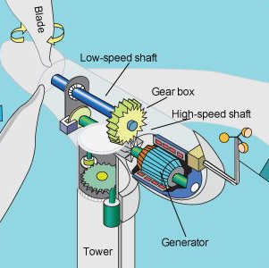
Agenda
Introduction
Aim & Objective
Methodology
Feature Selection
Exploratory Data analysis
Results
Conclusion

Slide 3

Introduction
In recent years, the energy landscape has been shifting towards more sustainable and renewable power sources.
Wind energy plays a significant role in this transition.
Wind turbines are vital components of this shift as they harness the wind's kinetic energy to generate electricity.
The gearbox, a crucial component that converts low-speed rotor rotation into high-speed rotation for the generator.
Failures in the gearbox can result in costly downtime and repair expenses.
Therefore, effective maintenance strategies, such as predictive maintenance, are essential for the wind energy industry to maximize efficiency and sustainability.

Slide 4
Aim and Objective
The Primary aim of our project is to enhance the reliability and efficiency of wind turbine operations by implementing advanced predictive maintenance techniques.
Objective:-
1. Data Acquisition:
We utilized SCADA(Supervisory Control and Data Acquisition) data from Penmanshill wind farm.
2. Data Preprocessing:
Cleaned and pre-processed the collected data to ensure quality and accuracy.
Performed feature engineering to extract relevant features that may indicate faults or predict RUL.

Slide 5
Aim and Objective
3. Fault Diagnosis:
Implemented Univariate Adaptive threshold Technique to identify faults and generate class labels using front-bearing temperature as a key indicator.
4. Remaining Useful Life Prediction:
Tested various Machine learning algorithms to predict the RUL of the gearbox based on operational conditions and historical data.
Validate the predictive models using appropriate evaluation metrics.

Slide 6
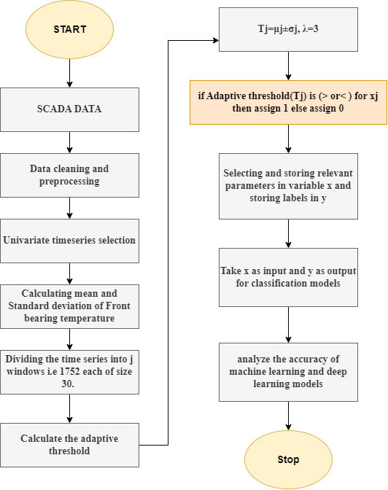
Methodology
The Univariate Adaptive Threshold technique used for anomaly detection.

Slide 7
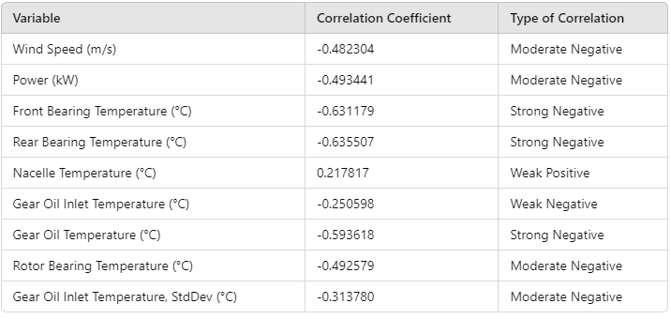
Feature Selection
The Pearson correlation technique was employed to identify the most relevant features from the dataset.

Slide 8
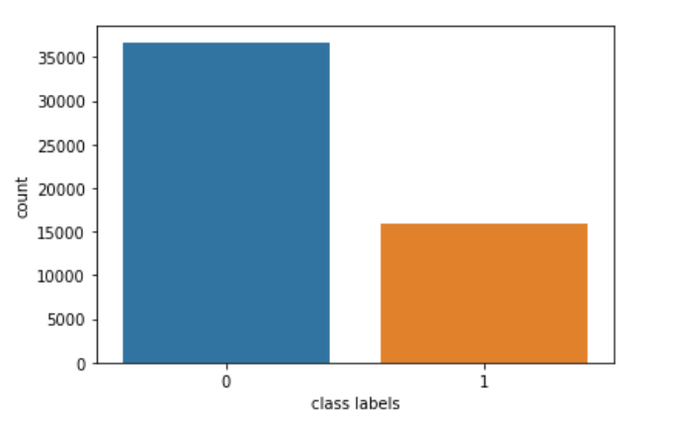
Exploratory Data Analysis
Figure shows the Count plot for healthy vs. non-healthy instances.

Slide 9
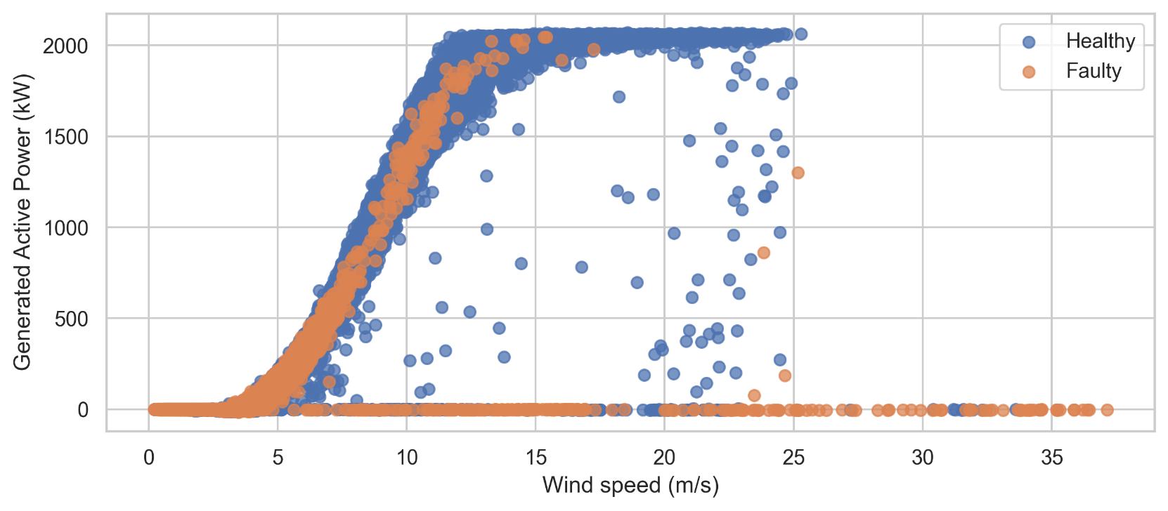
Exploratory Data Analysis
Figure shows the Scatter Plot for active power in kW versus wind speed in m/sec.

Slide 10
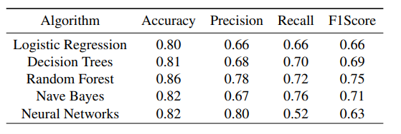
Results
The Results depict that among the models, Random Forest stands out with the highest accuracy of 0.86, demonstrating its superior overall performance.

Slide 11

Conclusion
Applied Binary Classification Models on SCADA data.
Achieved the highest accuracy of 86% with Random Forest Model.
Improved Fault detection via Adaptive thresholding

Slide 12
Thank you

