Slide 1
Online examination system EXAMIA

Slide 2
Introduction
Online Examination System has become a fast growing examination method because of its speed and accuracy. It is also needed less manpower to execute the examination. Almost all organizations now-a-days, are conducting their objective exams by online examination system, it saves students time in examinations. Organizations can also easily check the performance of the student that they give in an examination. As a result of this, organizations are releasing results in less time. It also helps the environment by saving paper. According to today’s requirement, online examination is very useful to learn it.
Some modules of project
The admin is responsible for adding and editing subjects and professors and make an approval for exams for the professors.
Professors prepare for their subjects' exams with adding, editing questions, identifying the correct answer, set timing and choose the level of difficulty for exam.
Students take the exam with different random questions and options and the results and ranking are stored to be shown for the student and professor.

Slide 3
Stack used for develop this system
Software:
Front-end
HTML5, CSS3, bootstrap, js
Back-end
PHP
Database
MySQL
Server:
XAMPP

Slide 4
Key Features
Admin:
Has the ability of approval the exam
Editing and delete professors
Manage subjects
Adding departments and subject details
Seeing students feedbacks
Professors:
Has ability to delete exams
Seeing his students and their ranking
Add exam with its questions and optional answers
Students:
Get his exams
Seeing his result and his ranking

Slide 5
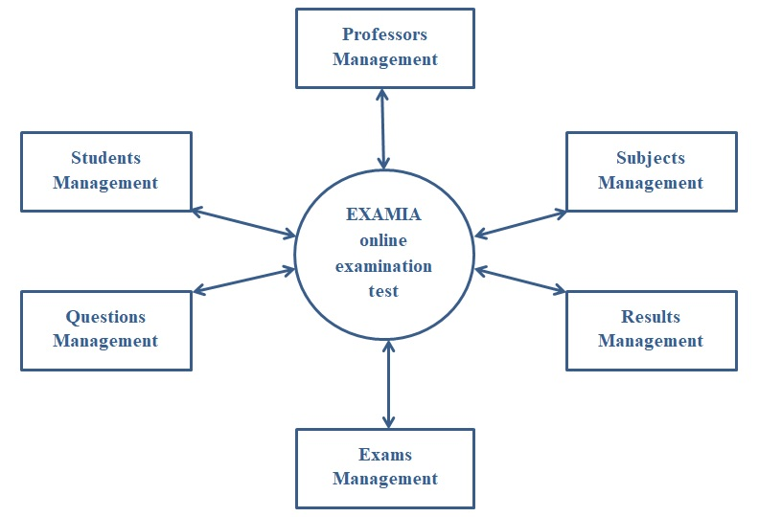
Data flow diagram
system

Slide 6

Home page with new entry form for students

Slide 7
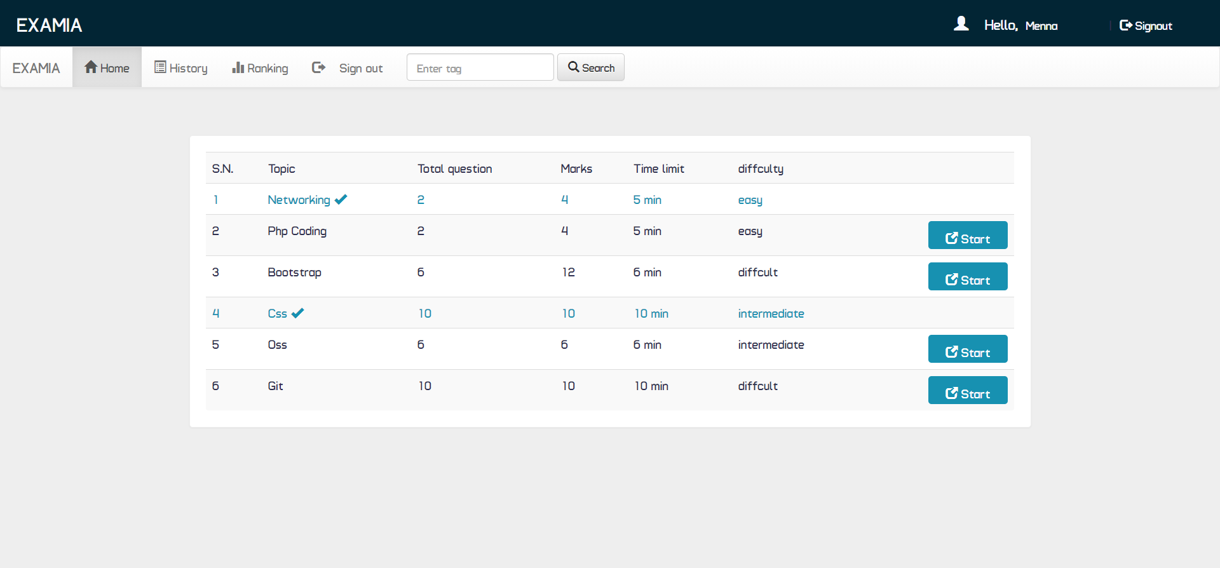
students home

Slide 8
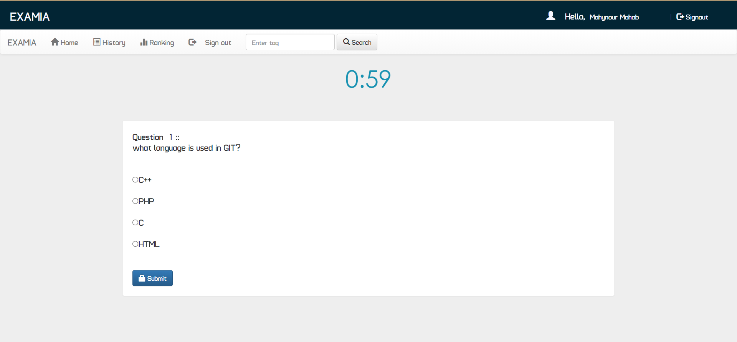
Show exam

Slide 9
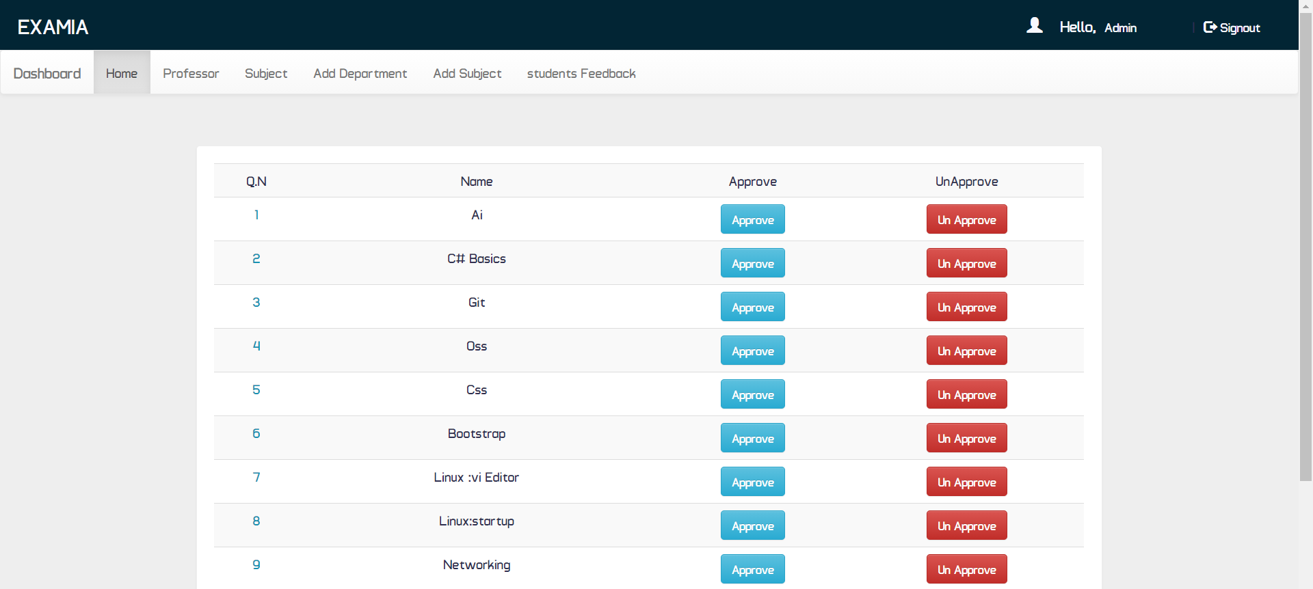
Admin home

Slide 10
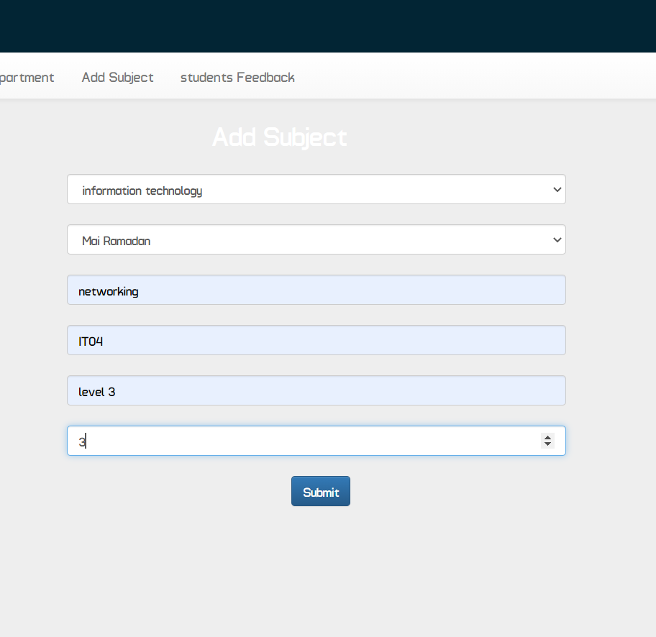
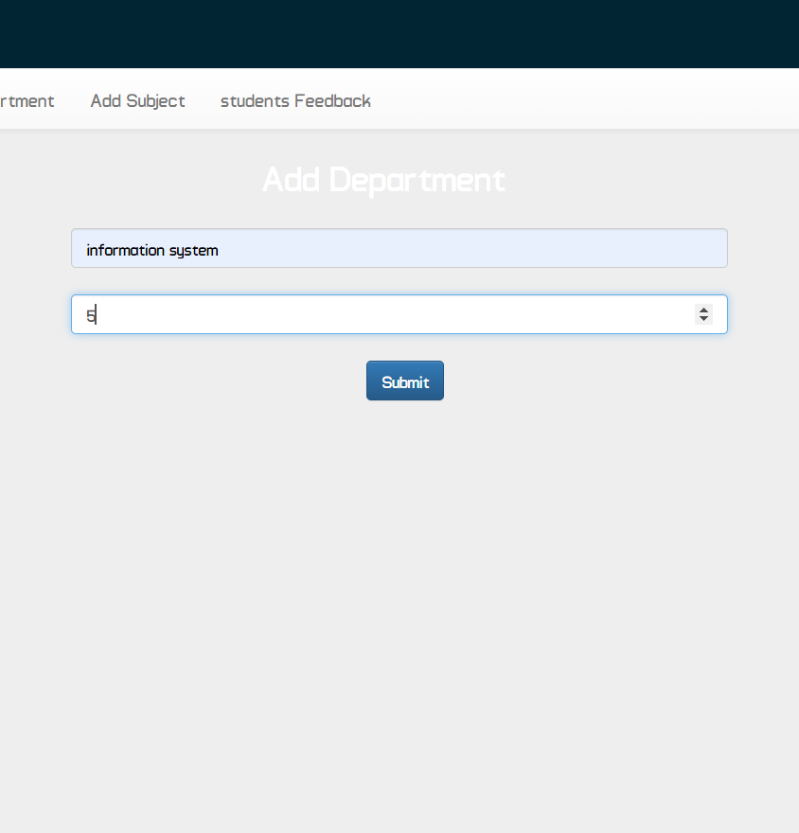
Add departments
Add subjects

Slide 11
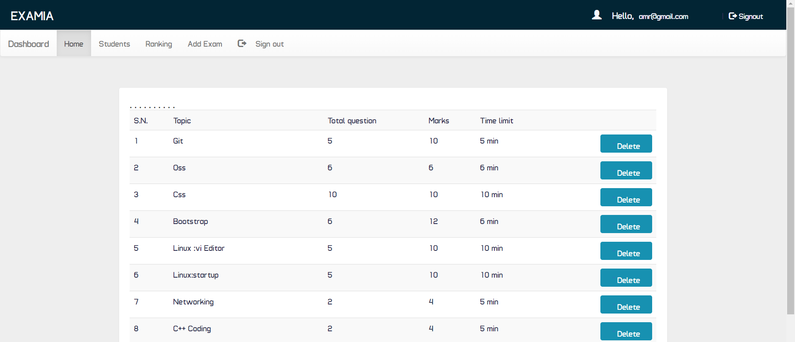
Professors home

Slide 12
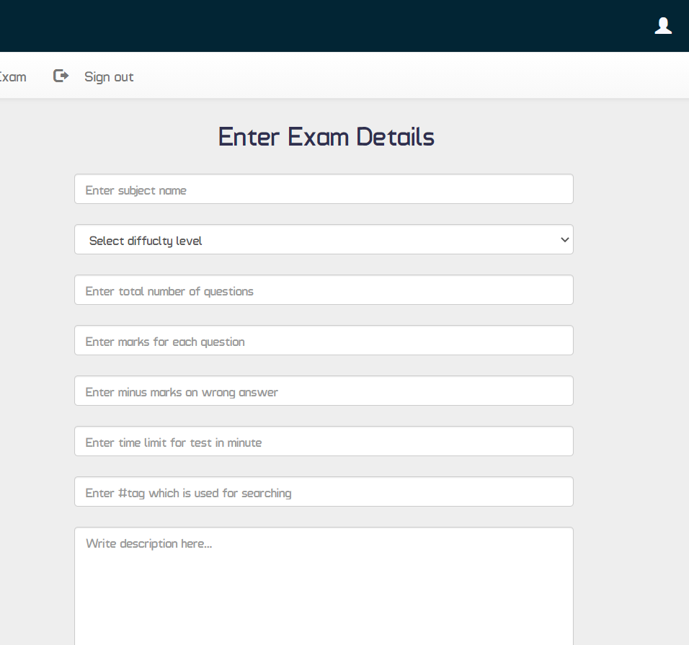
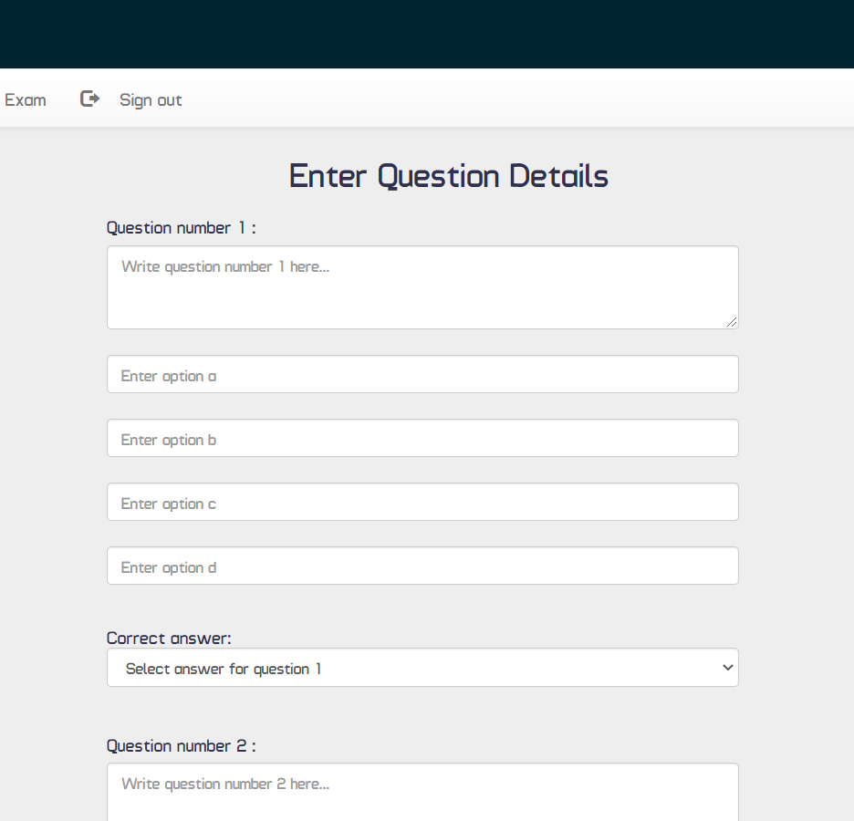
Add exams

Slide 13
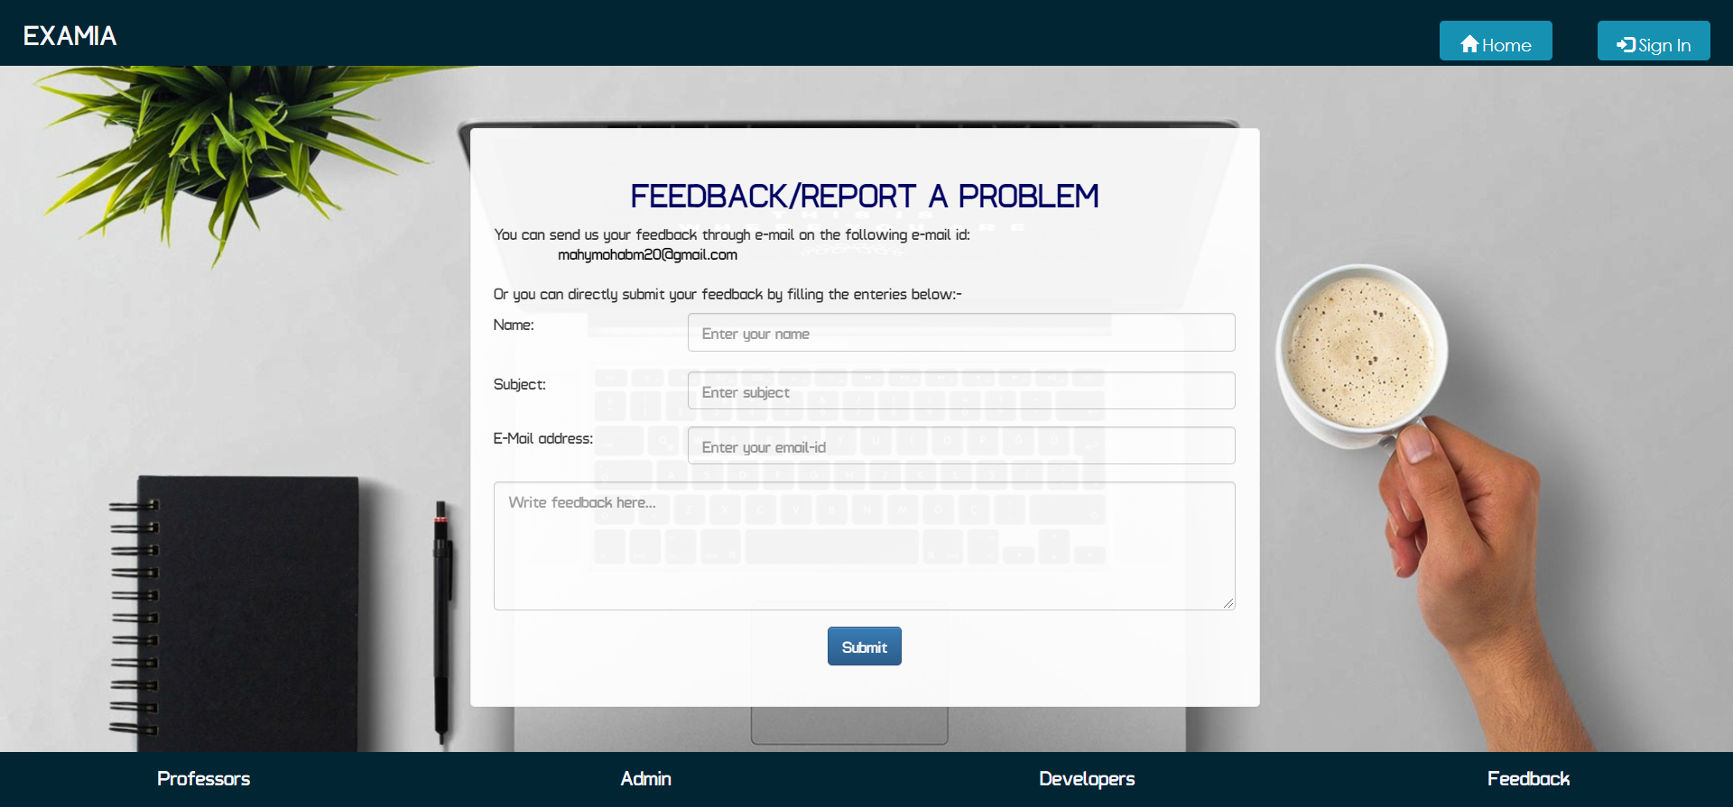
Students feedbacks

Slide 14
Team partners:
Mahynour mohab (Team leader)
Menna emara
Mayar Ibrahim
For source code visit:
https://github.com/mahy209/online-examination

Slide 15
Special Thanks to
DR. Amr abo hany for his efforts.

