Slide 1
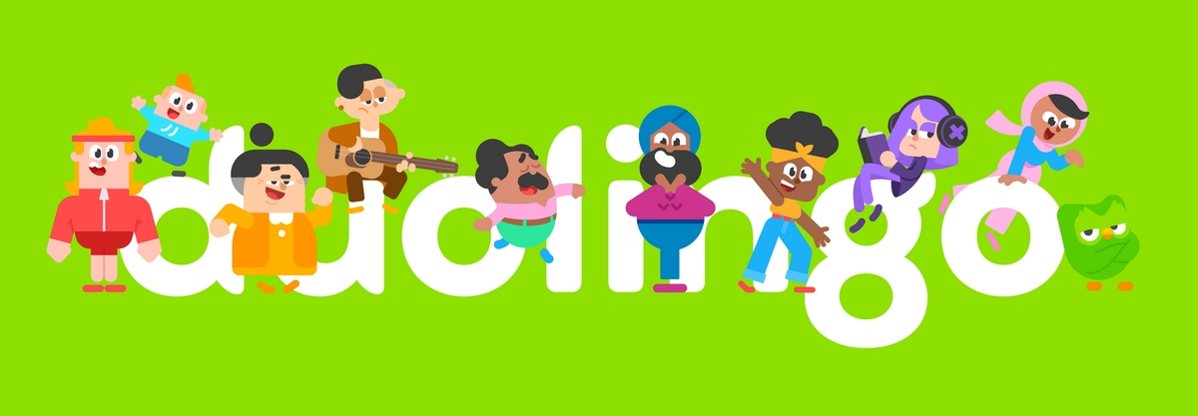
How Duolingo’s AI Learns What You Need to Learn?
K. Bicknell, C. Brust, B. Settles
Presented by: Mahya Shahshahani

Slide 2
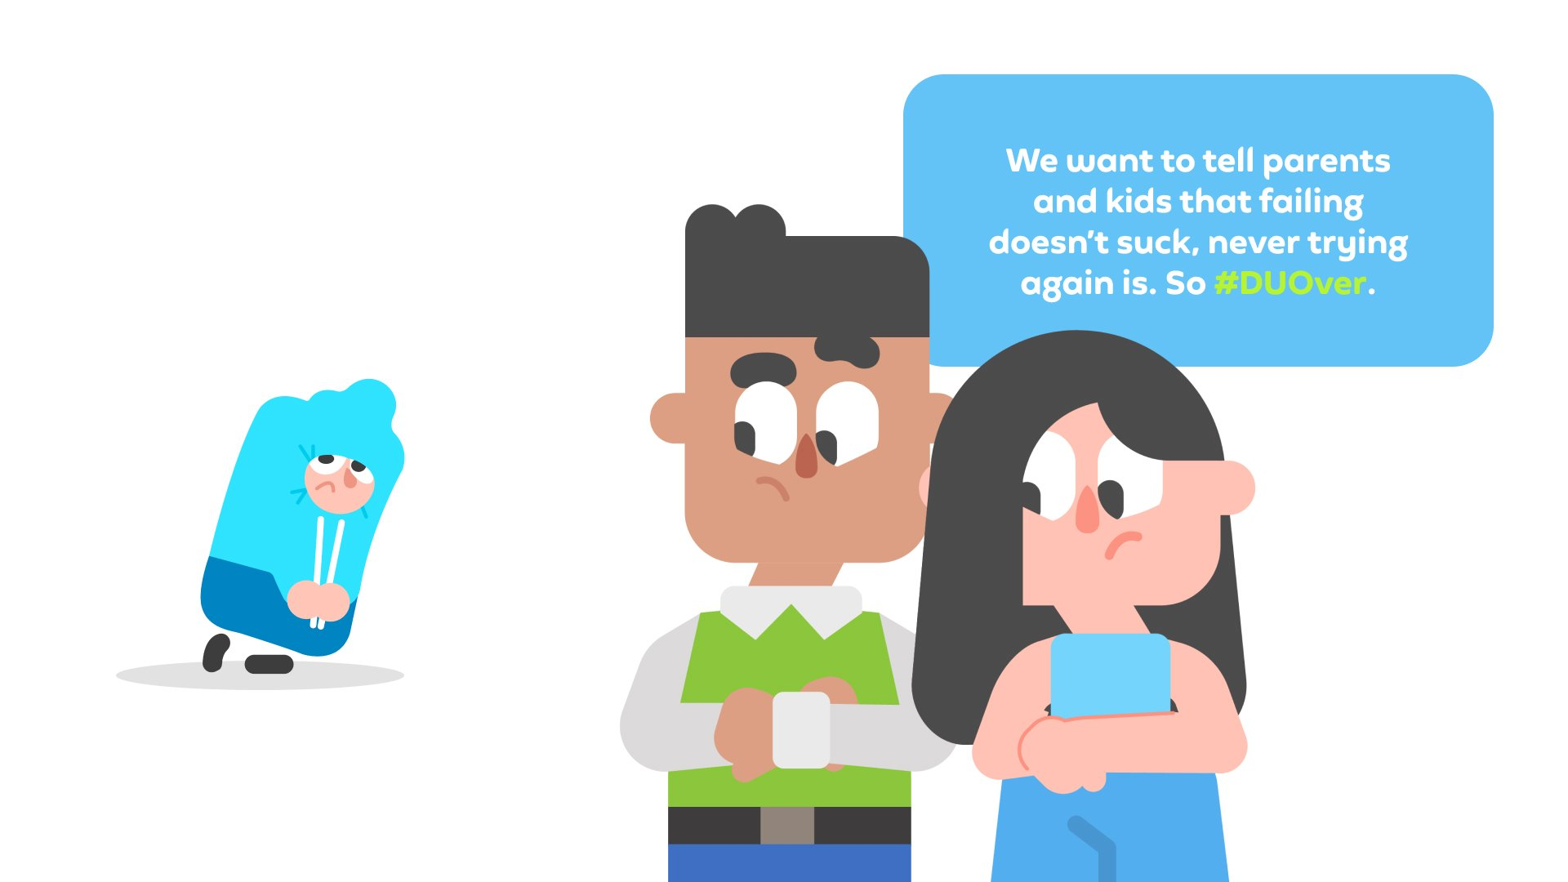
Table of Contents
What is Duolingo?
Origins of Duolingo
Birdbrain
Birdbrain V1
Scaling Challenges
Birdbrain V2
Future Directions
Ref: K. Bicknell, C. Brust, B. Settles, “How Duolingo’s AI Learns What You Need to Learn,” IEEE Spectrum, Feb. 2023. [Online]. Available: https://spectrum.ieee.org/duolingo

Slide 3
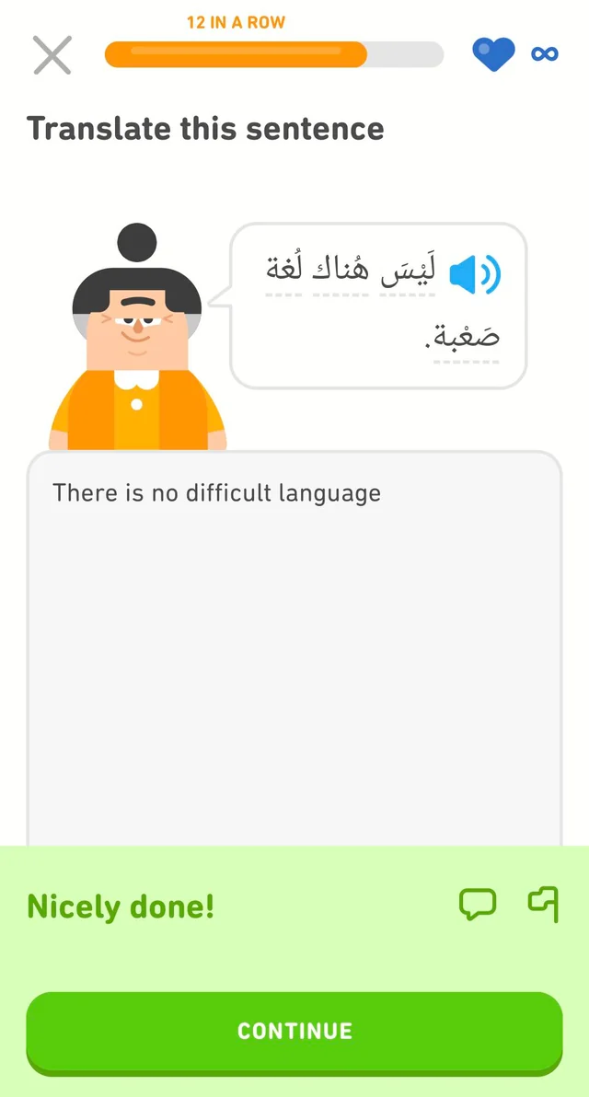
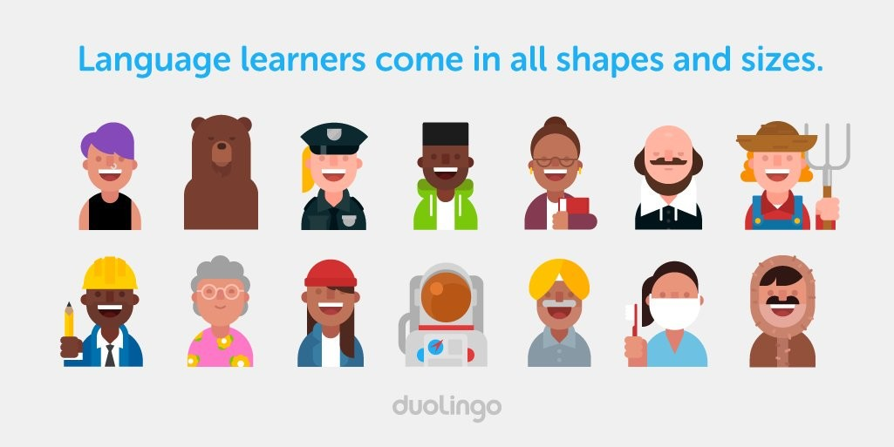
What is Duolingo?
A popular language learning app powered by AI

Slide 4
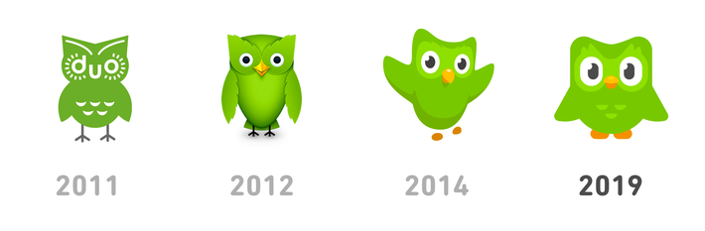
Origins of Duolingo
Inspired by Bloom's 2-sigma problem
Mimicking qualities of great tutors
Expertise
Engagement
Personalization

Slide 5
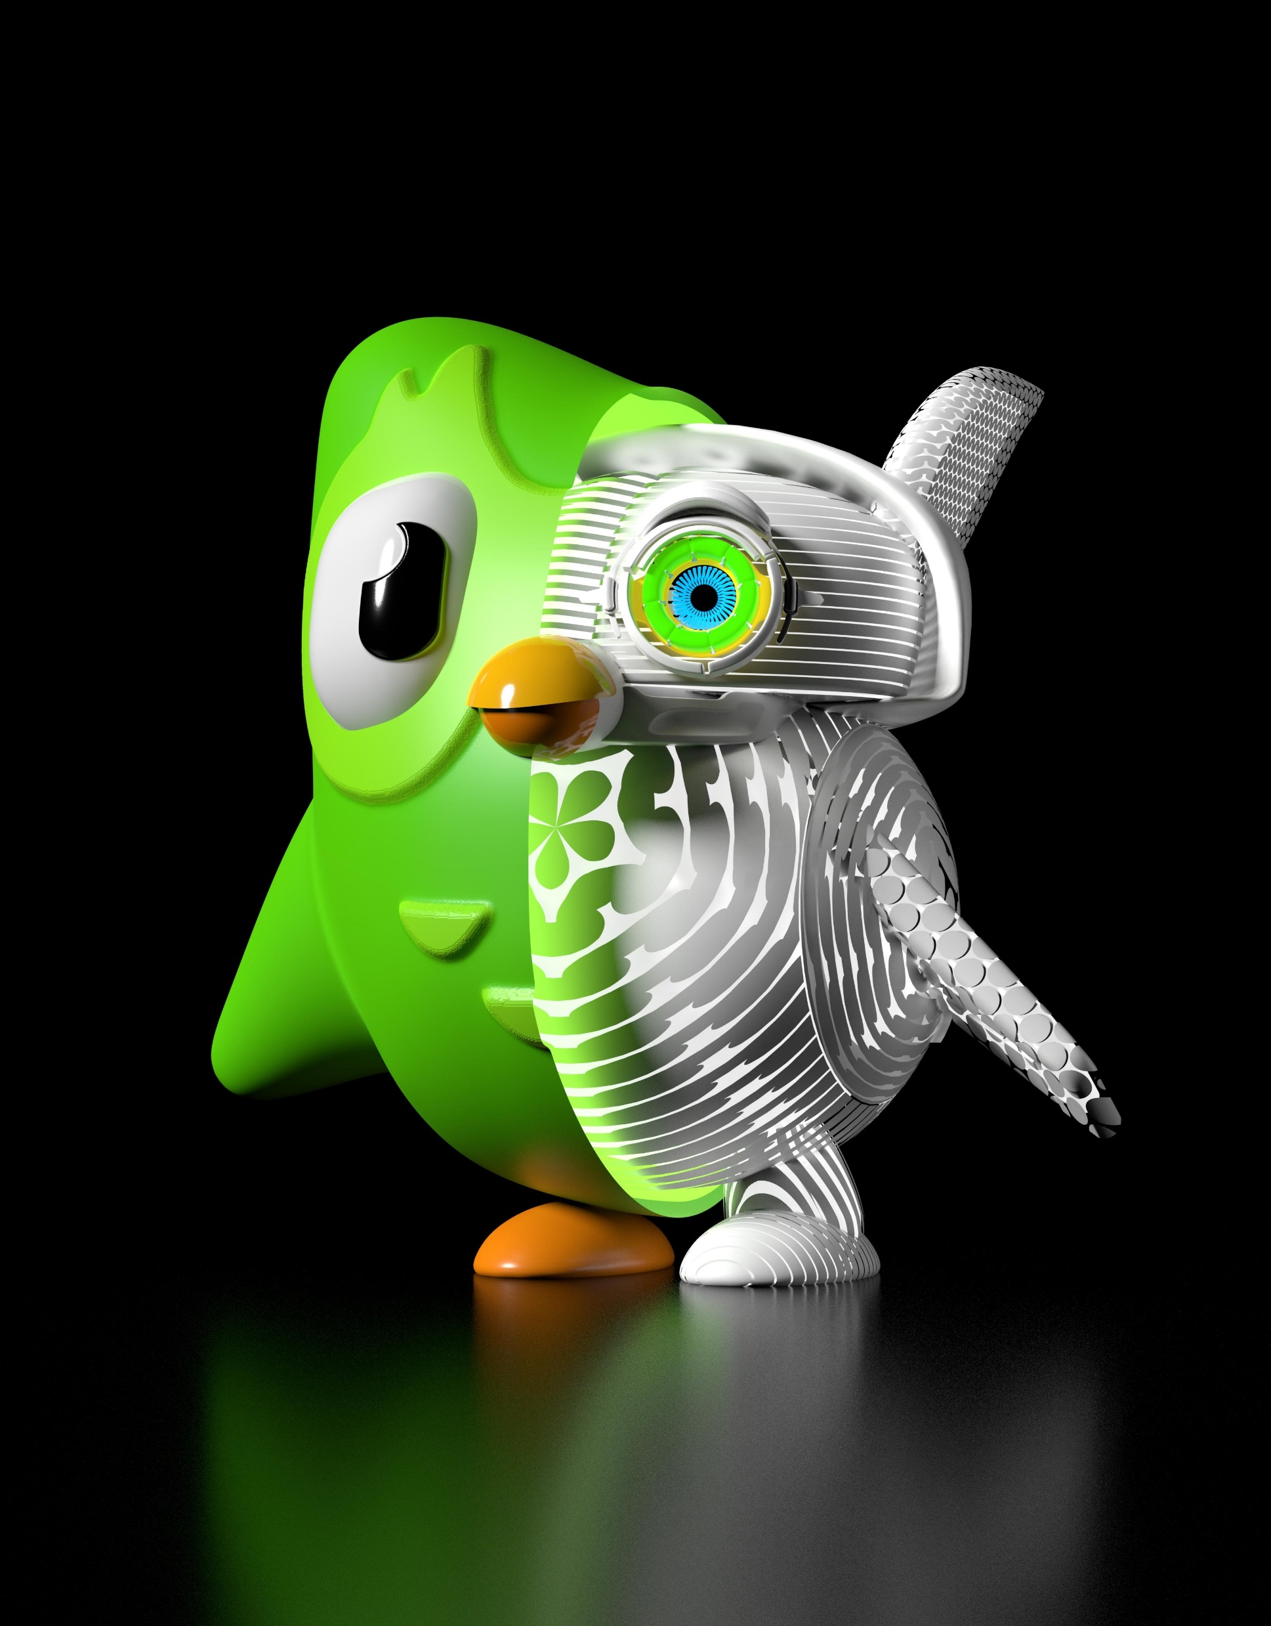
Birdbrain
Combining educational psychology & machine learning
Understanding learner abilities
Creating customized curriculum

Slide 6
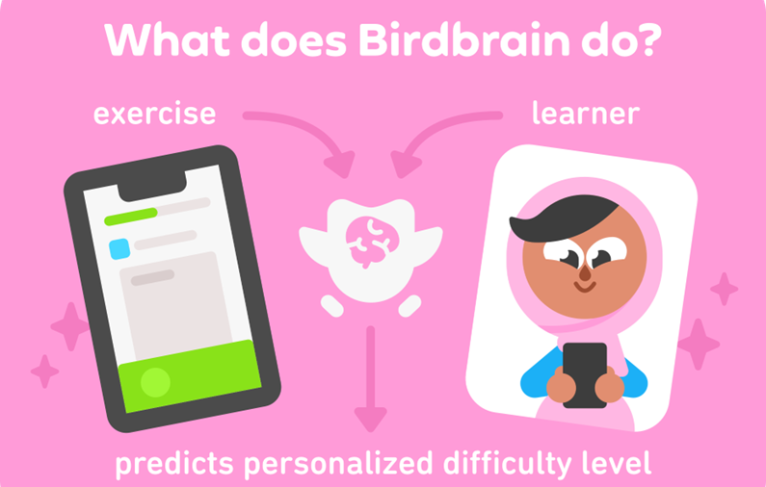
Birdbrain V1
Logistic regression model inspired by psychometrics
Estimating difficulty and proficiency
Adjusting based on performance (like chess rating systems)
Increased engagement and learning outcomes

Slide 7
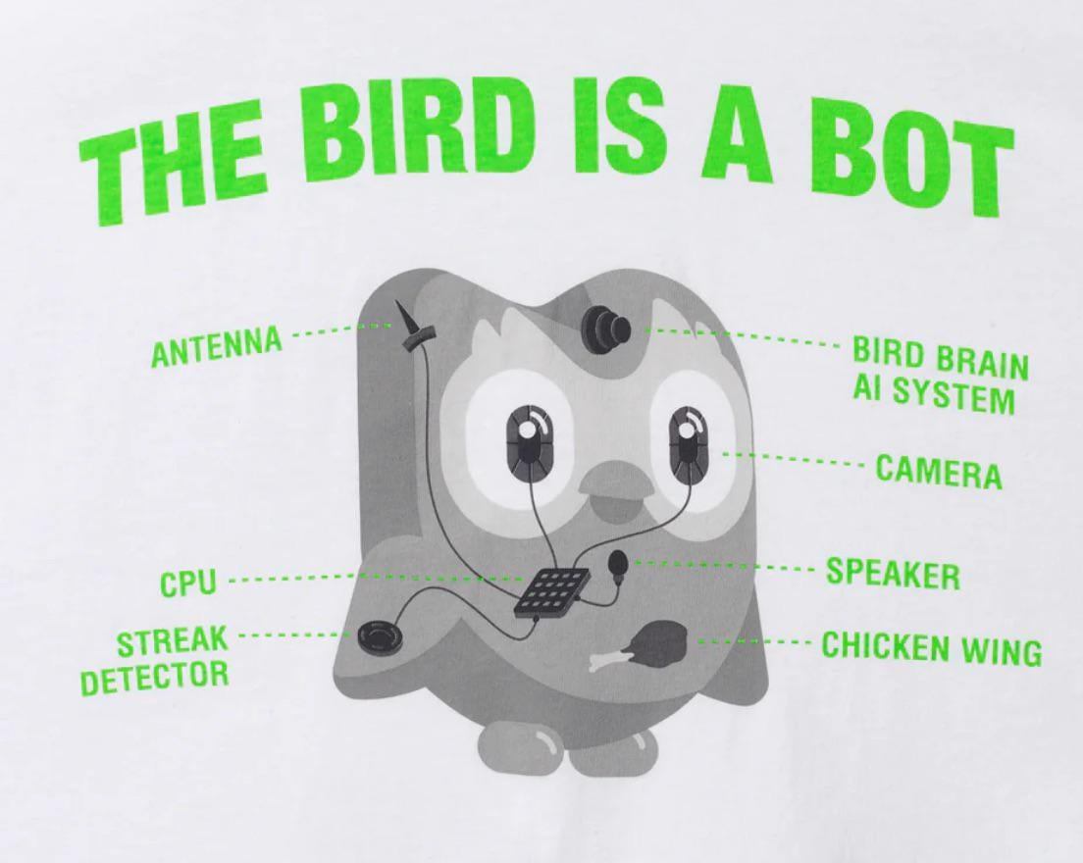
Scaling Challenges
Challenges of billions of daily exercises
Innovative engineering solutions
Data chunking
Real-time streaming

Slide 8
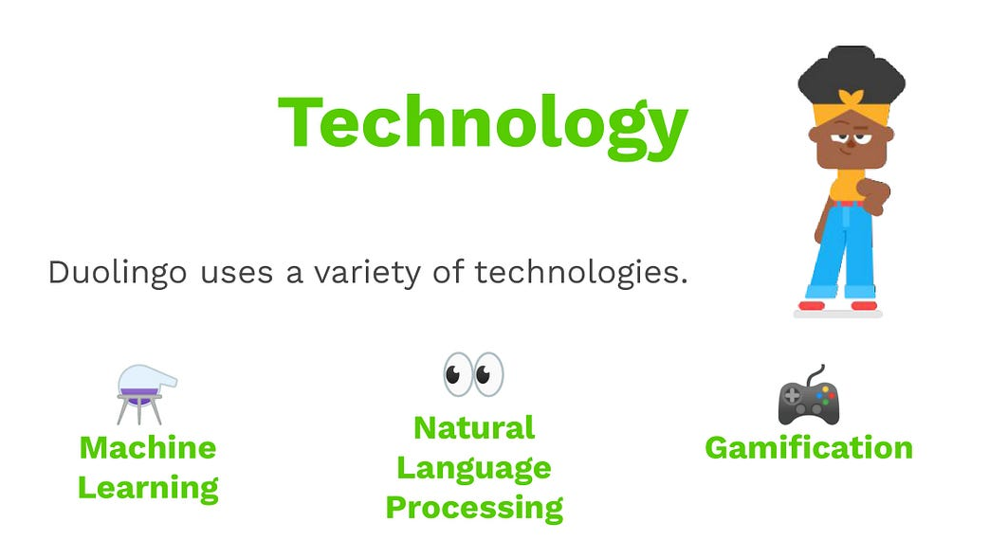

Birdbrain V2
Utilizing Recurrent neural networks (RNNs) for richer learner representation
Using 40-dimension vector model for learning trajectory and struggles
Identifying specific areas of difficulty (e.g., future tense)
Improved engagement and learning over V1

Slide 9

Future Directions
Creating even more adaptive AI systems
Emulate qualities of great tutors
Respond to individual learning styles
Identify effective exercise formats
Expanding beyond language learning
Applications in math, literacy, and more

