Slide 1
Influencer Marketing
Proposal for software engineering project

Slide 2
Marketing Strategies
Traditional Marketing
Modern Marketing
Digital Marketing
Influencer Marketing

Slide 3
Influencers
Influential members of a social media platform.
Has access to a large audience
Can persuade others by means of their reach.

Slide 4
Why Influencer Marketing?
Reasonable advertising cost
with respect to traditional methods
Rapid growth of social media platforms
Targeting only the right audience
Increased sense of trust

Slide 5
Influencer marketing without us
Difficulty of establishing a connection among users
Difficulty of targeting and validating the influencers
The consequences of choosing the wrong entity
Evaluating the feedbacks
Pricings

Slide 6
Our Solution
Gathering and classifiying the influencers
Bridging the gap between marketers and influencers
Choosing the best audience for their messages

Slide 7
How?
Analyzing the influencers
Detecting the intersts of their followers
Measuring the actual audience size
Using their full business potential

Slide 8
Financial justification
Costs
Incomes
Technical Costs:
Severs, Developers, ...
Advertising Costs
Human Recourses Costs
Influencers gain income by using our software
Their participation attracts marketers even more
This cycle of demand and return is self-sufficient

Slide 9
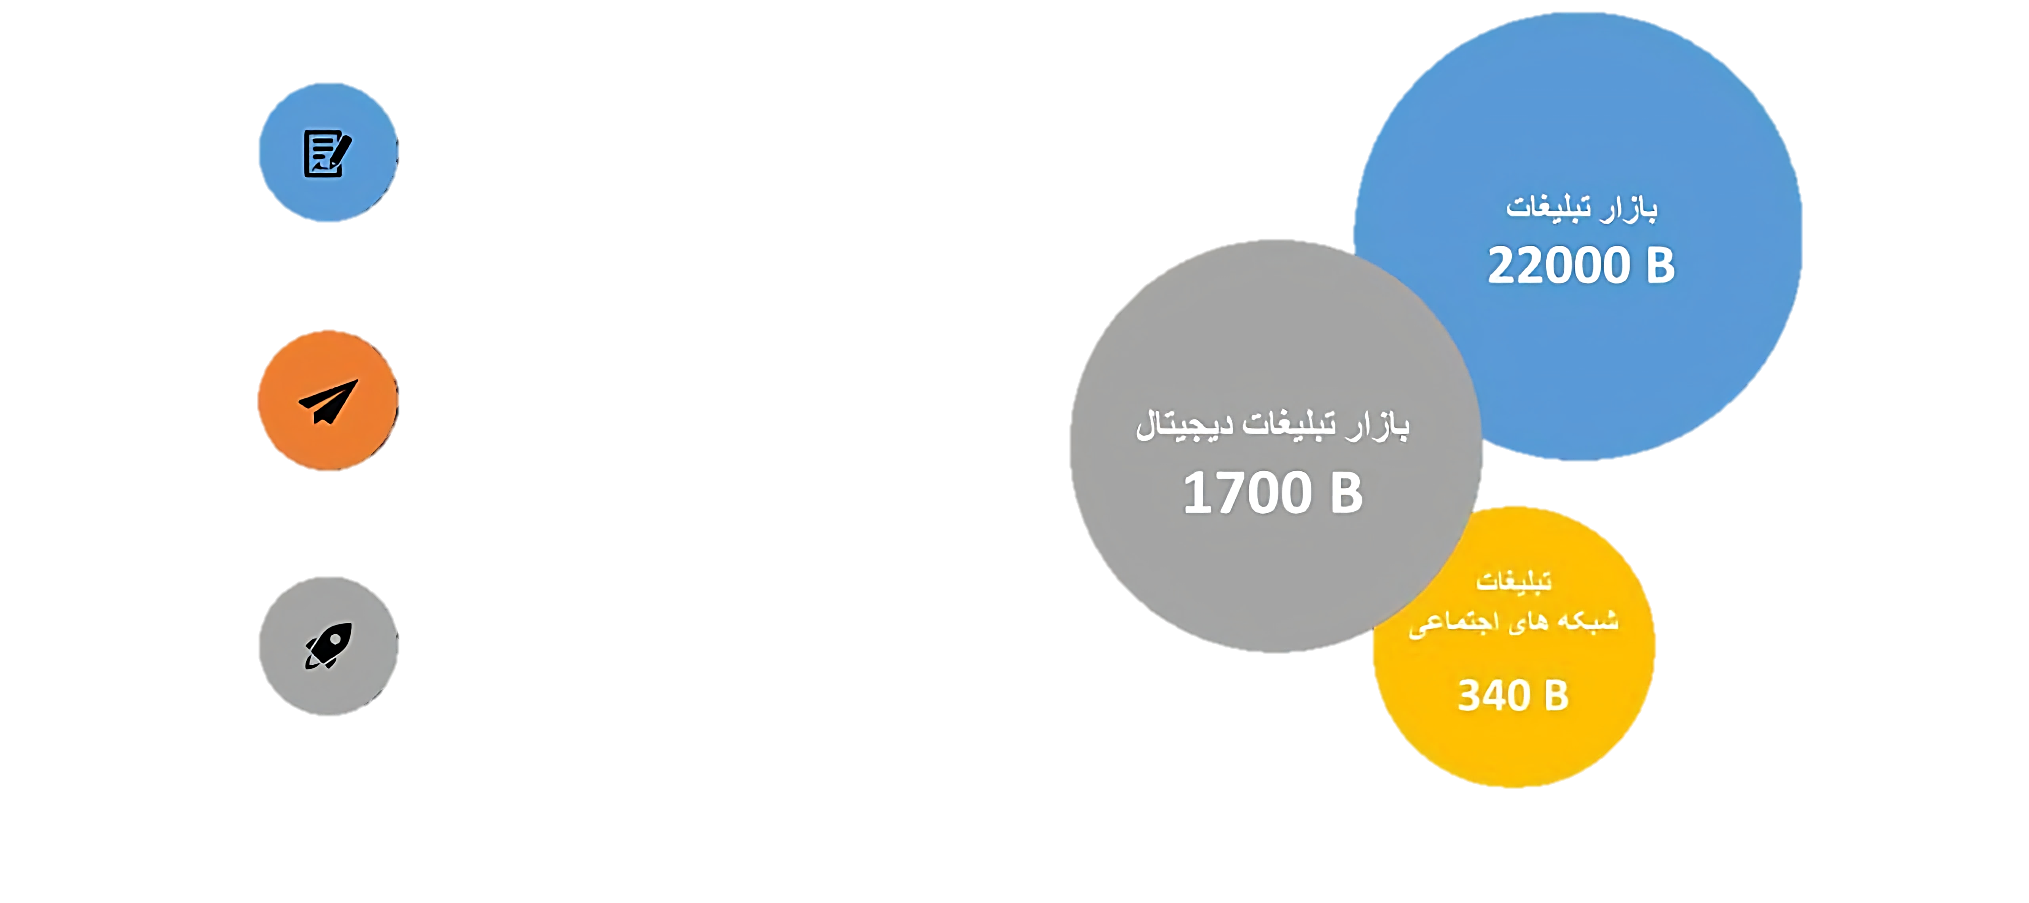
Market Size
Advertising Growth Rate of 15%
Market Size
Digital Advertising Growth Rate of 62%
Digital Market Size
Prediction for 2020:
5000 Billion Net worth for DM
Social Media Marketing

Slide 10






Rivals

Slide 11
Work Packages
User Management
Account Management
Submitting new Advertisments
Advertising
Influencer Suggestion
Feedback Analyzing
Gathering feedbacks
Analysis
Content Generation
See feedback analysis report

Slide 12
Scheduling
Planning
Analysis
Design
Modeling the system’s core
Sketching the relations between system parts
Requirement Extraction
User experience design

Slide 13
Risks
Uninformed users in the sense of digital advertising
Possiblity of inaccurate inputs by the users and hence, imprecise analysis
Filtering (Social medias)

Slide 14
Future
Increase in experience and connections between team members
The scientific methods used in this platform can be further improved

Slide 15
Thank You for your Attention!
Any Questions?

