Slide 1
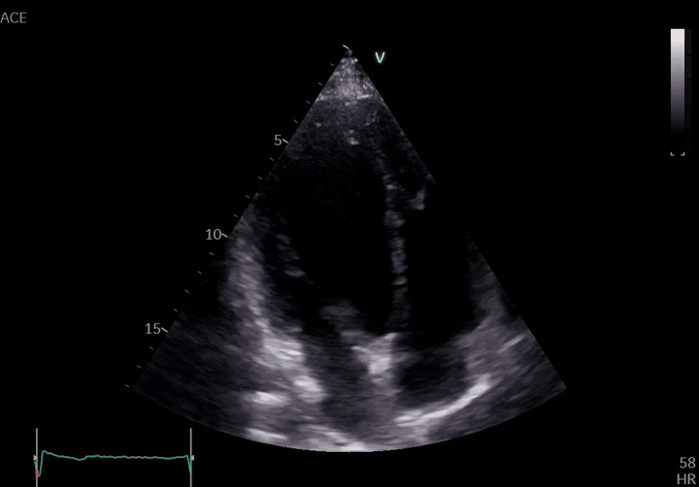
HOW DOES A RESEARCH PROJECT EVOLVE?
From a clinical question to a research program
Mahyar Bolhassani · ECE 695 · October 2026
01
Notes:
Hi everyone. I’m Mahyar Bolhassani. Today I want to tell you the story of how our echocardiography project evolved.
rather than walking through a list of our papers, I want to show you how a clinical question developed into a broader research program.
This is an echocardiogram, an ultrasound video of the moving heart.

Slide 2
A patient looked healthy. Months later, the story changed.
FIRST VISIT
MONTHS LATER
THE QUESTION
Chest pain
Routine exams
Reassuring Discharged
Returned with more serious
heart disease, specifically HFpEF
Was something subtle
already present in the earlier echo?
Could machine learning detect an early signal that was missed?
02
Notes:
The project began with an observation from our collaborators in cardiology. They had seen patients who came in with symptoms such as chest pain. At that visit, the routine evaluation was reassuring, and the patients went home. Then, months later, some returned with more serious heart disease, specifically heart failure with preserved ejection fraction, or HFpEF.
That led to a compelling question: was there already something subtle in an earlier echocardiogram that could have indicated future risk? Could a computational model find a pattern that was difficult to recognize during the initial evaluation?

Slide 3
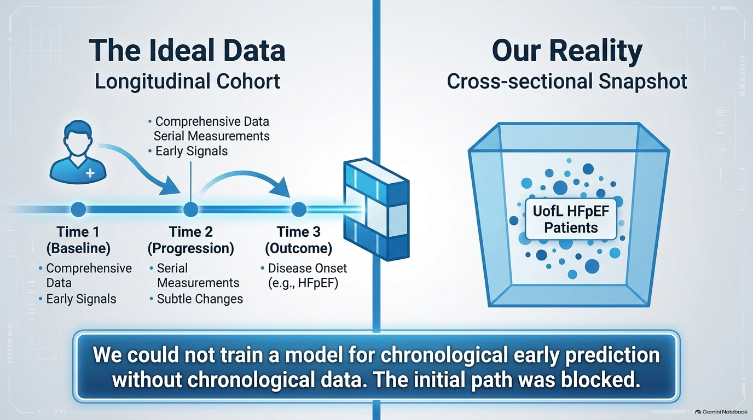
03
Notes:
Now imagine you are designing a study to answer that question. What would you need?
You would need echocardiograms from the earlier visits. Then you would need to know what happened to that same patients months or years later. You would also need patients who did not develop HFpEF, so that you could compare their earlier echoes.
On the other side is the snapshot we had.
This is something I think students sometimes underestimate. Before asking which neural network to use, you have to ask whether the available data can answer the question at all. No model architecture can recover a patient timeline that was never collected.
We could have stopped there. Instead, we asked: what meaningful question can we answer with the echoes we have?
What we actually had was about 200 echocardiograms from patients who already had HFpEF. Those are valuable data, but they answer a different kind of question. If the disease is already present when the echo is acquired, we cannot use that study to claim that we predicted its future onset.

Slide 4
THE PIVOT
We changed the question to one we could test
ORIGINAL AIM
Can an early echo predict future HFpEF?
ANSWERABLE NOW
What distinguishes HFpEF in an existing echo video?
04
Notes:
We decided to change the immediate research question. The original goal remained interesting, but we needed a first step that was scientifically testable.

Slide 5
THE COMPARISON PROBLEM
Our HFpEF group had no local controls yet
UofL
PUBLIC DATA
≈200 HFpEF studies
Healthy + HFrEF
Disease label and data source were entangled.
A model might learn hospital or acquisition differences instead of pathology.
05
Notes:
But there was another problem. If I show a model 200 HFpEF videos and nothing else, what can it learn to distinguish them from?
We needed healthy echoes as a baseline. We also wanted echoes from patients with heart failure with reduced ejection fraction, or HFrEF. That would let us ask whether a pattern is associated with heart failure generally or differs between these groups. The reason for including both is that they provide different clinical comparisons for the model.
At first, we had the HFpEF videos from our institution, but we had to look elsewhere for the comparison groups.

Slide 6
Each answer created the next question
Clinical question
Can we detect early risk?
Data Constraint
Only 200 HFpEF
Foundation models
Transformer-based
Domain Gap
Distribution shift
Combine public Data
HErEF and Healthy
Cycle-aware
Proxy estimation
05
06
Notes:
Here is where the research path begins to branch. We had a clinical motivation, then a data limitation, then a feasible classification question. We tried a video model, but the first results were difficult to interpret. To understand why, we had to split the large problem into smaller experiments.
I’ll walk through those experiments in the order in which the questions arose.

Slide 7
THE FIRST ATTEMPT
Could the model learn from the moving heart?
Estimate cycles
and ED / ES
TimeSformer
video model
The ED and ES frames came from maximum/minimum image proxies,
not manual annotations.
Echo video
07
Notes:
Because an echocardiogram is a video, we wanted a model that could consider both what the heart looks like and how it moves. We tried TimeSformer, a model designed to learn relationships across video frames.
We also wanted the clips to reflect the cardiac cycle. But our videos came with disease labels, not manually annotated ED and ES frame positions. So we estimated those landmarks using image based proxies, then constructed clips around them.
That gave us a plausible first approach.

Slide 8
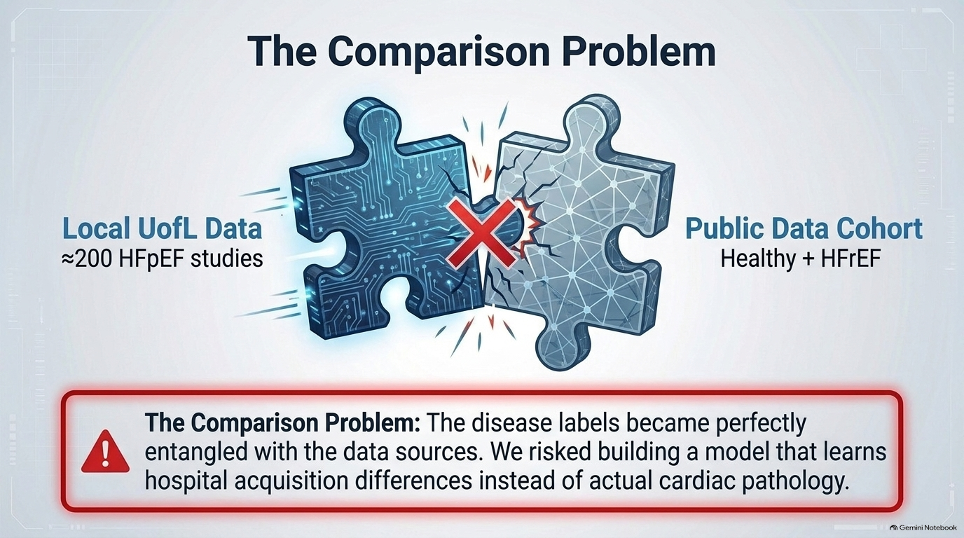
08
Notes:
Here is the especially important complication. Our HFpEF examples came from UofL, while the healthy and HFrEF examples initially came from a public dataset.
Suppose I train a three-class model and it performs very well. Can I immediately conclude that it learned the three conditions?
Probably not. The disease label and the data source are tied together. The model might recognize differences in acquisition, scanning protocol, or patient population. In the worst case, it could be answering ‘Where did this video come from?’ when I think it is answering ‘What condition does this patient have?’
We used consistent preprocessing and explored normalization, but those steps alone cannot establish that the source difference has disappeared.”

Slide 9
How can fine-tuning a foundation model improve diagnosis?
Clinical question
Can we detect early risk?
Data Constraint
Only 200 HFpEF
Foundation models
Transformer-based?
Domain Gap
Distribution shift?
Combine public Data
HErEF and Healthy
Positional or Temporal
TimeSformer?
Cycle-aware
Proxy estimation
09
Notes:
So we took one piece of the problem out and examined it on its own: can adapting a video foundation model help with an echo classification task under a cleaner comparison?
For this experiment, we worked within the public cohort and studied healthy versus HFrEF. We set aside the local HFpEF group, which removed the particular problem of having one class exclusively from our institution and the others from the public source.
We adapted TimeSformer to this task and compared approaches to using the pretrained model.

Slide 10
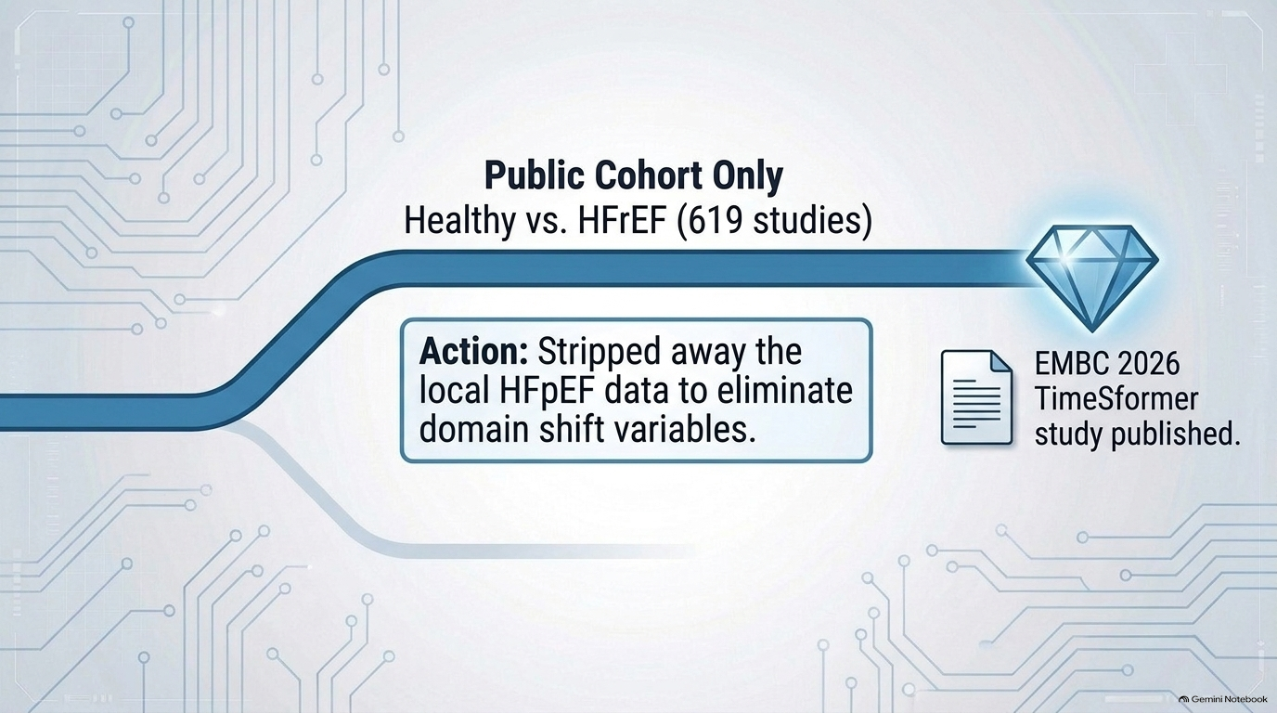
10
Notes:
This became our EMBC 2026 study.
It answered a narrower question about adapting a general video model to echocardiography. It did not answer the original early HFpEF prediction question, and it did not prove that domain shift was solved. But it gave us a more interpretable experiment than the initial mixed-source three-class setup.

Slide 11
BRANCH TWO
New local data unlocked a cleaner three-class study
HEALTHY
HFrEF
HFpEF
≈200
≈200
≈200
We trained 3D CNN models locally, then tested on a public cohort.
11
Notes:
Then our cardiology collaborators gave us something we had been missing: approximately 200 healthy and 200 HFrEF echocardiograms from UofL. Together with our HFpEF studies, we finally had all three groups from the same institution. That let us revisit the three-class question without tying HFpEF exclusively to one data source and the other classes to another.

Slide 12
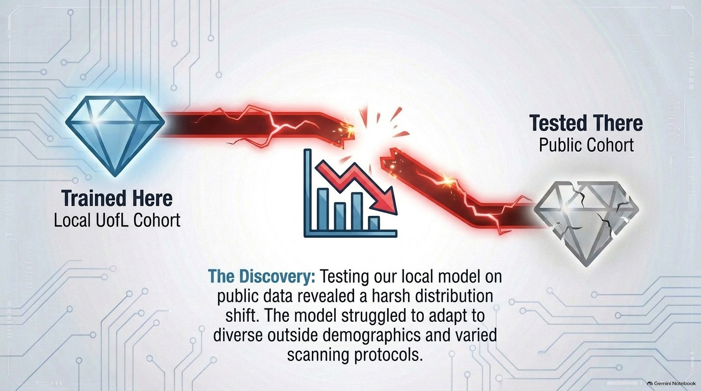
12
Notes:
We trained a 3D CNN with those local studies. But we also wanted to know whether what it learned would carry over to a public dataset. When we tested it there, performance dropped. So a good local result was only part of the story.

Slide 13
Each answer created the next question
Clinical question
Can we detect early risk?
Data Constraint
Only 200 HFpEF
Foundation models
Transformer-based
Domain Gap
Distribution shift
3D CNN models
3-way classification
Combine public Data
HErEF and Healthy
New institutional Data
HErEF and Healthy
Positional or Temporal
TimeSformer
Cycle-aware
ES-ED frames
Z-Normalization
Per video
13
Notes:
One possible contributor was variation in the videos’ intensity and contrast. We introduced video-level z-normalization to reduce those differences and tested whether it improved performance across datasets. This was a direct response to the external test, although normalization alone could not address every difference between the patient groups or scanning settings.

Slide 14
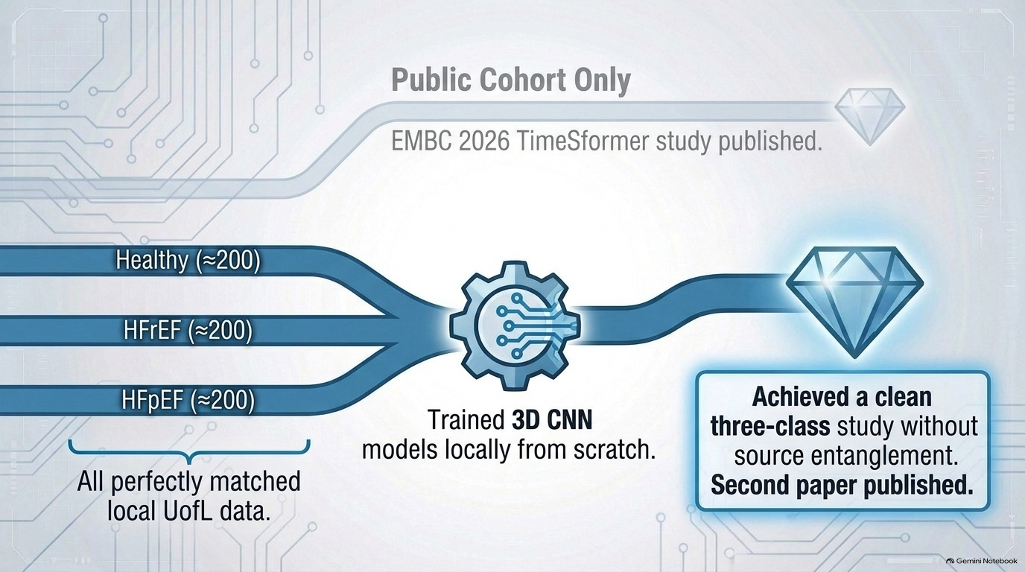
14
Notes:
Together, the local three-class experiment, external evaluation, and normalization analysis formed another study, which we published at SPIE 2026. But there was another question left over from our first video experiment. Remember how we selected end-diastolic and end-systolic frames? We did not have those frames manually marked in our original videos. We used a proxy based on image measurements. That made the experiment possible, but how reliable were those estimated frames? And could we learn cardiac timing more directly from the video?

Slide 15
Can we trust proxy-estimation method?
Clinical question
Can we detect early risk?
Data Constraint
Only 200 HFpEF
Foundation models
Transformer-based
Domain Gap
Distribution shift
3D CNN models
3-way classification
Combine public Data
HErEF and Healthy
New institutional Data
HErEF and Healthy
Positional or Temporal
TimeSformer
Cycle-aware
ES-ED frames
proxy estimation
Continuous Phase Prediction
Z-Normalization
Per-video
15
Notes:
That question led to a separate study, for which we have now submitted an abstract. Instead of looking for only two isolated frames, the new method predicts where every frame lies within the repeating cardiac cycle. From that continuous prediction, we can locate ED and ES.
One useful feature is that training does not require someone to label every frame. It starts with sparse expert annotations of an ED and an ES frame and constructs a training signal across the cycle. We tested the method on EchoNet-Dynamic and also evaluated it on a separate dataset, CAMEO. In the submitted abstract, the average localization errors were around two frames for ED and ES on both datasets.
The broader lesson is that a practical shortcut in one experiment can become its own research question. Here, asking whether our proxy was reliable led us to study cardiac phase estimation directly.
So that addressed one source of uncertainty: where are we in the cardiac cycle? Another uncertainty remained from our cross-dataset experiments: what changes when an echo comes from a different data source?

Slide 16
THE NEW FINDING
External testing changed the research question again
TRAINED HERE
TESTED THERE
UofL cohort
Public cohort
Why did performance change across datasets?
16
Notes:
After seeing the performance drop across datasets, we tried video-level z-normalization. That was a useful first response, but differences between datasets can extend beyond brightness or contrast. The patients, scanning practices, and image characteristics may all differ. So we began studying the domain gap itself: what changes between the datasets, and how does that change affect the model?

Slide 17
How to generalize our model and overcome domain gaps
Clinical question
Can we detect early risk?
Data Constraint
Only 200 HFpEF
Foundation models
Transformer-based
Domain Gap
Distribution shift
3D CNN models
3-way classification
Combine public Data
HErEF and Healthy
New institutional Data
HErEF and Healthy
Positional or Temporal
TimeSformer
OOD
Cycle-aware
ES-ED frames
proxy estimation
Continuous Phase Prediction
Test-time adaptation
Z-Normalization
17
Notes:
That question has led us to two substantial research directions.
The first is out-of-distribution detection, or OOD. Before relying on a prediction, can we recognize that this echo differs from the cases the model learned from? This is a research problem in its own right: we need to decide what counts as unfamiliar and test whether an OOD score actually identifies the cases where the model is less reliable.
The second is test-time adaptation. If a new hospital’s echoes differ from the training data, can the model adjust when it encounters them, even without disease labels for those new videos? Here the challenge is to improve predictions without allowing the adjustment to reinforce mistakes.
Both are active areas of research, and we are working on both. OOD detection asks when should we be cautious? Test-time adaptation asks can we respond to the difference safely? Together, they grew directly from the performance gap we observed.

Slide 18
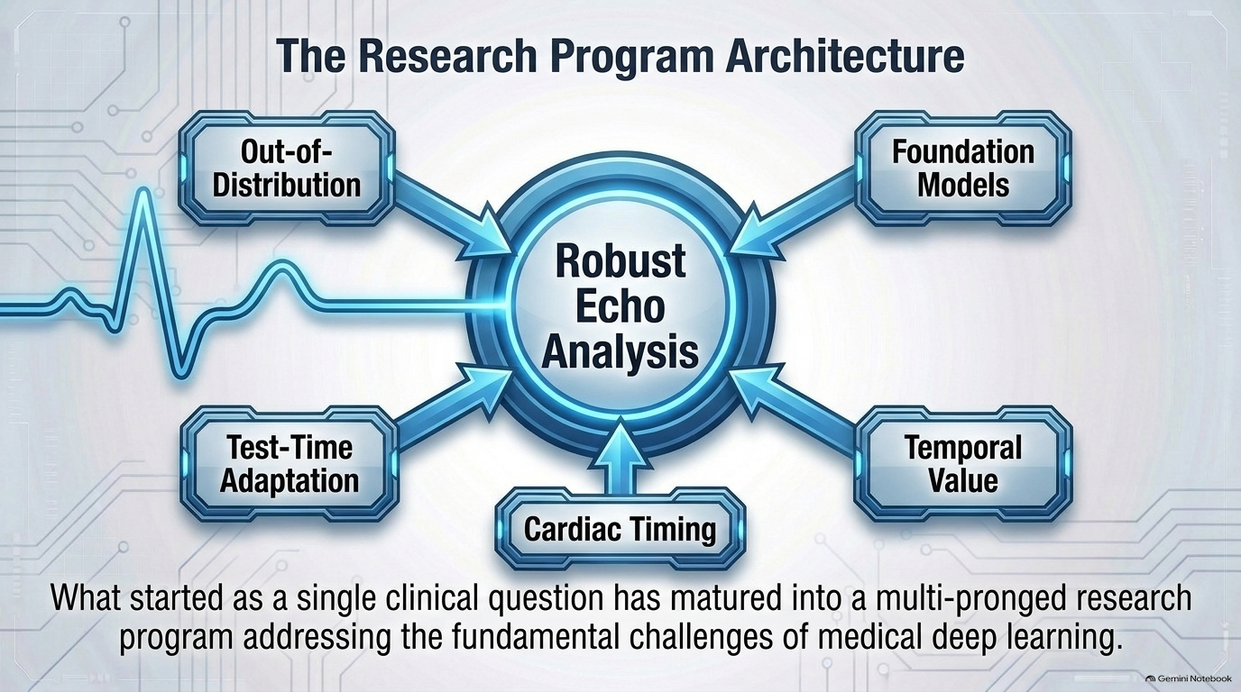
18
Notes:
This diagram shows how one clinical question has now grown into several connected lines of work.
Cardiac timing addresses uncertainty in how we locate meaningful moments in a heartbeat. Temporal modeling asks whether the motion across the cycle provides information beyond selected frames. OOD detection asks when a new video is unfamiliar. Test-time adaptation asks whether the model can respond safely to a new setting.
And foundation modeling asks a different question: instead of starting with a model trained on everyday videos, what could we learn by first training on a very large collection of echocardiograms?
These are research directions we are investigating. The diagram shows how they relate; it does not mean each one has already produced a clinically validated solution.

