Slide 1
Innovators
Gigalytics! (Advanced Data Management Project, Group 2, Peak analytics)

Slide 2
Contents (1 of 2)
Introduction
Business Scenario: Music Industry and Event Management
5 Business questions
Initial set of requirements
Key features to be analysed
Key features and Business questions

Slide 3
Contents (2 of 2)
Big Data and Distributed Systems (BDDS) and Data Integration (DI) tools
Data Quality Issues
Data Extraction and Cleansing
Extract Transform and Load (ETL)
Data Warehouse
Reports
Interpretation

Slide 4
Introduction
Team Gigalytics!
The Business Scenario
Initial business questions
Datasets and justification
Summary Interpretation

Slide 5
Introduction: Team Gigalytics!
Shak Makanjuola (Database Administrator)
Mahyar Mottaghi Zadeh (Lead Programmer)
Isaac Odeghe (Team Leader)
Debola Omolaja (Data Engineer)

Slide 6
Introduction: The Business Scenario
Which artist (national or international) to invite for a gig?
The artist must have a social following and recent success!
This gig must have a lot of impact!
Which location, venue, date, and time is suitable for the gig?

Slide 7

Introduction: Why live music Industry?
Graham, 2018
Ticket prices for gigs have risen over 27% since late 1990’s
The average ticket cost £22.58 in 1999, it is £47.14 in 2018
In 1998 it cost £23.50 to see the Spice Girls at Wembley Stadium
In June 2018 Taylor Swift played at Wembley Stadium for ticket prices of about £120
According to Pollstar, money taken by the biggest events has jumped by 33% to £4.52bn since 2011

Slide 8

Introduction: Why not News or Public Service?
The group initial analyses of external data sources revealed:
Good data sources for Live Music, News, and Public Service
Each group member made their case for their choice
A vote was taken
Live Music came on top

Slide 9
Introduction: Initial business questions
Which artist have enjoyed the most stream count and have tracks in the top chart position in the UK?
1
What is most popular time of the year and the day of week to hold an event in the UK?
2
Which UK location and venue is most popular for live music events?
3

Slide 10
Introduction: Why business question 1?
Provide a monthly breakdown of artists by the number of streams, the number of tracks in the weekly top chart and track peak position in the UK between Mar-2019 and Feb-2020
Why?
To identify which artist (national or international) to invite for the gig

Slide 11
Introduction: Why business question 2?
Provide a monthly analysis of number of live music events by event type (festival or live concerts) and day of week in the UK between Mar-2019 and Feb-2020
Why?
To identify a suitable date and time for the gig

Slide 12
Introduction: Why business question 3?
Provide a city by city breakdown of venues in the UK by number of events and average popularity between Mar-2019 and Feb-2020
Why?
To identify a suitable venue for the gig

Slide 13
Introduction: Initial Datasets
Spotify Charts
MusicBrainz
Songkick
Last.fm

Slide 14
Introduction: Datasets and justification
Spotify Charts
124 million subscribers compared to Apple music’s 60 million (Feb 2020, musically.com)
To provide data to identify artists (national or international) to invite for the gig
To provide data to identify artists with recent success
MusicBrainz
MusicBrainz Identifiers (MBIDs) links music datasets
Songkick
To provide data to identify events or gigs with a lot of impact
To provide data to identify suitable location, venue, date, and time for the gig

Slide 15
Introduction: Why not last.Fm?
No user’s location data associated with play-counts
Play-count data useful for global analysis
To get useful data will involve complex data mining

Slide 16
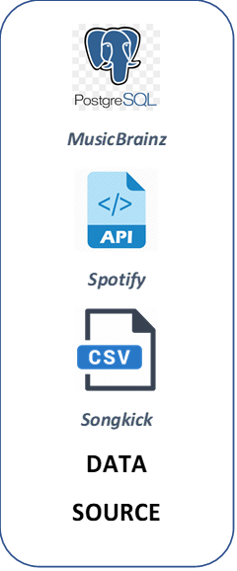
Introduction: data sources

Slide 17
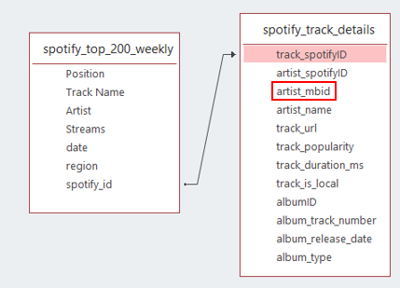
Spotify charts

Slide 18
Musicbrainz
# | Name | Data Type | Column Description | References
1 | Id | Int | Sequential Id in MusicBrainzDB
2 | Gid | Guid | Unique Id of the artists (MBID)
3 | Name | String | Full name
4 | Sort_Name | String | Normalized name of t he artists. In some cases the artist name is reversed. (ie. Lewis Capaldi => capaldi_lewis)
5 | Type | Int | Artist_type foreign key: 1. Person 2.Group | Artists_Type table
6 | Area | Int | Area foreign key | Area table
7 | Gender | Int | Gender foreign key | Genders table
8 | Ended | Bit | Active artist flag

Slide 19
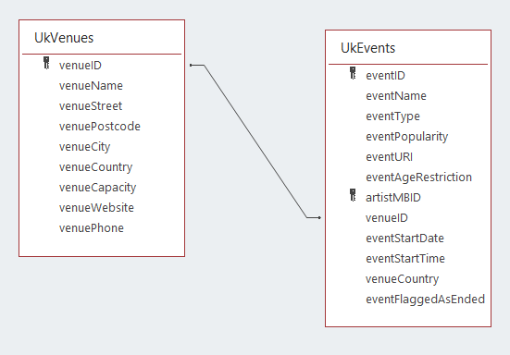
Songkick

Slide 20
Introduction: Extract Transform and Load (ETL)

Slide 21
Introduction: Summary interpretation
Which artist (national or international) to invite for a gig?
Lewis Calpadi
The artist must have a social following and recent success!
Lewis Calpadi
This gig must have a lot of impact!
Concert
Which location, venue, date, and time is suitable for the gig?
London
Fabric: 1600 capacity, selected
Spring/Summer 2021
May 2021
Friday
7pm
Notes:
High demand for events in may 2021 due to the virus.

Slide 22
Business scenario: Music industry and event management

Slide 23
Business questions 1 & 2
Which artist have enjoyed the most stream count and have tracks in the top chart position in the UK?
Provide a monthly breakdown of artists by number of streams, number of tracks in the weekly top-200 chart and track peak position in the UK between Mar-2019 and Feb-2020
What is most popular time of the year and the day of week to hold an event in the UK?
Provide a monthly analysis of number of live music events by event type (festival or live concerts) and day of week and in the UK between Mar-2019 and Feb-2020.

Slide 24
Business questions 3 to 5
Which UK location and venue is most popular for live music events?
Provide a city by city breakdown of venues in the UK by number of events and average popularity between Mar-2019 and Feb-2020
What time of the day is the most popular time to start a live music event in the UK?
Provide a monthly analysis of the number of live music events in the UK starting at different hours of the day between Mar 2019 and Feb 2020
Which artists have enjoyed significant number of stream-count and at the same time performed in live music across UK?
Provide monthly breakdown of artists by number of events and total stream-count in the UK between Mar-2019 and Feb-2020.

Slide 25
Initial set of requirements
Provide a monthly breakdown of artists by number of streams, number of tracks in the weekly top chart and track peak position in the UK between Mar-2019 and Feb-2020.
Provide a monthly analysis of number of live music events by event type (festival or live concerts) and day of week in the UK between Mar-2019 and Feb-2020.
Provide monthly breakdown of artists by number of events and total stream-count in the UK between Mar-2019 and Feb-2020.

Slide 26
Key features to be analysed
Which artist (national or international) to invite for a gig?
The artist must have a social following and recent success!
This gig must have a lot of impact!
Which location, venue, date, and time is suitable for the gig?

Slide 27
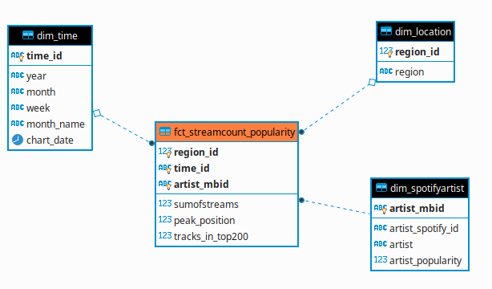
Key feature and Business question 1
Which artist (national or international) to invite for a gig?
Which artist have enjoyed the most stream count and have tracks in the top chart position in the UK?
Provide a monthly breakdown of artists by number of streams, number of tracks in the weekly top chart and track peak position in the UK between Mar-2019 and Feb-2020.

Slide 28
Key feature and Business question 1(Issues)
Issue while analysing the data and linking features
Artists RussMB and Russ Millions have the same mbid but different name
Action Taken
Update to RussMB in spotify_top_200_weekly and spotify_track_details
update spotify_top_200_weekly set artist = 'RussMB’ where artist in ('RussMB', 'Russ Millions');
update spotify_track_details set artist_fychart_name = 'RussMB’ where artist_mbid = 'b2252b38-dbbc-47dc-b7c7-1dfc3cd2dd59';

Slide 29
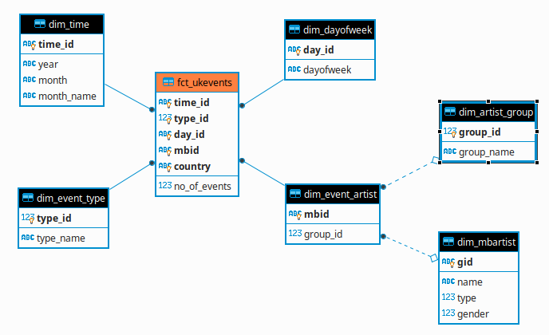
Key feature and Business question 2
Which date, and time is suitable for the gig?
What is most popular time of the year and the day of week to hold an event in the UK?
Provide a monthly analysis of number of live music events by event type (festival or live concerts) and day of week in the UK between Mar-2019 and Feb-2020

Slide 30
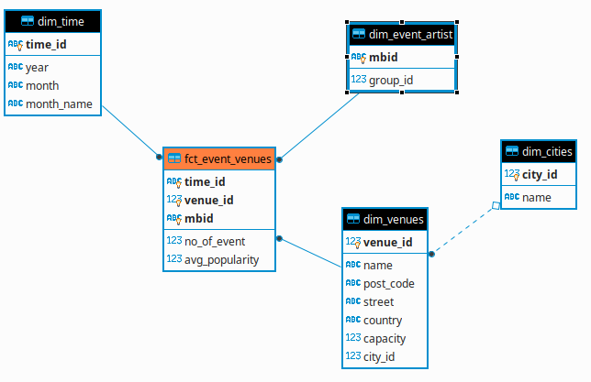
Key feature and Business question 3
Which location and venue is suitable for the gig?
Which UK location and venue is most popular for live music events?
Provide a city by city breakdown of venues in the UK by number of events and average popularity between Mar-2019 and Feb-2020

Slide 31
Key feature and Business question 3 (Issue 1 of 3)
Issue while analysing the data and linking features
Error creating foreign key between venued_id (float) on songkick_uk_events and venue_id songkick_uk_venues (int)
Action Taken
Change venue_id on songkick_uk_venues to float datatype
ALTER TABLE public.songkick_uk_venues ALTER COLUMN venue_id TYPE float8 USING venue_id::float8;

Slide 32
Key feature and Business question 3 (Issue 2 of 3)
Issue while analysing the data and linking features
Events with the same event_id having different popularity index
Action Taken
Update events with the average of popularity index
For example: update songkick_uk_events set popularity = (select avg(popularity) from songkick_uk_events de2 where de2.event_id = 32538374) where event_id in (32538374);

Slide 33
Key feature and Business question 3 (Issue 3 of 3)
Issue while analysing the data and linking features
Events with venue id but no venue details. 10 events out of 47,045 events
Action Taken
Exclude from event venue analysis

Slide 34
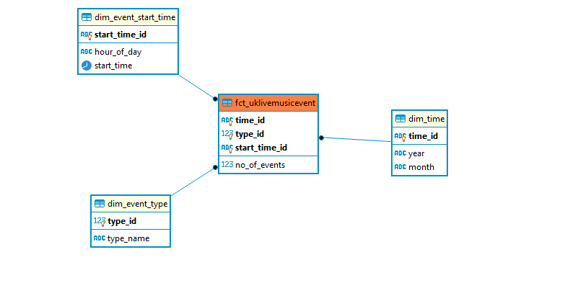
Key feature and Business question 4
What time is suitable for the gig?
What time of the day is the most popular time to start a live music event in the UK?
Provide a monthly analysis of the number of live music events in the UK starting at different hours of the day between Mar 2019 and Feb 2020

Slide 35
Key feature and Business question 4 (Issue)
Issue while analysing the data and linking features
Less than 29% of (13, 471 out of 47,045) events have no start-time
Action Taken
Excluded from the event start-time analysis

Slide 36
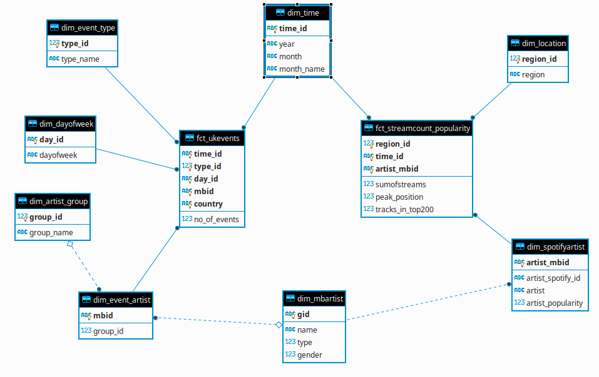
Key feature and Business question 5
The artist must have recent success. Also, the gig must have a lot of impact!
Which artists have enjoyed significant number of stream-count and at the same time performed in live music events across UK?
Provide monthly breakdown of artists by number of events and total stream-count in the UK between Mar-2019 and Feb-2020

Slide 37
Big Data and Distributed Systems (BDDS) tools
PostgreSQL
Data storing and staging
Jupyter Notebook
Development environment
Python
Data extraction, cleaning, and analysis
GitHub repository

Slide 38
Data Integration (DI) tools
Microsoft Access
Data cleaning and analysis
Microsoft Excel
Data cleaning and analysis
Tableau
User reports
Notepad
Data cleaning
PostgreSQL
Data warehouse
Dbeaver
Data analysis

Slide 39
Data Quality issues
Incomplete/missing values
Using Python Pandas Dataframe missing data handling, automate the replacement of missing data in each field
Wrong data
Using Microsoft Excel remove all double quotation marks (“)
Duplicate data
Using Python Pandas Dataframe duplicate data handling
Other errors – a comma in the field treated by the database as a delimiter
Using Microsoft Excel remove all commas (,)

Slide 40
Data Extraction
Spotify Charts
Extracted from Songkick using fychart Python library
Keywords and search terms
‘global’ and Great Britain (‘gb’)
Target date: Weekly charts between 1 March 2019 and 29 February 2020
Duration
About 5 minutes

Slide 41
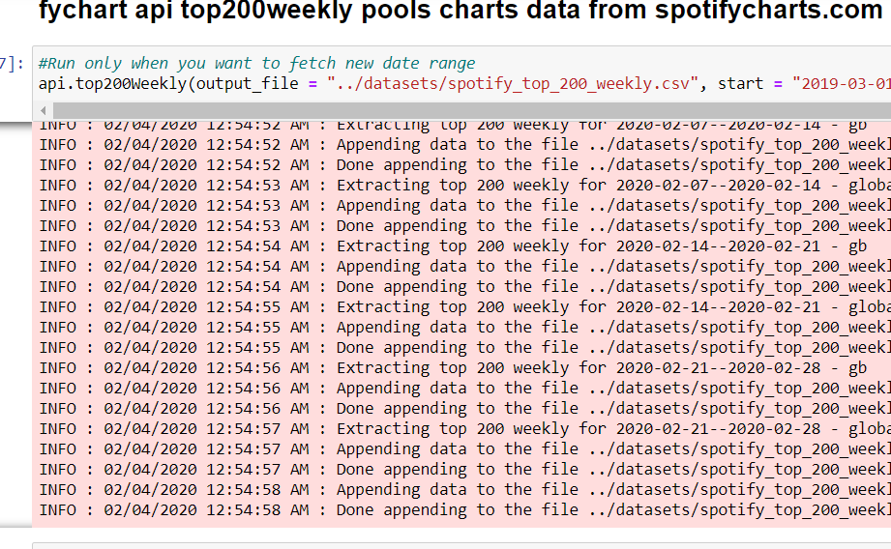
Extracting Spotify charts

Slide 42
Data cleansing
Spotify Charts
Using Python Pandas
Remove duplicate rows and automate missing data replacement
Check valid date values
Convert string column into date, e.g. Spotify track details
Write cleansed dataset to repository

Slide 43
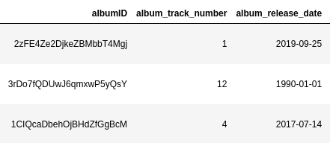
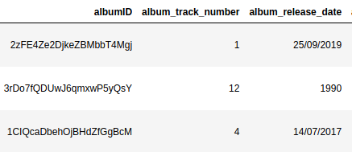
Data cleansing
Spotify Charts
Convert string column into date, e.g. Spotify track details

Slide 44
Data Extraction
Artists
Extracted from MusicBrainz using postgres
Keywords and search terms
Artist table with MBID field is extracted from database. MBID field provides link between datasets
Duration
About 3 hours 10 minutes

Slide 45
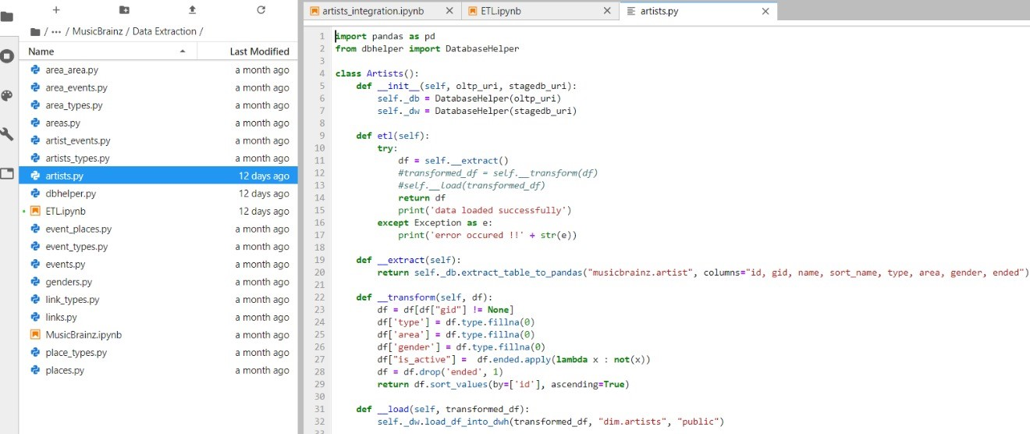
Extracting artists

Slide 46
Data cleansing
Artists
2 Cleansing stages
Remove all inactive artists using SQL
Remove duplicate rows and automate missing data replacement using Python Pandas Dataframe and levenshtein algorithm
Write cleansed dataset to repository

Slide 47
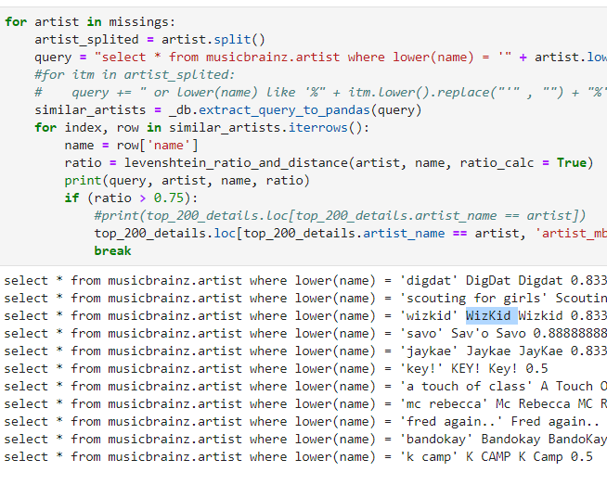
Data cleansing
Artists
2 Cleansing stages
Remove duplicate rows and automate missing data replacement using Python Pandas Dataframe and levenshtein algorithm

Slide 48
Data Extraction
UK Events
Extracted from Songkick using Python
Keywords and search terms
MBIDs of all active artist from MusicBrainz (Provides link between datasets)
Target date: all UK Events between 1 March 2019 and 29 February 2020
Duration
Over 2 days

Slide 49
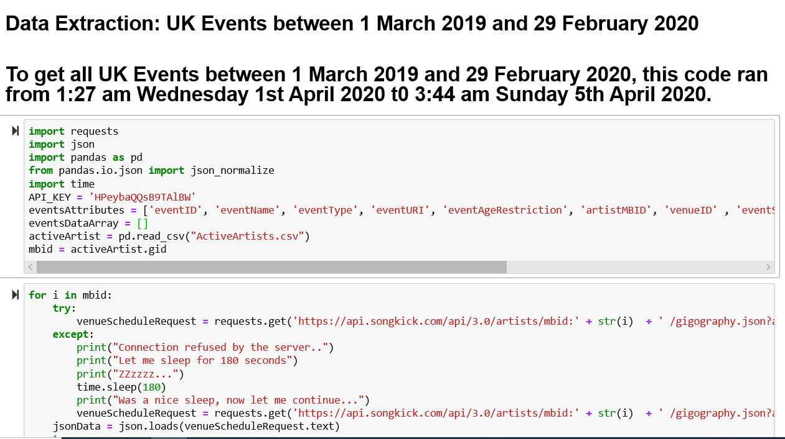
Extracting UK Events

Slide 50
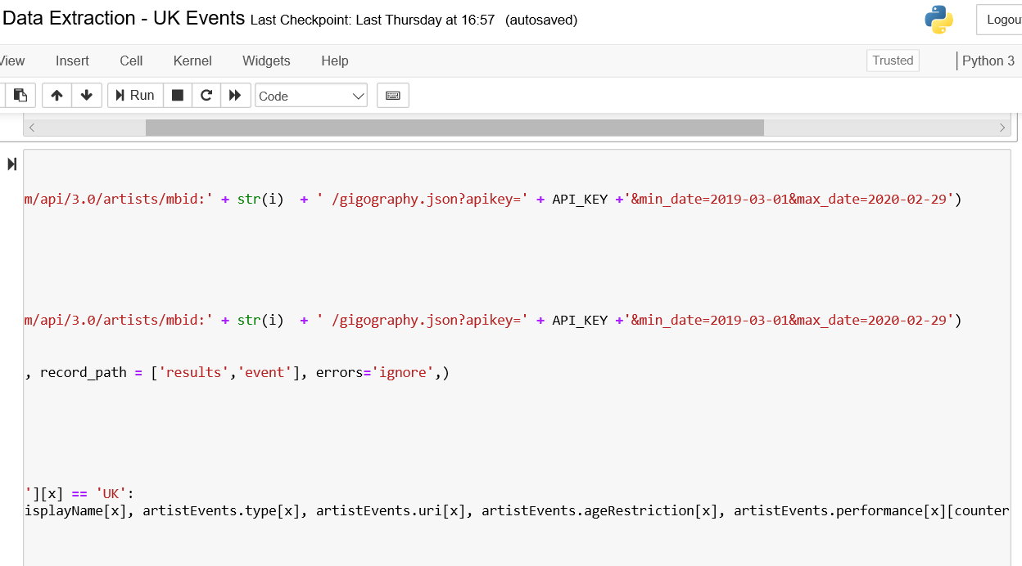
UK events extraction: keywords & search terms

Slide 51
Data cleansing
UK Events
Error classification
Data quality analysis
2 Cleansing stages
Remove commas (,) and double quotes (“) using Microsoft Excel
Remove duplicate rows and automate missing data replacement using Python Pandas Dataframe
Write cleansed dataset to repository

Slide 52
Data cleansing
UK Events
Error classification
(a) Incomplete/missing values
(b) Corrupted values
(c) Out of range values
(d) Wrong data
(e) Duplicate data
(f) Other errors – a comma in the field treated by the database as a delimiter

Slide 53
Data cleansing
S/No. | Field | Data Error | Cleaning stage (Remedy)
1 | eventID | e | 2
2 | eventType | e | 2
3 | eventPopularity | e | 2
4 | eventURI
5 | eventAgeRestriction | a, d, f | 1, 2
6 | artistMBID | e | 2
7 | venueID | a | 2
8 | eventStartDate
9 | eventStartTime | a | 2
10 | venueCountry
11 | eventFlaggedAsEnded
UK Events
Data quality analysis

Slide 54
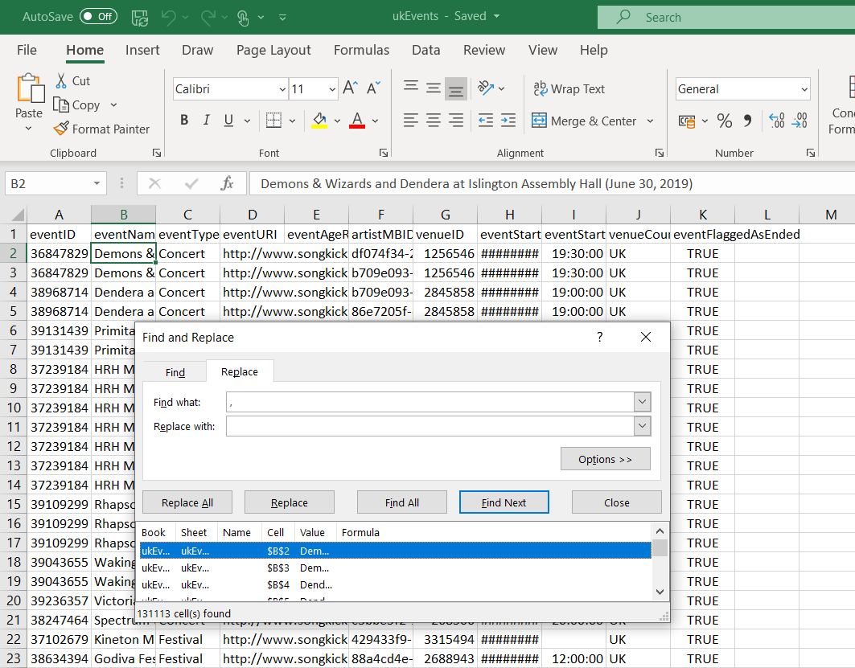
Data cleansing
UK Events
2 Cleansing stages
Remove commas (,) and double quotes (“) using Microsoft Excel

Slide 55
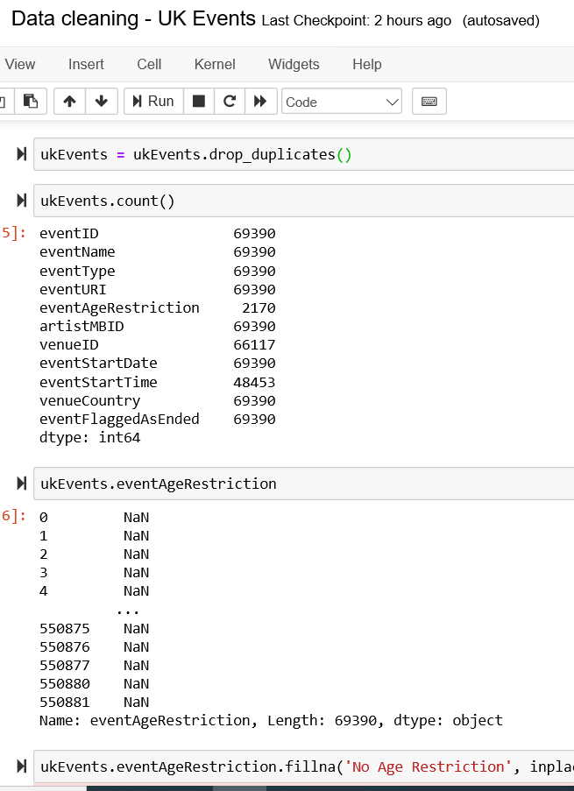
Data cleansing
UK Events
2 Cleansing stages
Remove duplicate rows and automate missing data replacement using Python Pandas Dataframe

Slide 56
Data Extraction
UK Venues
Extracted from Songkick using Python
Keywords and search terms
Venue ID
Duration
15 minutes

Slide 57
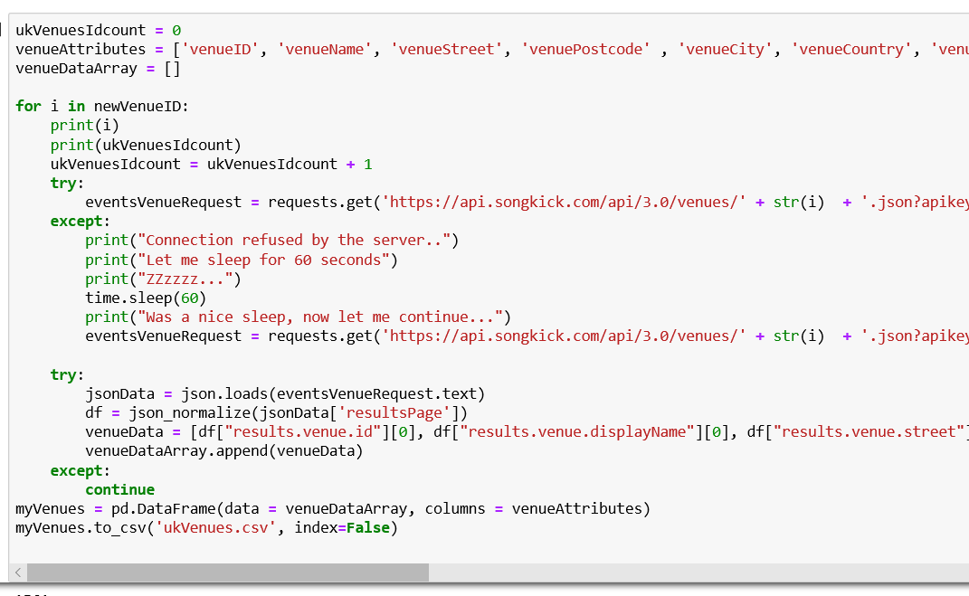
UK venues extraction: keywords & search term

Slide 58
Data cleansing
UK Venues
Error classification
Data quality analysis
3 Cleansing stages
Remove commas (,) and double quotes (“) using Microsoft Excel
Using Notepad for every single record that occupies two lines, adjusts it to occupy a single line
Remove duplicate rows and automate missing data replacement using Python Pandas Dataframe
Write cleansed dataset to repository

Slide 59
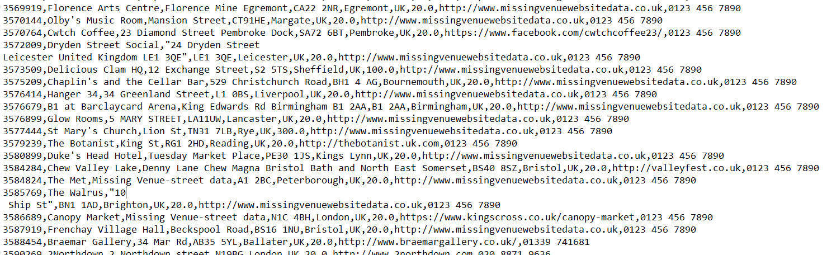
Data cleansing
UK Events
3 Cleansing stages
Using Notepad for every single record that occupies two lines, adjusts it to occupy a single line

Slide 60
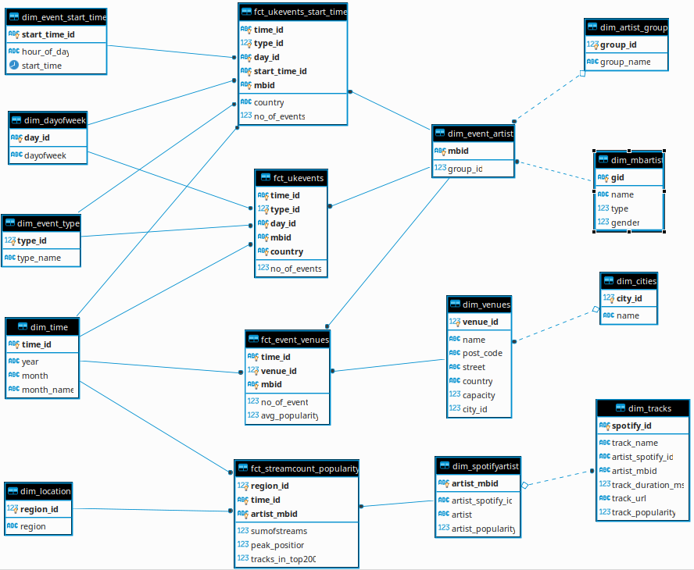
Data Warehouse ERD

Slide 61
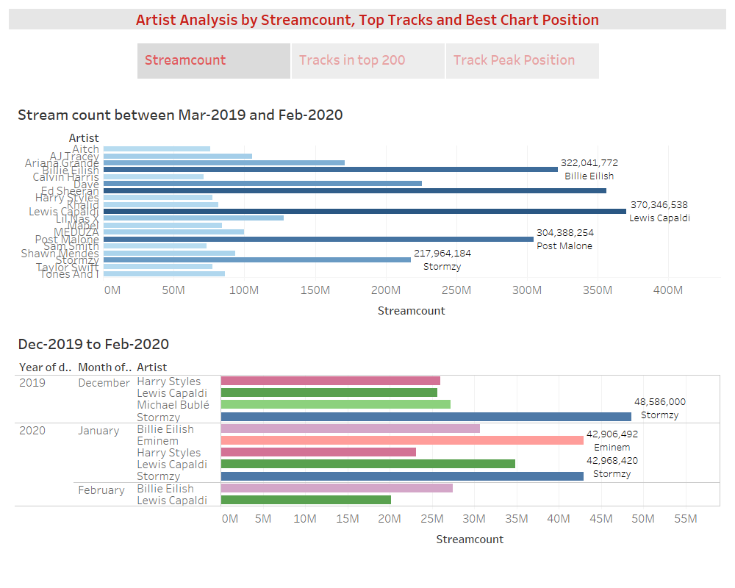
Reports: Business question 1 (1 of 3)
Which artist have enjoyed the most stream count and have tracks in the top chart position in the UK between Mar-2019 and Feb-2020?
Stream count

Slide 62
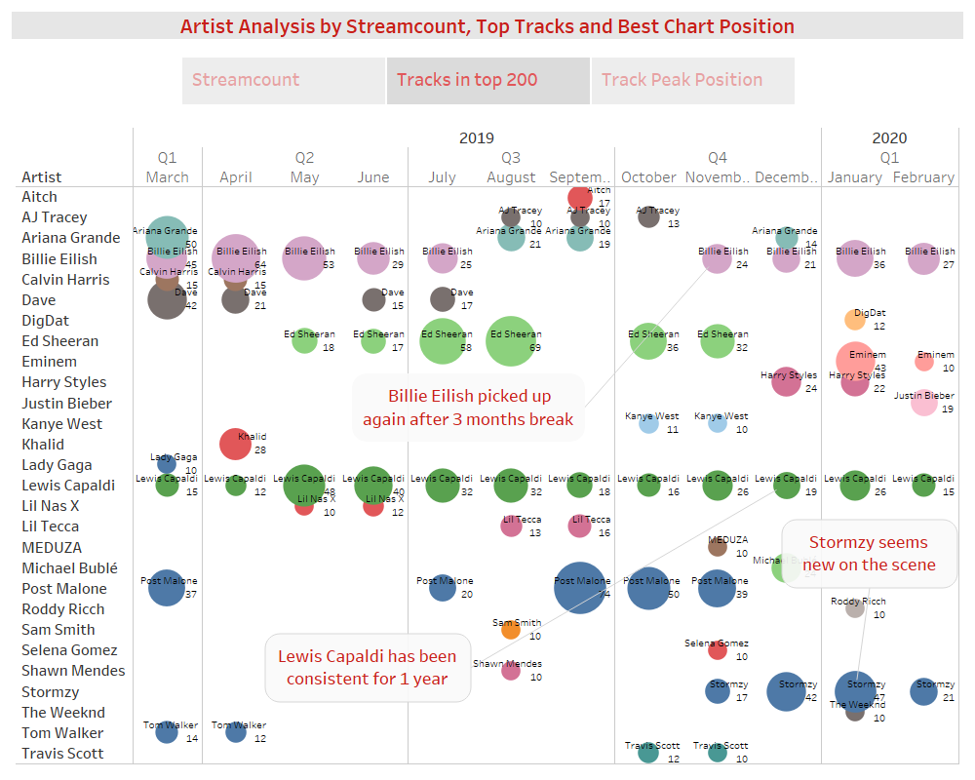
Reports: Business question 1 (2 of 3)
Which artist have enjoyed the most stream count and have tracks in the top chart position in the UK between Mar-2019 and Feb-2020?
Tracks in top 200

Slide 63
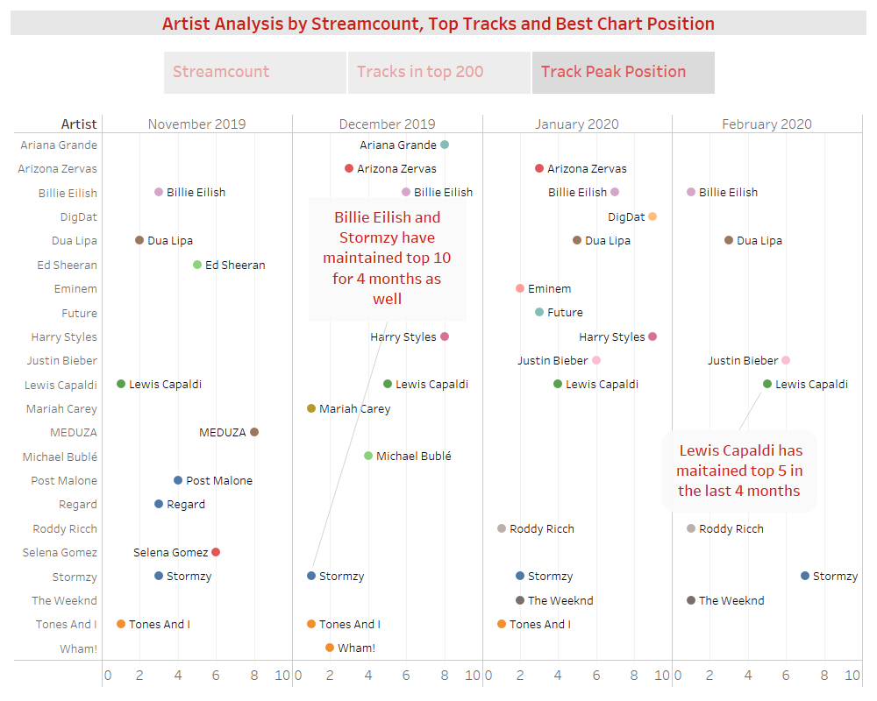
Reports: Business question 1 (3 of 3)
Which artist have enjoyed the most stream count and have tracks in the top chart position in the UK between Mar-2019 and Feb-2020?
Track peak position

Slide 64
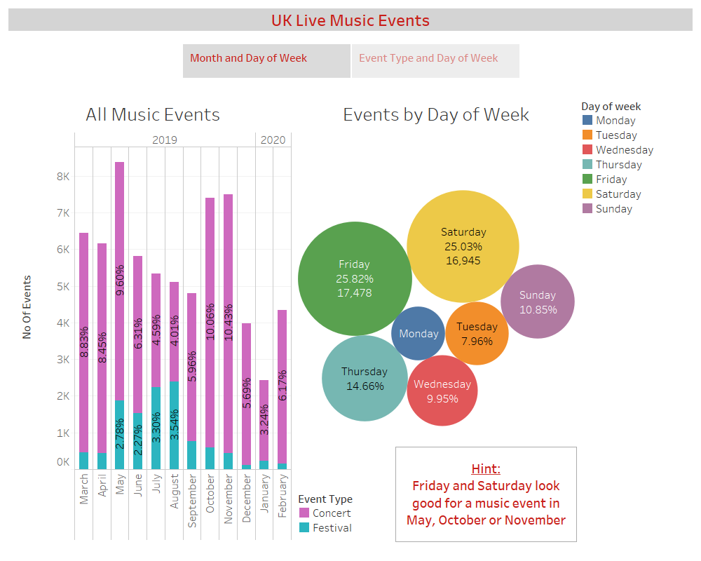
Reports: Business question 2 (1 of 2)
What is most popular time of the year and the day of week to hold an event in the UK between Mar-2019 and Feb-2020?
Month and Day of the week

Slide 65
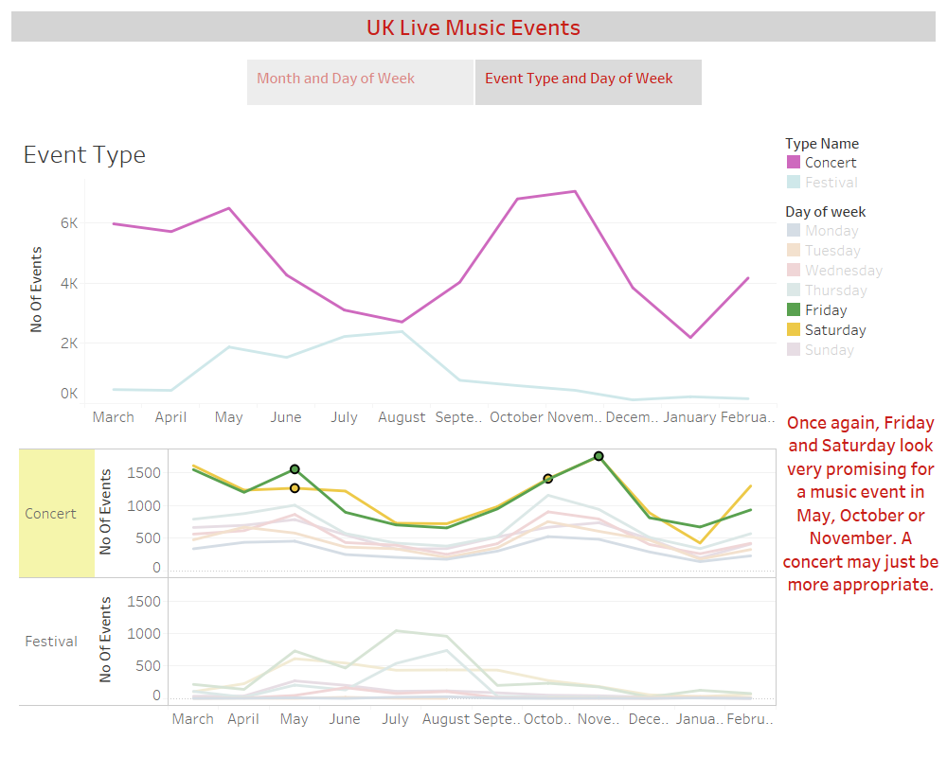
Reports: Business question 2 (2 of 2)
What is most popular time of the year and the day of week to hold an event in the UK between Mar-2019 and Feb-2020?
Event type and Day of the week

Slide 66
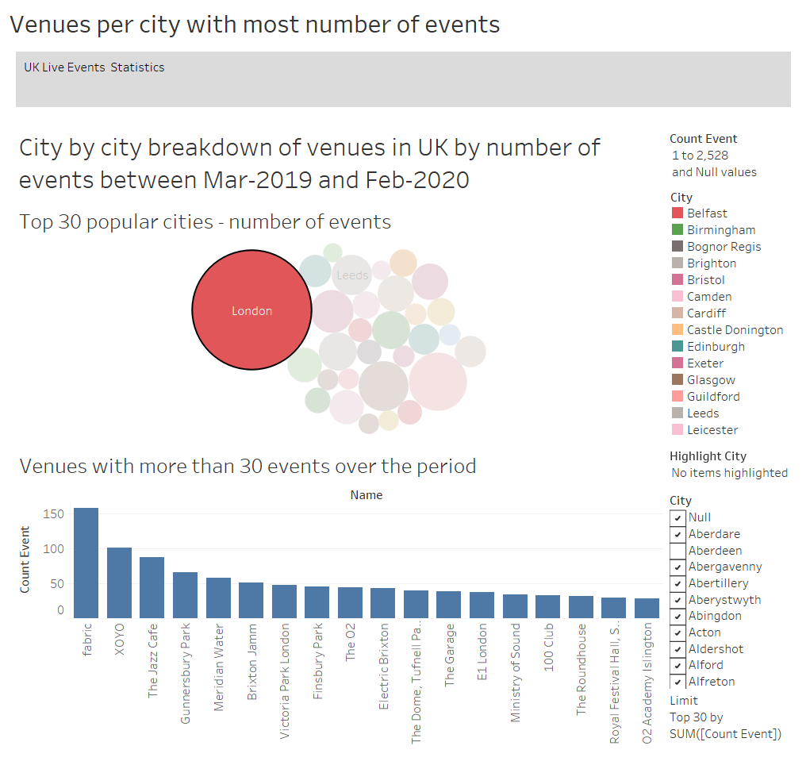
Reports: Business question 3 (1 of 2)
Which UK location and venue is most popular for live music events between Mar-2019 and Feb-2020?
City with the greatest number of events

Slide 67
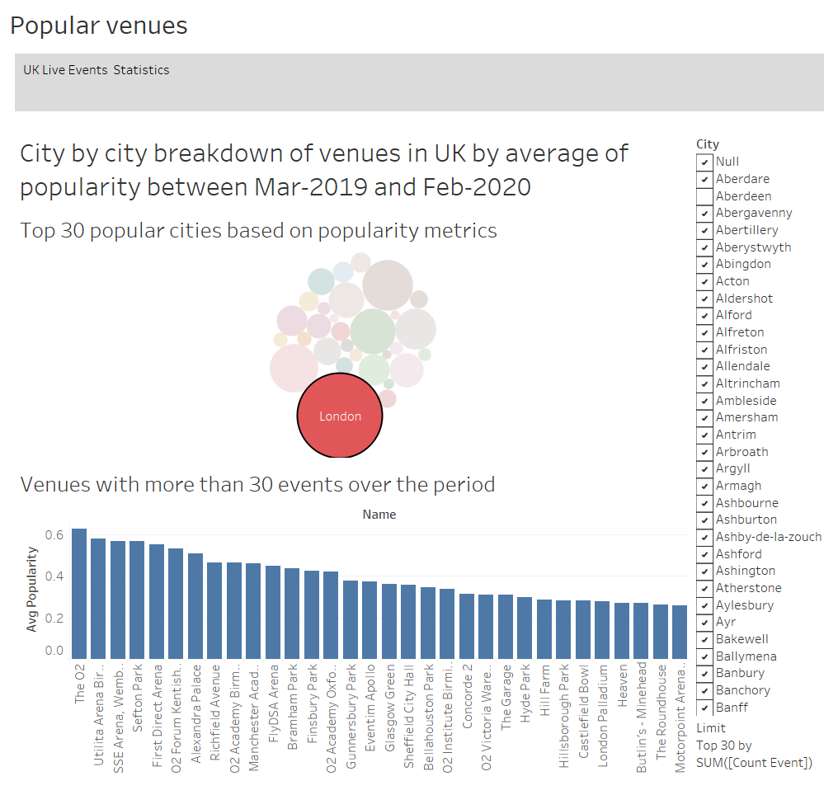
Reports: Business question 3 (2 of 2)
Which UK location and venue is most popular for live music events between Mar-2019 and Feb-2020?
Popular venues

Slide 68
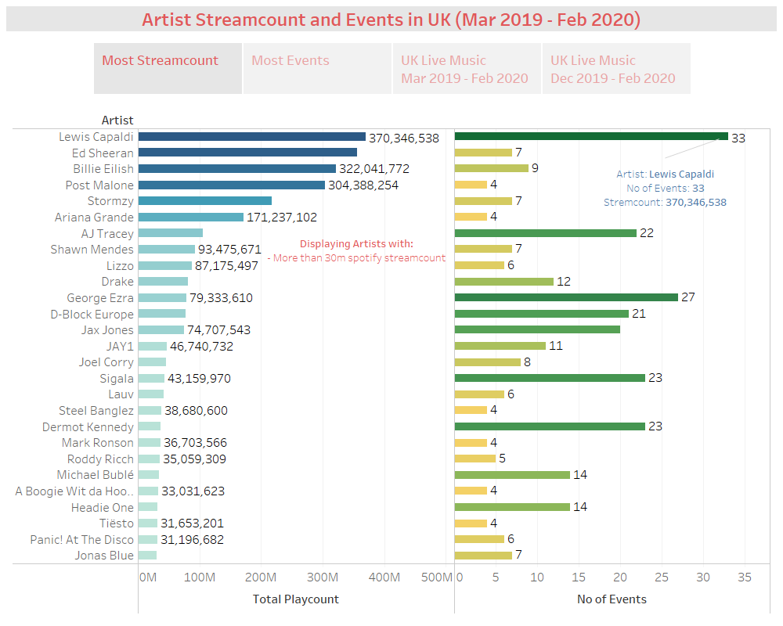
Reports: Business question 5 (1 of 4)
Which artists have enjoyed significant number of stream-count and at the same time performed in live music events across UK between Mar-2019 and Feb-2020?
Artist with the most stream count

Slide 69
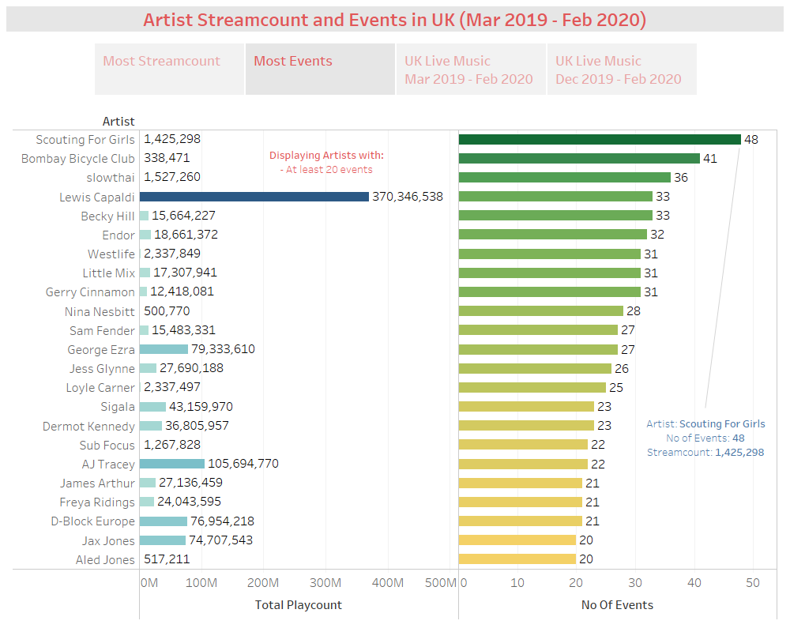
Reports: Business question 5 (2 of 4)
Which artists have enjoyed significant number of stream-count and at the same time performed in live music events across UK between Mar-2019 and Feb-2020?
Artist with the most UK events

Slide 70
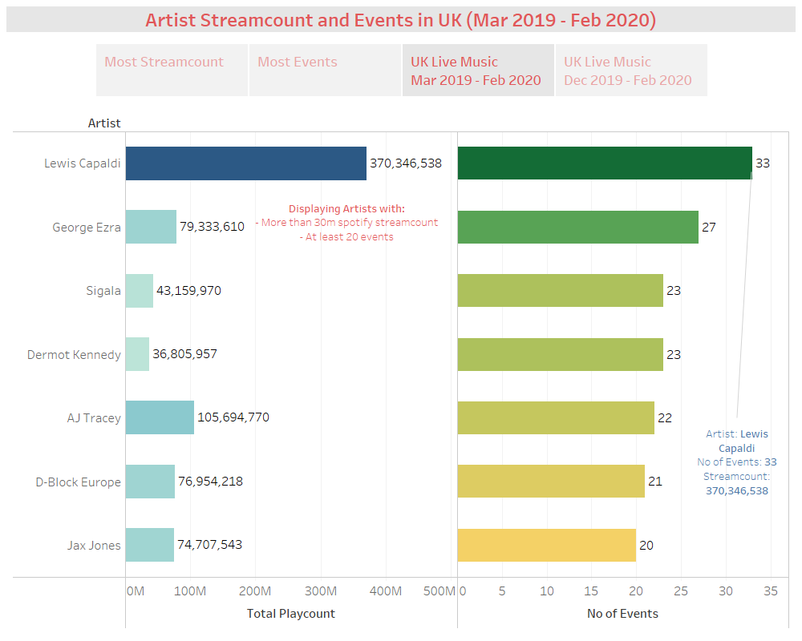
Reports: Business question 5 (3 of 4)
Which artists have enjoyed significant number of stream-count and at the same time performed in live music events across UK between Mar-2019 and Feb-2020?
Within the last year

Slide 71
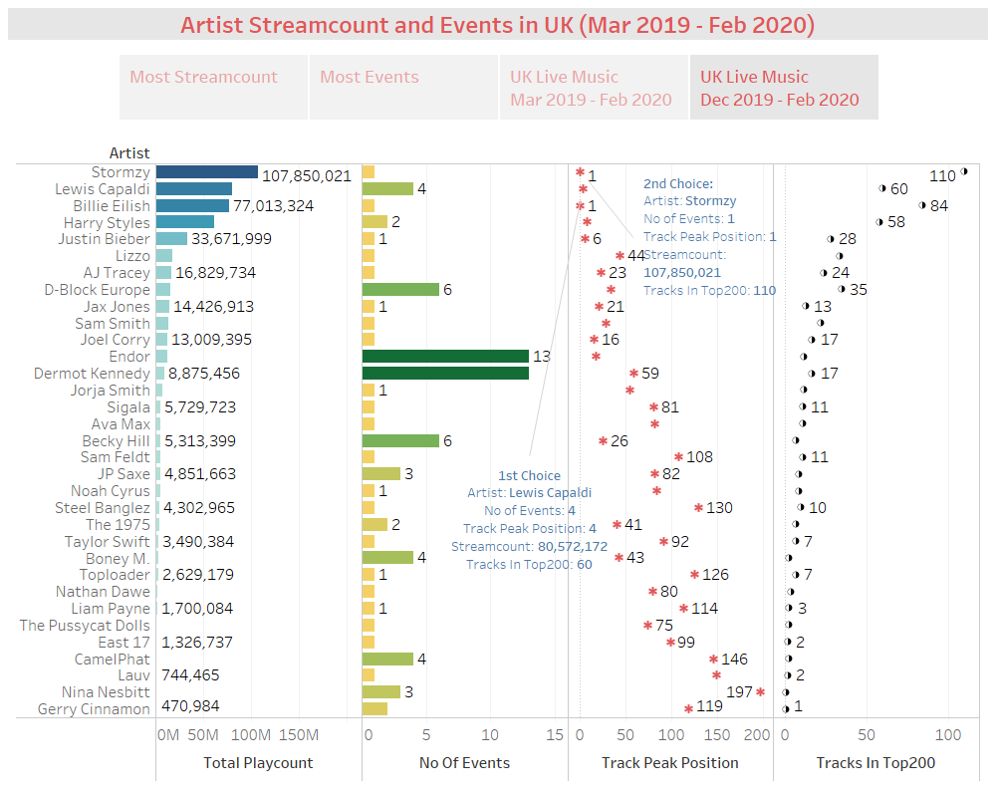
Reports: Business question 5 (4 of 4)
Which artists have enjoyed significant number of stream-count and at the same time performed in live music events across UK between Dec-2019 and Feb-2020?
Within the last quarter

Slide 72
Interpretation
Which artist (national or international) to invite for a gig?
Lewis Calpadi
The artist must have a social following and recent success!
Lewis Calpadi
This gig must have a lot of impact!
Concert
Which location, venue, date, and time is suitable for the gig?
London
Victoria Park : not good for concert
Fabric: 1600 capacity, selected
Jazz Café: 350 capacity
Spring/Summer
May
Friday
7pm

Slide 73
References
Freso. (2018). Spotify2musicbrainz. Retrieved from https://mbspotify.musicbrainz.org/
Gakuo Kelvin. (2020). Spotify-charts-API. Retrieved from https://github.com/kelvingakuo/fycharts
Graham, J. (2018). Gig ticket prices have doubled since 1990s. ().BBC. Retrieved from https://www.bbc.co.uk/news/business-42982769
MetaBrainz Foundation. (2020). MusicBrainz database. Retrieved from https://musicbrainz.org/doc/MusicBrainz_Database
Spotify. (2020a). Spotify FAQ. Retrieved from https://artists.spotify.com/faq/stats
Spotify. (2020b). Spotify for developers. Retrieved from https://developer.spotify.com/documentation/web-api/
Stuart Dredge. (2020). Spotify-apple-how-many-users-big-music-streaming-services. Retrieved from https://musically.com/2020/02/19/spotify-apple-how-many-users-big-music-streaming-services/

Slide 74
Any Questions?
Thank you for your attention.

