Slide 2


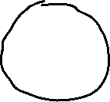







Symmetrically equivalent knives
Original knife

