Slide 1
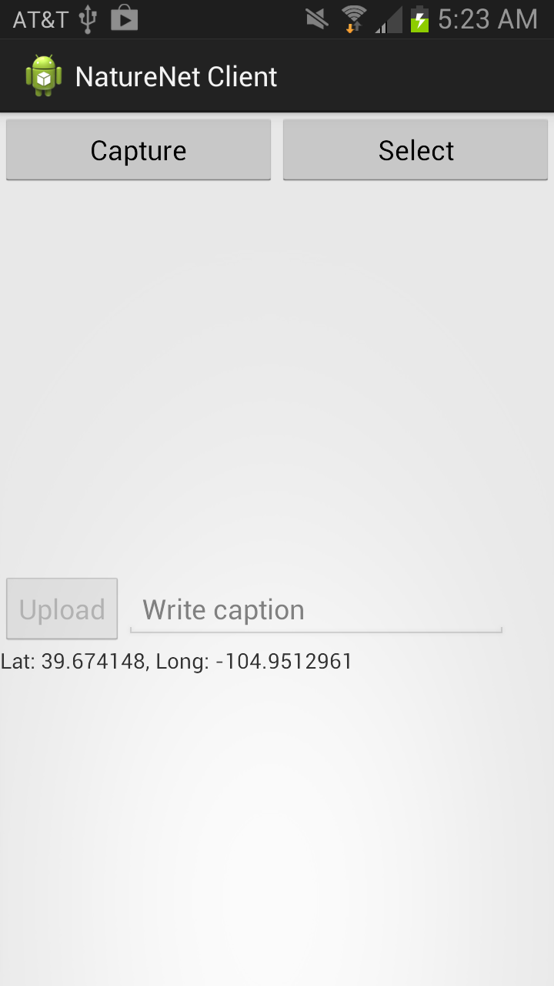
Main Screen
A uses can “capture” a new photo or “select” an existing photo stored on the device.
In this demo, the user chooses to “Capture” a new photo.

Slide 2
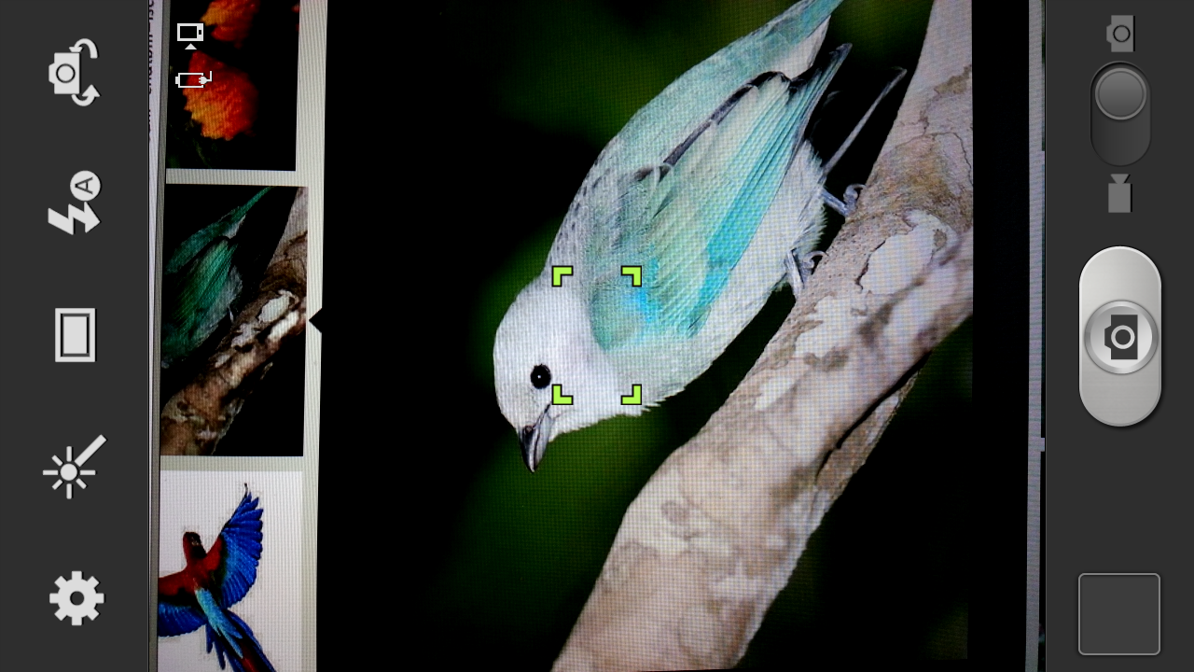
Camera
The user uses the built-in camera to capture a photo.

Slide 3
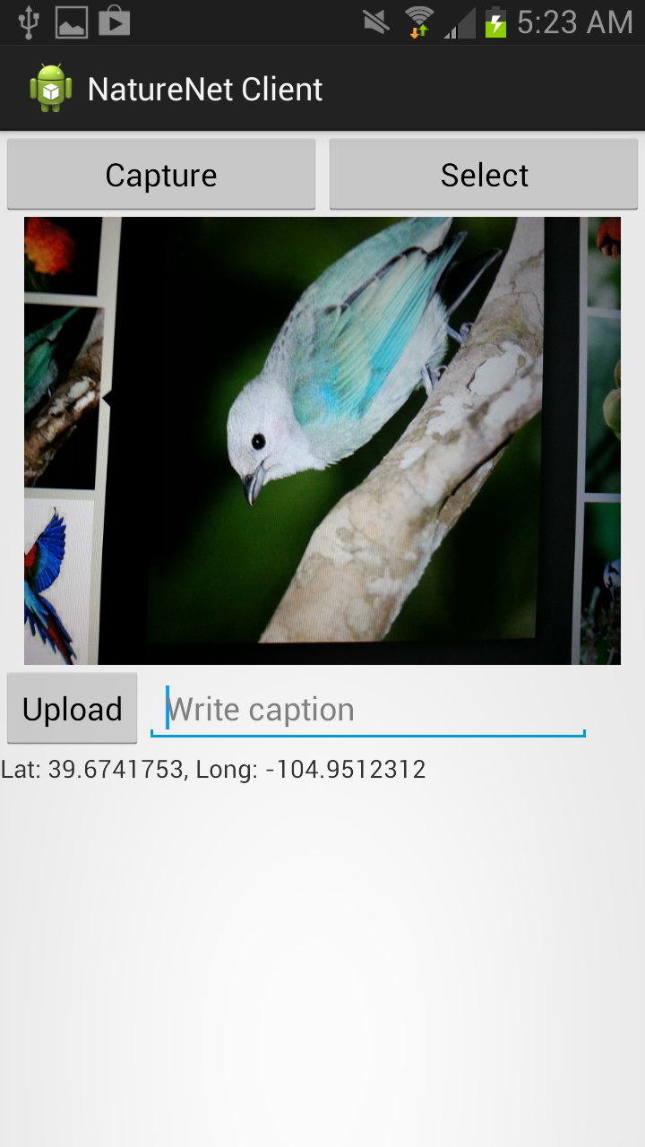
Main Screen (+ photo)
After a new photo is captured, the user sees the captured photo shown in the main screen.
The user also sees the GPS location.
The Upload button is enabled. The text input field below the photo is also enabled.

Slide 4

Main Screen
The user enters a caption for the new photo.
Then, the user presses the “Upload” button.

Slide 5
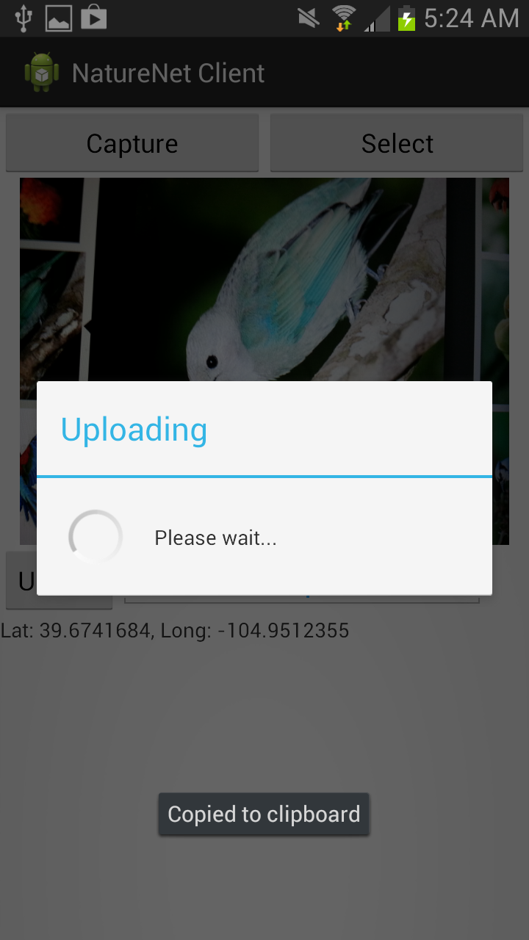
Main Screen
The user waits for the uploading operation to complete.
The photo is being uploaded to a 3rd party image host: imgur.com, using its public API.
Upon receiving an image, Imgur.com returns an image ID and a link to see the photo on its website.

Slide 6
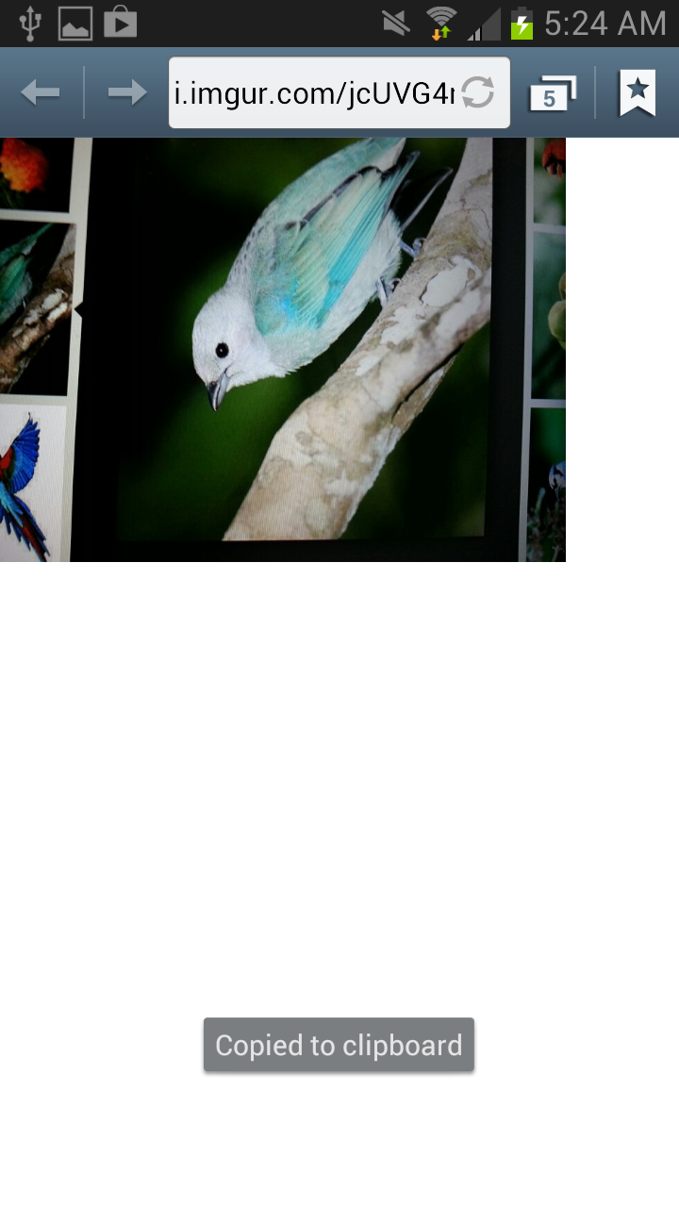
Web Browser
The user sees the uploaded image on imgur’s website.
In this case, the image ID is: jcUVG4m.
The next action we want to implement for the NatureNet client is to send this image ID to the NatureNet server along with other meta-data such as GPS location and caption.

