Slide 1
Notes:
First of all, I would like to thank all the members of the jury for being here, in my pdh defense today.
My thesis is about a MDE approach to build secure Iss.
It is supervised by Mss. Amel Mammar and Mrs. Regine Laleau

Slide 2

Information system
Introduction
Thesis context
Organizations use to collect, filter, process, create and distribute data.
Security properties should be taken into account ASAP.
Security
Notes:
My thesis work is in the context of developing trustworthy ISs.
We all know that Iss are now everywhere around us
Organizations use them to collect, exchange, and distribute information,
Data becomes the core value of many companies.
Therefore, protecting the sensitive data is very important.
Who has right the access the data?
When/where data is accessible?
However, developers are reluctant to take into account non-functional requirements at the beginning of the development process.
Because:
They want to build the app ASAP
Security requirements are very complicated
There is a lack of tools supporting
The fact that errors are mostly detected during the integration of security into the system.
If we discover an error too late,
It is more difficult to fix it
And it is more costly: time and money
Even destroy the whole system.

Slide 3
Objectives
Introduction
Thesis objectives
Specify security properties since the early development phases.
Static security rules are independent from the system’s states
e.g. Only doctors can validate medical records of patients
Dynamic security rules relate to the history of the system
e.g. To validate a medical record, the doctor should be present, in the hospital, since the arrival time of the patient.
Ensure their correct deployment on a given technological infrastructure.
Notes:
Our objective is to deal with security requirement along with the functionalities of a system since the early development phases
In the thesis, we divide security requirements into 2 categories:
Static rules are …
Dynamic rules relate to…
For example, in the hospital system, we may want to specify
A static access control rule like…
A dynamic access control rule like…
After specifying functional and security requirements, we want to make sure that the specified security requirements are correctly deployed.
In the following I am going to present the motivations that inspired our work.

Slide 4
Combining graphical and formal notations (UML and B)
Introduction
Thesis motivation
This approach provides:
A graphical view of the system
A precise specification for the validation/verification
Current approaches:
Automate the translation of UML into B
Focus on the functional requirements
The B4MSecure tool supports the functional and static access control requirements, but not dynamic access control requirements.
Notes:
One of the promising approaches is combining graphical and formal notations
Because:
we can have a graphical view of the system → participants like (designers, developers, end-users) can easily communicate to each other.
On the other hand, we have a precise spec that can validate the correctness of the system
We are interested in the combination of UML and B
Because:
There are many interesting studies on automating the translation of UML and B
But they focused only on the functional requirements.
The B4MSecure tool can generate the B spec for both functional and access control requirements
But only static AC requirements.
it does not support dynamic AC requirements

Slide 5

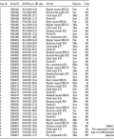

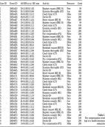

Security enforcement
Introduction
Thesis motivation
How to separately implement the functional logic and the security requirements?
Specified requirements
Developer
Notes:
Once security and functional requirements are specified, the development process consists in implementing them.
Our goal is to separate the security and functional codes so that the structure of the final system is clear and easy to maintain.

Slide 6

Security enforcement
Introduction
Thesis motivation
Solution: Aspect Oriented Programming (AOP)
Current approaches:
Separate the functional code and the security code
Only in the implementation phase
Generate the security code from not-yet-verified models
Notes:
AOP stands out to be the best solution for our need.
Because it allows a seperation of concerns
There has been many approaches using AOP to separate security code from the main program
But they focused only on enforcing security in the implementation phase of the development process
There are some works that allow to automatically generate the security code
But only from not-yet-verified models

Slide 7
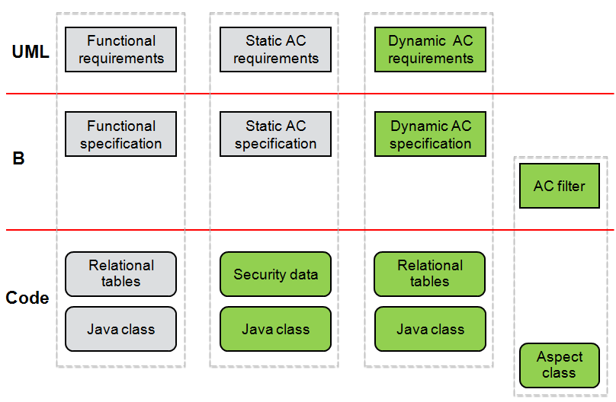
Specification of security design models
Introduction
Thesis contributions
We provide two views of functional/security requirements:
A graphical representation: UML
A formal representation: B
Notes:
In the thesis, we provide 2 views of a secure system:
the first one is a graphical representation of the system using uml diagrams
the second one is a formal representation of the system using the B method

Slide 8
Enforcement of access control policies
Introduction
Thesis contributions
Security enforcement code allows a separation of concerns:
Derived from the verified formal specification
Based on the AOP paradigm
Notes:
We also provide a security enforcement technique that allows to separate the functional and the security codes
The code is translated from a verified formal specification

Slide 9
Enforcement of access control policies
Introduction
Thesis contributions
We automate the transformations:
UML to B
B to AspectJ/Java/SQL
Notes:
Finally we built tools that support the automation of transformations
In particular, we can automatically translate:
uml models into b specs
and from B spec into an executable code
In the thesis, we adapt some existing works relating to the functional and the static AC requirements,
Which is represented in the grey part
And we contribute on dynamic AC policies,
Which is represented in they green part

Slide 10
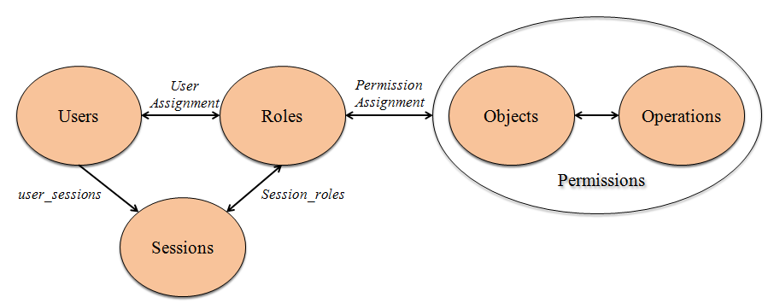
Role-Based Access Control
Introduction
Background
Notes:
Now i’m going to give you an overview about techniques that we used in our work
The first one is RBAC.
In the thesis, security requirements are based on RBAC
The idea is to regulate accesses to the resources of a system for users based on their roles.
RBAC permits to reduce the complexity and cost of security management within enterprises
The figure shows 5 basics elements of RBAC:
Users are the people using the system
Roles are job titles within organization
Permissions are the ability to perform operations on protected objects
Objects are potential resources to protect
Operations are actions through which users can perform on objects RBAC also introduces the concept of Sessions, which is associated with the dynamic aspect of RBAC. During a session, a user might activate one or many roles.
The central of RBAC is the concept of role relations, including User Assignment and Permission Assignment.

Slide 11
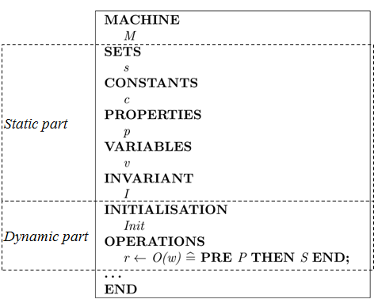
The B method
Introduction
Background
A formal language based on first order logic and set theory.
Allow the modularity in software development
Provide different abstraction levels of a system via the refinement process.
Proof obligations ensure:
The B specification is consistent
The B code complies with its specification
Tools: AtelierB, ProB, Rodin.
Notes:
To formalize functional and security requirements, we use the B method
It is a formal language based on…
It allows to modularize a system
And it covers the whole develoment process:
Starting by a very abstract specification
Detail information can be added gradually through the refinement step
The final refinement is the B implementation, which is close to a target language
To verify the correctness of a B specification, a set of proof obligations are generated
And we can use available tools like AtelierB to automaticaaly discharge them.
B specifications are organized in abstract machines.
Each machine contains the static and the dynamic parts:
The static part declares the state of a system in terms of sets, constants and variables
The INVARIANT clause permits to type the variables and to define the properties that they must always verify
The initialisation aims to set initial values for the variables.
The operations describe the evolution of a machine by modifying the state of that machine.
Operations are specified in the Generalized Substitution Language.
A substitution is like an assignment statement. It allows us to identify which variables are modified by an operation without mentioning the variables not modified.
Both specification and refinement steps give rise to proof obligations.
At the abstract level, proof obligations ensure that each operation maintains the invariant of the system,
whereas at the refinement level, they ensure that the transformation preserves the properties of the abstract level.

Slide 12
Outline
State of the art
Translation of UML-based models into B
Translation of the B specification into an executable code
Conclusion and future work
Notes:
For the rest of my presentation, I’m going to present…

Slide 13
Outline
State of the art
Security specification
Security enforcement
Translation of UML-based models into B
Translation of the B specification into an executable code
Conclusion and future work
Notes:
Regarding the state of the arts, i’m going to summarize 2 main topics related to our work

Slide 14
Formal techniques for security specification
State of the art
Security specification
UML/OCL–based approaches
Expressive
Limit in the automated analysis of security models
Validate security models only at the system’s current states
Alloy–based approaches
Automatically analyze security models using the Alloy Analyzer
Face the state space explosion problem since it is based on model-checking
Z–based approaches
Provide a clear structure of the specification using schemas
Lack tools supporting the automatic analysis
B–based approaches
Combine UML models and B formal specifications
The B4MSecure tool automatically translates UML into B
Not consider dynamic access control requirements
Dynamic access control requirements are modelled using ASTD (Algebraic State Transition Diagram)
Translation of ASTD into B is complicated
Notes:
For specifying security requirements together with the functional requirements of a system, we studied several approaches using formal techniques:
The first one uses OCL (Object Constraint Language) to express security constraints on UML models.
this technique is expressive.
But it is lack of tools supporting the automatic analysis UML models and constraints. Moreover, the validation can only executed at snapshots of the systems.
The second approach investigates the use of Alloy for specifying security policies.
Models written in Alloy can be automatically analyzed using the Alloy Analyzer.
But, since the verification techniques of Alloy are based on model-checking, it faces the problem of the state space explosion
The third formal techniques are based on the Z notation. Z has been mostly used to write precise application specifications.
Using this approach can have a clear structure of the spec,
One of the major drawback in using Z is the lack of tools supporting the automatic analysis of the formalized model.
The final technique is based on B
These studies proposed to combine UML models and B specs to specify both functional and security requirements
Especially, the B4MSecure tool, it allows to automatically generate a B spec from UML models
But currently, it does not support dynamic AC requirements
Dynamic AC requirements are modelled using ASTD
It is an extension of state transition diagram with eb3 operators
It is powerful to express dynamic AC requirements
But the translation into B is very complicated

Slide 15
Security enforcement
State of the art
Security enforcement
JAAS
An extension library to the Java Platform,
Separate the user authentication module from the application code
Separately develop the business program and security policies
The final system combines the functional code and the security code
Annotation-based approaches
Annotate the protected elements with roles in the program.
Declarative security enforcement
Cause the code tangling and scattering
AOP-based approaches:
Separate security concerns from the main program
Automatically merge them into the working system
Allow a separation of concerns
Dynamic security requirements are limited
Notes:
Regarding the security enforcement, we studied three main techniques:
The first one is a library released by Sun which enhances the Java platform with access control capabilities
The idea of JAAS is to isolate the user authentication module from the main program
But in order to user the library, the deveopler still has to write functions within the functional program
So, the final system is still a mixture of the functional and security codes.
The second approach is to annotate the protected elements (such as classes, interfaces, and methods) with role in the Java source code
The enforcement of RBAC policies is performed dynamically by inserting runtime checks to verify that the current user has the adequate roles when the annotated method is called.
However, annotations are placed on protected elements in all over the program.
It is remarkably difficult to know where a specific annotation should go, especially in large programs.
The problem about scattered and tangled code of the above approaches can be overcome by using AOP.
Indeed, this paradigm allows security concerns to be specified modularly and automatically merge them together into working systems.
There has been numerous studies on using AOP in security enforcement.
However, dynamic security requirements have not been investigated notably (e.g. history-based and order-based constraints).

Slide 16
Outline
State of the art
Translation of UML-based models into B
From a functional model to B
From a static security model to B
From a dynamic security model to B
A support tool
Translation of the B specification into an executable code
Conclusion and future work
Notes:
In the following, i’m going to present the modeling of functional/static/dynamic security requirements, using UML diagrams.
And the translations of these models into B

Slide 17
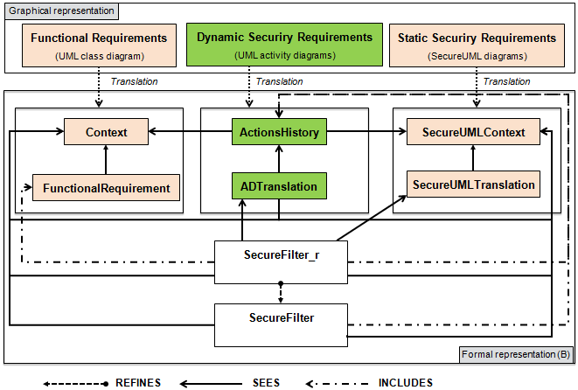
Approach
Translation of UML-based models into B
Notes:
In our approach, we use:
Class diagram to express functional requirements
secureUML to model static access control policies
AD to model dynamic security rule
These models are then translated into B machines.
As in the figure shows, the functional and static/dynamic security parts are treated separately and then they are linked together in a filter.
I will detail these translations in the next slides.

Slide 18
From a functional model to B
Translation of UML-based models into B
Adapt the translation rules in [R. Laleau and A. Mammar, 2000, 2006]
Notes:
The first translation we consider is from uml class diagram into B
The translation rules are adapted from the work of Régine and Amel.
a class diagram models the entities of a system, their attributes and their relationship.
so from a class diagram, we translate into 2 B machines

Slide 19
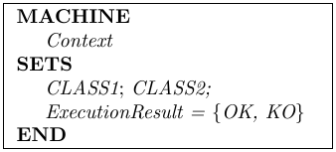
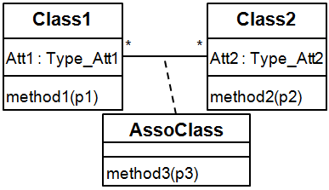
From a functional model to B
Mapping rules
UML class diagram
B machines
Class
Notes:
The first machine defines a set for each class in the diagram.
It represents all the possible values of the class

Slide 20
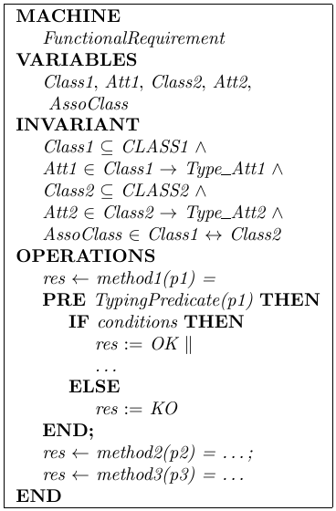
From a functional model to B
Mapping rules
UML class diagram
B machines
Class
Notes:
The second machine specifies the variables and the operations acting on them
from each class, we get a B variable:
which is a sub set of the set defined in the context machine
represents the existing value of the class

Slide 21
From a functional model to B
Mapping rules
UML class diagram
B machines
Class
Attribute
Notes:
Each attribute gives us a B variable:
which is a function from the class variable to its type

Slide 22
From a functional model to B
Mapping rules
UML class diagram
B machines
Class
Attribute
Association class
Notes:
An association class is translated into a variable
which is a relation between two associated classes

Slide 23
From a functional model to B
Mapping rules
UML class diagram
B machines
Class
Attribute
Association class
Method
Notes:
Each method is translated into an operation:
has all the parameters of the method
the precondition defines the typing predicates of the parameters
all other conditions are defined in the IF clause
if all the conditions are satisfied:
The system’s states are modified
and the operation returns a value OK to inform that it has been successfully executed
otherwise, it returns a value KO to say that it has been failed to execute

Slide 24
From a static security model to B
Translation of UML-based models into B
Translation of UML to B
Adapt the translation rules of the B4MSecure tool
Notes:
Now, i’m going to present the translation of a Secureuml diagram into B
The translation rules are adapted from the b4msecure tool

Slide 25
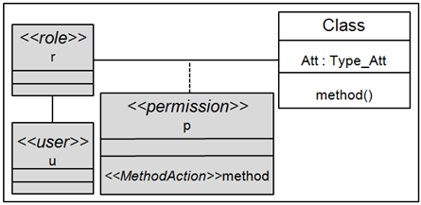
A SecureUML diagram
From a static security model to B
Modelling
An UML extension for modelling basic Role Based Access Control policies.
A SecureUML diagram specifies:
What is the protected resource?
Which roles are allowed to access the protected resource?
Who play the roles?

Slide 26
From a static security model to B
Mapping rules
SecureUML diagram
B machine
A set of roles
A set of users
The permission-role assignments
The user-role assignments
Notes:
From a secure uml diagram, we expect to get the lists of users, roles specified in the diagram
As well as the permission and user assignments

Slide 27
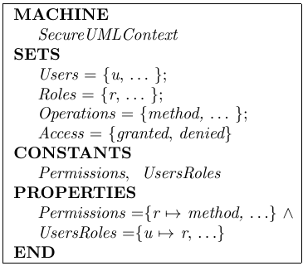
From a static security model to B
Mapping rules
SecureUML diagram
B machine
Notes:
So, the translated b spec of the secureuml diagram looks like this
It defines a set of users, a set of roles and a set of operations.
It also includes the constant permission represeting the relationship between a role and an operation
it means that this role has the right to perform this operation
And the constant Usersroles representing the relationship between a user and a role
it says that this user play this role
and a user can play several roles

Slide 28
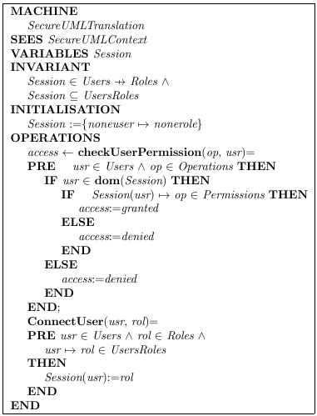
Static security check in B
From a static security model to B
Mapping rules
An additional B machine defines:
A variable gives the current roles of the users,
An operation activates a role of a user,
An operation checks the permission of a role on executing an operation
Notes:
In order to check static AC requirements, we define a new machine.
This machine specifies a variable session, that gives the current roles of the users.
The operation chachuserpermission is used to verify whether a user is permitted to perform a given operation or not,
Based on his current role.
This machine also includes an operation that allows a user to activate one of his roles

Slide 29
From a dynamic security model to B
Translation of UML-based models into B

Slide 30
A secure activity diagram
From a dynamic security model to B
Modelling
An UML extension for modelling dynamic security requirements.
These requirements can relate to:
history-based constraints
order-based constraints
user-based constraints
Notes:
In the thesis, we use activity diagrams to model dynamic AC requirements,
Which can be:
history-based constraints
order-based constraints
user-based constraints

Slide 31
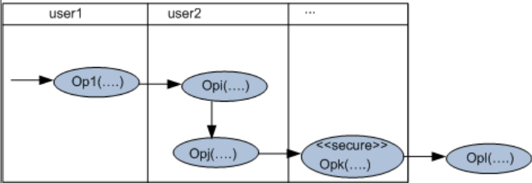
A secure activity diagram
From a dynamic security model to B
Modelling
Stereotype <<secure>> is applied to the protected action,
The preceded actions must be already performed,
Their execution order is modelled by the control flow,
The followed actions that should not be performed,
The actions executed by the same actor are placed in the same swim-lane.
Notes:
To do so,
We apply the stereotype secure to the protected method
all the methods must be already executed are placed before it
and the methods should not be executed are placed after it
the execution order of the history methods are represented by the control flow
we also use swimlanes to indicate the actors who execute the methods

Slide 32
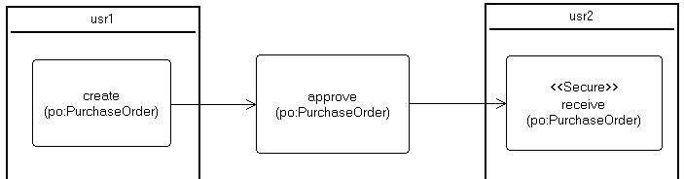
An example
From a dynamic security model to B
Modelling
Rule 1: A purchase order can be signed off to receive the goods only if it is approved. And its creation and its reception must be executed by two different people.
Notes:
For example

Slide 33

B log specification
From a dynamic security model to B
Mapping rules
Each action of a secure activity diagram derives:
Two variables: store the execution information:
The actor who performed the action,
The instant when the action is executed.
An operation: updates the value of these variables.
Op_{i}(p_{i1},...,p_{in})
Notes:
Because this kind of requirements relates to the history of the system, thus we define a log spec for each action.
It includes:

Slide 34
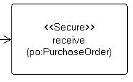
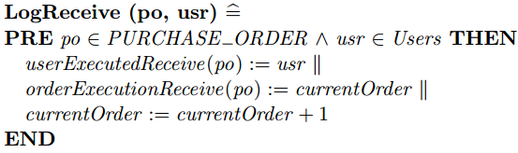
An example
From a dynamic security model to B
B log specification
translate
B variables:
B operation:
Notes:
For instance, the log spec of the receive method includes:
2 log variables which are the functions from the types of its parameters to users and an integer
The log operation
which has all the parameters of the receive method
and the user who executed it
it updates the values of the log variables

Slide 35
Dynamic security check in B
From a dynamic security model to B
Mapping rules
Each protected method derives a B operation:
Verify the execution history of the preceded methods,
Verify the execution history of the followed methods,
Verify the order execution of the preceded methods,
Verify the user-based constraints
Notes:
To check dynamic security rules, we define a dynamic security check for each protected method

Slide 36
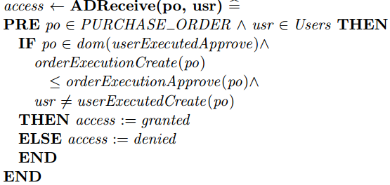
An example
From a dynamic security model to B
Dynamic security check in B
translate
Notes:
For example, the dynamic security check of the receive method translated from the activity diagram
It makes sure that …
If these conditions are hold, it grants the execution
Otherwise, it denies the execution

Slide 37
An access control filter
Translation of UML-based models into B
Combining part
Represent the interaction of the functional and security specifications.
Define the access decision:
Verify static/dynamic security requirements before an actual execution,
Call the protected method,
Log the execution of the protected method.
Notes:
As you can notice, we translate different uml diagrams into separate b machines.
the advantage is that: when adding/deleting a requirement, it affects only a particular part of the spec
but we need an additional step to link them together
So we define a filter for each protected operation that gives the final access decision:
...
…
…

Slide 38
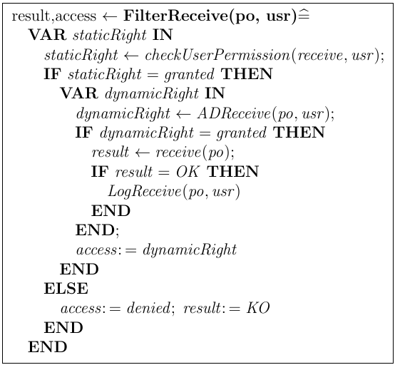
An example
Translation of UML-based models into B
An access control filter
Notes:
For instance, the filter of the receive operation:
first, verifies if the user who is trying to execute the receive operation has the right or not
if it is the case, it check dynamic constraints of the receive operation
if both security checks grant the execution, the receive operation is then called
also the log is called to save the execution if it is successful

Slide 39
A support tool
Translation of UML-based models into B
An existing work: the B4MSecure tool developed by the LIG laboratory [University of Grenoble]:
An Eclipse platform
Translate UML class diagram into B
Translate SecureUML into B
B4MSecure
UML
metamodel
B
metamodel
UML
model
B
model
generate
B machine
Notes:
To increase the productivity of the translation process, we want to build a tool that automates this process.
The b4msecure tool is a tool developed by a team in the lig laboratory.
It allows to translate class diagram and secureuml into B.
Basically, it has generators that map uml metamodels into b metamodels.
From a specific uml model, the tools generate a b model
from which, b specs are generated

Slide 40
Extend the B4MSecure tool
Translation of UML-based models into B
A support tool
Tool
Translate UML class diagrams into the B functional specification
Translate SecureUML diagrams into the B static security specification
Translate UML activity diagrams into the B dynamic security specification
Generate the access control filter
Adapt mapping rules
Extend for dynamic security properties
Notes:
We have adapt this tool for the translations of class diagram and secureuml into B
We also extend it to translate AD into B dynamic security spec.
The tool also generate the AC filter

Slide 41
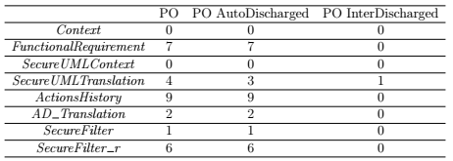
Proof obligations using AtelierB
Translation of UML-based models into B
Validation
Notes:
The obtained B spec is automatically proved by using atelierB.
The table shows the proof obligations result of a case study.
almost the proof obligations are automatically discharged
only one fails to automatically discharge that we have interactively proved.

Slide 42
Animation with ProB
Translation of UML-based models into B
Validation
Rule 1: The person who is trying to receive a purchase order must not be the person who created it.
Scenarios:
Tom logs into the system,
Tom creates a purchase order po,
Tom tries to receive the purchase order po.
Result: the action 3 fails
Notes:
to check the security rules, we animate the specification using the ProB [96] animator by applying several scenarios:
As expected, the last action fails since the access is denied.

Slide 43
Conclusion
Translation of UML-based models into B
Specify functional and static/dynamic security requirements using UML-based diagrams:
UML class diagrams for the functional requirements,
SecureUML diagrams for static security requirements,
Secure activity diagrams for dynamic security requirements.
Translate the graphical models into a B specification.
Automate the translation.
Notes:
So, i’ve just presented the specification of funcational as well as security requirements using uml models

Slide 44
Outline
State of the art
Translation of UML-based models into B
Translation of the B specification into an executable code
From an abstract B specification to a relational-like B implementation
Translation of an AspectJ implementation
A support tool
Conclusion and future work
Notes:
In the following, i’m going to present the translation of the b spec, obtained from previous step, into an executable code

Slide 45
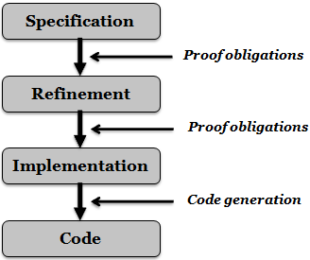
Approach
Translation of the B specification into an executable code
An abstract B specification can be refined until it is close to a target language.
The AOP paradigm allows a separation of concerns.
We propose:
Refine the B specification into a relational-like implementation
Map the final B refinement into an AspectJ-based program connected to the database.
Notes:
Using the b method, we can specify a system from a very abstract level,
Details are added gradually through several refinements steps,
Until the final refinement step is close to a target language.
We aim to an aop program, because it allows a separation of concerns.
So, we propose to…

Slide 46
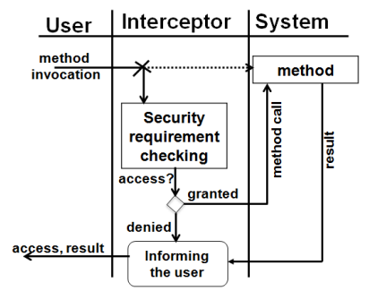
AspectJ
Background
Joinpoint: a position where the additional code is injected
Pointcut: a set of joinpoints
Advice: implement code at each joinpoint specified in a pointcut
Aspect: includes pointcuts and advices
Notes:
Aspectj is an aspect oriented extension for java language.
The main concepts are…

Slide 47
From an abstract B specification to a relational-like B implementation
Translation of the B specification into an executable code
Reuse the refinement rules in [A. Mammar, 2006]:
Data refinement
Behavioral refinement
Notes:
At this step, I present the refinement process to obtain a relational-like B implementation from the previous abstract specification.
To do so, we mainly reuse the B refinement rules of amel.
It consists of two main steps: Data refinement and Behavioral refinement.

Slide 48
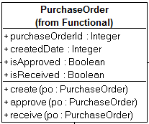
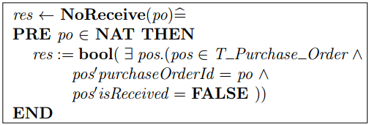
Data refinement
Translation of the B specification into an executable code
From an abstract B specification to a relational-like B implementation
Define a table structure gathering the different information related to an entity.
An example:
Define additional operations acting on the new variable
An example:
Notes:
The goal of the data refinement process is to transform the variables of the B specification in order to be close to the structure of the tables used in relational databases,

Slide 49
Behavioral refinement
From an abstract B specification to a relational-like B implementation
Replace substitution/predicate/expression with call to the operations acting on the structure variables.
Eliminate the preconditions
Replace the parallel operator with the sequential one.
Notes:
the behavioral refinement aims at replacing the parallel substitutions with sequential ones and eliminating preconditions

Slide 50
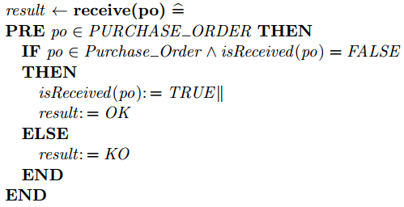
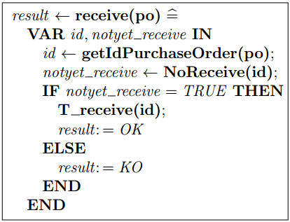
Behavioral refinement: an example
From an abstract B specification to a relational-like B implementation
An abstract specification
An implementation

Slide 51
Translation of an AspectJ implementation
Translation of the B specification into an executable code
Deployment of the class diagram
Deployment of the SecureUML diagram
Deployment of the secure activity diagrams
Deployment of the filter
Notes:
By applying these refinement rules, we obtain a b refined spec.
That we use to translate into an aspectj-based impl.
The translation consists of 4 parts according to 4 b specs.

Slide 52
Deployment of the class diagram
Translation of the B specification into an executable code
B functional specification
Data
SQL table
Java class
Operation
SQL stored procedure
Java method
DB
Att_{x1} | … | Att_{xn}
… | … | …
… | … | …
SP
(Class_{x:} Att_{x1},…,Att_{xn})
Notes:
From the b spec of the class diagram

Slide 53
Deployment of the SecureUML diagram
Translation of the B specification into an executable code
B static security specification
Java class
Static security check
Database connection
Database security
Users
Roles
Permissions
Role
Stored procedure
User assignments
User
Role
Notes:
From the b spec of the secureuml

Slide 54
Deployment of the SecureUML diagram
Translation of the B specification into an executable code
B static security specification
Java class
Static security check
Database connection
Database security
Users
Roles
Permissions
Role
Stored procedure
User assignments
User
Role

Slide 55
Deployment of the secure activity diagram
Translation of the B specification into an executable code
B dynamic specification
Log
Log table
Java class
Dynamic security check
Java method
DB
p_{x1} | … | p_{xn} | Actor | Time
… | … | … | … | …
… | … | … | … | …
(operation_{x:} p_{x1},…,p_{xn})
Notes:
From the b spec of the activity diagram

Slide 56
Deployment of the filter
Translation of the B specification into an executable code
Filter operation
Filter operation
AC filter
translate
AspectJ class
Pointcut
The protected method
Advice
(around)
Call the security checks
Execute the actual method
Call the log
Notes:
- Pointcut: Point out the place (method) where the security checks are injected.
- Advice: The code executed at the pointcut

Slide 57
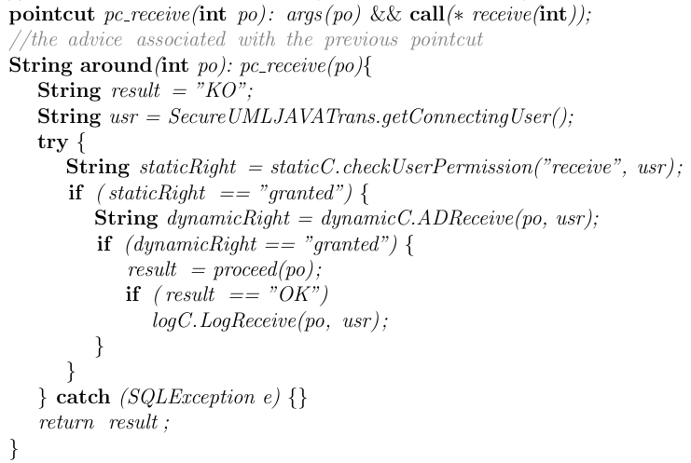
Deployment of the filter: an example
Translation of the B specification into an executable code

Slide 58
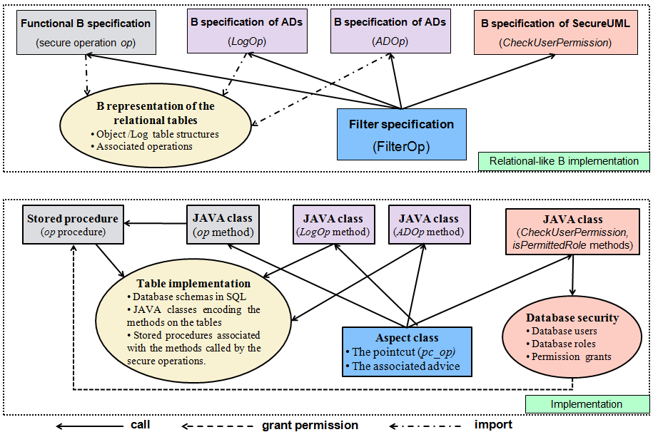
An AspectJ-based implementation
Translation of the B specification into an executable code

Slide 59
A support tool
Translation of the B specification into an executable code
An Eclipse plugin
Technologies: Xtext, Xpand
B grammars
Generator
B spec
Code
(Java/SQL/AspectJ)
Generator
B structure → SQL table
B operation → SQL stored procedure
Static specification → Database security
AC filter → AspectJ class
B operation → Java method
Notes:
To automate the translation, we built a tool using xtext and xpand.
First, we define grammars for b
and the generators from b to different languages
so from a b spec, the tool can generate java/sal/aspectj code according to the generator we choose
In particular, we can translate …

Slide 60
Conclusion
Translation of the B specification into an executable code
A systematic approach to generate an executable code:
Refine a proven B specification to a relational-like B implementation.
Translate the B implementation into an AspectJ-based program
The obtained code respects separation of concerns principles.
Automate the transformation.
Notes:
I’ve presented a systematic approach…

Slide 61
Outline
State of the art
Translation of UML-based models into B
Translation of B into an executable code
Conclusion and future work

Slide 62
Conclusion
Conclusion and future work
Specification of access control and functional requirements of a system using UML-based models.
Definition of mapping rules from these graphical models into a B specification.
Transformation of the abstract specification to a secure database-like implementation using the B refinement technique .
Definition of mapping rules from the refined B specification into an AspectJ-based program.
Development of tools to support the proposed approach .
Notes:
Our approach to build secure:
starts by …

Slide 63
Future work
Conclusion and future work
Short term:
Automate the refinement process
Experiment the developed tools for real-size systems
Long term:
Investigate the diversity of security concerns
Validate the transformation process
Notes:
In the future, we would like to automate the refinement process.
I think it’s possible since refinement rules are already formalized
we also want to experiment…
Long term:
- It would be interesting to consider other constraints, such as delegation, prerequisite, cardinality, and so on.
Validate the transformations process can be done by defining a merged metamodel of the source and the target metamodels, and defining a set of invariants

Slide 64
Publications
Thi Mai Nguyen, Amel Mammar, Regine Laleau and Samir Hameg, A tool for the generation of a secure access control filter, IEEE 10th International Conference on Research Challenges in Information Science, RCIS 2016, Grenoble, France, June 2016
Amel Mammar, Thi Mai Nguyen and Regine Laleau, Formal development of a secure access control filter, IEEE 17th International Symposium on High Assurance Systems Engineering, HASE 2016, Orlando, Florida, USA, January 2016.

Slide 65

Thank you for your attention!

Slide 66
Thank you!

