Slide 1
Notes:
First of all, I would like to thank all the members of the jury for being here, in my pdh defense today.
My thesis is about a MDE approach to build secure Iss.
It is supervised by Mss. Amel Mammar and Mrs. Regine Laleau

Slide 2

Information system
Introduction
Thesis context
Organizations use to collect, filter, process, create and distribute data.
Security properties should be taken into account ASAP.
Security
Notes:
My thesis work is in the context of developing trustworthy ISs.
We all know that Iss are now everywhere around us
Organizations use them to collect, exchange, and distribute information,
Even sensitive information
Therefore, protecting the sensitive data from unauthorized people is very important.
However, developers are reluctant to take into account non-functional requirements at the beginning of the development process.
In fact, this kind of requirements are often considered at the end of software development
Because:
They want to build the app ASAP
They are not security experts and
Security requirements are very complicated
There is a lack of tools supporting
But security constraints may relate to several the functionalities
Thus, if we consider security rules too late, the errors are detected too late
It is more difficult to fix it
And it is more costly: time and money

Slide 3
Objectives
Introduction
Thesis objectives
Specify security properties since the early development phases.
Static security rules are independent from the system’s states
e.g. Only doctors can validate medical records of patients
Dynamic security rules relate to the history of the system
e.g. To validate a medical record, the doctor should be present, in the hospital, since the arrival time of the patient.
Ensure their correct deployment on a given technological infrastructure.
Notes:
Our objectives are:
First, we want to deal with security requirement alongside with the functionalities of a system since the early development phases
Then, we want to make sure that the specified security requirements are correctly deployed.
MDE has been an promissing approach to
In the following I am going to present the motivations that inspired our work.

Slide 4
Combining graphical and formal notations (UML and B)
Introduction
Thesis motivation
This approach provides:
A graphical view of the system,
A precise specification for the validation/verification
Current approaches:
Automate the translation of UML into B
Focus on the functional requirements
The B4MSecure tool supports the functional and static access control requirements
We want to complement existing works with dynamic access control requirements.
Notes:
Our objectives are:
First, we want to deal with security requirement alongside with the functionalities of a system since the early development phases
Then, we want to make sure that the specified security requirements are correctly deployed.
MDE has been a promissing approach to
In the following I am going to present the motivations that inspired our work.

Slide 5

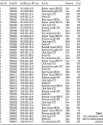

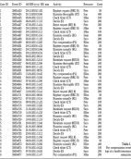

Security enforcement
Introduction
Thesis motivation
How to separately implement the functional logic and the security requirements?
Specified requirements
Developer
Notes:
Once security and functional requirements are specified, the development process consists in implementing them.
Our goal is to separate the security and functional codes so that the structure of the final system is clear and easy to maintain.
AOP stands out to be the best solution for our need.

Slide 6

Security enforcement
Introduction
Thesis motivation
Solution: Aspect Oriented Programming (AOP)
Current approaches:
Separate the functional code and the security code
Only in the implementation phase
Generate the security code from not-yet-verified models
We want to generate the code from a verified formal specification.
Notes:
Once security and functional requirements are specified, the development process consists in implementing them.
Our goal is to separate the security and functional codes so that the structure of the final system is clear and easy to maintain.
AOP stands out to be the best solution for our need.

Slide 7
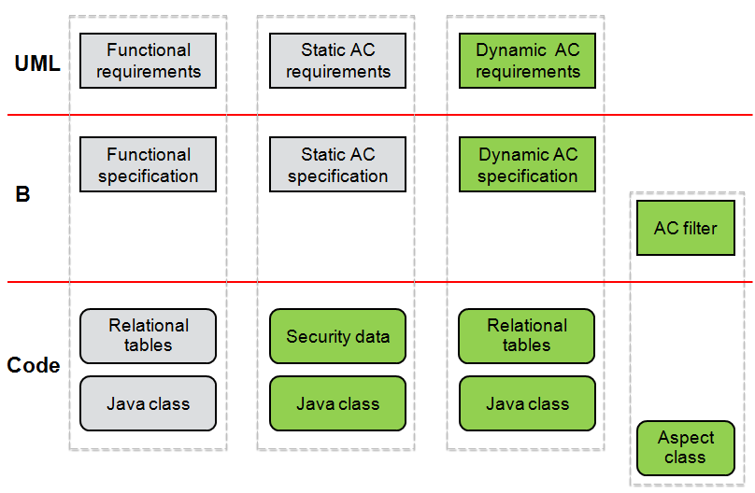
Specification of security design models
Introduction
Thesis contributions
We provide two views of functional/security requirements:
A graphical representation: UML
A formal representation: B
Notes:
Our approach covers the whole development life-cycle of secure systems:
it starts by graphically modeling the functional and security requirements.
the graphical models are then translated into formal specifications that are successively validated and verified.

Slide 8
Enforcement of access control policies
Introduction
Thesis contributions
Security enforcement code allows a separation of concerns:
Derived from the verified formal specification
Based on the AOP paradigm
Notes:
Our approach covers the whole development life-cycle of secure systems:
it starts by graphically modeling the functional and security requirements.
the graphical models are then translated into formal specifications that are successively validated and verified.

Slide 9
Enforcement of access control policies
Introduction
Thesis contributions
We automate the transformations:
UML to B
B to AspectJ/Java/SQL
Notes:
Our approach covers the whole development life-cycle of secure systems:
it starts by graphically modeling the functional and security requirements.
the graphical models are then translated into formal specifications that are successively validated and verified.

Slide 10
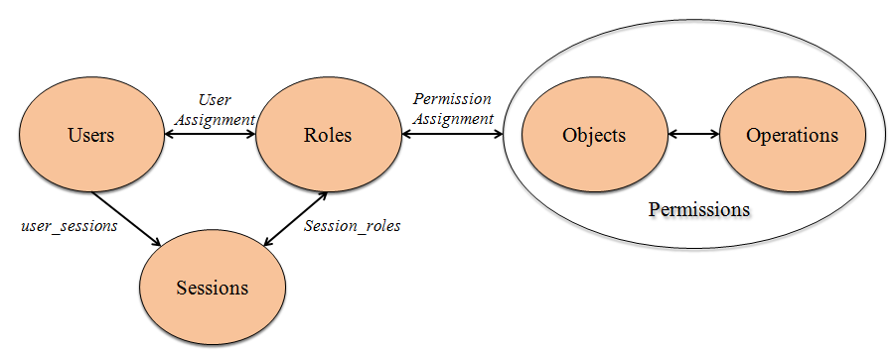
Role-Based Access Control
Introduction
Background
Notes:
(RBAC) is a de facto standard for controlling access to information systems, widely used in industrial projects
The idea is to regulate accesses to the resources of a system basing on the roles of the users.
RBAC permits to reduce the complexity and cost of security management within enterprises
The figure shows 5 basics elements of RBAC:
Users are the people using the system
Roles are job titles within organization
Permissions are the ability to perform operations on protected objects
Objects are potential resources to protect
Operations are actions through which users can perform on objects RBAC also introduces the concept of Sessions, which is associated with the dynamic aspect of RBAC. During a session, a user might activate one or many roles.
The central of RBAC is the concept of role relations, including User Assignment and Permission Assignment.

Slide 11
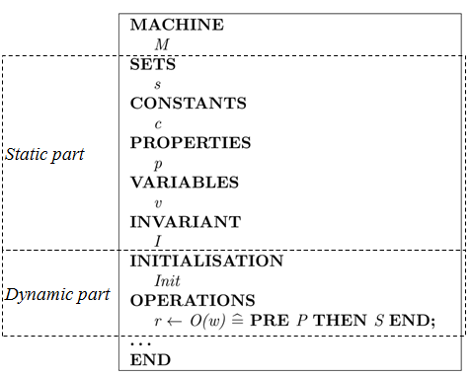
The B method
Introduction
Background
A formal language based on first order logic
Allow the modularity in software development
Provide different abstraction levels of a system via the refinement process.
Notes:
B specifications are organized in abstract machines.
Each machine contains the static and the dynamic parts:
The static part declares the state of a system in terms of sets, constants and variables
The INVARIANT clause permits to type the variables and to define the properties that they must always verify
The initialisation aims to set initial values for the variables.
The operations describe the evolution of a machine by modifying the state of that machine.
Operations are specified in the Generalized Substitution Language.
A substitution is like an assignment statement. It allows us to identify which variables are modified by an operation without mentioning the variables not modified.
Both specification and refinement steps give rise to proof obligations.
At the abstract level, proof obligations ensure that each operation maintains the invariant of the system,
whereas at the refinement level, they ensure that the transformation preserves the properties of the abstract level.

Slide 12
Outline
State of the art
Translation of UML-based models into B
Translation of the B specification into an executable code
Conclusion and future work
Notes:
For the rest of my presentation, I’m going to present…

Slide 13
Outline
State of the art
Security specification
Security enforcement
Translation of UML-based models into B
Translation of the B specification into an executable code
Conclusion and future work
Notes:
Regarding the state of the arts, i’m going to summarize 2 main topics related to our work

Slide 14
Security specification
State of the art
Security specification
UML/OCL–based approaches
Expressive
Limit in the automated analysis of security models
Validate security models only at the system’s current states
Alloy–based approaches
Automatically analyze security models using the Alloy Analyzer
Face the state space explosion problem since it is based on model-checking
Z–based approaches
Provide a clear structure of the specification using schemas
Lack tools supporting the automatic analysis
B–based approaches
Combine UML models and B formal specifications
The B4MSecure tool automatically translates UML into B
Not consider dynamic access control requirements
[Milhau et al., 2011] coped with dynamic access control requirements using ASTD (Algebraic State transition Diagram)
Translation of ASTD into B is very complicated
Notes:
For specifying security requirements of a system, we studied several approaches existing in the littérature:
The first one uses UML and OCL (Object Constraint Language) to express security constraints together with UML models. This technique is expressive. But it is lack of tools supporting the automatic analysis UML models and constraints. Moreover, the validation can only executed at snapshots of the systems.
The second approach investigates the use of Alloy for specifying security policies. Models written in Alloy can be automatically analyzed using the Alloy Analyzer.
However, the discussed solutions mainly focus on the static aspect of security. Dynamic access control policies are partially covered in some proposals.
Moreover, since the verification techniques of Alloy are based on model-checking, it is not efficient for analyzing large models. The explosion of the system state space is the main issue of the model-checking techniques that has to be tackled.
The other formal techniques reviewed are based on the Z notation. Z has been mostly used to write precise application specifications. One of the major drawback in using Z is the lack of tools supporting the analysis of the formalized model.
The work of Milhau et al. [11] based on the B method covers various types of access control requirements, including static and dynamic rules. These requirements also involve the functional aspect of the application.
Nonetheless, the use of ASTD only for visualizing security requirements may be too complicated. We believe that the visual representations of a system should be easily understandable/readable to disburden the communications among participants, i.e. the designer, the developer, and the end-user.
In our approach, we propose to model both functional and security requirements using UML-based models, and then translate them into B specifications.

Slide 15
Security enforcement
State of the art
Security enforcement
JAAS
An extension library to the Java Platform,
Separate the user authentication module from the application code
Separately develop the business program and security policies
The final system combines the functional code and the security code
Annotation-based approaches
Annotate the protected elements with roles in the program.
Declarative security enforcement
Cause the code tangling and scattering
AOP-based approaches:
Separate security concerns from the main program
Automatically merge them into the working system
Allow a separation of concerns
Dynamic security requirements are limited
Notes:
Regarding the security enforcement, we studied three main techniques:
Sun Microsystems has released a security framework and library called JAAS which enhances the Java platform with access control capabilities
In JAAS, the authentication is used to check who is running the system (called subject). Both users and computing services can represent subjects. Once authentication has been verified, JAAS provides an authorization check based on privileges (principles) associated with the authenticated subject. JAAS also allows enforcing access controls upon roles/groups just as they are with any principle.
Although the goal of JAAS is to isolate the user authentication module from the application code and treat it independently, the developer still needs to write code within the functional program in order to use methods of JAAS. As a result, the final program is tangled and scattered, thus it is difficult to maintain.
Another notable approach is to apply annotations in Java programs for security enforcement.
In particular, protected elements, such as classes, interfaces, and methods in the Java source code, are annotated with roles. Only the users who have at least one of the roles annotated on a method are permitted to access that method.
The enforcement of RBAC policies is performed dynamically by inserting runtime checks to verify that the current user has the adequate roles when the annotated method is called.
However, annotations are placed on protected elements in all over the program. It is remarkably difficult to know where a specific annotation should go, especially in large programs.
The problem about scattered and tangled code of the above approaches can be overcome by using AOP. Indeed, this paradigm allows to express separately multiple concerns and automatically merge them together into working systems.
To our best knowledge, none of the studies based on AOP consider dynamic security requirements (e.g. history-based and order-based constraints).
In this thesis, we propose a security enforcement approach that includes both static and dynamic security properties of an information system. The proposed aspect checks the permission of authenticated users as well as history-based and orderbased conditions associated to each method called by the users. Moreover, the security program is generated from a proved formal specification.

Slide 16
Outline
State of the art
Translation of UML-based models into B
From a functional model to B
From a static security model to B
From a dynamic security model to B
A support tool
Translation of the B specification into an executable code
Conclusion and future work
Notes:
In the following, i’m going to present the modeling of functional/static/dynamic security requirements, using UML diagrams.
And the translations of these models into B

Slide 17
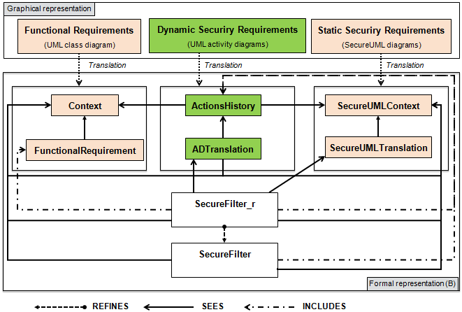
Approach
Translation of UML-based models into B
Notes:
In our approach, we use:
Class diagram to express functional requirements
secureUML to model static access control policies
AD to model dynamic security rule
These models are then translated into B machines.
As in the figure shows, the functional and static/dynamic security parts are treated separately and then they are linked together in a filter.
I will detail these translations in the next slides.

Slide 18
From a functional model to B
Translation of UML-based models into B
Adapt the translation rules in [R. Laleau and A. Mammar, 2000, 2006]

Slide 19
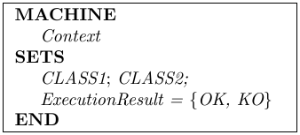
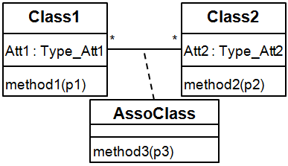
From a functional model to B
Mapping rules
UML class diagram
B machines
Class

Slide 20
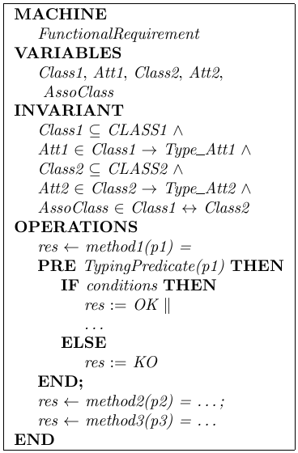
From a functional model to B
Mapping rules
UML class diagram
B machines
Class

Slide 21
From a functional model to B
Mapping rules
UML class diagram
B machines
Class
Attribute

Slide 22
From a functional model to B
Mapping rules
UML class diagram
B machines
Class
Attribute
Association class

Slide 23
From a functional model to B
Mapping rules
UML class diagram
B machines
Class
Attribute
Association class
Method

Slide 24
From a static security model to B
Translation of UML-based models into B
Translation of UML to B
Adapt the translation rules of the B4MSecure tool

Slide 25
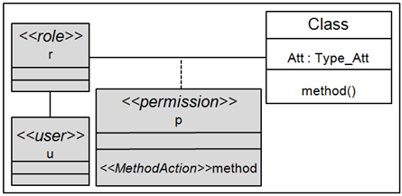
A SecureUML diagram
From a static security model to B
Modelling
An UML extension for modelling basic Role Based Access Control policies.
A SecureUML diagram specifies:
What is the protected resource?
Which roles are allowed to access the protected resource?
Who play the roles?

Slide 26
From a static security model to B
Mapping rules
SecureUML diagram
B machine
A set of roles
A set of users
The permission-role assignments
The user-role assignments

Slide 27
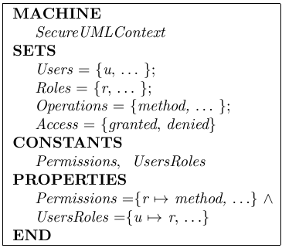
From a static security model to B
Mapping rules
SecureUML diagram
B machine

Slide 28
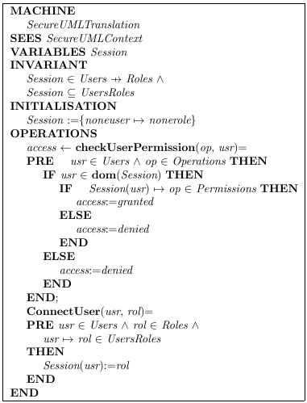
Static security check in B
From a static security model to B
Mapping rules
An additional B machine defines:
A variable gives the current roles of the users,
An operation activates a role of a user,
An operation checks the permission of a role on executing an operation

Slide 29
From a dynamic security model to B
Translation of UML-based models into B

Slide 30
A secure activity diagram
From a dynamic security model to B
Modelling
An UML extension for modelling dynamic security requirements.
These requirements can relate to:
history-based constraints
order-based constraints
user-based constraints
Notes:
It’s able to express:
- Which system’s states in the past must be taken into account at the requested moment?
- What is the order of these history states?
- Who is allowed or forbidden to access?

Slide 31
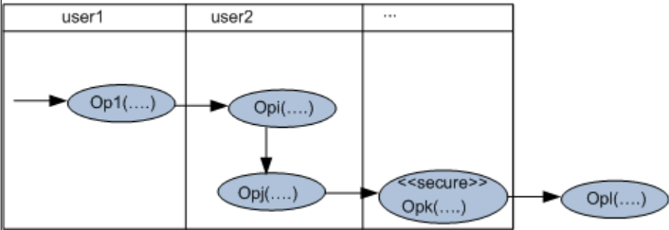
A secure activity diagram
From a dynamic security model to B
Modelling
Stereotype <<secure>> is applied to the protected action,
The preceded actions must be already performed,
Their execution order is modelled by the control flow,
The followed actions that should not be performed,
The actions executed by the same actor are placed in the same swim-lane.

Slide 32
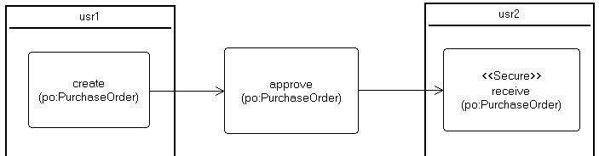
An example
From a dynamic security model to B
Modelling
Rule 1: A purchase order can be signed off to receive the goods only if it is approved. And its creation and its reception should be executed by two different people.

Slide 33

B log specification
From a dynamic security model to B
Mapping rules
Each action of a secure activity diagram derives:
Two variables: store the execution information:
The actor who performed the action,
The instant when the action is executed.
An operation: updates the value of these variables.
Op_{i}(p_{i1},...,p_{in})
Notes:
Because this kind of requirements relates to the history of the system, thus we define a log spec for each action.
It includes:

Slide 34
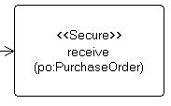
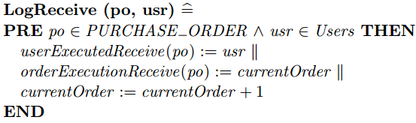
An example
From a dynamic security model to B
B log specification
translate
B variables:
B operation:

Slide 35
Dynamic security check in B
From a dynamic security model to B
Mapping rules
Each protected method derives a B operation:
Verify the execution history of the preceded methods,
Verify the execution history of the followed methods,
Verify the order execution of the preceded methods,
Verify the user-based constraints

Slide 36
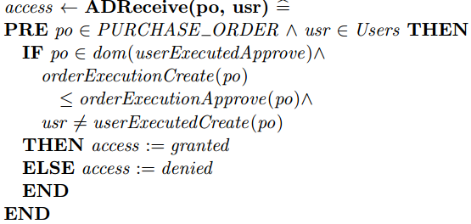
An example
From a dynamic security model to B
Dynamic security check in B
translate

Slide 37
An access control filter
Translation of UML-based models into B
Combining part
Represent the interaction of the functional and static/dynamic security specifications.
Define the access decision:
Verify static/dynamic security requirements before an actual execution,
Call the protected method,
Log the execution of the protected method.

Slide 38
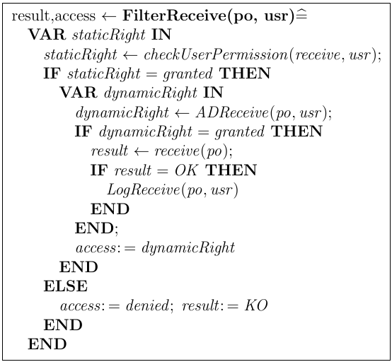
An example
Translation of UML-based models into B
An access control filter

Slide 39
A support tool
Translation of UML-based models into B
An existing work: the B4MSecure tool developed by the LIG laboratory [University of Grenoble]:
An Eclipse platform
Translate UML class diagram into B
Translate SecureUML into B
B4MSecure
UML
metamodel
B
metamodel
UML
model
B
model
generate
B machine

Slide 40
Extend the B4MSecure tool
Translation of UML-based models into B
A support tool
Tool
Translate UML class diagrams into the B functional specification
Translate SecureUML diagrams into the B static security specification
Translate UML activity diagrams into the B dynamic security specification
Generate the access control filter
Adapt mapping rules
Extend for dynamic security properties

Slide 41
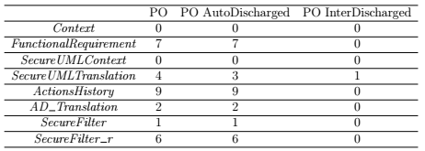
Proof obligations using AtelierB
Translation of UML-based models into B
Validation
Notes:
To verify the correctness of the obtained B specification, a set of proof obligations have been generated using the Proof Obligations Generator of AtelierB. This table gives the statistics of the proof phase where:
Let us note that these proof obligations ensure that all the properties expressed as invariants are satisfied and the development of the filter by refinement is also correct. 1. PO: denotes the number of proof obligations generated for each machine, 2. AutoDischarged PO: denotes the number of proof obligations automatically discharged by the provers of AtelierB without any human intervention, 3. PO InterDischarged: denotes the number of proof obligations interactively discharged. The intervention of the user is necessary for some proof obligations to help the prover find the rules to apply to discharge them.
For the running case study, the prover fails to automatically discharge only one proof obligation (for the machine SecureUMLTranslation) that we have interactively proved.

Slide 42
Animation with ProB
Translation of UML-based models into B
Validation
Rule 1: A purchase order can be signed off to receive the goods only if it is approved. And its creation and its reception should be executed by two different people.
Scenarios:
Tom logs in to the system,
Tom creates a purchase order po,
Tom tries to receive the purchase order po.
Notes:
to check the security rules, we animate the specification using the ProB [96] animator by applying several scenarios:
As expected, the last action fails since the access is denied.

Slide 43
Conclusion
Translation of UML-based models into B
Specify functional and static/dynamic security requirements using UML-based diagrams:
UML class diagrams for the functional requirements,
SecureUML diagrams for static security requirements,
Secure activity diagrams for dynamic security requirements.
Translate the graphical models into a B specification.
Automate the translation.

Slide 44
Outline
State of the art
Translation of UML-based models into B
Translation of the B specification into an executable code
From an abstract B specification to a relational-like B implementation
Translation of an AspectJ implementation
A support tool
Conclusion and future work

Slide 45
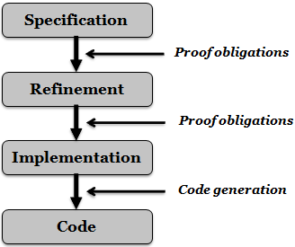
Approach
Translation of the B specification into an executable code
An abstract B specification can be refined until it is close to a target language.
The AOP paradigm allows a separation of concerns.
We propose:
Refine the B specification into a relational-like implementation
Map the final B refinement into an AspectJ-based program connected to the database.

Slide 46
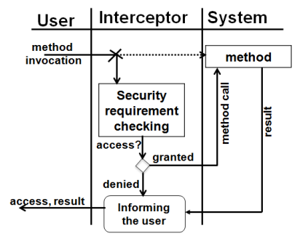
AspectJ
Background
Joinpoint: a position where the additional code is injected
Pointcut: a set of joinpoints
Advice: implement code at each joinpoint specified in a pointcut
Aspect: includes pointcuts and advices

Slide 47
From an abstract B specification to a relational-like B implementation
Translation of the B specification into an executable code
Reuse the refinement rules in [A. Mammar, 2006]:
Data refinement
Behavioral refinement
Notes:
At this step, I present the refinement process to obtain a relational-like B implementation from the previous abstract specification. To do so, we mainly reuse the B refinement process defined in [104]. It consists of two main steps: Data refinement and Behavioral refinement.
The goal of the data refinement process is to transform the variables of the B specification in order to be close to the structure of the tables used in relational databases,
whereas the behavioral refinement aims at replacing the parallel substitutions with sequential ones and eliminating preconditions since they are supported neither in JAVA nor in SQL languages.

Slide 48
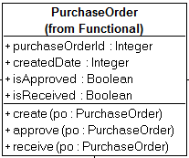
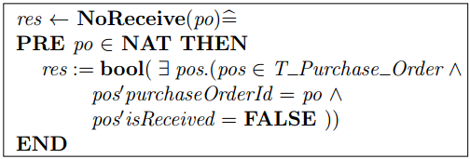
Data refinement
Translation of the B specification into an executable code
From an abstract B specification to a relational-like B implementation
Define a table structure gathering the different information related to an entity.
An example:
Define additional operations acting on the new variable
An example:

Slide 49
Behavioral refinement
From an abstract B specification to a relational-like B implementation
Replace substitution/predicate/expression with call to the operations acting on the structure variables.
Eliminate the preconditions
Replace the parallel operator with the sequentail one.
Notes:
The variables of the first level have been replaced by new ones to represent the relational tables.
This is why we have to replace each substitution/predicate/expression of the initial variables with call to the operations acting on the new variables.
all the preconditions can be eliminated since they are just typing constraints and then are already assumed as true.
the sequential operator is introduced to replace the parallel one.

Slide 50
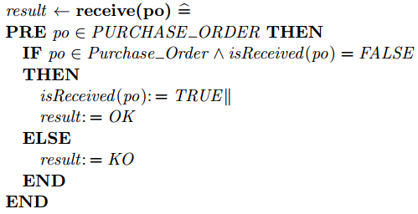
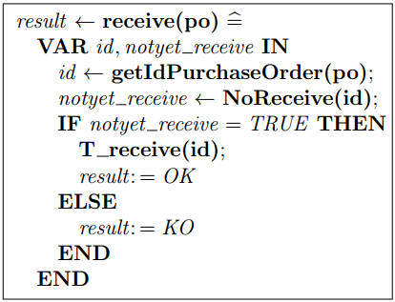
Behavioral refinement: an example
From an abstract B specification to a relational-like B implementation
An abstract specification
An implementation

Slide 51
Translation of an AspectJ implementation
Translation of the B specification into an executable code
Deployment of the class diagram
Deployment of the SecureUML diagram
Deployment of the secure activity diagrams
Deployment of the filter

Slide 52
Deployment of the class diagram
Translation of the B specification into an executable code
B functional specification
Data
SQL table
Java class
Operation
SQL stored procedure
Java method
DB
Att_{x1} | … | Att_{xn}
… | … | …
… | … | …
SP
(Class_{x:} Att_{x1},…,Att_{xn})

Slide 53
Deployment of the SecureUML diagram
Translation of the B specification into an executable code
B static security specification
Java class
Static security check
Database connection
Database security
Users
Roles
Permissions
Role
Stored procedure
User assignments
User
Role

Slide 54
Deployment of the SecureUML diagram
Translation of the B specification into an executable code
B static security specification
Java class
Static security check
Database connection
Database security
Users
Roles
Permissions
Role
Stored procedure
User assignments
User
Role

Slide 55
Deployment of the secure activity diagram
Translation of the B specification into an executable code
B dynamic specification
Log
Log table
Java class
Dynamic security check
Java method
DB
p_{x1} | … | p_{xn} | Actor | Time
… | … | … | … | …
… | … | … | … | …
(operation_{x:} p_{x1},…,p_{xn})

Slide 56
Deployment of the filter
Translation of the B specification into an executable code
Filter operation
Filter operation
AC filter
translate
AspectJ class
Pointcut
The protected method
Advice
(around)
Call the security checks
Execute the actual method
Call the log
Notes:
- Pointcut: Point out the place (method) where the security checks are injected.
- Advice: The code executed at the pointcut

Slide 57
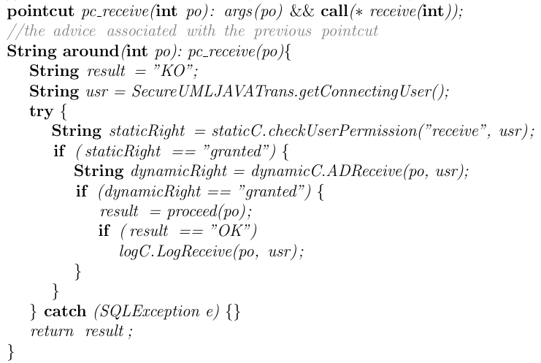
Deployment of the filter: an example
Translation of the B specification into an executable code

Slide 58
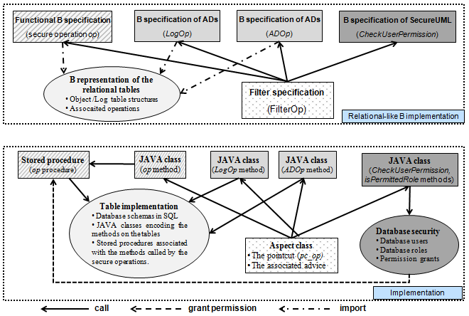
An AspectJ-based implementation
Translation of the B specification into an executable code

Slide 59
A support tool
Translation of the B specification into an executable code
An Eclipse plugin
Technologies: Xtext, Xpand
B grammars
Generator
B spec
Code
(Java/SQL/AspectJ)
Generator
B structure → SQL table
B operation → SQL stored procedure
Static specification → Database security
AC filter → AspectJ class
B operation → Java method

Slide 60
Conclusion
Translation of the B specification into an executable code
A systematic approach to generate an executable code:
Refine a proven B specification to a relational-like B implementation.
Translate the B implementation into an AspectJ-based program
The obtained code respects separation of concerns principles.
Automate the transformation.
Notes:
The process is done through 2 steps:
Refine the verified B specification to a relational-like B implementation.
translate the B implementation into an AspectJ-program

Slide 61
Outline
State of the art
Translation of UML-based models into B
Translation of B into an executable code
Conclusion and future work

Slide 62
Conclusion
Conclusion and future work
Specified access control and functional requirements of a system using UML-based models.
Defined mapping rules of these graphical models into a B specification.
Applied the B refinement technique to transform the abstract specification to a secure database-like implementation.
Defined mapping rules of the refined B specification into an AspectJ-based program.
Developed tools to support the proposed approach .

Slide 63
Future work
Conclusion and future work
Short term:
Automate the refinement process,
Validate the transformation process.
Long term:
Investigate the diversity of security concerns,
Experiment the developed tools for real-size systems.
Notes:
Validate the transformations process can be done by defining a merged metamodel of the source and the target metamodels, and defining a set of invariants.
It would be interesting to consider other constraints, such as delegation, prerequisite, cardinality, and so on.
We are aware that adding new kinds of security requirements will bring new challenges. But we are confident that the benefits of our approach will help us dealing with it.
Indeed, our approach allows the modularity of different aspects throughout the development life-cycle: from the design phase to the implementation phase. As a result, additional security constraints can enhance the safety and security of a system without having a remarkable impact on the existing components.
To take into account new types of security constraints, other UML-based diagrams may be necessary, for example, sequence diagrams and state diagrams.
A set of translation rules is also required for the transformations from graphical models into B and from B specifications into Java/SQL.

Slide 64
Publications
Thi Mai Nguyen, Amel Mammar, Regine Laleau and Samir Hameg, A tool for the generation of a secure access control filter, IEEE 10th International Conference on Research Challenges in Information Science, RCIS 2016, Grenoble, France, June 2016
Amel Mammar, Thi Mai Nguyen and Regine Laleau, Formal development of a secure access control filter, IEEE 17th International Symposium on High Assurance Systems Engineering, HASE 2016, Orlando, Florida, USA, January 2016.

Slide 65

Thank you for your attention!

Slide 66
Thank you!

