Slide 1
Notes:
First of all, I would like to thank all the members of the jury for being here, in my pdh defense today.
My thesis is about a MDE approach to build secure Iss.
It is supervised by Mss. Amel Mammar and Mrs. Regine Laleau

Slide 2





Information system
Introduction
Thesis context
Organizations use to collect, filter, process, create and distribute data.
Challenge: security (who, when, where information is accessible?)
Security concerns should be taken into account ASAP.
Notes:
My thesis work is in the context of developing trustworthy ISs.
We all know that Iss are now everywhere around us
Organizations use them to collect, exchange, and distribute information,
Even sensitive information
Therefore, protecting the sensitive data from unauthorized people is very important.
However, developers are reluctant to take into account non-functional requirements at the beginning of the development process.
In fact, this kind of requirements are often considered at the end of software development
Because:
They want to build the app ASAP
They are not security experts and
Security requirements are very complicated
There is a lack of tools supporting
But security constraints may relate to several the functionalities
Thus, if we consider security rules too late, the errors are detected too late
It is more difficult to fix it
And it is more costly: time and money

Slide 3
Goals
Introduction
Thesis objectives
Define adequate security policies since the early development phases.
Static security rule
e.g. Only doctors can validate medical records of patients
Dynamic security rule
e.g. A person cannot borrow a book before being registered.
Ensure their correct deployment on a given technological infrastructure.
Notes:
Our objectives are:
First, we want to deal with security requirement alongside with the functionalities of a system since the early development phases
Then, we want to make sure that the specified security requirements are correctly deployed.
MDE has been an promissing approach to
In the following I am going to present the motivations that inspired our work.

Slide 4
Combing graphical and formal notations
Introduction
Thesis motivation
Graphical notations (UML)
Formal methods (B)
Advantage:
Intuative view
Facilatate the communication between stakeholders
Disadvantage:
Inacdequate semantics
It may lead to undired interpretations
Advantage:
Precise semantics
Validate/Verify the considered specification
Disadvantage:
Mathematical logic
It is difficult to understand and use.
Notes:
UML has been a standard modeling lanuage in software engineering:
UML models provide a graphical view of the system,
Stakeholders use them to communicate to each other,
However, their semantics are imprecise enough that may easily lead to confusions or wrong interpretations.
On the other hand, formal languages have precise semantics that aim to the validation and the verification of the considered system.
Therefore, the combination of formal and graphical techniques can produce specifications which, on one hand, can be understood and then validated by participants (e.g.developers, designers, and users) and, on the other hand, can be formally verified using the different tools available for formal methods
We are interested precisely in the B method
as it is a complete formal language,
and it has been used in many industrial projects, especially in railway systems (Metro line 14, the Charles de Gaule airport shuttle automated pilot, etc.).
Moreover, it has reliable free tools (AtelierB [25], ProB [26]) to support the whole software development process.

Slide 5

Security enforcement
Introduction
Thesis motivation
I want to focus on the functionalities of the system.
Developer
I want to focus on security policies.
Security expert
How to program a clear application which can be easily traced and maintained?
Aspect Oriented Programming
Notes:
Once security and functional requirements are specified, the development process consists in implementing them.
Our goal is to separate the security and functional codes so that the structure of the final system is clear and easy to maintain.
AOP stands out to be the best solution for our need.

Slide 6
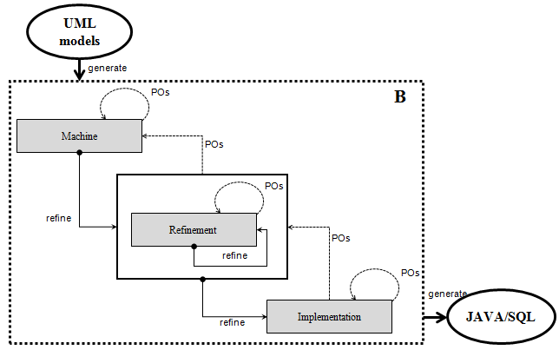
Specification of security design models
Introduction
Thesis contributions
We provide two views of functional/security requirements:
Graphical representation: UML
Formal representation: B
Notes:
Our approach covers the whole development life-cycle of secure systems:
it starts by graphically modeling the functional and security requirements.
the graphical models are then translated into formal specifications that are successively validated and verified.

Slide 7
Enforcement of access control policies
Introduction
Thesis contributions
We provide a security enforcement technique that allows a separation of concerns:
Derived from the refined formal specification
Based on the AOP paradigm
Notes:
3. the proved specifications are in turn refined until it is possible to straightforwardly map them into an AOP-based program.

Slide 8
Automation of the languages transformations
Introduction
Thesis contributions
We automate the transformations of:
UML to B
B to AspectJ/Java/SQL
Notes:
4. finally, we build a tool that supports the models transformations.
Basically, we can automatically derive the B specification from the UML models of a systems
And the code from the refined B specification.

Slide 9
Outline
State of the art
Translation of system-design models into B
Translation of the B specification into AOP-based application
Conclusion and future work
Notes:
For the rest of my presentation, I’m going to present…

Slide 10
Outline
State of the art
Security specification
Security enforcement
Translation of system-design models into B
Translation of the B specification into AOP-based application
Conclusion and future work

Slide 11
Security specification
State of the art
Security specification
UML/OCL–based approaches [3, 4, 5, 6, 7, 8, 49, 53]
Limit in the automated analysis of security models
Validation is performed at the system’s current states
Alloy–based approaches [9, 10, 54, 55]
Focused on static security requirements
Explode the state space since it is based on model-checking
Z–based approaches [24, 57, 58, 59, 60]
Lack of tool supporting the analysis
B–based approach [similar work 11]
Translation of Algebraic State transition Diagram (ASTD) into B is very complicated (ASTD is used to model history-based requirement)
Notes:
For specifying security requirements of a system, we studied several approaches existing in the littérature:
The first one uses UML and OCL (Object Constraint Language) to express security constraints together with UML models. This technique is expressive. But it is lack of tool supporting the automatic analysis UML models and constraints. Moreover, the validation can only executed at snapshots of the systems.
The second approach investigates the use of Alloy for specifying security policies. Models written in Alloy can be automatically analyzed using the Alloy Analyzer.
However, the discussed solutions mainly focus on the static aspect of security. Dynamic access control policies are partially covered in some proposals.
Moreover, since the verification techniques of Alloy are based on model-checking, it is not efficient for analyzing large models. The explosion of the system state space is the main issue of the model-checking techniques that has to be tackled.
The other formal techniques reviewed are based on the Z notation. Z has been mostly used to write precise application specifications. One of the major drawback in using Z is the lack of tools supporting the analysis of the formalized model.
The work of Milhau et al. [11] based on the B method covers various types of access control requirements, including static and dynamic rules. These requirements also involve the functional aspect of the application.
Nonetheless, the use of ASTD only for visualizing security requirements may be too complicated. We believe that the visual representations of a system should be easily understandable/readable to disburden the communications among participants, i.e. the designer, the developer, and the end-user.
In our approach, we propose to model both functional and security requirements using UML-based models, and then translate them into B specifications.

Slide 12
Synthesis
State of the art
Security specification
Approaches | Authorization | SSD | DSD | V/V w.r.t .functional models | Tool
UML-OCL based approaches
[3, 7] | + | - | - | - | -
[4] | + | + | - | + | RAE
[5, 6] | + | + | + | - | -
[49] | + | + | + | - | USE
[8, 53] | + | + | - | + | SecureMOVA
Alloy-based approaches
[9, 47] | + | + | + | + | Alloy analyzer
[10] | + | + | - | + | Alloy analyzer
[54] | + | + | - | - | Alloy analyzer
[55] | + | + | - | - | Alloy analyzer
Z-based approaches
[24] | + | - | - | + | Jaza
[58] | + | + | + | - | Z/EVES
[60] | + | + | - | - | -
B-based approach
[11] | + | + | + | + | AtelierB/ProB
SSD/DSD: Static/Dynamic Separation of duty, V/V: Validate/Verify, w.r.t: with respect to
Notes:
This table summarizes the approaches and shows the diversity of access control constraints they covered.
Note that:
authorization: who has right to access?
A SSD constraint can be defined during the assignment of users to roles. For example, we may want to state that two conflict roles should not be assigned to the same user.
a DSD policy should be verified during the execution of the system. For instance, a user is allowed to activate two exclusive roles independently but it is prohibited to activate them simultaneously.
From this table we can see that static access control, e.g. authorization and SSD, are widely investigated. Whereas, dynamic access control rules like DSD are partially covered in some works.
The validation and verification of security models are mostly performed without considering the functional model.
except for UML/OCL approaches but they concern only the current states of the systems

Slide 13
Security enforcement
State of the art
Security enforcement
JAAS
Separately develop the bussiness program and security policies
Functional code and security code have to be combined in the final system
Annotation-based approaches [69, 70]
Declarative security enforcement
Cause the code tangling and scattering
AOP-based approaches (modeling [71, 72, 73], enforcement [15, 30, 31, 32, 33, 74])
Allow a separation of concerns
Dynamic security requirements are limited
Notes:
Regarding the security enforcement, we studied three main techniques:
Sun Microsystems has released a security framework and library called JAAS which enhances the Java platform with access control capabilities
In JAAS, the authentication is used to check who is running the system (called subject). Both users and computing services can represent subjects. Once authentication has been verified, JAAS provides an authorization check based on privileges (principles) associated with the authenticated subject. JAAS also allows enforcing access controls upon roles/groups just as they are with any principle.
Although the goal of JAAS is to isolate the user authentication module from the application code and treat it independently, the developer still needs to write code within the functional program in order to use methods of JAAS. As a result, the final program is tangled and scattered, thus it is difficult to maintain.
Another notable approach is to apply annotations in Java programs for security enforcement.
In particular, protected elements, such as classes, interfaces, and methods in the Java source code, are annotated with roles. Only the users who have at least one of the roles annotated on a method are permitted to access that method
The enforcement of RBAC policies is performed dynamically by inserting runtime checks to verify that the current user has the adequate roles when the annotated method is called.
However, annotations are placed on protected elements in all over the program. It is remarkably difficult to know where a specific annotation should go, especially in large programs.
The problem about scattered and tangled code of the above approaches can be overcome by using AOP. Indeed, this paradigm allows to express separately multiple concerns and automatically merge them together into working systems.
To our best knowledge, none of the studies based on AOP consider dynamic security requirements (e.g. history-based and order-based constraints).
In this thesis, we propose a security enforcement approach that includes both static and dynamic security properties of an information system. The proposed aspect checks the permission of authenticated users as well as history-based and orderbased conditions associated to each method called by the users. Moreover, the security program is generated from a proved formal specification.

Slide 14
Conclusion
State of the art
Security specification
Partially validate: UML/OCL-based approaches
Difficult to understand: Z/Alloy-based approaches
Combining graphical and formal notations: Milhau et al. (2011)
Security enforcement
Dynamic security constraints are partially investigated.
AOP-based approaches allow to separate the security and bussiness code of a system:
Notes:
To sum up, in our approach we want take security requirements into account together with the functional requirements of a system since the design phase of softare development.
We want to define them in a unified language such as B in order to validate the correctness and the interaction of these requirements using available tools (AtelierB, ProB).
We have been inspired from the combining graphical and formal notations approaches that are proposed to specify both functional and non-functional requirements.
For the security enforcement, we aim at separating security and application code of the system.

Slide 15
Outline
Outline
State of the art
Translation of system-design models into B
A functional model to B
A static security model to B
A dynamic security model to B
A tool support
Translation of the B specification into AOP-based application
Conclusion and future work

Slide 16
Motivations
Translation of system-design models into B
UML is a standard modeling language in software development, but UML models are often the source of ambiguities.
The B method has been successfully applied in industrial critical-safety systems.
→ We propose:
model both functional and static/dynamic security requirements using UML diagrams
translate these models into B for the validation and verification
Notes:
- UML has been a standard modeling language in software development

Slide 17
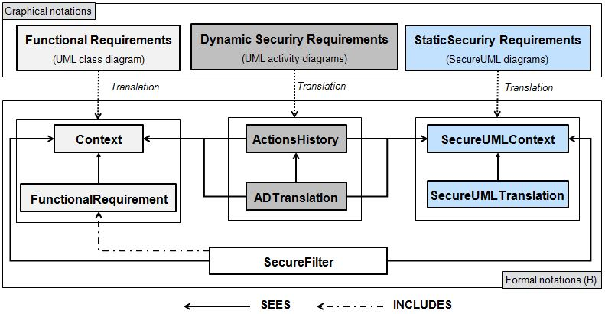
Approach
Translation of system-design models into B

Slide 18
1. A functional model to B
Translation of system-design models into B

Slide 19
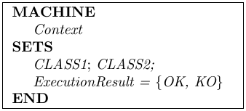
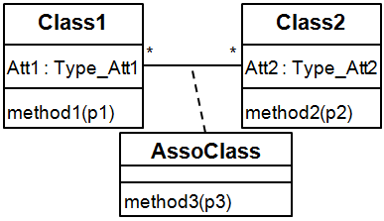
A functional model to B
Mapping rules
UML class diagram
B machines
Class

Slide 20
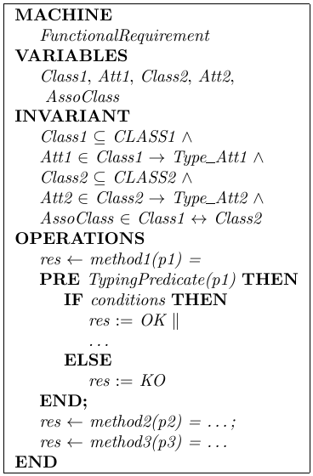
A functional model to B
Mapping rules
UML class diagram
B machines
Class

Slide 21
A functional model to B
Mapping rules
UML class diagram
B machines
Class
Attribute

Slide 22
A functional model to B
Mapping rules
UML class diagram
B machines
Class
Attribute
Association class

Slide 23
A functional model to B
Mapping rules
UML class diagram
B machines
Class
Attribute
Association class
Method

Slide 24
2. A static security model to B
Translation of system-design models into B
Translation of UML to B

Slide 25
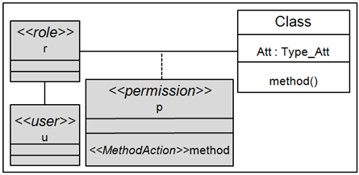
A SecureUML diagram
A static security model to B
Modelling
An UML extension for modeling basic Role Based Access Control policies.
These static security policies concern:
What is the protected resource?
Which roles are allowed to access the protected resource?
Who play the roles?

Slide 26
A static security model to B
Mapping rules
SecureUML diagram
B machines
A set of roles
A set of users
The permission-role assignment
The user-role assignment

Slide 27
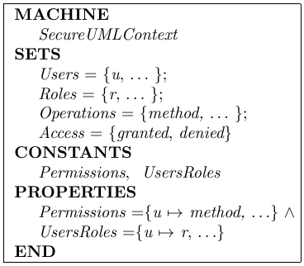
A static security model to B
Mapping rules
Static security policies in B
SecureUML diagram
B machines

Slide 28
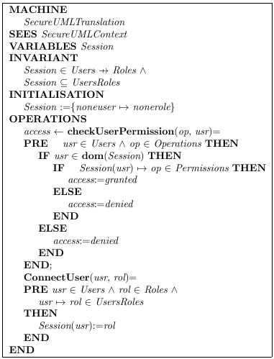
Static security checking in B
A static security model to B
Mapping rules
The B specification of the static security model includes:
A B operation that connects a user with a role,
A B operation that checks a permission of a given role.

Slide 29
3. A dynamic security model to B
Translation of system-design models into B

Slide 30
A secure activity diagram
A dynamic security model to B
Modelling
An UML extension for modeling dynamic security requirements.
These requirements relate to:
history-based constraints:
order-based constraints
user-based constraints
Which system’s states in the past must be taken into account at the requested moment?
What is the order of these history states?
Who is allowed or forbidden to access?

Slide 31
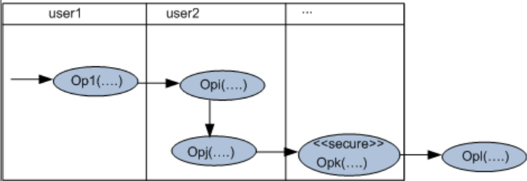
A secure activity diagram
A dynamic security model to B
Modelling
Stereotype <<secure>> applied to the protected action,
The preceded methods represent the history actions that must be already performed,
The order of the history actions is expressed by the control flow,
The methods placed after the protected method represent the actions that should not be performed,
The actions executed by the same actor are placed in the same swimlane.

Slide 32
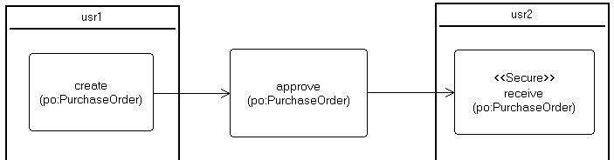
An example
A dynamic security model to B
Modelling
Rule 1: A purchase order can be signed off to receive the goods only if it is approved. And its creation and its reception should be executed by two different people.

Slide 33

B log specification
A dynamic security model to B
Mapping rules
Each action of a secure activity diagram derives:
Variables that store the execution of the actions in a secure activity diagram:
The actor who performed the action,
The instant when the action is executed.
An operation that updates its execution:
Op_{i}(p_{i1},...,p_{in})

Slide 34
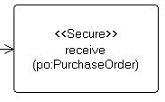
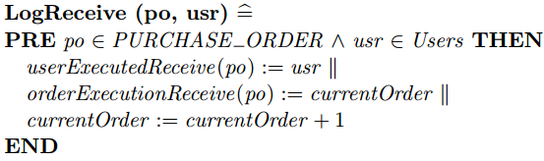
An example
A dynamic security model to B
B log specification
translate
B variables:
B operation:

Slide 35
Dynamic security checking in B
A dynamic security model to B
Mapping rules
Each protected method derives a dynamic security checking B operation:
Verify the execution history of the preceded methods,
Verify the order execution of the preceded methods,
Verify the actor constraints

Slide 36
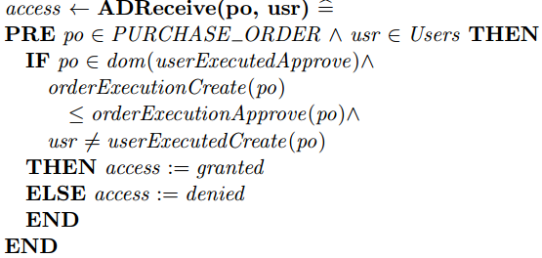
An example
A dynamic security model to B
Dynamic security checking in B
Each protected method derives a dynamic security checking B operation:
Verify the execution history of the preceded methods,
Verify the order execution of the preceded methods,
Verify the actor constraints
translate

Slide 37
4. An access control filter
Translation of system-design models into B
Combining part
Represent the interaction of the functional and static/dynamic security specifications.
Define the access decision by:
Verify static/dynamic security constraints before an actual execution,
Call the actual method,
Log the execution of the called method.

Slide 38
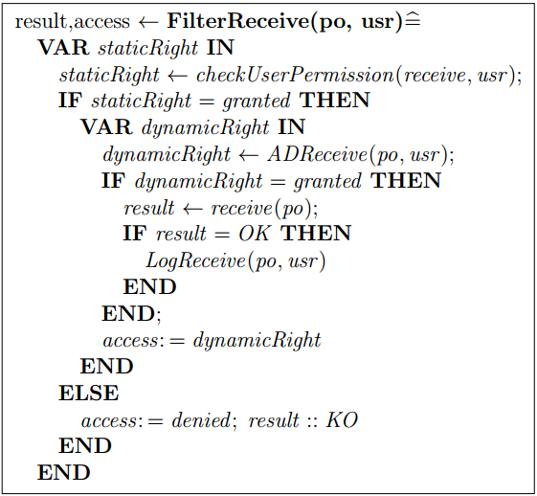
An example
Translation of system-design models into B
An access control filter

Slide 39
Motivation
Translation of system-design models into B
A tool support
The B4MSecure tool:
An Eclipse platform
Translate UML class diagram into B
Translate SecureUML into B
B4MSecure
UML metamodel
B
metamodel
UML
model
B
model
generate
B machine

Slide 40
UML to B
Translation of system-design models into B
A tool support
Extend the B4MSecure tool:
Adapt mapping rules of the functional and SecureUML models into B,
Extend for dynamic security properties
Features
Translate UML class diagrams into the B functional specification
Translate SecureUML diagrams into the B static security specification
Translate UML activity diagrams into the B dynamic security specification
Generate the access control filter

Slide 41
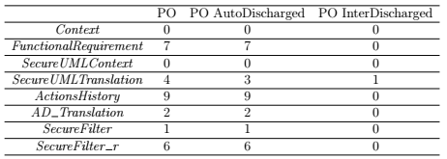
Proof obligations using AtelierB
Translation of system-design models into B
Validation
Notes:
To verify the correctness of the obtained B specification, a set of proof obligations have been generated using the Proof Obligations Generator of AtelierB. This table gives the statistics of the proof phase where:
Let us note that these proof obligations ensure that all the properties expressed as invariants are satisfied and the development of the filter by refinement is also correct. 1. PO: denotes the number of proof obligations generated for each machine, 2. AutoDischarged PO: denotes the number of proof obligations automatically discharged by the provers of AtelierB without any human intervention, 3. PO InterDischarged: denotes the number of proof obligations interactively discharged. The intervention of the user is necessary for some proof obligations to help the prover find the rules to apply to discharge them.
For the running case study, the prover fails to automatically discharge only one proof obligation (for the machine SecureUMLTranslation) that we have interactively proved.

Slide 42
Animation with ProB
Translation of system-design models into B
Validation
Rule 1: A purchase order can be signed off to receive the goods only if it is approved. And its creation and its reception should be executed by two different people.
Scenarios:
Tom logs in to the system,
Tom create the purchase order po,
Tom tries to receive the purchase order.
Notes:
to check the security rules, we animate the specification using the ProB [96] animator by applying several scenarios:
As expected, the last action fails since the access is denied.

Slide 43
Conclusion
Translation of system-design models into B
We have specified functional and static/dynamic security requirements using UML-based diagrams:
UML class diagram for the functional requirements,
SecureUML diagram for static security rules,
Secure activity diagram for dynamic security rules.
The graphical models are translated into a B specification:
Prove their correctness
Verify their interactions
This transformation is automated.

Slide 44
Outline
Outline
State of the art
Translation of system-design models into B
Translation of the B specification into an AOP-based application
From an abstract B specification to a relational-like B implementation
The AspectJ implementation of the application
Automate the translation
Conclusion and future work

Slide 45
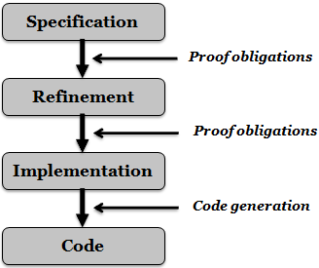
Motivations
Translation of B to JAVA/SQL/AspectJ
An abstract B specification can be refined until it is close to a target language.

Slide 46
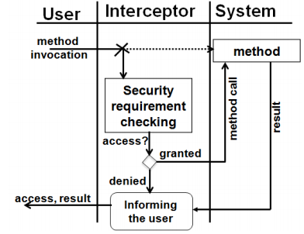
Motivations
Translation of B to JAVA/SQL/AspectJ
An abstract B specification can be refined until it is close to a target language.
The AOP paradigm allows a separation of concerns.

Slide 47
Motivations
Translation of B to JAVA/SQL/AspectJ
An abstract B specification can be refined until it is close to a target language.
The AOP paradigm allows a separation of concerns.
→ We propose to refine the previous obtained B specification until its implementation is close to an AspectJ-based program.

Slide 48
Approach
Translation of B to JAVA/SQL/AspectJ
Refine the B specification into a relational-based implementation
Map the final B refinement into an AspectJ-based application connected to the database.

Slide 49
1. From an abstract B specification to a relational-like B implementation
Translation of B to JAVA/SQL/AspectJ
The refinement process [A. Mammar, 2006]:
Data refinement
Goal: SQL table
Behavioral refinement:
Replace the parallel substitutions with sequential ones
Eliminate preconditions
Notes:
At this step, I present the refinement process to obtain a relational-like B implementation from the previous abstract specification. To do so, we mainly reuse the B refinement process defined in [104]. It consists of two main steps: Data refinement and Behavioral refinement.
The goal of the data refinement process is to transform the variables of the B specification in order to be close to the structure of the tables used in relational databases,
whereas the behavioral refinement aims at replacing the parallel substitutions with sequential ones and eliminating preconditions since they are supported neither in JAVA nor in SQL languages.

Slide 50
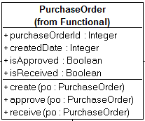
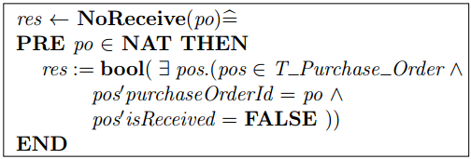
1.1. Data refinement
Translation of B to JAVA/SQL/AspectJ
From an abstract B specification to a relational-like B implementation
Define a table structure gathering the different information related to an entity.
An example:
Define additional operations acting on the new variable
An example:

Slide 51
1.2. Behavioral refinement
Translation of B to JAVA/SQL/AspectJ
From an abstract B specification to a relational-like B implementation
Replace each substitution/predicate/expression of the initial variables with call to the operations acting on the structure variables.
Eliminate the preconditions
Replace the parallel operator with the sequentail one.
Notes:
The variables of the first level have been replaced by new ones to represent the relational tables.
This is why we have to replace each substitution/predicate/expression of the initial variables with call to the operations acting on the new variables.
all the preconditions can be eliminated since they are just typing constraints and then are already assumed as true.
the sequential operator is introduced to replace the parallel one.

Slide 52
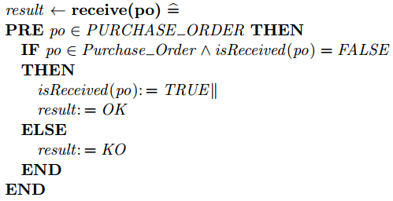
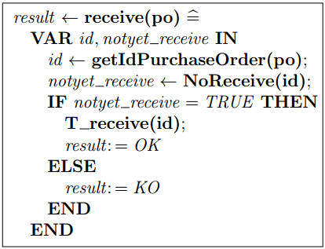
1.2. Behavioral refinement: an example
Translation of B to JAVA/SQL/AspectJ
From an abstract B specification to a relational-like B implementation
An abstract specification
An implementation
Notes:
The variables of the first level have been replaced by new ones to represent the relational tables.
This is why we have to replace each substitution/predicate/expression of the initial variables with call to the operations acting on the new variables.
all the preconditions can be eliminated since they are just typing constraints and then are already assumed as true.
the sequential operator is introduced to replace the parallel one.

Slide 53
2. The AspectJ implementation of the application
Translation of B to JAVA/SQL/AspectJ
Deployment of the class diagram
Deployment of the SecureUML diagram
Deployment of the secure activity diagrams
Deployment of the filter

Slide 54
2.1. Deployment of the class diagram
Translation of B to JAVA/SQL/AspectJ
The AspectJ implementation of the application
Abstract B functional spec
Data
SQL table
Java class
Operation
SQL stored procedure
Java method
DB
Att_{x1} | … | Att_{xn}
… | … | …
… | … | …
SP
(Class_{x:} Att_{x1},…,Att_{xn})

Slide 55
2.2. Deployment of the SecureUML diagram
Translation of B to JAVA/SQL/AspectJ
The AspectJ implementation of the application
B static security specification
Java class
Check static security rule
Connect to database
Database security
Users
Roles
Permissions
Role
Stored procedure
User assignments
User
Role

Slide 56
2.2. Deployment of the SecureUML diagram
Translation of B to JAVA/SQL/AspectJ
The AspectJ implementation of the application
B static security specification
Java class
Check static security rule
Connect to database
Database security
Users
Roles
Permissions
Role
Stored procedure
User assignments
User
Role

Slide 57
2.3. Deployment of the secure activity diagrams
Translation of B to JAVA/SQL/AspectJ
The AspectJ implementation of the application
B dynamic specification
Log
Log table
Java class
Dynamic security check
Java method
DB
p_{x1} | … | p_{xn} | Actor | Time
… | … | … | … | …
… | … | … | … | …
(operation_{x:} p_{x1},…,p_{xn})

Slide 58
2.4. Deployment of the filter
Translation of B to JAVA/SQL/AspectJ
The AspectJ implementation of the application
Filter operation
Filter operation
Filter operation
translate
Pointcut
The protected methods
Advice
(around)
Call the security checks
Execute the actual method
Call the log
Notes:
- Pointcut: Point out the place (method) where the security checks are injected.
- Advice: The code executed at the pointcut

Slide 59
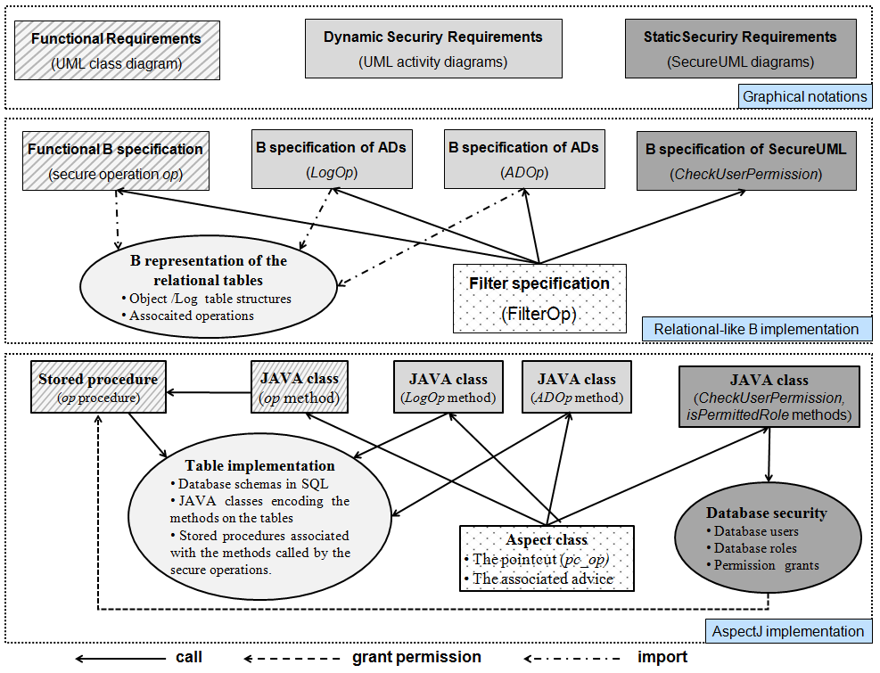
An AspectJ-based application
Translation of B to JAVA/SQL/AspectJ

Slide 60
Tool support
Translation of B to JAVA/SQL/AspectJ
Automation
B grammars
Generator
B spec
Code
(Java/SQL/AspectJ)
Eclipse platform
Technologies: Xtext, Xpand
Features
Generate a SQL table from a B structure
Generate a Java method from a B operation
Generate the database security from the static specification
Generate an AspectJ class from the AC filter
Generate a SQL stored procedure from a B operation

Slide 61
Conclusion
Translation of B to JAVA/SQL/AspectJ
We have systematicly generated an executable code:
A verified B specification is refined to obtain a relational-like B implementation.
The B implementation is mapped into an AspectJ-program
The derived application respects separation of concerns princicples.
The transformation is automated.
Notes:
The process is done through 2 steps:
Refine the verified B specification to a relational-like B implementation.
translate the B implementation into an AspectJ-program

Slide 62
Outline
Outline
State of the art
Translation of system-design models into B
Translation of the B specification into AOP-based application
Conclusion and future work

Slide 63
Conclusion
Conclusion and future work
We visualized security policies and functional requirements of a system using UML-based languages:
We defined mapping rules of these graphical models into a B specification, validated and verified using AtelierB and ProB.
We use the refinement technique to transform the abstract specification to an AOP-based implementation.
We developed a tool to support the approach proposed in this thesis.

Slide 64
Future work
Conclusion and future work
Short term:
Automate the refinement process
Long term:
Investigate the diversity of security concerns.
Experiment the developed tool for real-size systems.
Notes:
It would be interesting to consider other constraints, such as delegation, prerequisite, and so on.
We are aware that adding new kinds of security requirements will bring new challenges. But we are confident that the benefits of our approach will help us dealing with it.
Indeed, our approach allows the modularity of different aspects throughout the development life-cycle: from the design phase to the implementation phase. As a result, additional security constraints can enhance the safety and security of a system without having a remarkable impact on the existing components.
To take into account new types of security constraints, other UML-based diagrams may be necessary, for example, sequence diagrams and state diagrams.
A set of translation rules is also required for the transformations from graphical models into B and from B specifications into Java/SQL.

Slide 65
Publications
Thi Mai Nguyen, Amel Mammar, Regine Laleau and Samir Hameg, A tool for the generation of a secure access control filter, IEEE 10th International Conference on Research Challenges in Information Science, RCIS 2016, Grenoble, France, June 2016
Amel Mammar, Thi Mai Nguyen and Regine Laleau, Formal development of a secure access control filter, IEEE 17th International Symposium on High Assurance Systems Engineering, HASE 2016, Orlando, Florida, USA, January 2016.

Slide 66
Thank you for your attention!
Q/A

Slide 67
Thank you!

Slide 68
Models transformations
Introduction
Thesis motivation
How to increase the productivity of the development process?
Notes:
In addition, since our approach relates to different languages, we want to maximize the productivity of the development process.
Automating model transformations from security models to formal specifications is an obvious need of developers

Slide 69
Conclusion
Conclusion and future work
We visualized security policies and functional requirements of a system using UML-based languages:
UML class diagram: functional requirements
SecureUML diagram: static security rules
UML activity diagram: dynamic security rules
We defined mapping rules of these graphical models into a B specification, validated and verified using AtelierB and ProB.
We use the refinement technique to transform the abstract specification to an AOP-based implementation.
The functional component is transformed into a relational-based application,
The security component is mapped into Java/AspectJ classes.
We developed a tool to support the approach proposed in this thesis.

