Slide 1

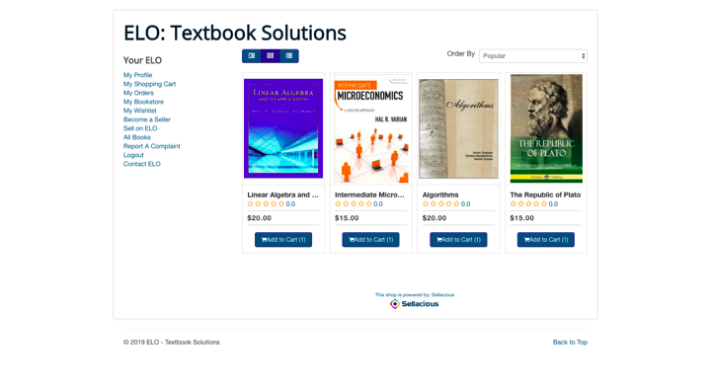
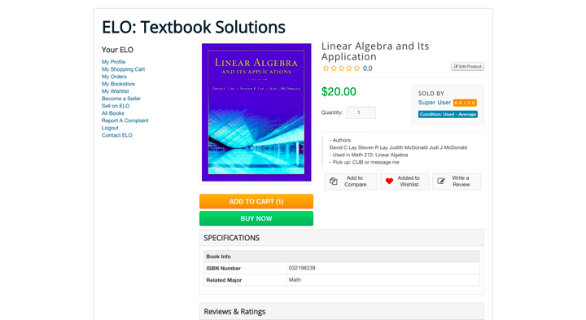
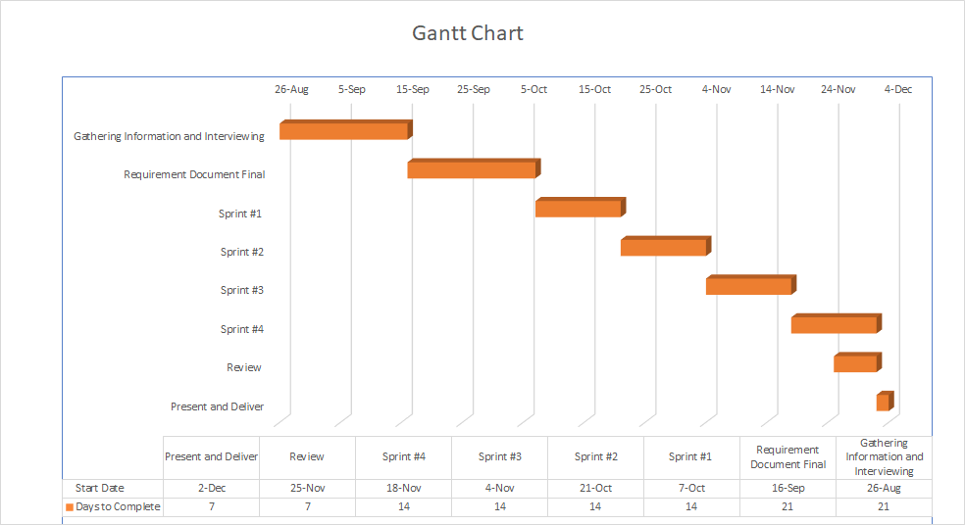

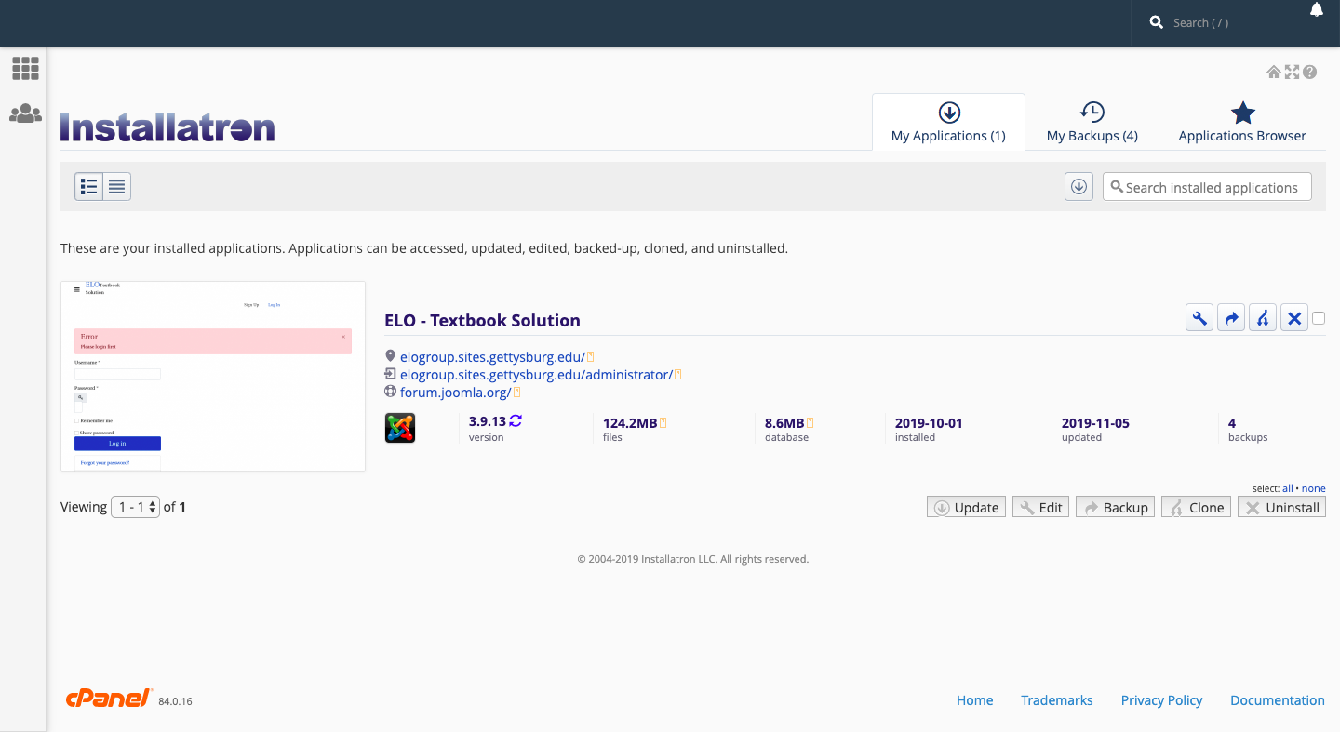

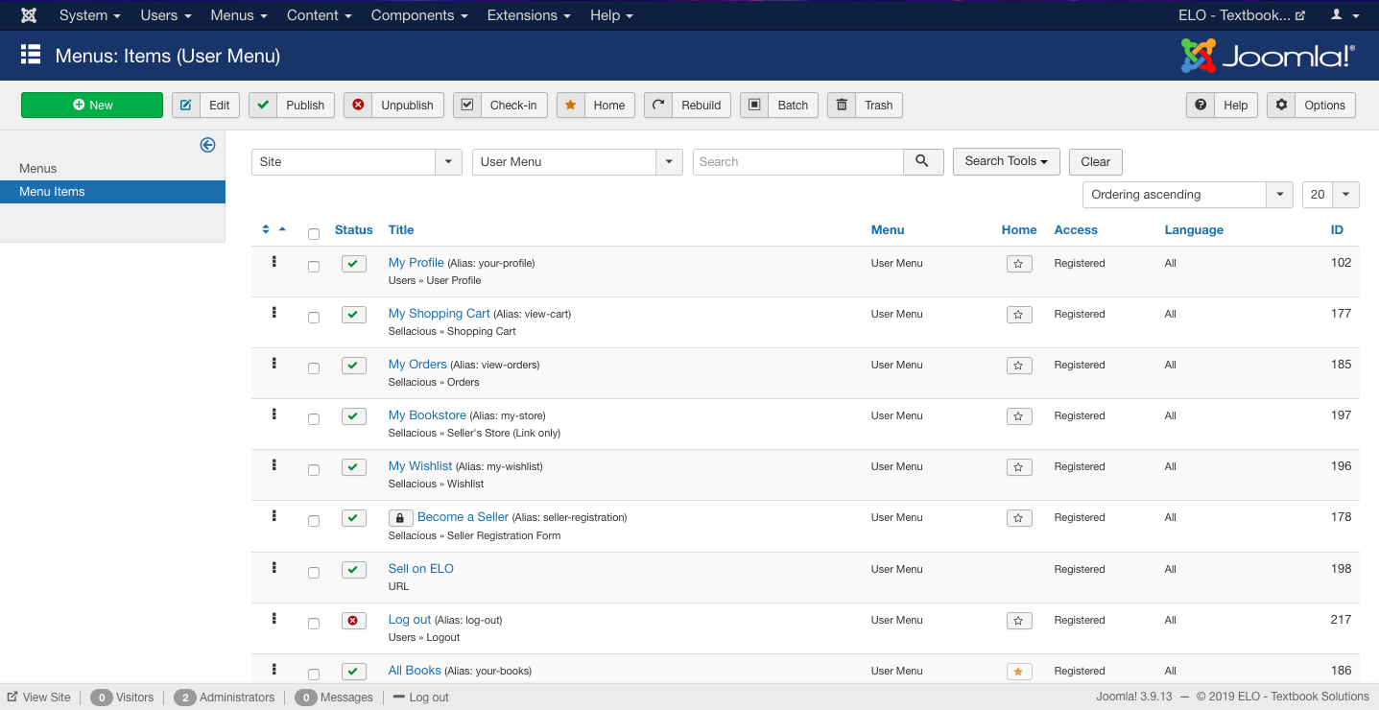


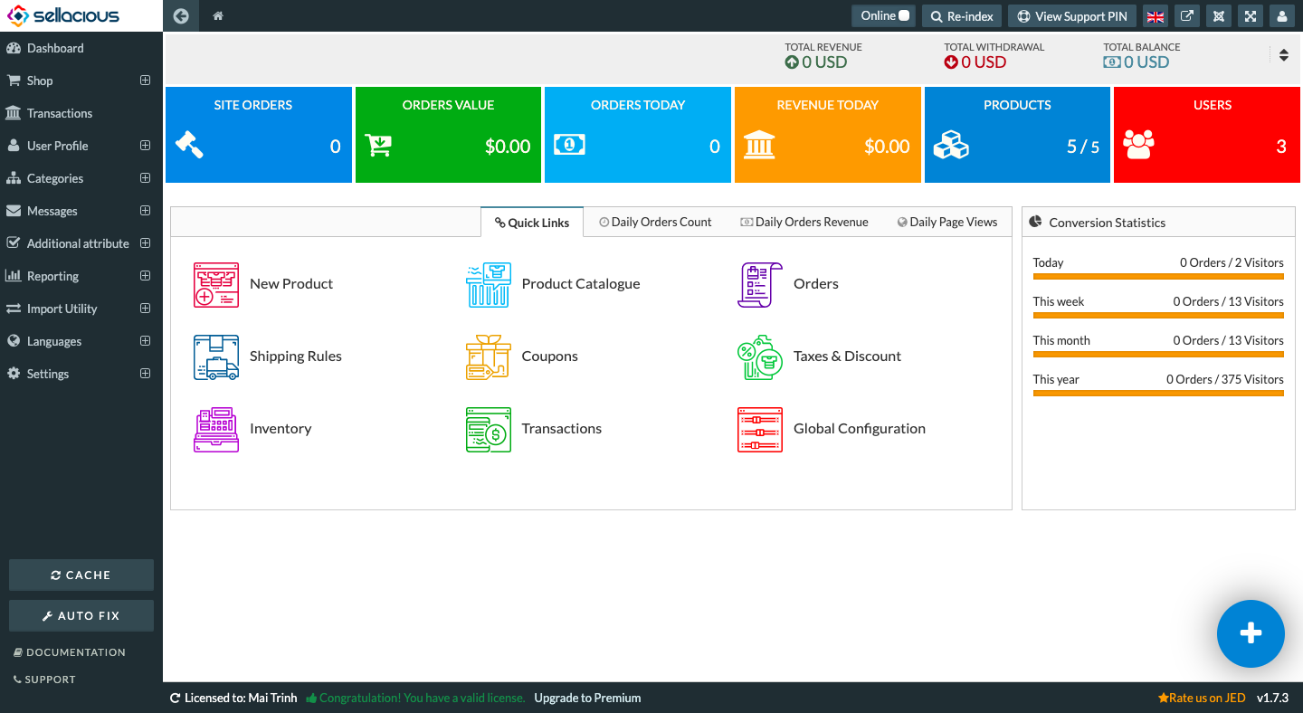
ELO - Affordable Textbook Solution
Jivan Kharel, Mai Trinh, Tony Shi
Computer Science Department, Gettysburg College, Gettysburg PA
Introduction
At Gettysburg College, there is no single platform for students to buy, sell, rent textbooks from another students. Buy-back options for students have usually significantly lower the original price of the books, and students often have to invest a large amount of time in finding suitable and affordable textbooks. Most of the time, purchased books were only used for one or two semesters, and then sit idle until multiple semesters. That is what motivated Raven Waters' 19, a Gettysburg College alumni and Entrepreneurship Fellow, to come up with ELO, with the hope to help our college's students with their textbook purchasing process.
For our senior capstone class as Computer Science majors, we were assigned to plan, design and develop ELO. Our goal is to create a functional prototype version of ELO and create a solid foundation for the project to further develop in the future.
ELO is a web application that allows Gettysburg College students to buy and sell textbooks from other students at affordable prices. ELO aims to help Gettysburg College students with the surging textbook prices by providing a platform for affordable textbook options.
Interface and Core Functionalities
Timeline
Aug. 26 – Sep. 15 Gathering information and interviewing with client.
Sep.15 – Oct.7 Finish the requirement documentation.
Oct.7 – Oct.21 Preparation and Functionalities (Setting up Database and Backend, Landing Page, Login, Signup, etc.)
Oct.21 – Nov.4 Core functionalities (buying books , selling books, Wishlist, Custom fields, etc.)
Nov.4 – Nov.18 More functionalities (search bar with sorting and filter option in Sellacious, plugin for payment, recommendation rystem, in app messaging)
Nov.18 – Nov.25 Implement the last few functionalities and debug.
Nov.25 – Dec.2 Review and documentation and presentation preparation.
Dec.2 – Dec.6 Presentation and deliverables meeting.
Front-End
In the application's main page, a student user will see all available books once they have logged in. Students will be able to buy a book by clicking on Add to cart, or hover over a book and add it to their wish list by clicking on Add to wish list.
There is a side-bar on the left in which the user can find all functionalities: view profile, view shopping cart, view order, view wish list, report a complaint, contact ELO, etc.
On the upper-right corner, the user can also sort the books by popularity, ratings, lowest price or highest price.
Once a user clicks on a book, the page will display all information about the book: title, price, quantity, sold by who, short description (authors, used for what specific course, pick-up time and location). The user can also see the ISBN number and the major pertaining to the book under the Specifications field.
Information of the book can only be edited the seller of the book, and all edits of the book have to be done in the back-end on Sellacious.
Tools and Technology
Back-End
Joomla is hosted on Gettysburg College's web server Sites at Gettysburg, and is installed via Installatron.
Using Installatron's File Manager and Database Manager, we can access the application's massive codebase and see the database tables. We use this feature to create or modify any component or functionality.
We also back-up our data on Joomla once every week or before implementing any new major feature to make sure that our website won't crash and we don't lose existing data.
Site & users management: site structure, hyperlinks, redirects, user permissions.
Image: The Gantt Chart for our team’s time line
Future Approach
More functional implementationa such as the core rent book function, push notification, redirect to Gettysburg bookstore if the book cannot be found on ELO.
Scaling our database and testing with larger data sets such as products, users, order history, etc.
More intuitive and aesthetically UI design for the front-end.
Test with multiple focus group of Gettysburg College student users to see what they think about the application and have any suggestions for future implementation and development.
On Joomla administrator panel, we manage users access level, create menu structure, install new component, modify existing modules and install new UI templates.
We also find and install Joomla's extensions using the Joomla! Extension Directory, to make sure that the extensions is compatible with Joomla and Sellacious.
Market & users management: products (books), pricing, seller and buyer management, market analytics.
On Sellacious administrator site, administrators can manage all sellers, buyers, and all books available on ELO. This give the administrators full control over their site and maintain the marketplace's security.
ELO's students users can also access Sellacious, however with restricted permission, to add, edit, delete any information about the books that they are selling.
Acknowledgment This work was supported by our professors Clifton Presser and Rodney Tosten, our client Raven Waters, the class of CS440, the Gettysburg Computer Science Department and Gettysburg College's IT Department. Thank you so much for supporting us along the development process.
In App Messaging
Payment and Card Management

