Slide 1

Note: The data and information in this document is reflective of a hypothetical situation and client. This document is to be used for KPMG Virtual Internship purposes only.
Sprocket Central Pty Ltd
Data analytics approach
[Division Name] - [Engagement Manager], [Senior Consultant], [Junior Consultant]

Slide 2
Note: The data and information in this document is reflective of a hypothetical situation and client. This document is to be used for KPMG Virtual Internship purposes only.
Agenda
Introduction
Data Exploration
Model Development
Interpretation

Slide 3
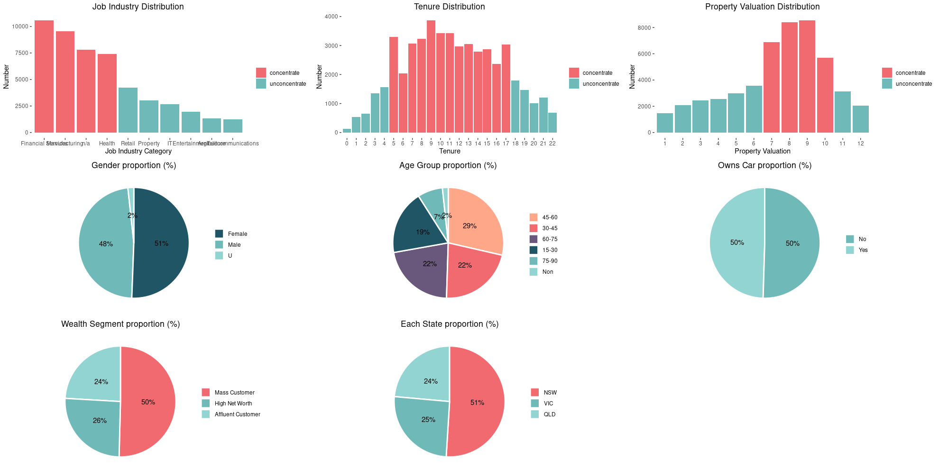
Note: The data and information in this document is reflective of a hypothetical situation and client. This document is to be used for KPMG Virtual Internship purposes only.
Introduction
This presentation will explore potential customer data and transaction history to develop potential customer model

Slide 4
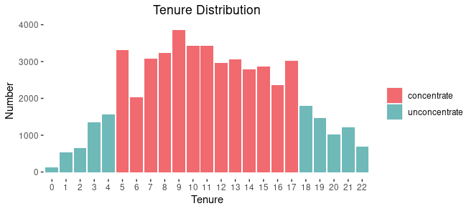
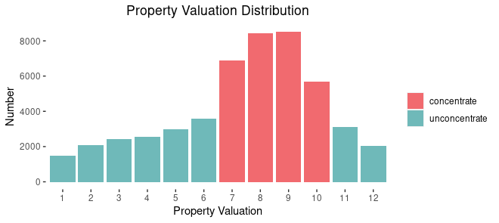
Note: The data and information in this document is reflective of a hypothetical situation and client. This document is to be used for KPMG Virtual Internship purposes only.
Data Exploration
Base on the number of purchase in 3 year to identify the major group which account highest proportions
Tenure data:
The data indicate that customers which have the tenure between 5 to 17 tend to spent on bike related product more than the orther in the past 3 years. (each have higher than 2000 product).
Property Valuation data:
It is clear that propety valuation form 7 to 10 make up much higher proportion in the char (all 4 propety valuation are higher than 6000 product while orthers are less than 4000)

Slide 5
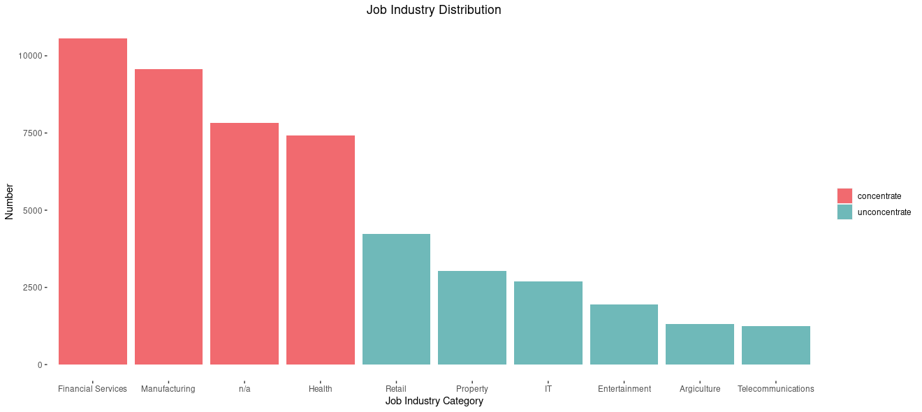
Note: The data and information in this document is reflective of a hypothetical situation and client. This document is to be used for KPMG Virtual Internship purposes only.
Data Exploration
Job Industry data:
Three major job industries is Financial, Manufacturing and Health which account more than a haft of all job industries

Slide 6
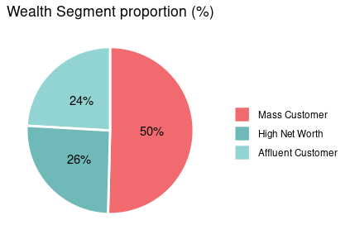
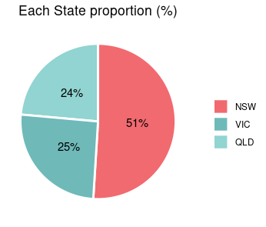
Note: The data and information in this document is reflective of a hypothetical situation and client. This document is to be used for KPMG Virtual Internship purposes only.
Data Exploration
Wealth Segment and State data:
These two data are quite similar in proportion, the Mass Custormer and New South Wales make up the highest proportions about 50% in Wealth Segment and State respectively

Slide 7
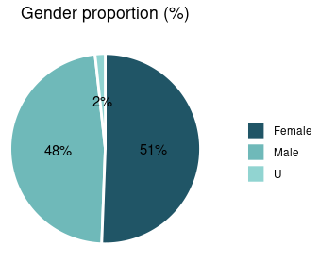
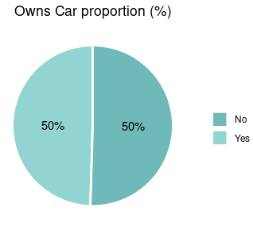
Note: The data and information in this document is reflective of a hypothetical situation and client. This document is to be used for KPMG Virtual Internship purposes only.
Data Exploration
Place headline insight or information here. This should be the most important point for this slide.
Gender and Onw Car data:
Both of these data are equa in proportion so there are no conclution about which customer should be targeted

Slide 8
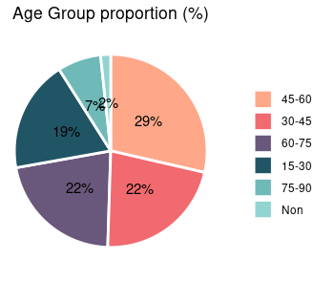
Note: The data and information in this document is reflective of a hypothetical situation and client. This document is to be used for KPMG Virtual Internship purposes only.
Data Exploration
Place headline insight or information here. This should be the most important point for this slide.
Age group data:
Age group distrinution is quite balance between 4 age groups (45-60, 30-45, 60-75, 15-30)

Slide 9
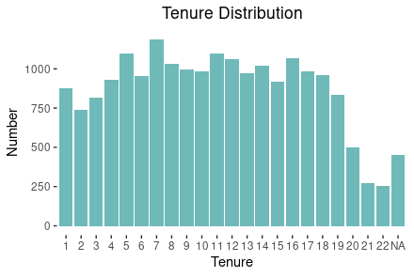
Note: The data and information in this document is reflective of a hypothetical situation and client. This document is to be used for KPMG Virtual Internship purposes only.
Model Development
After explorating the potential customers data we went back checking on history transaction of old customers demographic
The proportion between demographic data are quite similar in Gender, Car Owner, Wealth Segment, Propety Valuation, job industries, Wealth Segment and State. Only Tenure and Age group show different proportions
Tenure:
In transacton data, the number of transacton between tenures do not show big different

Slide 10
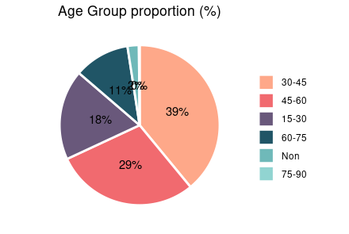
Note: The data and information in this document is reflective of a hypothetical situation and client. This document is to be used for KPMG Virtual Internship purposes only.
Model Development
Place headline insight or information here. This should be the most important point for this slide.
Age Group:
Differ from potential customers data, transaction data show huge gap in distributed, the data indicate that customers from 30-60 account almost 70% compare to orther ages
Place any supporting images, graphs, data or extra text here.

Slide 11
Note: The data and information in this document is reflective of a hypothetical situation and client. This document is to be used for KPMG Virtual Internship purposes only.
Model Development
From all the above information, I suggest the model:
Property
Job Industry
BUYING DECITION
Wealth Segment
Age

Slide 12
Note: The data and information in this document is reflective of a hypothetical situation and client. This document is to be used for KPMG Virtual Internship purposes only.
Interpretation
Place headline insight or information here. This should be the most important point for this slide.
Place any information about this point here.
Place any supporting images, graphs, data or extra text here.

Slide 13
Note: The data and information in this document is reflective of a hypothetical situation and client. This document is to be used for KPMG Virtual Internship purposes only.
Appendix

Slide 14
Note: The data and information in this document is reflective of a hypothetical situation and client. This document is to be used for KPMG Virtual Internship purposes only.
Appendix
This is an optional slide where you may place any supporting items.

