Slide 1

Blockchain / Ethereum

Slide 2
Hash functions
An hash function consists on a function that can be used to map data of arbitrary size to data of fixed size.
Arbitrary Size Data
Hash Function
0xfe88c94d860f01a17f961bf4bdf…

Slide 3
Hash functions
Main properties
  Deterministic
  Easy to verify output
  Hard to guess input from output

Slide 4
Blockchain
History
  Blockchain technology was invented by Satoshi Nakamoto in 2008 to serve as Bitcoin’s public ledger.
  Soon after many different applications of blockchain technology started to emerge.

Slide 5

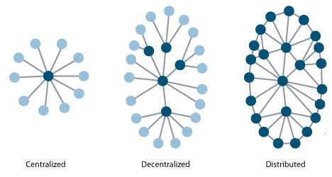

Blockchain
Distributed Trust Platform

Slide 6
Blockchain
Demo:
https://anders.com/blockchain/blockchain.html

Slide 7
“Bitcoin is great as a form of digital money, but its scripting language is too weak for any kind of serious advanced applications to be built on top.”
- Vitalik Buterin
Co-founder of Ethereum

Slide 8
Ethereum
Ethereum vs Bitcoin
  Bitcoin – transactions
  Ethereum – that and much more

Slide 9

Ethereum
Accounts
  In the world of Ethereum an account lives in a separate world from the networks, that means that each network can be tied to the account address but the balance is not shared between networks.
  Two types of accounts:
    Externally owned
    Contract accounts

Slide 10
Ethereum
Network
  Are formed by one or more nodes
  Various networks:
    Main
    Private / Local / Test /Forks

Slide 11
Ethereum
Node
  A machine running an Ethereum client
  Two types of nodes:
    Light client
    Full node

Slide 12
Ethereum
Blocks
  Ethereum blocks contain a copy of both the transaction list and the most recent state. Aside from that, two other values, the block number and the difficulty are also stored in the block.

Slide 13
Ethereum
  Contains:
    Recipient
    Sender
    Amount
    Data (optional)
    StartGas
    GasPrice
Transaction
  A transaction is used to refer to the signed data package that stores message to be sent from an externally owned account.

Slide 14
Ethereum
Message
  Messages are used for contracts to communicate between each other.
  Exist only in the Ethereum execution environment.
  Contains:
    Recipient
    Sender
    Amount
    Data (optional)
    StartGas

Slide 15
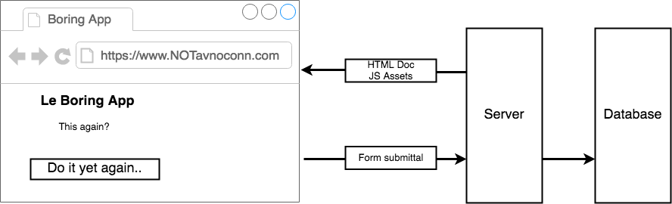
Ethereum
Ethereum App Architecture (DApps)
  Traditional Architecture

Slide 16
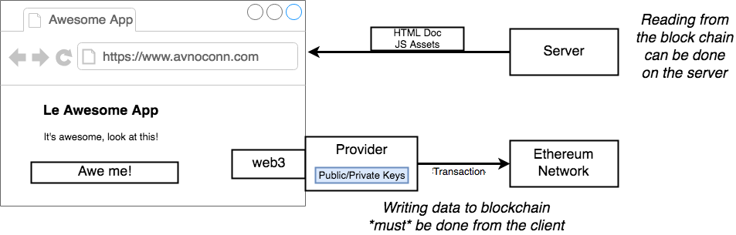
Ethereum
Ethereum App Architecture (DApps)
  DApp Architecture

Slide 17
Ze end!

