Slide 1


ColoMaia & IRIS integration
For internal purposes

Slide 2

Agenda
ColoMaia introduction
Colonoscopy examination process
Integration pilot
Architecture
Current situation and next steps

Slide 3
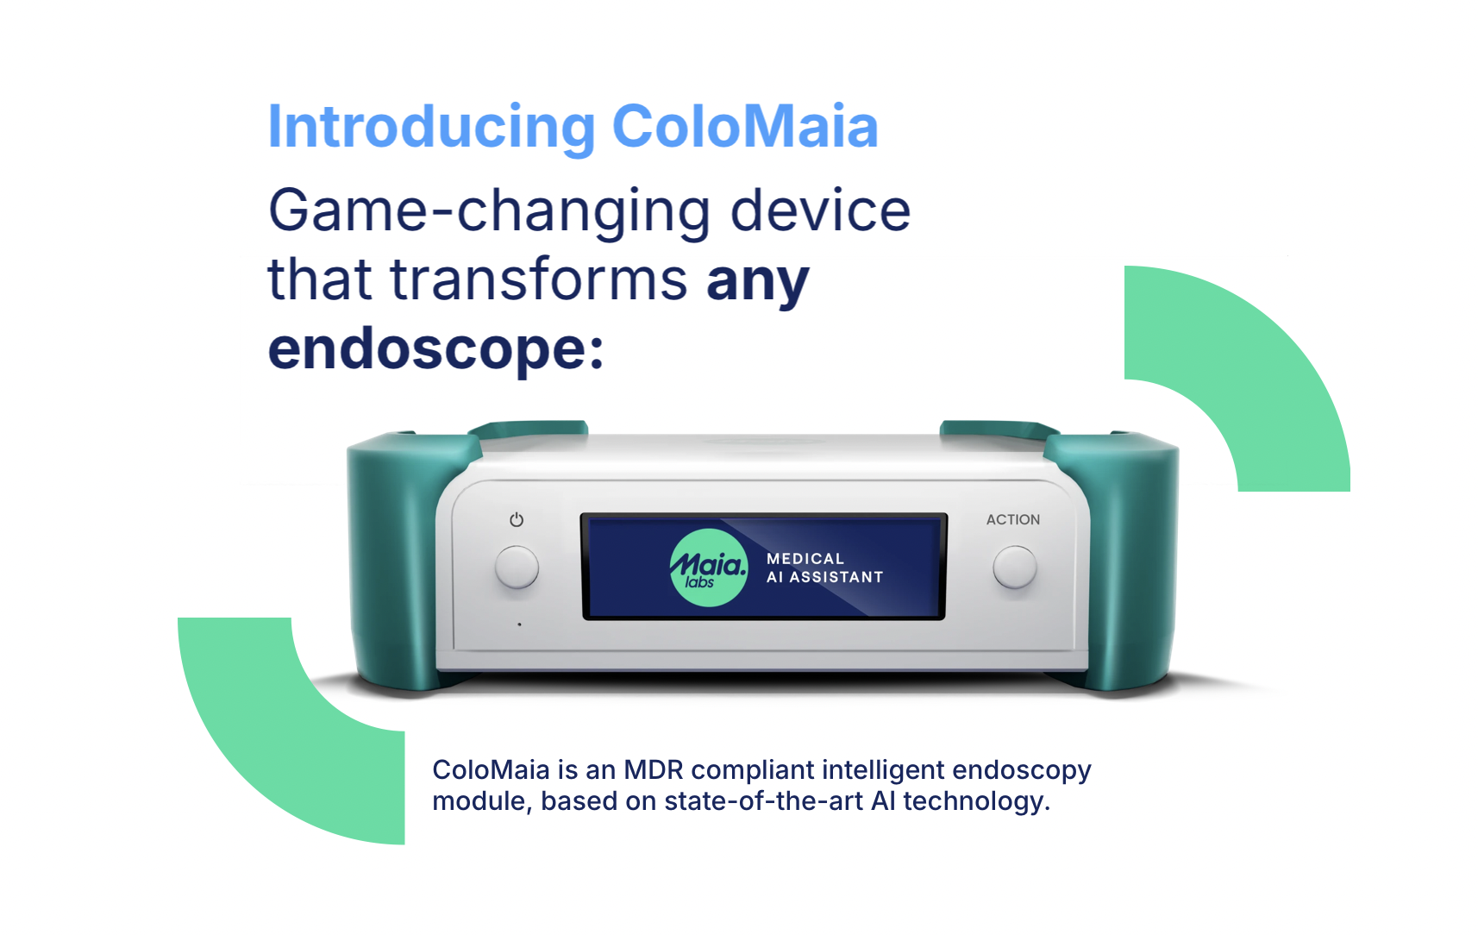

Slide 4
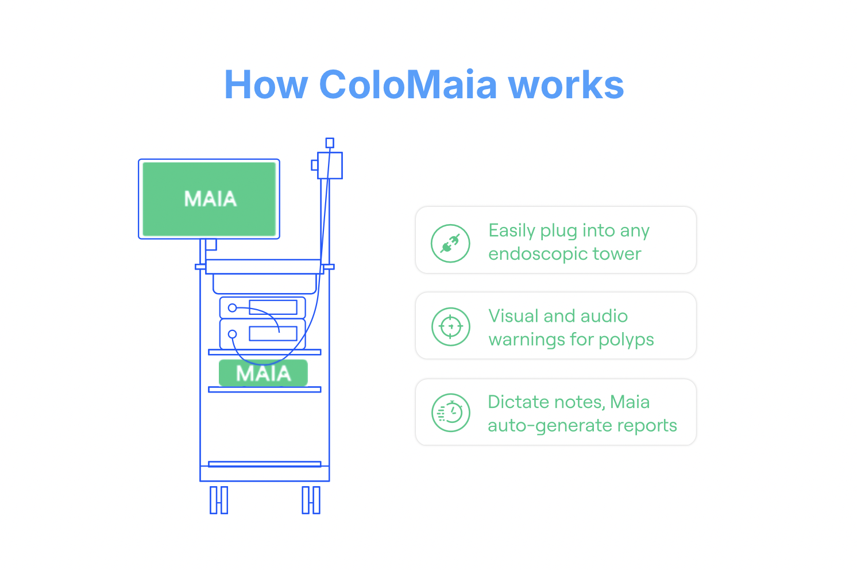
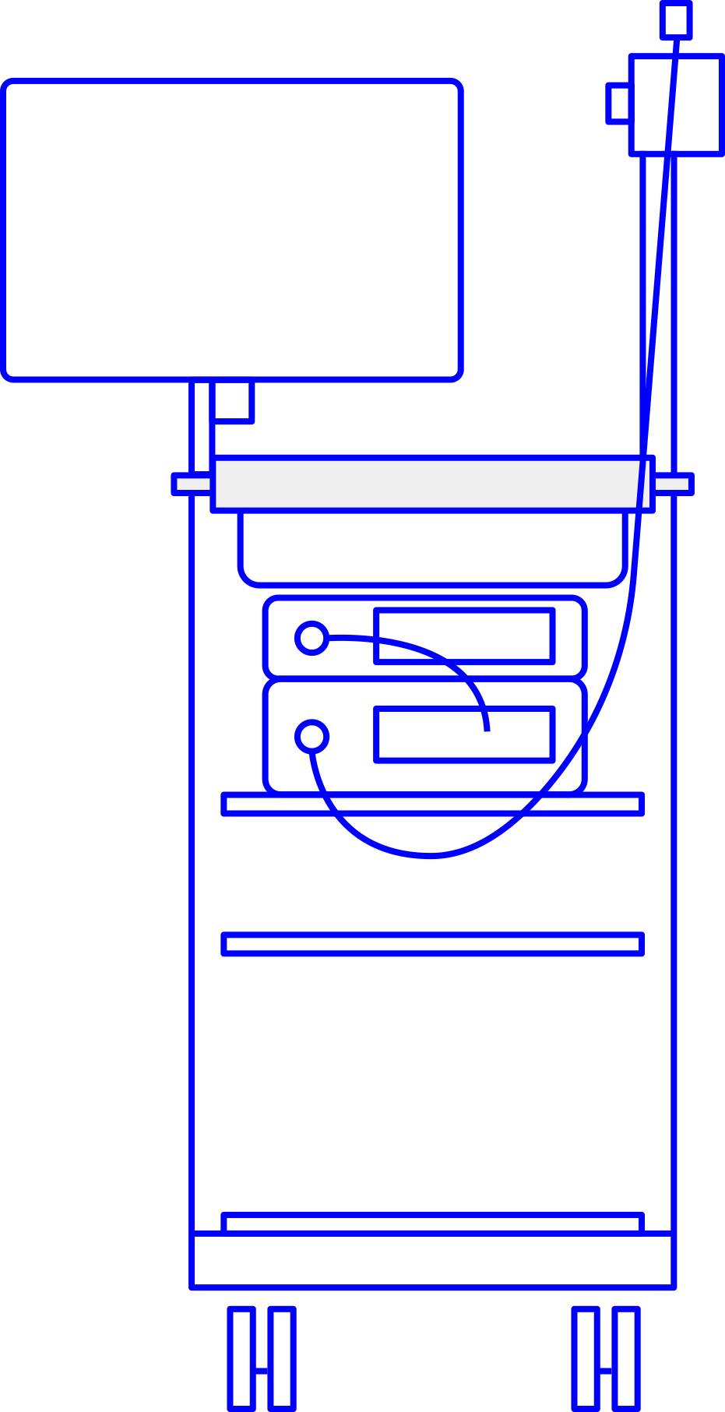



Slide 5
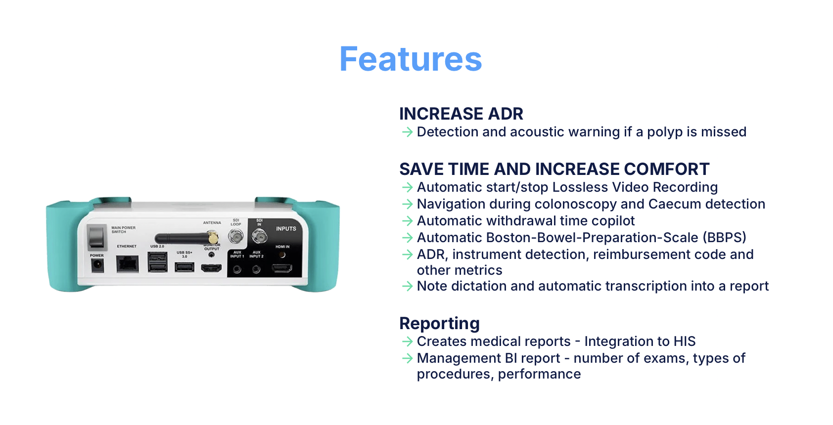

Slide 6

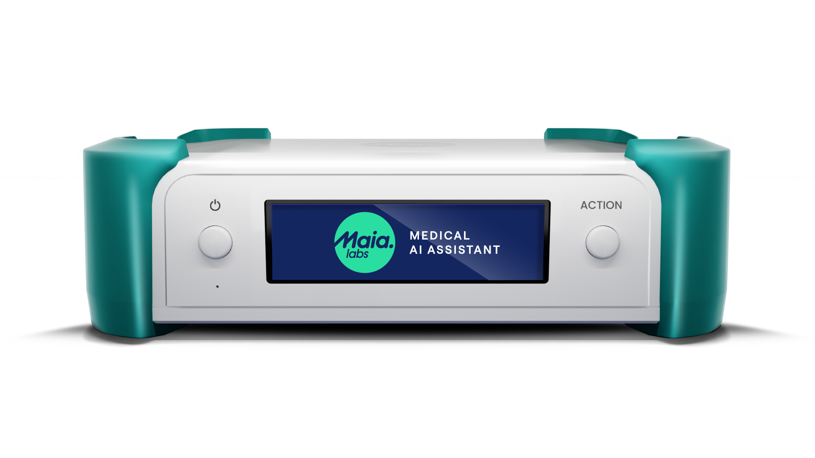
Benefity použití ColoMaia
Zvyšuje detekci polypů
Šetří čas a zvyšuje komfort lékařům
Automatický start/stop nahrávání bez zásahu lékaře
Diktování hlasem a automatický přepis do zprávy (dostupný v průběhu roku 2025)
Vytváření snímků během vyšetření
Automatické zprávy s nálezy a příprava lékařských zpráv
Automatické vytváření značek ve videu s nálezy
Možnost editace videozáznamů

Slide 7
Risk Factors:
Age (50+), family history, and genetic predispositions.
Lifestyle factors: poor diet, lack of physical activity, smoking, and alcohol consumption.
Importance of Early Detection:
Highly treatable when detected early.
Regular screenings can reduce mortality by 50%.
Prevention Strategies:
Healthy diet rich in fiber, fruits, and vegetables.
Regular exercise and maintaining a healthy weight.
Screening programs (colonoscopy, stool tests)

Slide 8
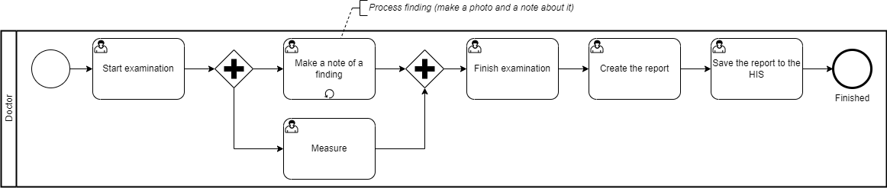
Colonoscopy examination process

Slide 9
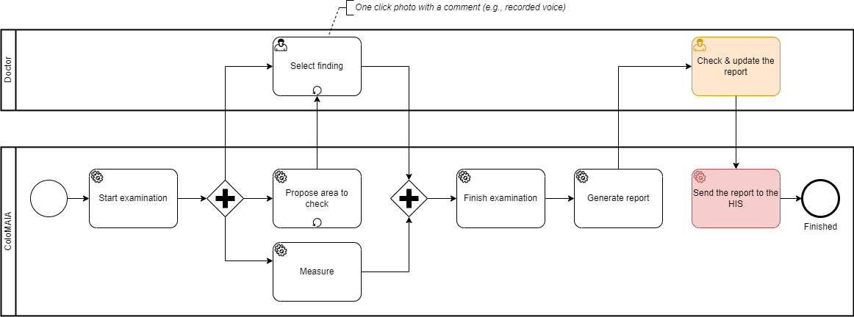
Examination process with ColoMAIA

Slide 10
Integration pilot
Main goal is to communicate with as many as possible 3rd party information systems via unified interface
Spend minimal effort on MAIA Labs side
IRIS implementation cooperation with Daniel K.

Slide 11
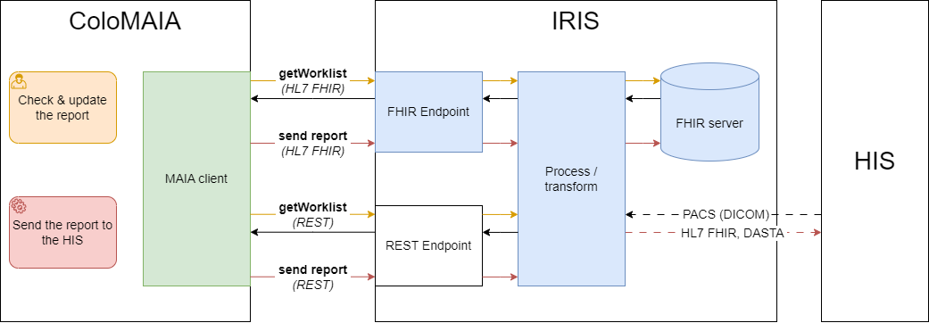
Architecture

Slide 12
Current communication pilot
Check & update the report
Worklist for the concrete ColoMAIA device is pre-loaded from the HIS (Hospital Information System)
Fill in mandatory fields,
e.g. select a patient from the worklist
Send the report to the HIS
Send simple text report

Slide 13
Next steps
Check & update the report
Worklist for the concrete ColoMAIA device is pre-loaded from the HIS (Hospital Information System)
Fill in mandatory fields,
e.g. select a patient from the worklist
Load other data from the HIS (e.g. doctor and nurse)
Send the report to the HIS
Send simple text report
Send structured data
Common approach with Intersystems cz
Install the ColoMAIA in the hospital (Olomouc) and collect feedback

Slide 14
Demo
Pre-load the worklist from the IRIS (FHIR server)
Show the patient list in IRIS
Show the patients in the ColoMAIA selection box
Change the patient list in IRIS
Update the report with new patient
Send the report to HIS (to the IRIS)
Show the report in the IRIS

