Slide 1
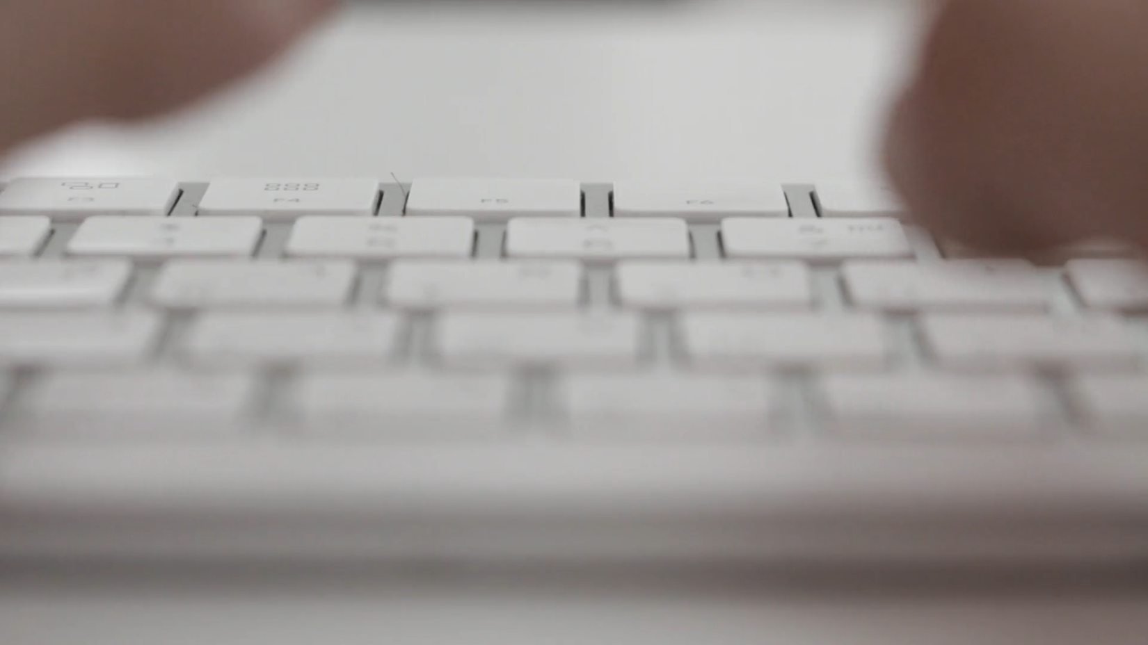
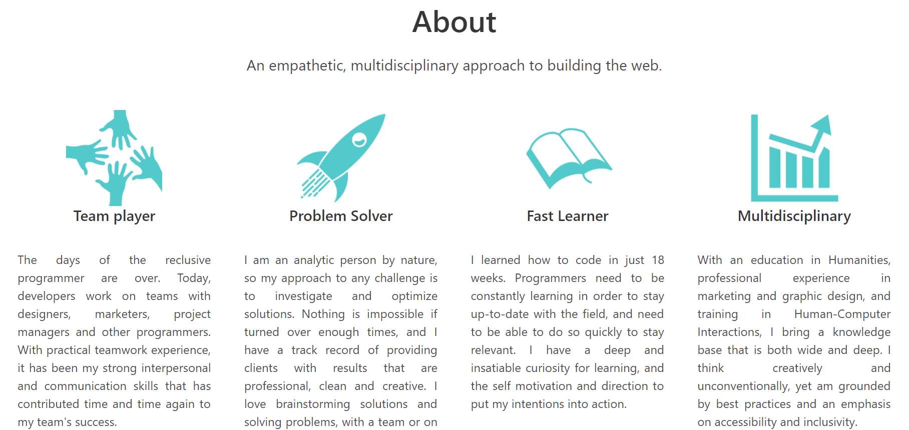
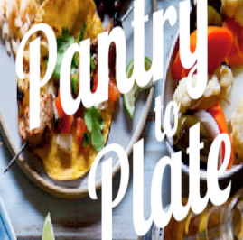
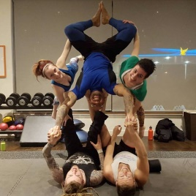
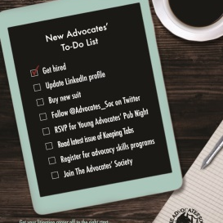
h1 – Hero Title
Hi, I’m Maia
h2 – Section Title
h3 – Hero Subtitle
I’m a developer based in Wellington, NZ
h4 – Subject Title, Quote Body
h5 – Section Subtitle, Quote Source
My Work
Hire Me
Hero Button
Option
Option
Tag
Button
Dark Purple #8B509E
RGB 139,80,158
Light Purple #AE7DBD
RGB 174,125,189
Dark Bronze
#C39E37
RGB 195,158,55
Light Bronze
#DDB41D
RGB 221,180,29
Accent Teal #23AC7F
RGB 35,172,127
About
An empathetic, multidisciplinary approach to building the web
Team Player
Problem Solver
Fast Learner
Multidisciplinary
When I'm not coding, I'm spending time doing acroyoga, cooking delicious vegan food, cylcing/hiking, or making pottery.
‘
‘
Positive. Succinct. Professional. Driven. If you are looking for an energetic breath of fresh air, Maia’s your person!
— Deborah Jolly, Client, The Advocates’ Society
My Work
Coding
Marketing
Design
Writing
Pantry to Plate
Make Me Acro
Global Timeline
Tired of staring into your fridge or pantry and thinking, "I have nothing to eat!" As our final project at EDA, our group of five solved this problem by developing a website to offer recipe ideas based on what you have, and a shopping list of what you need.
Tired of staring into your fridge or pantry and thinking, "I have nothing to eat!" As our final project at EDA, our group of five solved this problem by developing a website to offer recipe ideas based on what you have, and a shopping list of what you need.
Tired of staring into your fridge or pantry and thinking, "I have nothing to eat!" As our final project at EDA, our group of five solved this problem by developing a website to offer recipe ideas based on what you have, and a shopping list of what you need.
React
Redux
Teamwork
React
Redux
Teamwork
React
Redux
Teamwork
See it live
See it live
See it live

