Slide 1

EmporiUm
Sales Analysis for ​
P​resented by Maia Black

Slide 2
What Was
Analyzed
Revenue
Rank
Comparison
Total Monthly Revenue
Total Sales Revenue Per Month
Store sales performance
Top customers
Comparing customer ID with rewards ID
Most popular products​

Slide 3
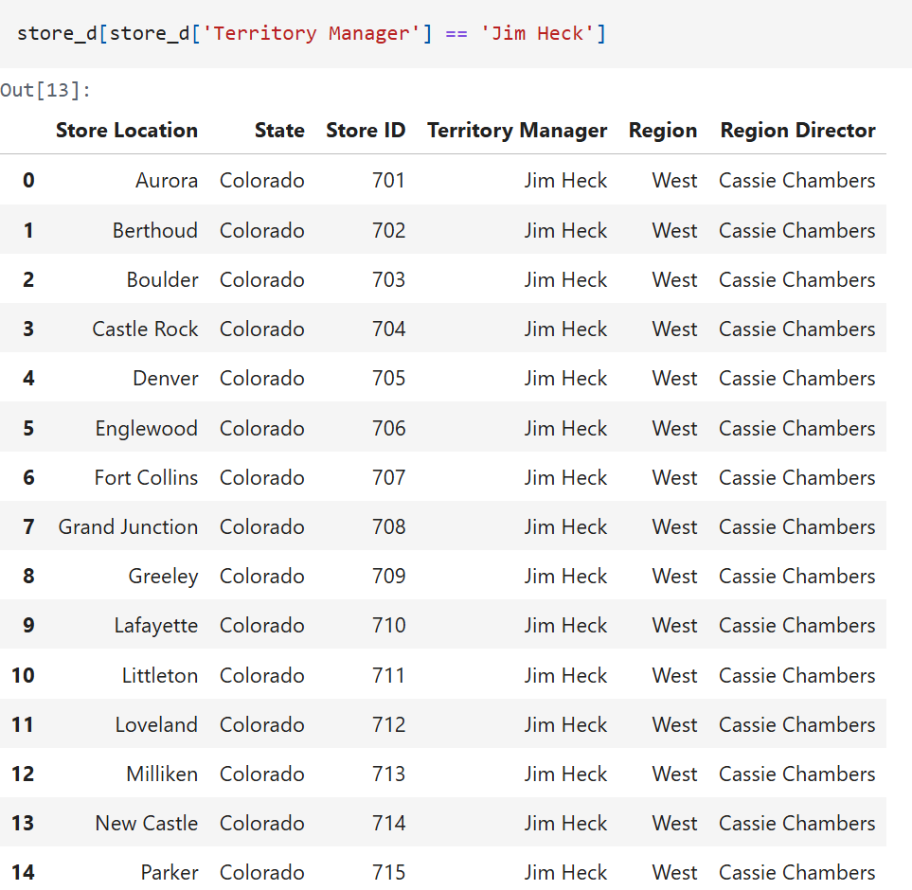
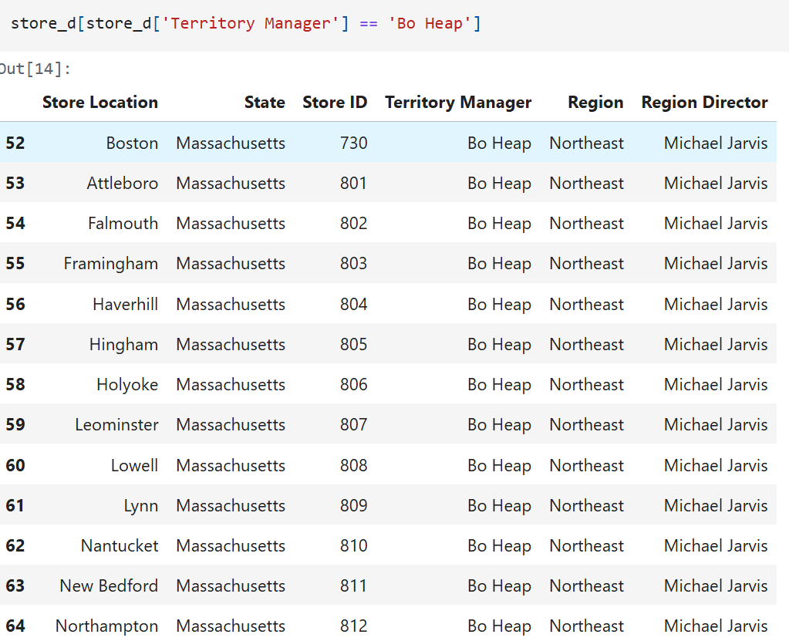
Sales Territories and their managers...

Slide 4
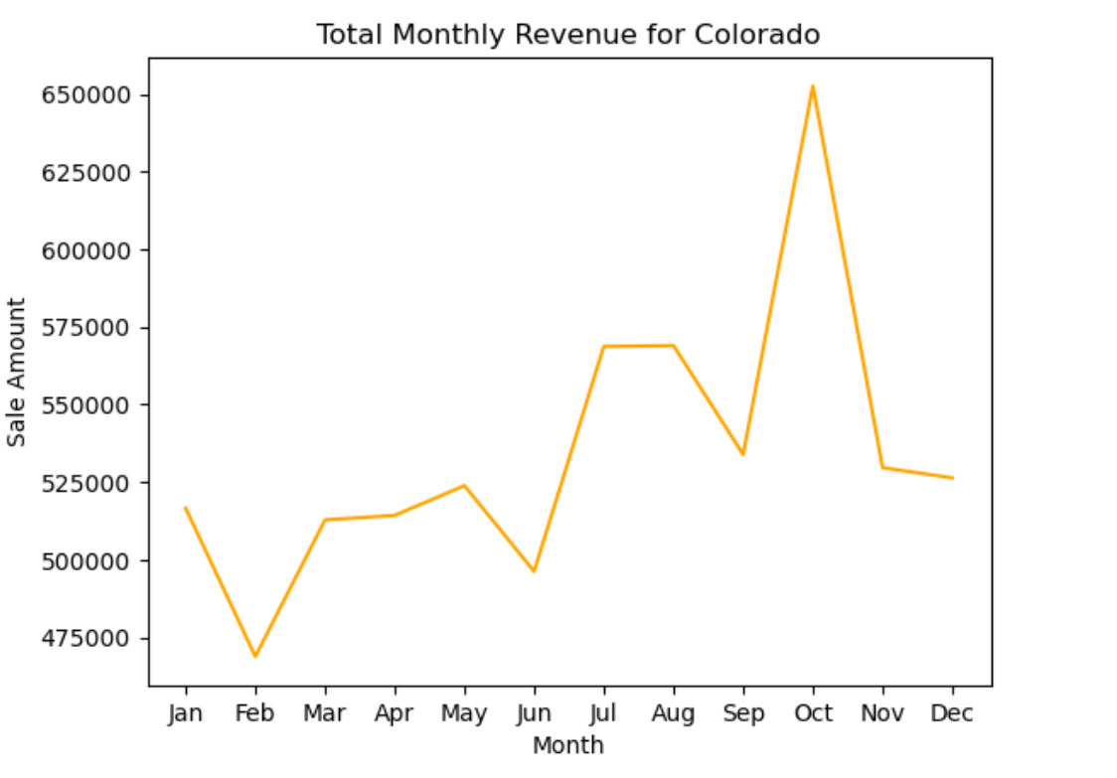

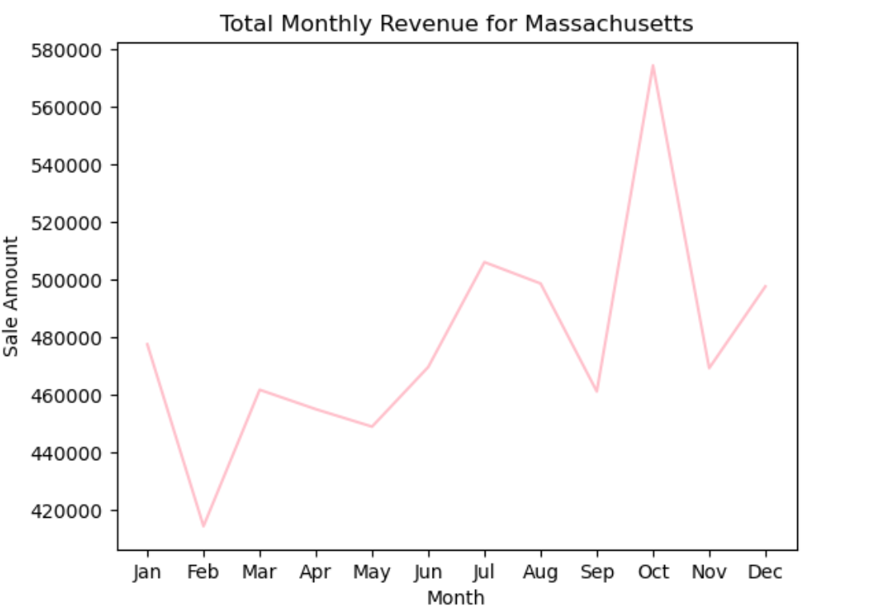
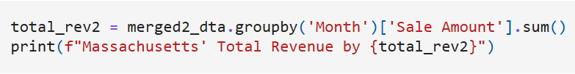
Total Monthly Revenue
October was the highest at $652,587.32 for Colorado
October was the highest at $574,303.55 for Massachusetts

Slide 5
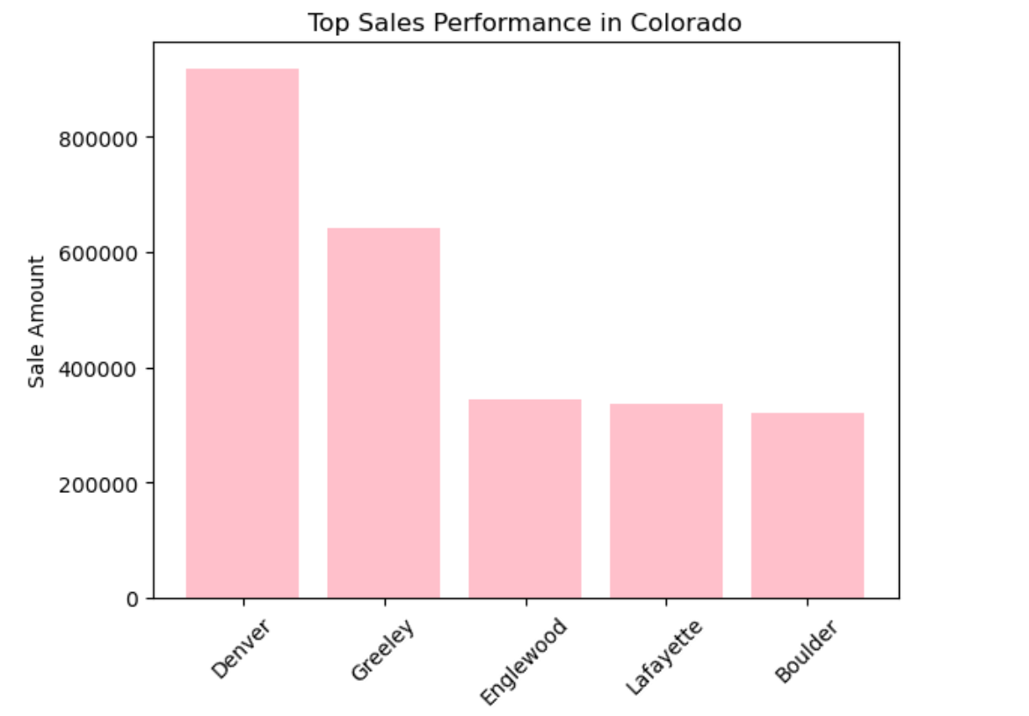
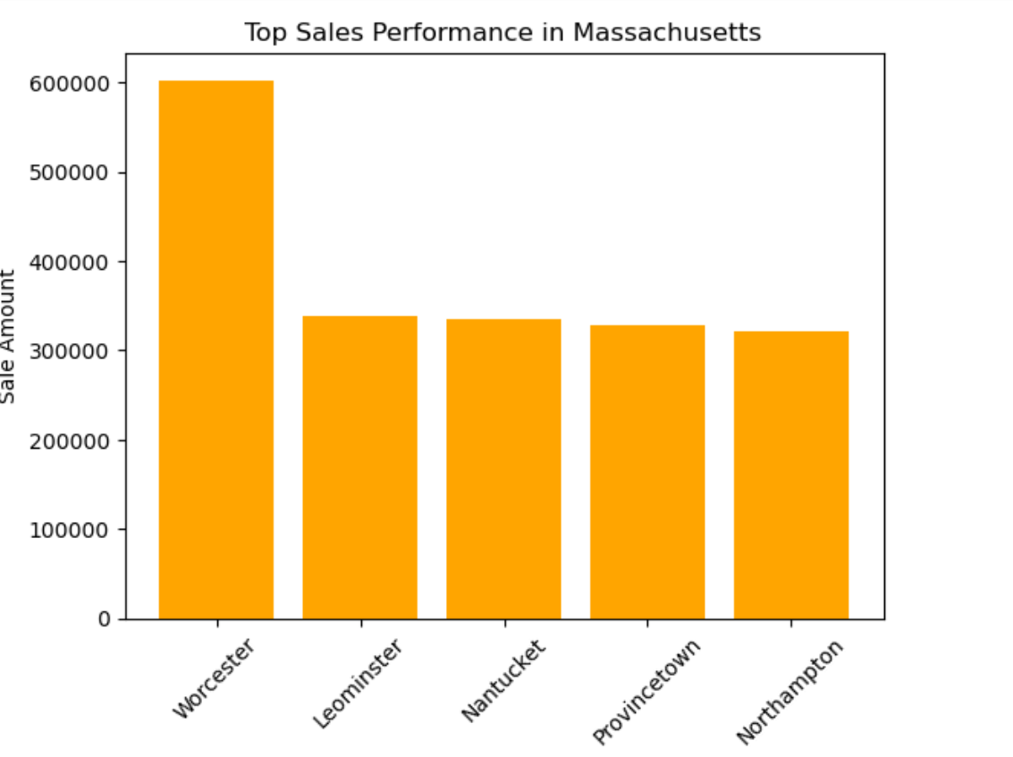
Top Sales Performance
For Each Territories Stores
Store 704 , which is Denver, had Top Sales Performance for Colorado
Store 817, which is Worcester, had the Top Sales Performance for Massachusetts

Slide 6
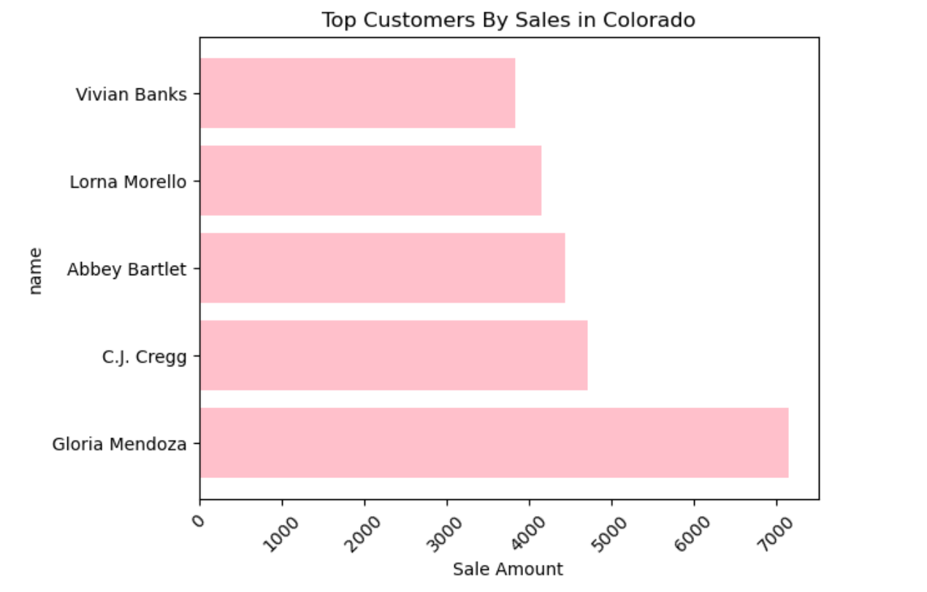
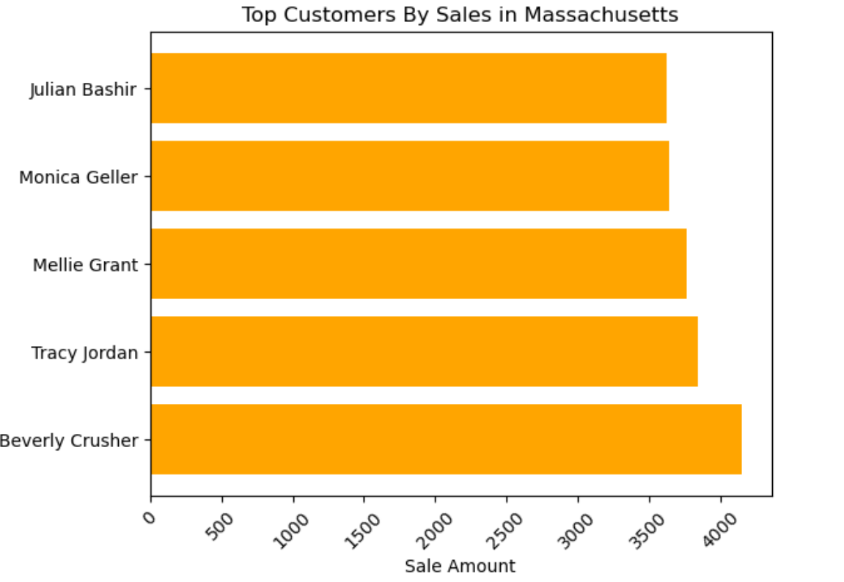
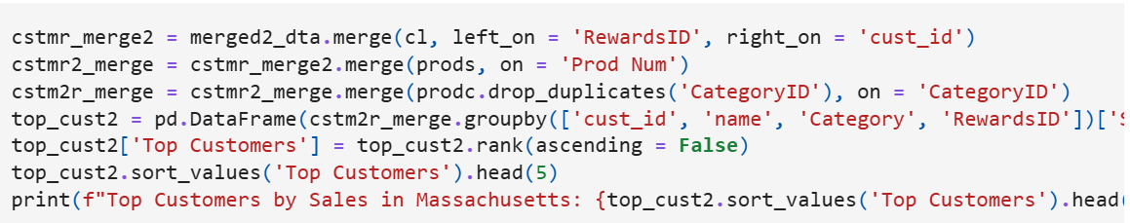
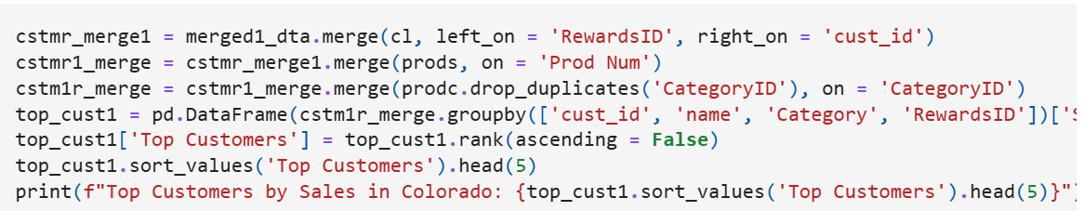
Top
Customers

Slide 7
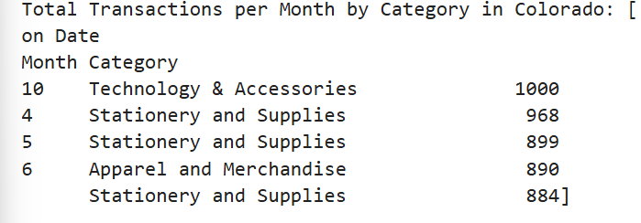
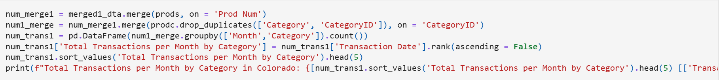
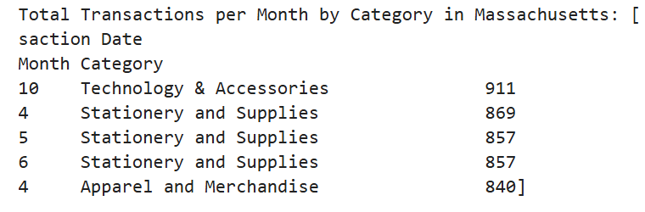
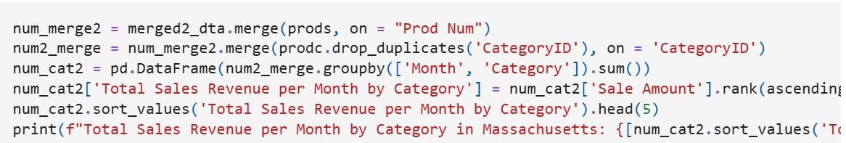
Total Transactions per Month by Category

Slide 8
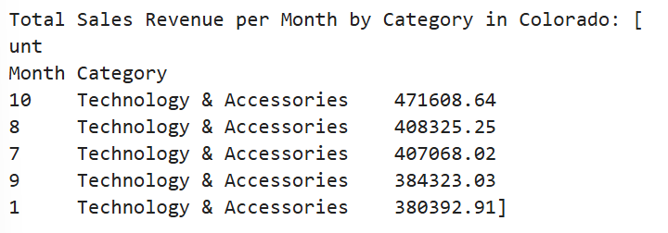
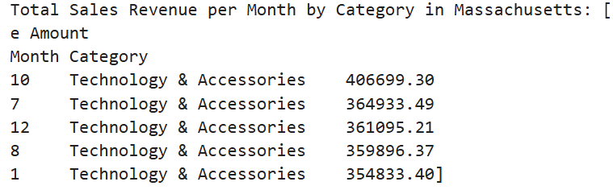
Total Sales Revenue per Month by Category

Slide 9
Marketing
Technology & Accessories is the highest product category in terms of revenue, which is especially remarkable given its importance as an educational need for our customers.
Customers who make up the majority of those sales but are not members of our rewards program need to be encouraged to become members, as they would greatly benefit from being awarded for their purchases, big or small.
Focusing on pushing the rewards program will boost sales in Technology & Accessories, but can also boost sales of other items that haven't garnered a high enough total revenue.
With the right strategy, the rewards program can garner more financial gain for the company, especially since our customer base is college students who are in need of something that brings financial ease when purchasing things needed for their classes.

Slide 10
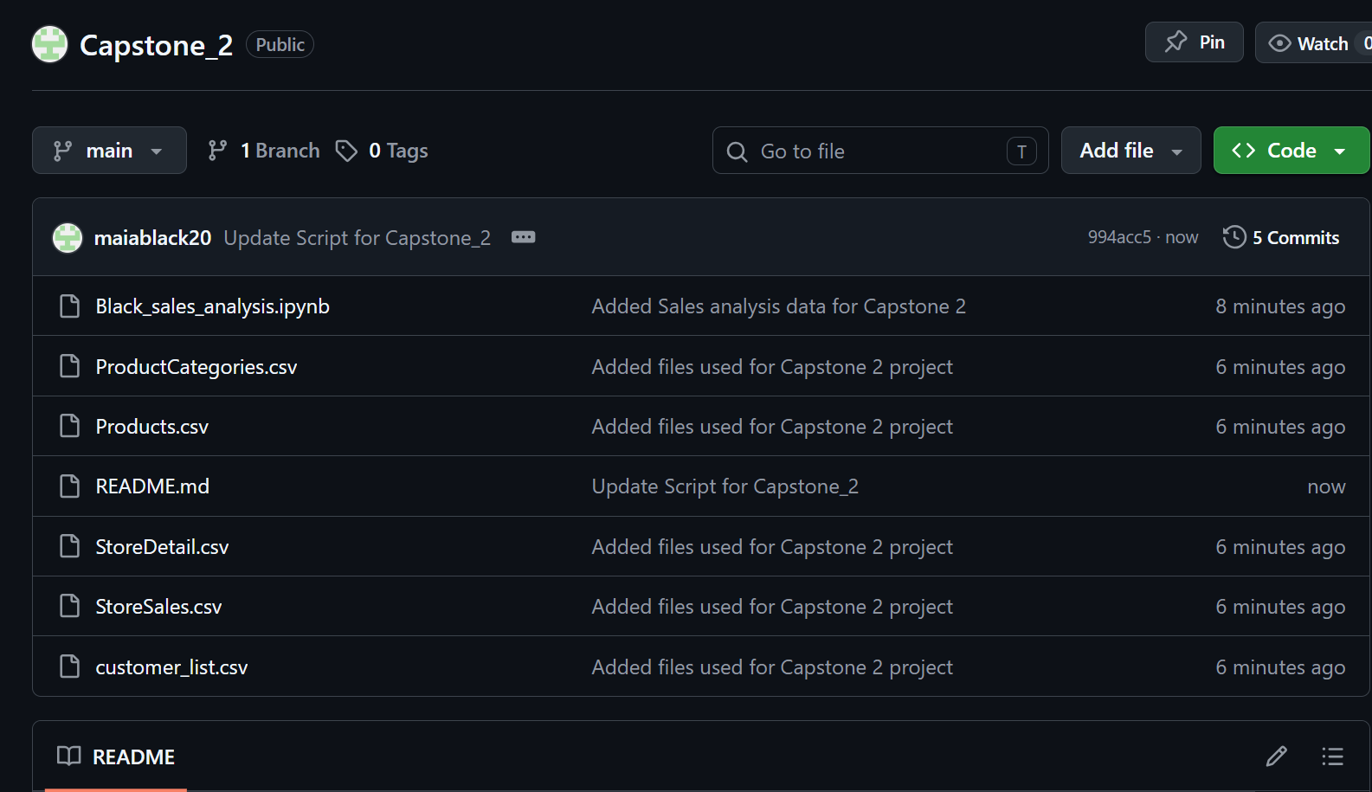
My Github Respository

Slide 11
Thank you all
For Listening

