Slide 1
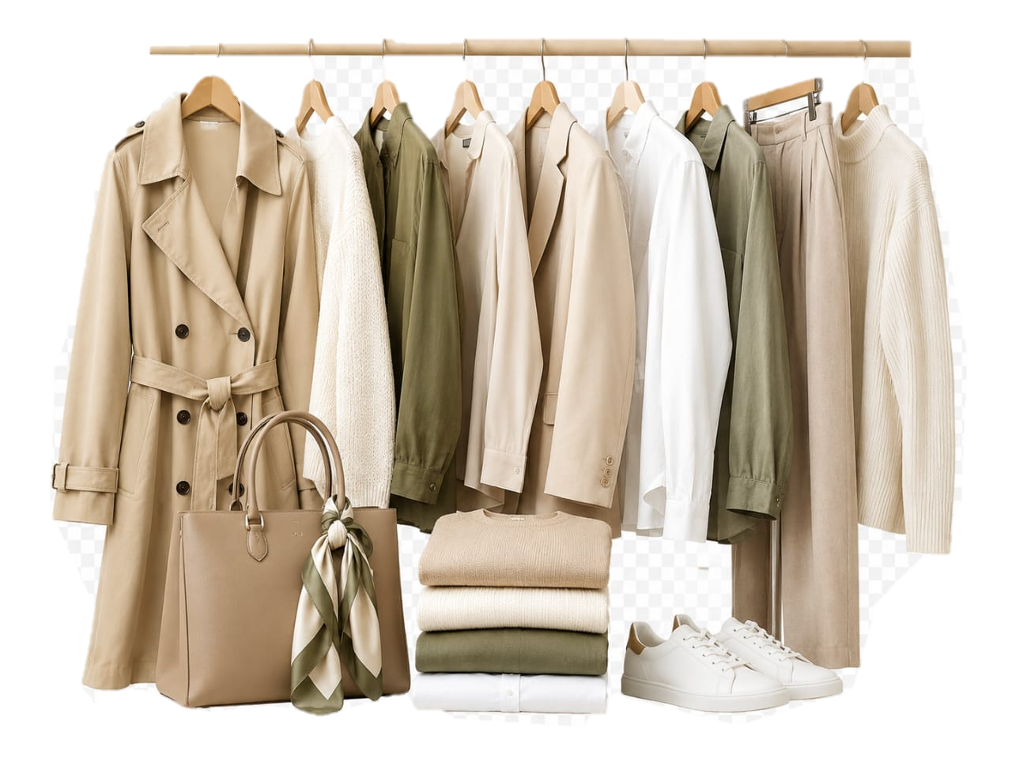

FASHION
STORE
FASHON STORE
Sales & Inventory Analytics Dashboard
HOME
An interactive analysis of sales, orders, products, customers, and inventory performance.
OVERVIEW
MARKETING TREND
ORDERS BY STATUS
SALES BY CATEGORY
INVENTORY OVERVIEW
Explore sales, customer behavior, and inventory performance across the dashboard.
VIEW DASHBORD
INVENTORY FORECAST

Slide 2
OVERVIEW
FASHION
STORE
A complete summary of sales, orders, profit, customers, and store performance.
OVERVIEW
TOTAL SALES
$10,827,118.90
TOTAL ORDERS
125,226
TOTAL PROFIT
$5,618,763.61
PROFIT MARGIN
51.90%
SALES PER ORDER
$86.46
HOME
MARKETING TREND
Top Category
Outwear & Coats
Best Selling Product
The North Face Apex Bionic Jacket
Top Distribution Center
Houston TX
ORDERS BY STATUS
SALES BY CATEGORY
Quick snapshot of overall business performance.
INVENTORY OVERVIEW
INVENTORY FORECAST

Slide 3
MARKETING TREND
FASHION
STORE
An analysis of sales performance and customer activity over time.
MARKETING TREND
HOME
OVERVIEW
ORDERS BY STATUS
SALES BY CATEGORY
INVENTORY OVERVIEW
PEAK SALES MONTH
January 2024 $826,763.25
YOY SALES GROWTH
187.64%
INVENTORY FORECAST

Slide 4
ORDERS BY STATUS
FASHION
STORE
An analysis of order completion, shipping, processing, cancellations, and returns..
ORDERS BY STATUS
TOTAL ORDERS
125,226
COMPLETED ORDERS
31,354
CANCELLED ORDERS
18,609
RETURNED ORDERS
12,530
RETURN RATE
10.01%
HOME
MARKETING TREND
OVERVIEW
SALES BY CATEGORY
INVENTORY OVERVIEW
INVENTORY FORECAST

Slide 5
SALES BY CATEGORY
FASHION
STORE
An analysis of sales, profit, and order performance across product categories
SALES BY CATEGORY
TOTAL SALES
$10,827,118.90
TOTAL PROFIT
$5,618,763.61
PROFIT MARGIN
51.90%
TOP CATEGORY
Outerwear & Coats
HOME
MARKETING TREND
OVERVIEW
ORDERS BY STATUS
INVENTORY OVERVIEW
INVENTORY FORECAST

Slide 6
INVENTORY OVERVIEW
FASHION
STORE
An analysis of stock levels, inventory availability, and product distribution across categories and distribution centers.
INVENTORY OVERVIEW
TOTAL INVENTORY ITEMS
490,705
SOLD ITEMS
181,759
AVAILABLE ITEMS
308,946
INVENTORY VALUE
$8,854,752.69
LOW STOCK PRODUCTS
15,229
PRODUCTS WITH 1-10 ITEMS AVAILABLE
HOME
MARKETING TREND
OVERVIEW
ORDERS BY STATUS
SALES BY CATEGORY
INVENTORY FORECAST

Slide 7
INVENTORY FORECAST
FASHION
STORE
A forecast of future inventory demand, stock availability, and potential replenishment needs.
INVENTORY FORECAST
FORECAST DEMAND
14,905
EXPECTED AVAILABLE STOCK
308,946
STOCK GAP
249,041
REORDER REQUIRED
NO
HOME
MARKETING TREND
OVERVIEW
ORDERS BY STATUS
SALES BY CATEGORY
INVENTORY OVERVIEW

Slide 8
KEY INSIGHTS
Summary of the most important findings from the sales and inventory analysis.
FINANCIAL PERFORMANCE
$10.83M Sales
$5.62M Profit
51.90% Margin
125,226 Orders
$86.46 per Order
TOP PERFORMANCE
Outerwear & Coats The North Face Apex Bionic Jacket Houston TX
ORDER PERFORMANCE
SALES MOMENTUM
Peak Month: January 2024Sales: $826,763.25YoY Growth: 187.64%
INVENTORY POSITION
490,705 Total Items
308,946 Available
$8.85M Inventory Value
FORCAST OUTLOOK
Forecast Demand: 14,905
Stock Gap: 294,041
Reorder Required: No

Slide 9
RECOMMENDATIONS
Suggested actions based on sales, order, and inventory performance.
INVENTORY PLANNING
Maintain sufficient stock for high-demand categories, especially Outerwear & Coats.
Prioritize top-selling products in purchasing and marketing campaigns.
RETURNS & CANCELLATIONS
Investigate returned and cancelled orders to improve customer experience and reduce losses.
PRODUCT STRATEGY
Allocate more inventory to high-performing distribution centers such as Houston TX.
DEMAND FORECASTING
Use monthly forecasting to support purchasing and replenishment decisions.
Monitor the 15,229 products with only 1–10 items available and prioritize urgent replenishment.
DISTRIBUTION OPTIMIZATION
LOW STOCK CONTROL

