Slide 1
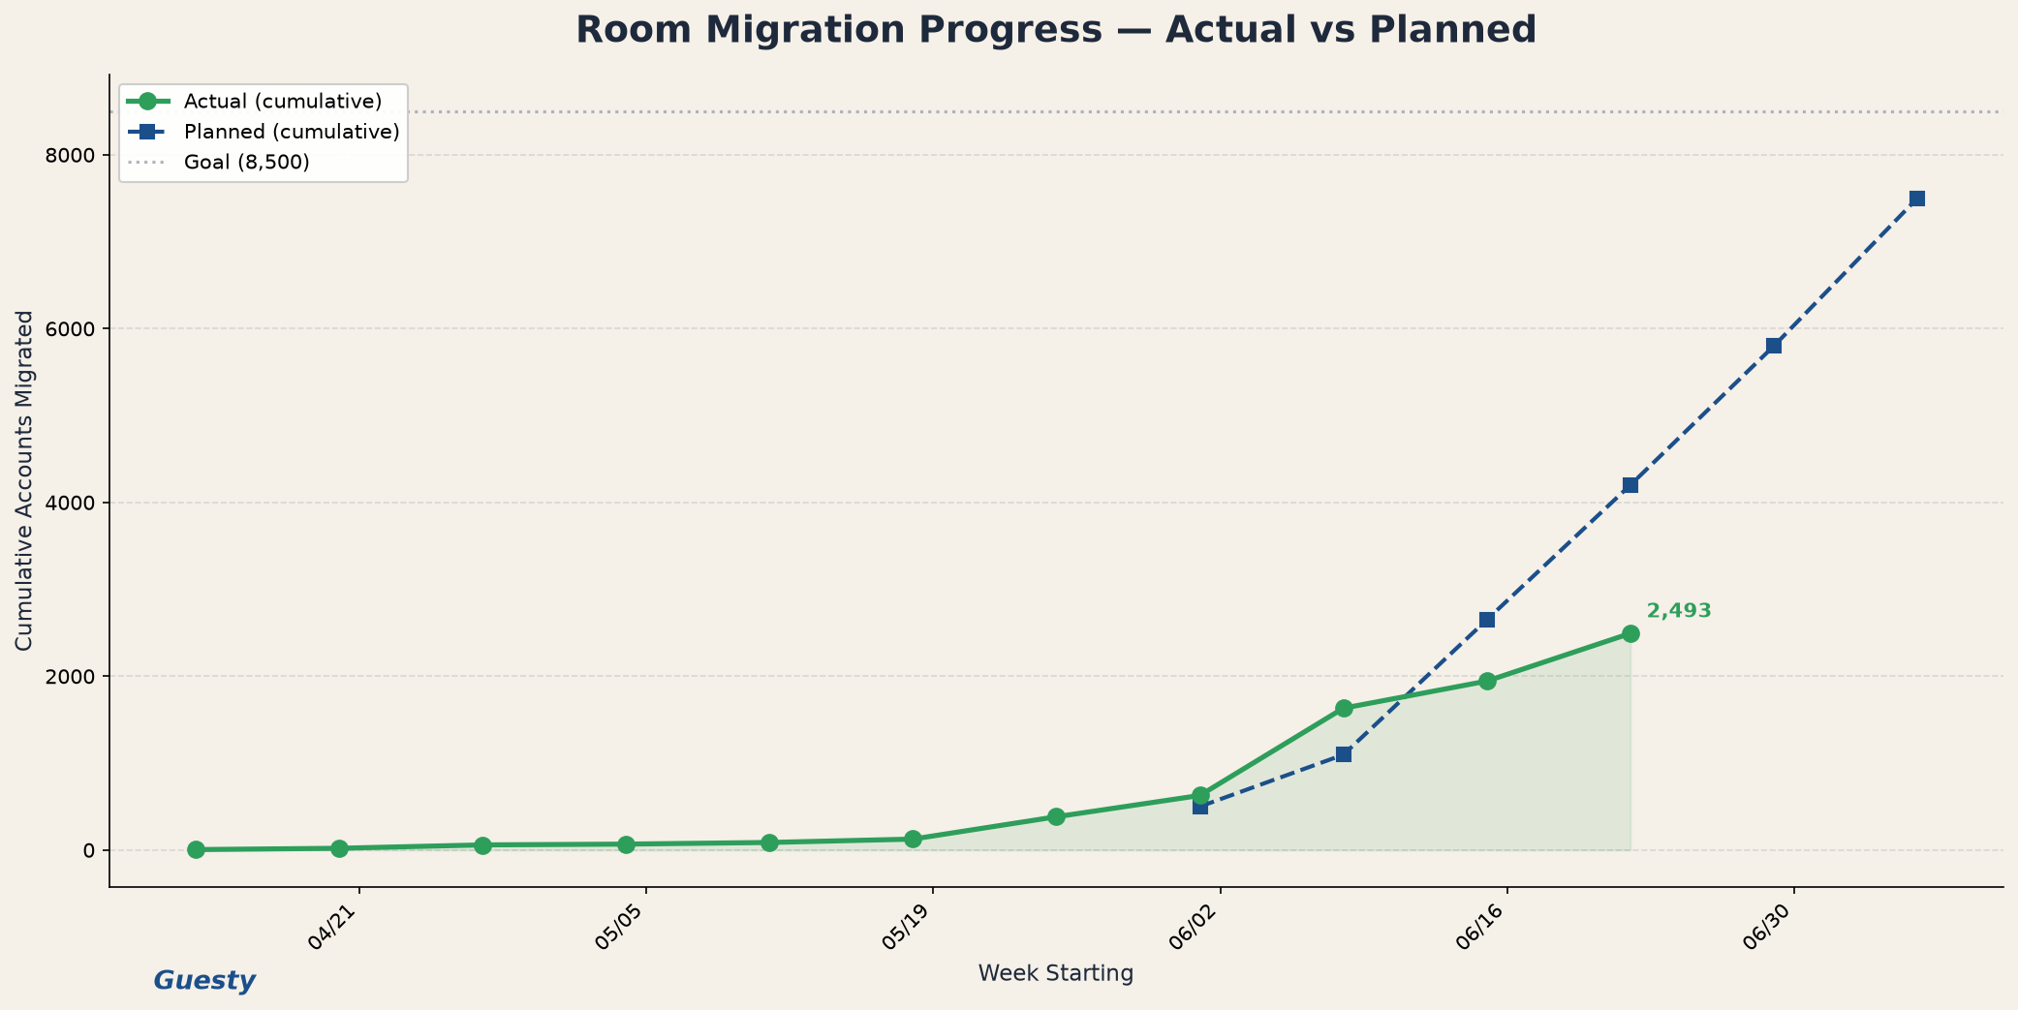
Room Migration Progress — Cumulative Totals
As of 6/22/2026 · Click any tab below to navigate
Cumulative Total
Planned Target
Variance
Goal
2,493
4,200
-1,707
8,500
All weeks combined through this date
Plan for 6/22/2026
Actual minus planned
Near-term account target
Recent cumulative totals (click Chart for full view →)
Week | Weekly | Cumulative Total | Planned
6/1/2026 | 245 | 628 | 500
6/8/2026 | 1,004 | 1,632 | 1,097
6/15/2026 | 312 | 1,944 | 2,650
6/22/2026 | 549 | 2,493 | 4,200
▸ Click chart to enlarge
Overview
Chart
Cumulative Data
Weekly Detail
Phases

Slide 2
Actual vs Planned — Cumulative Line Chart
Green = cumulative actual total per date · Blue dashed = planned · Click Data tab to edit numbers
✎ Edit data on Cumulative Data slide
Overview
Chart
Cumulative Data
Weekly Detail
Phases

Slide 3
Cumulative Data (Editable)
Edit Weekly columns — Cumulative Total = sum of all prior weeks through that date
Week | Wk Lite | Wk Pro | Wk Ent | Wk Total | Cum Lite | Cum Pro | Cum Ent | Cum Total | Planned | Variance
4/13/2026 | 5 | 0 | 0 | 5 | 5 | 0 | 0 | 5
4/20/2026 | 11 | 4 | 0 | 15 | 16 | 4 | 0 | 20
4/27/2026 | 28 | 11 | 0 | 39 | 44 | 15 | 0 | 59
5/4/2026 | 6 | 3 | 0 | 9 | 50 | 18 | 0 | 68
5/11/2026 | 11 | 8 | 0 | 19 | 61 | 26 | 0 | 87
5/18/2026 | 23 | 16 | 0 | 39 | 84 | 42 | 0 | 126
5/25/2026 | 159 | 98 | 0 | 257 | 243 | 140 | 0 | 383
6/1/2026 | 109 | 136 | 0 | 245 | 352 | 276 | 0 | 628 | 500 | +128
6/8/2026 | 424 | 571 | 9 | 1004 | 776 | 847 | 9 | 1632 | 1097 | +535
6/15/2026 | 0 | 312 | 0 | 312 | 776 | 1159 | 9 | 1944 | 2650 | -706
6/22/2026 | 3 | 546 | 0 | 549 | 779 | 1705 | 9 | 2493 | 4200 | -1,707
6/29/2026 |  |  |  |  |  |  |  |  | 5800
7/6/2026 |  |  |  |  |  |  |  |  | 7500
Overview
Chart
Cumulative Data
Weekly Detail
Phases

Slide 4
Weekly Detail by Segment (Editable)
Enter weekly counts only — not cumulative. Totals roll up on Cumulative Data slide.
Week Starting | Lite | Pro | Enterprise | Weekly Total
4/13/2026 | 5 | 0 | 0 | 5
4/20/2026 | 11 | 4 | 0 | 15
4/27/2026 | 28 | 11 | 0 | 39
5/4/2026 | 6 | 3 | 0 | 9
5/11/2026 | 11 | 8 | 0 | 19
5/18/2026 | 23 | 16 | 0 | 39
5/25/2026 | 159 | 98 | 0 | 257
6/1/2026 | 109 | 136 | 0 | 245
6/8/2026 | 424 | 571 | 9 | 1004
6/15/2026 | 0 | 312 | 0 | 312
6/22/2026 | 3 | 546 | 0 | 549
Grand cumulative total through 6/22/2026: 2,493
Overview
Chart
Cumulative Data
Weekly Detail
Phases

Slide 5
Migration Phases (Editable)
Phase | Start | End | Days | Reservations | Accounts | Res/Acct
Ramp-up | 6/15/2026 | 8/3/2026 | 50 | 7,090,000 | 11,509 | 616
Steady Growth | 8/4/2026 | 9/22/2026 | 50 | 11,360,000 | 8,513 | 1335
Acceleration | 9/23/2026 | 11/11/2026 | 50 | 15,640,000 | 7,689 | 2034
Full Speed | 11/12/2026 | 12/31/2026 | 50 | 19,910,000 | 7,290 | 2731
Overview
Chart
Cumulative Data
Weekly Detail
Phases

