Slide 1
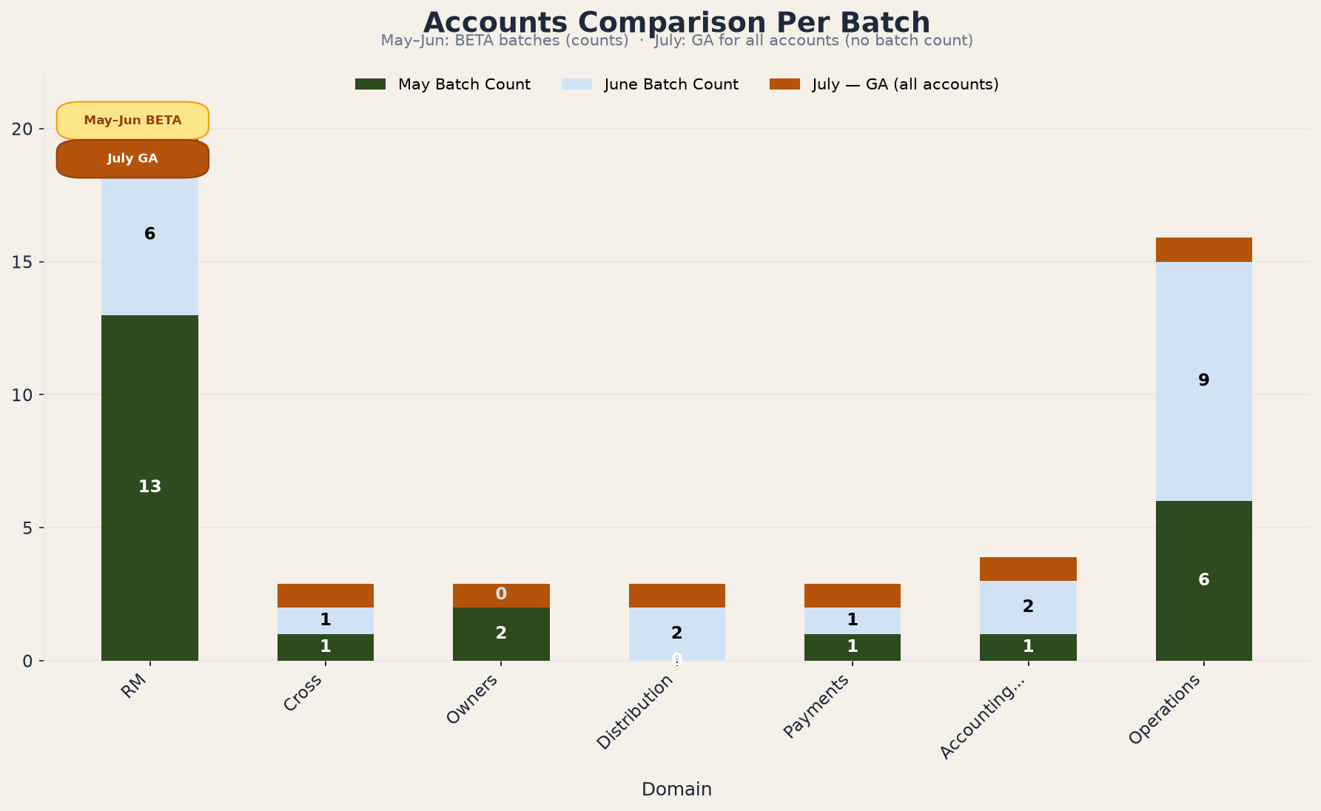
Slide 2 contains editable data · Upload to Google Drive → Open with Google Slides

Slide 2
Accounts Comparison Per Batch — Data (Editable)
Edit values below, then regenerate the chart if needed.
Domain | May Batch Count | June Batch Count | July | May+Jun Total
RM | 13 | 6 | GA (all) | 19
Cross | 1 | 1 | GA (all) | 2
Owners | 2 | 0 | GA (all) | 2
Distribution | 0 | 2 | GA (all) | 2
Payments | 1 | 1 | GA (all) | 2
Accounting... | 1 | 2 | GA (all) | 3
Operations | 6 | 9 | GA (all) | 15
■ May Batch Count (dark green) ■ June Batch Count (light blue) ■ July — GA for all accounts (amber; no per-domain count)

