Slide 1
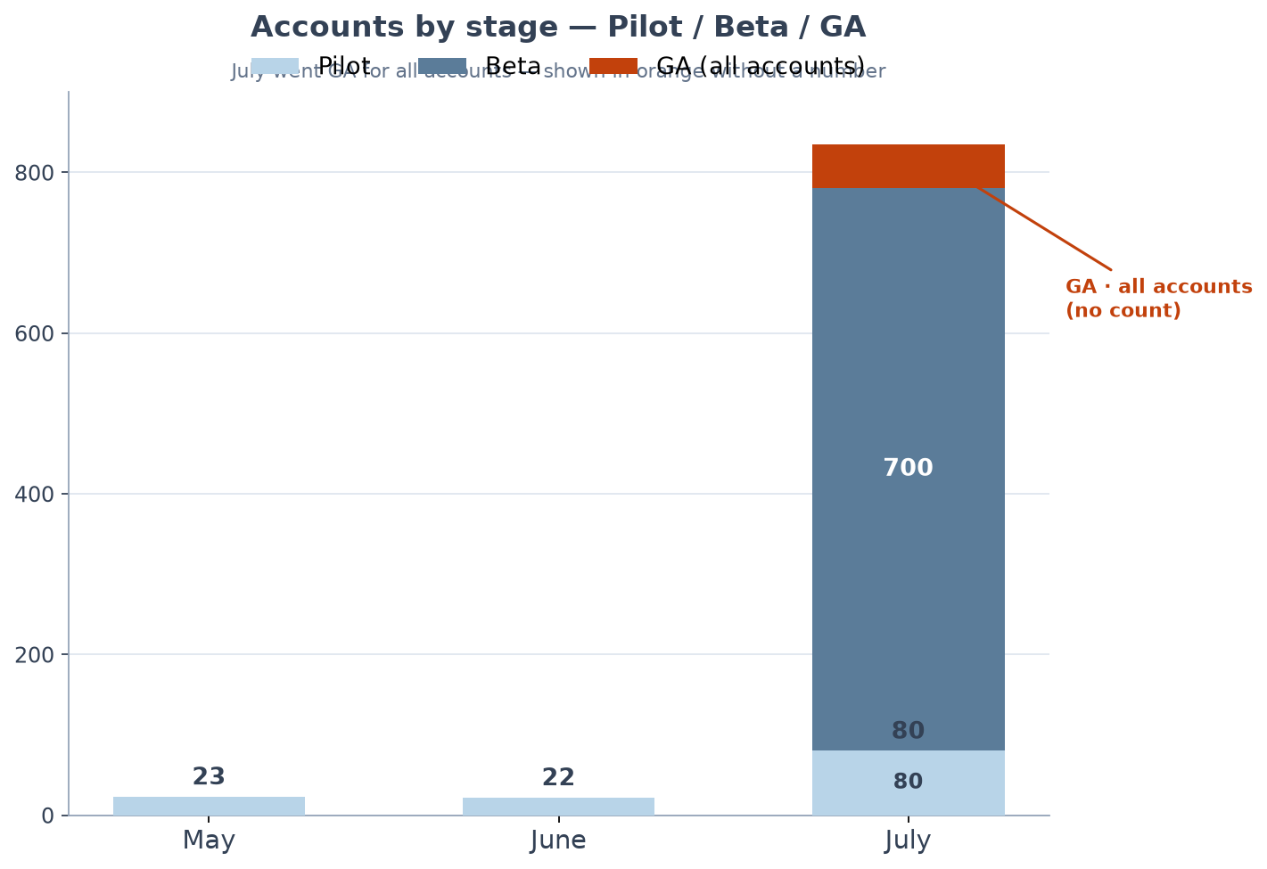
Slide 2 has editable data · Upload to Google Drive → Open with Google Slides

Slide 2
Accounts by stage — Pilot / Beta / GA (Editable)
July GA is for all accounts — leave the GA column blank / unlabeled in the chart.
Month | Pilot | Beta | GA | Pilot+Beta total
May | 23 | 0 | — | 23
June | 22 | 0 | — | 22
July | 80 | 700 | all accounts (no count) | 780
How to mirror this in Google Sheets: 1. Keep Pilot and Beta series with their numbers (and data labels). 2. Add a third series named "GA (all accounts)" with blank/0 in May–June and a small placeholder in July only for the orange stack color. 3. Turn OFF data labels for the GA series so no number appears. 4. Optionally rename the July category to "July (GA)" or add a chart annotation.

