Slide 1
CUDAREX
AURA, your personal AI workspace
Learning context you can inspect. Actions you choose.
Notes:
Personal AI Track. This deck describes a local test build. The live NVIDIA model call through Nebius is pending verification because no key was available during preparation. The platform is CUDAREX and the assistant is AURA.

Slide 2
The student workflow
A preference
A practice attempt
“Use examples and keep the first explanation short.”
“I tried the problem. What should I work on next?”
Product hypothesis: useful context and next steps belong in one inspectable workspace.
Notes:
This is an illustrative student scenario, not a quote from a user study. We have not measured demand or learning improvement. The first audience is students who want guided practice and control over retained context.

Slide 3
One coherent journey
01
Memory
Save a preference, then inspect or correct it.
02
Practice
Attempt a problem, request a hint, and try again.
03
Skills
Review a proposed improvement before it changes.
04
Planning
Approve an exact local event and inspect the audit.
Notes:
Demonstrate this sequence in the application rather than moving through disconnected pages. Six curated numerical practice problems support deterministic grading. User-created skills provide reusable instructions. In no-key mode their invocation shows an honest preview. Generated skill responses need the configured model.

Slide 4
Learning evidence
Six curated problems
Independent practice
A correct attempt before the solution reveal adds evidence for that topic.
Progressive hints and numerical checks make the result inspectable.
Assisted practice
A revealed answer does not add independent success credit.
Notes:
The bank covers Newton’s second law, Ohm’s law, kinetic energy, speed, uniform acceleration and a linear equation. This is bounded practice, not arbitrary homework grading or a validated assessment of general ability. Numeric attempts and hint state persist in SQLite.

Slide 5
Model advice and action authority
Nebius text generation
Server-side decisions
Open-ended explanation and reusable skill instructions
Permission checks, exact stored payloads, single-use approval and conflict checks
Live NVIDIA model verification remains pending
Notes:
A server-side adapter targets the configured Nebius text-completion endpoint. Keys never belong in the browser. Saved memory sharing is off by default and separately controlled. The model has no executable tool channel. Before final submission, show an actual successful runtime request using an available NVIDIA open-source model. Do not replace this disclosure with an untested claim. Official requirement: https://nebiusglobalaihackathon.devpost.com/rules

Slide 6
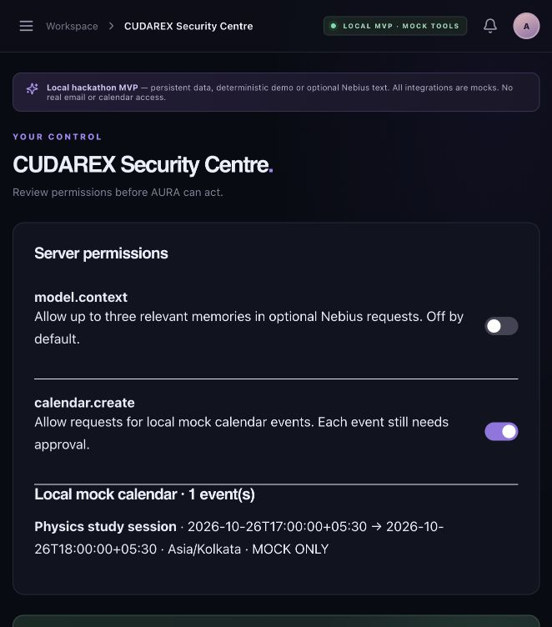
Approval is part of the product
Exact proposal
The user chooses the title and time. The server checks permission and conflicts again at approval.
Calendar remains a local mock. ICS export lets the user choose a manual import.
Notes:
The screenshot comes from the local MVP verification and contains sample QA data. The current build adds editable title/time proposals, conflict checks and manual ICS export. No Google Calendar OAuth or account access exists. A local record is not a claim of an external calendar write.

Slide 7
Next validation
A complete local test build
Persistent memory and evidence. Reusable skills. User-reviewed actions.
Next: verify the NVIDIA runtime on Nebius, record the real flow, and test the experience with students.
Notes:
No user study, usage count, learning gain or performance benchmark has been claimed. The local service runs while open and is not yet a hosted always-on agent. Live integration work follows identity, ownership, token storage and independent security review. Final entry also needs public repository and video links and actual provider feedback.

