Slide 1
The housekeeping proteome
Status updates week 7
Mai Nguyen
Main supervisor: Evelina Sjöstedt

Slide 2
Introduction: Project motivations
Target: the human housekeeping genes/proteins (HKGs/HKPs)
Commonly defined as:
Essential for cell survival,
Consistently expressed across tissues, cell types or context
Involved in cellular maintenance function
Highly conserved across species
→ There is a need for an update on the definition and the list of human housekeeping proteins
challenged by several research groups

Slide 3
Introduction: Project aim
Define the human housekeeping genes and proteins based on 4 data sets:
Single cell type - 81 cell types
Single nuclei (brain) - 34 cluster types
Immune cell (flow sorted cells) - 19 immune cells (18 pbmc)
Cell lines - 1206 different cell lines

Slide 4
Project preliminary workflow
Data preprocess
Wide-format conversion
Assessment 1: “always expressed” analysis
Find genes that were always expressed in all samples for each data set
Assessment 2: stability of expression analysis
Find genes that were stable expressed in all samples for each data set
UMAP/PCA
Assess the overlaps between four data sets
Assess the overlaps between four data sets
Assessment 3: functional enrichment analysis
Perform functional enrichment on the overlapped list and expected HKPs list
Assess the overlaps
Assessment 4: essentiality analysis
Extract the degree of essentiality of the overlapped list
Assess the essentiality and define a threshold
Cross validation
With GTEx data set
With other publication
Overlaps joint

Slide 5
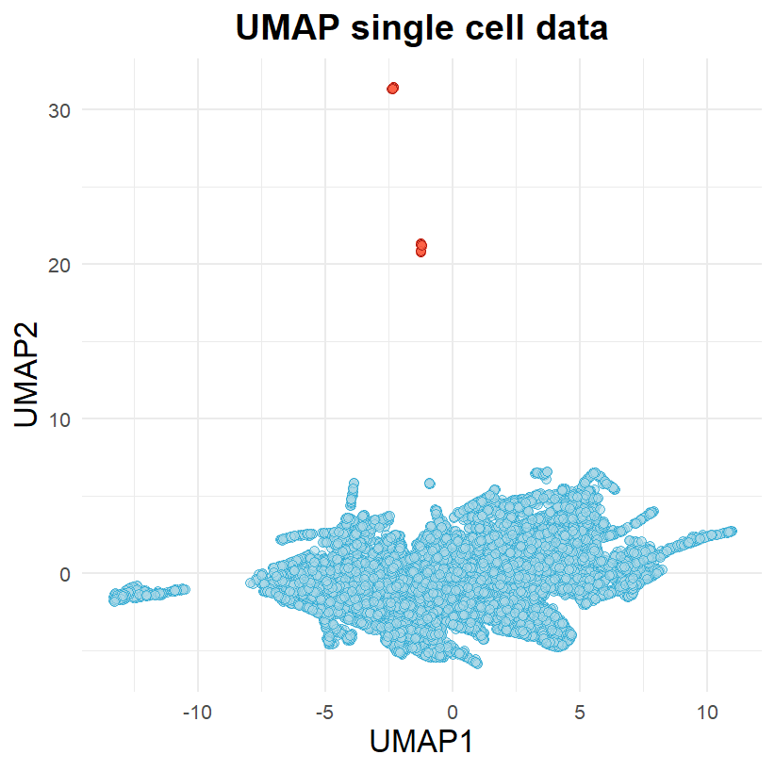
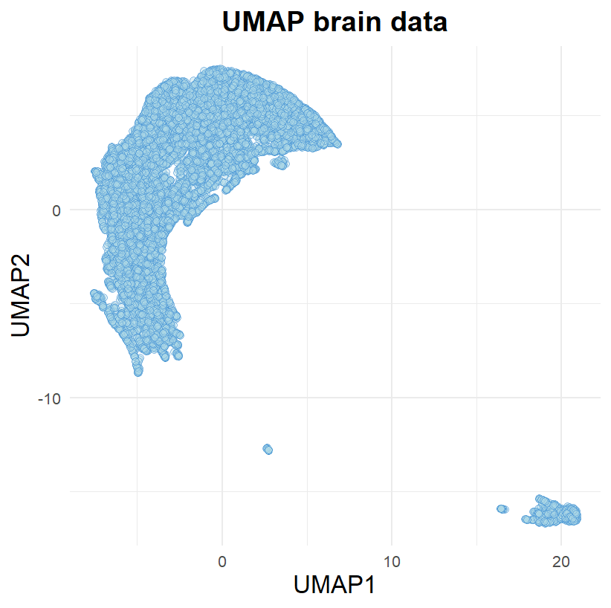
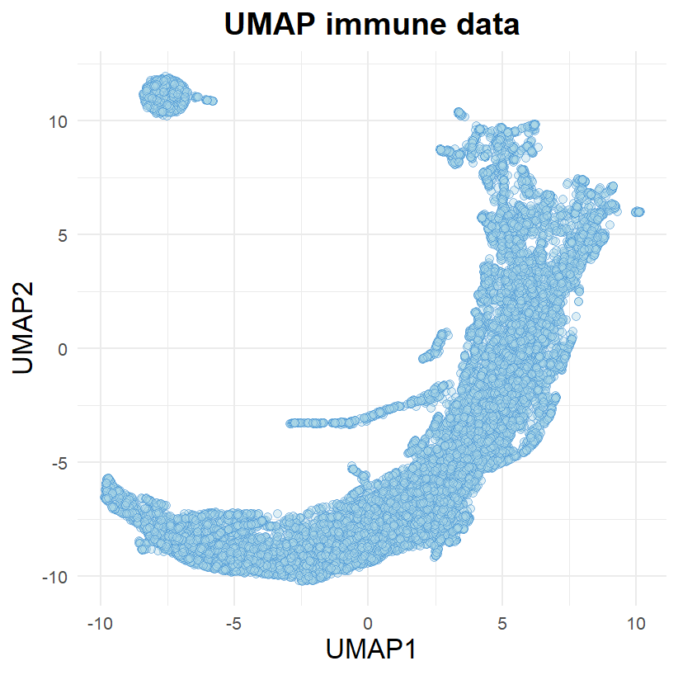
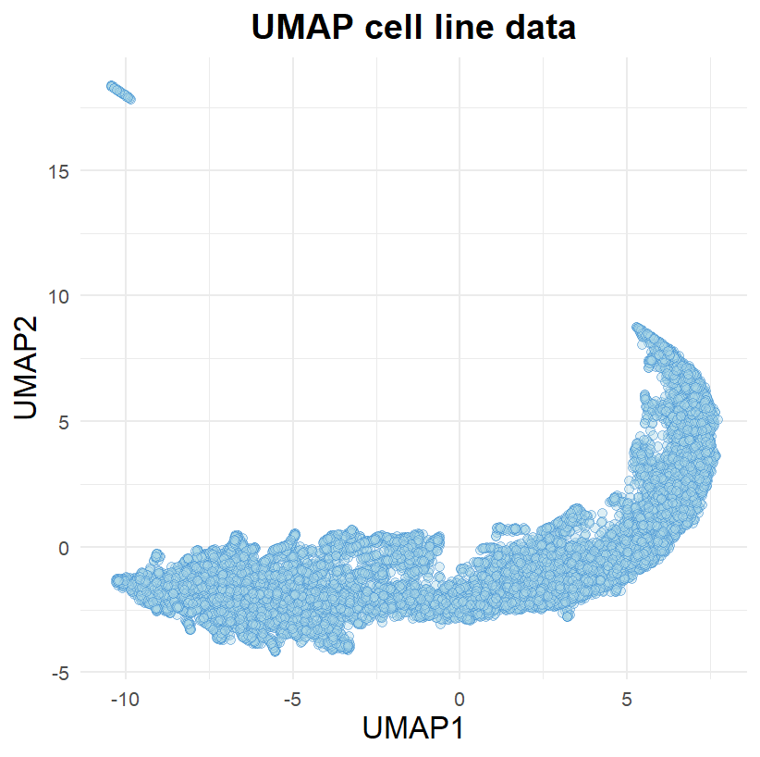
Data pre-process: UMAP

Slide 6
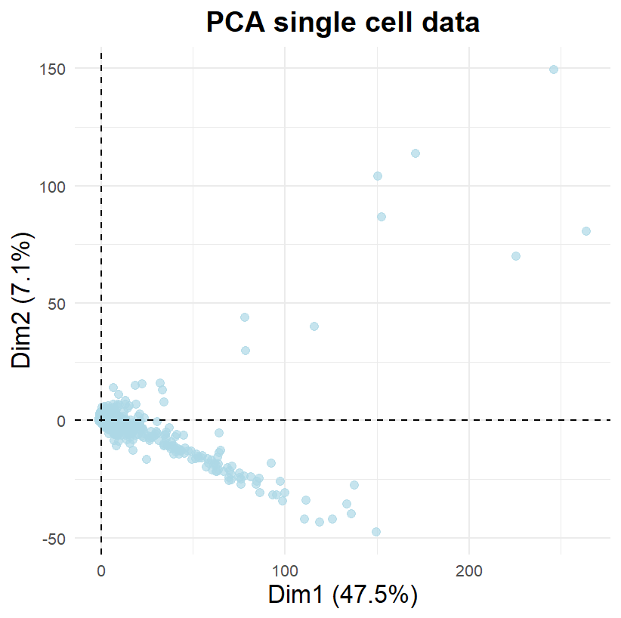
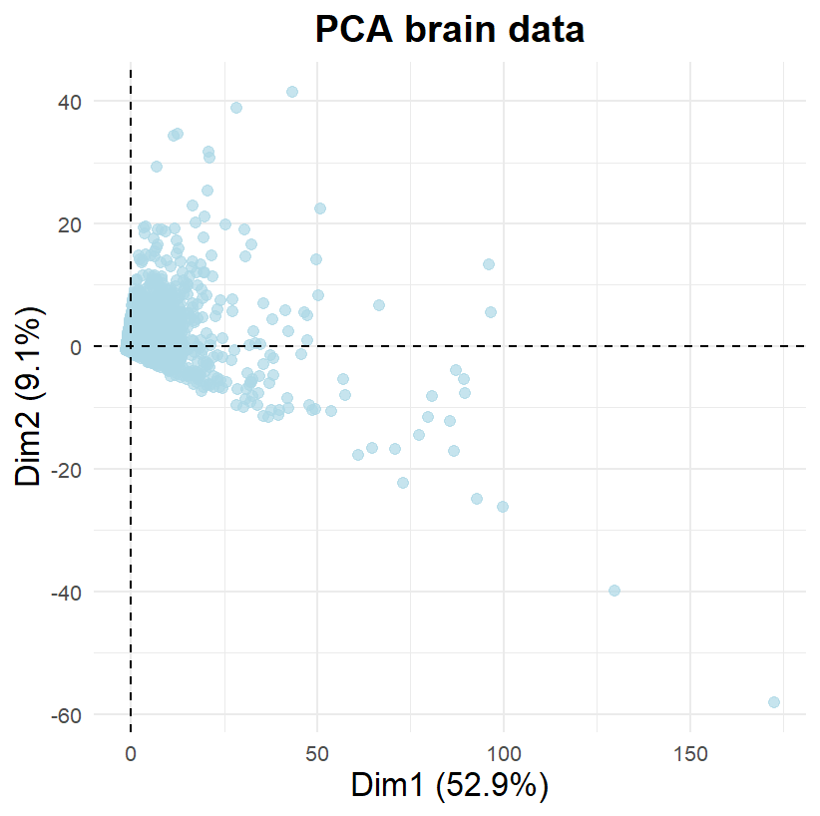
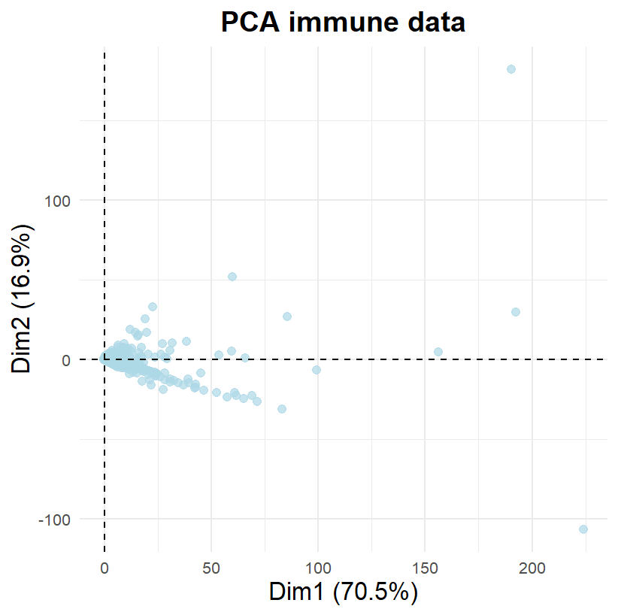
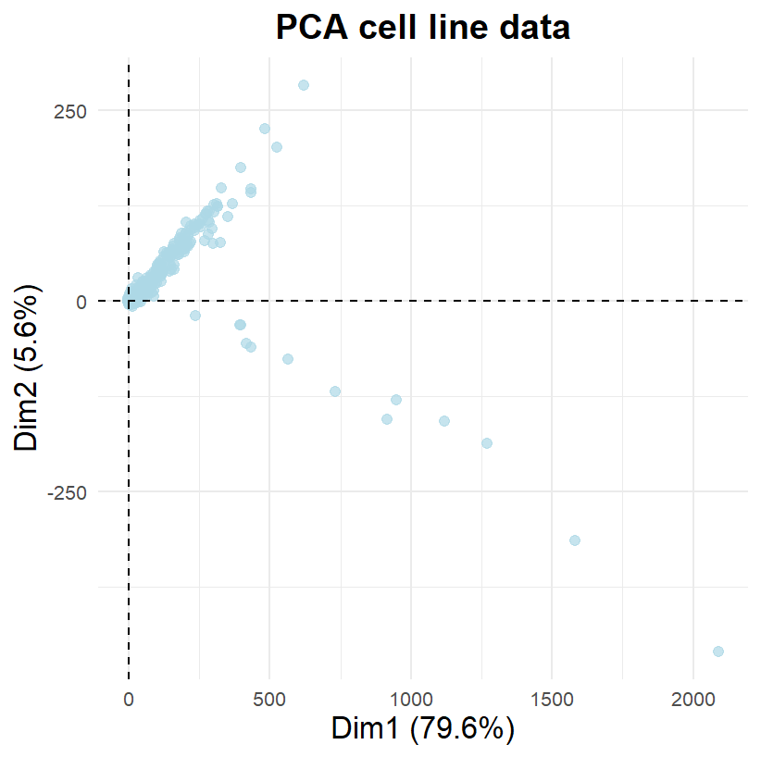
Data pre-process: PCA

Slide 7
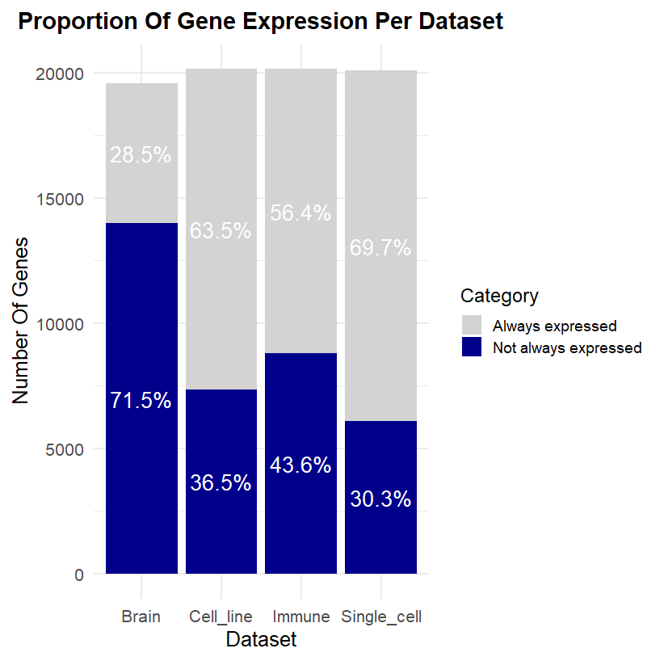
Assessment 1: “always expressed” analysis
Criteria: a gene is always expressed when it has nTPM > 0 in all samples (100%)
Stacked bar plot of 2 categories: “always expressed” or not

Slide 8
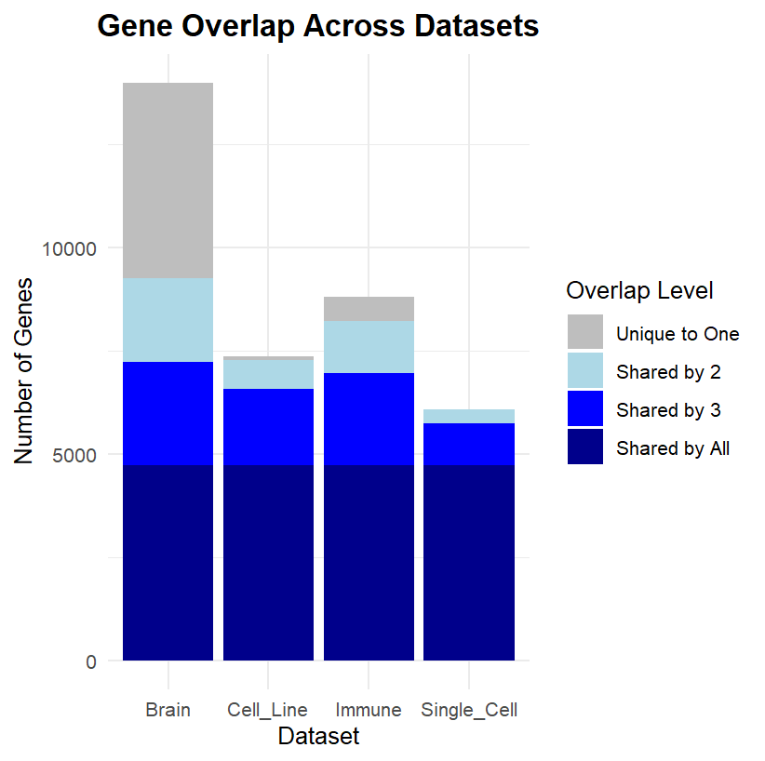
Assessment 1: “always expressed” analysis
Among “always expressed” genes, about 4500 genes are shared between 4 data sets

Slide 9
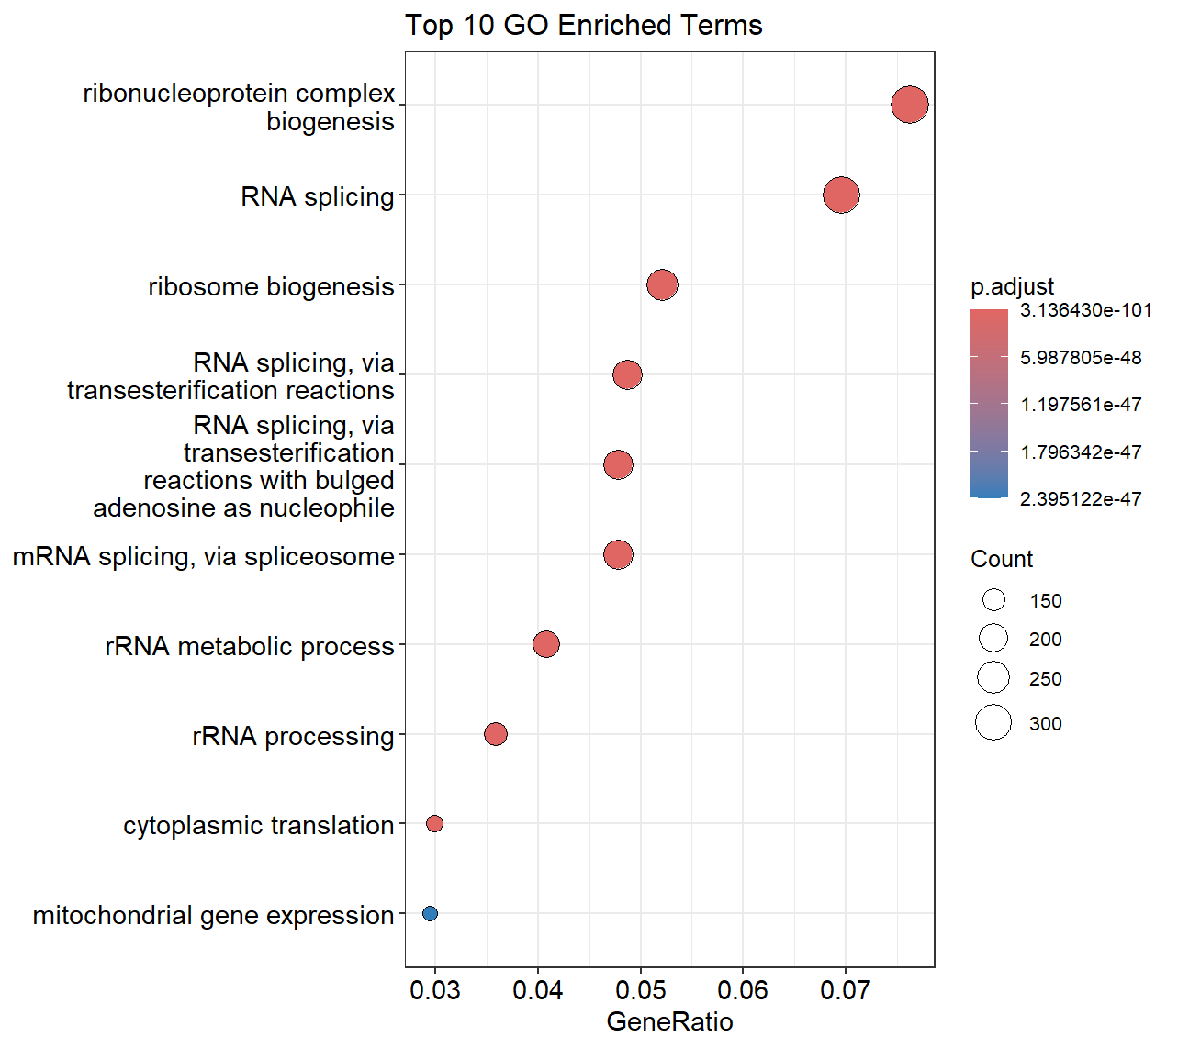
Assessment 1: “always expressed” analysis
A quick functional enrichment of the “always expressed” genes, in which most of them are already basic cellular maintenance pathways

Slide 10
Next step
Assessment 1 touchup?
Start assessment 2: Stable expression analysis
Possible method: Gini Coefficient

