Slide 1
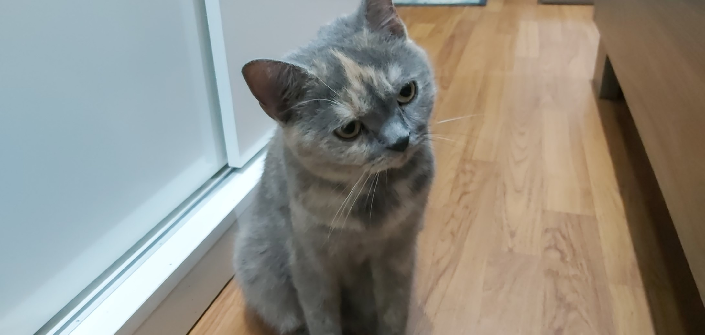
Analysis of new Olink proteomics data from S3WP: toward multi-omics integration
Project in Molecular Life Science
Student: Mai Nguyen – MTLS
Supervisor: María Bueno Álvez

Slide 2
Analysis of new Olink proteomics data from S3WP: toward multi-omics integration
Project in Molecular Life Science
Student: Mai Nguyen – MTLS
Supervisor: María Bueno Álvez

Slide 3
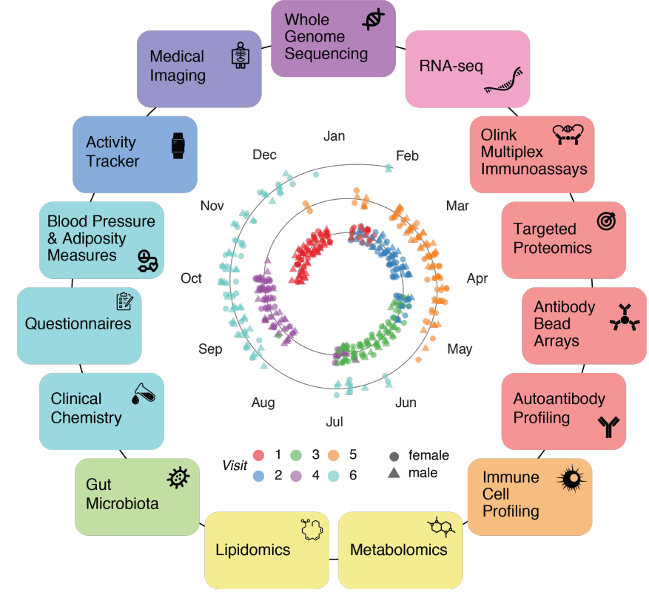

Introduction
101 healthy volunteers,
6 visits
The Swedish SCAPIS SciLifeLab Wellness Profiling (S3WP) program
Notes:
omprehensive, nationwide research initiative aimed at enhancing the prediction and prevention of cardiovascular disease (CVD) and chronic obstructive pulmonary disease (COPD).
To define the “wellness profile” of individuals using state-of-the art molecular analyses

Slide 4
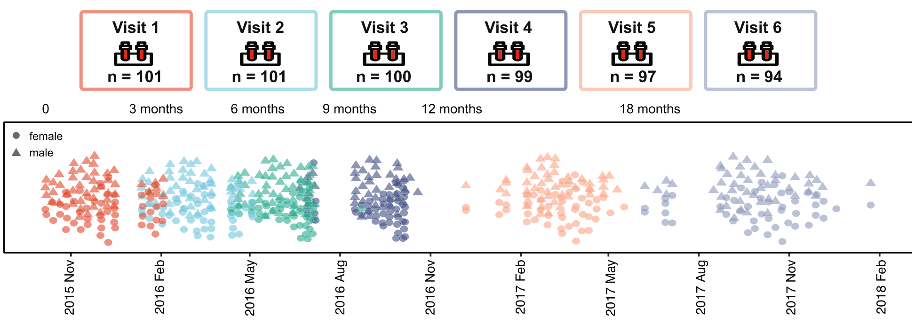
Introduction
Longitudinal sample collection

Slide 5
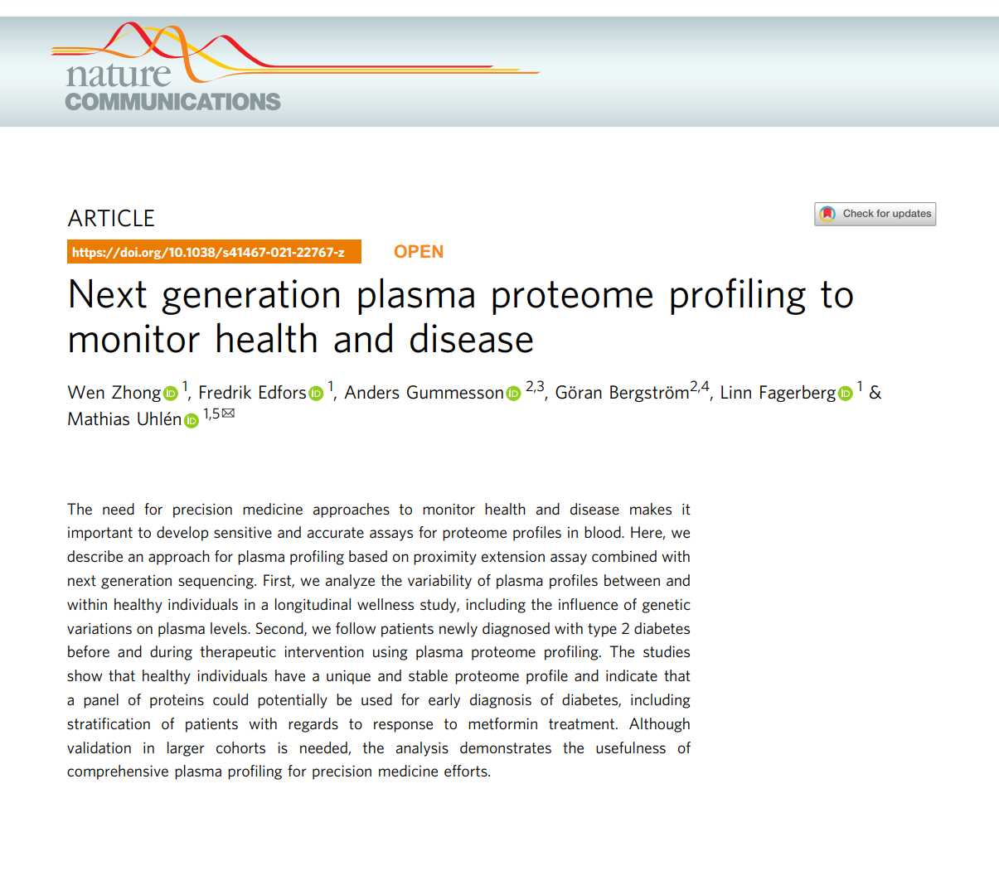

Introduction
Olink NGS - 2019
Olink HT - 2024

Slide 6
Research questions
Re-analyze the longitudinal plasma protein profile of more than 5000 proteins
Extract significant health information
Compare with findings from earlier proteomics platforms
Potential of multi-omics integration

Slide 7
Project plan
Tasks | Deliverables | Week
 |  | 44 | 45 | 46 | 47 | 48 | 49 | 50 | 51 | 52 | 01 | 02
Literature search | Understand the research topic via prior publications | x |  |  |  |  |  | x | x
Method exploration | Discover and test essential R packages for the analysis | x | x
QC & pre-processing | QC and normalization for batch/technical bias |  | x | x
Platform comparison | Compare data from Olink Explorer (3) and (new) Olink HT |  | x | x | x
New proteomics analyses | Multivariate analyses, protein correlation across longitudinal samples, pathway enrichment |  |  |  | x | x | x | x | x | x
Result interpretation | Visualization of the analysis result |  |  |  | x | x | x | x | x | x
Presentation | Half-time and final presentation |  |  |  | x |  |  |  |  |  | x | x
Report | Project report |  |  |  |  |  |  |  |  | x | x | x

Slide 8
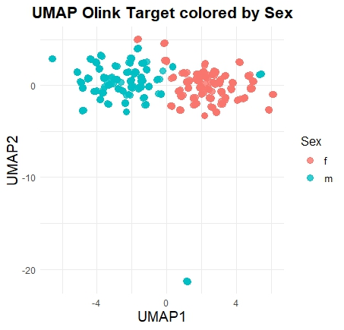
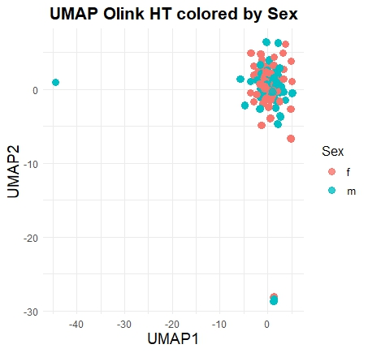
Initial results

Slide 9
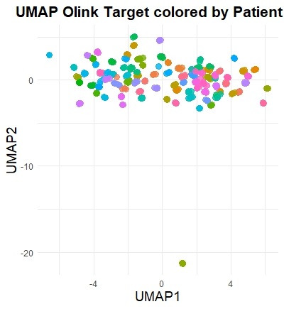
Initial results

Slide 10
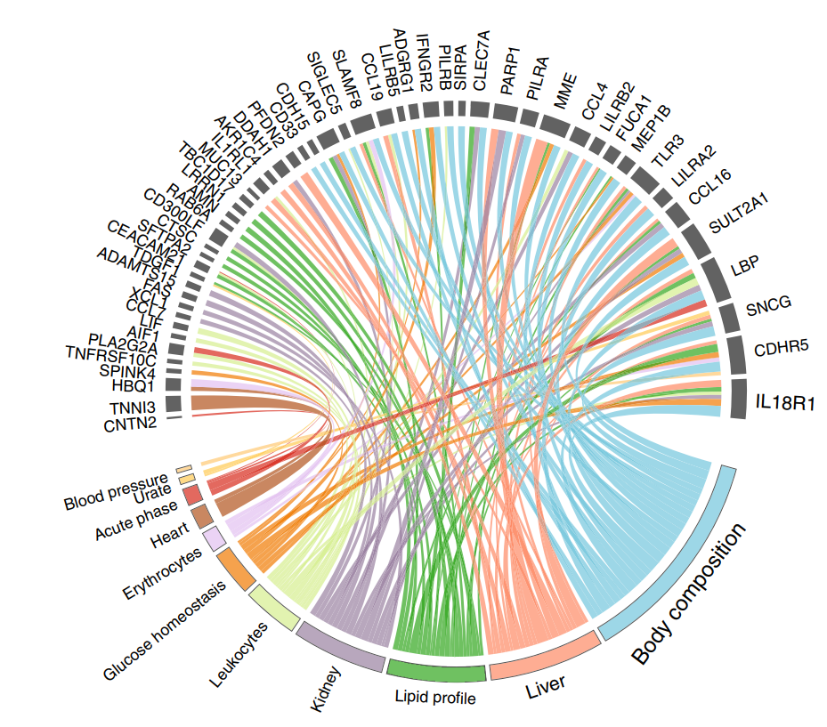
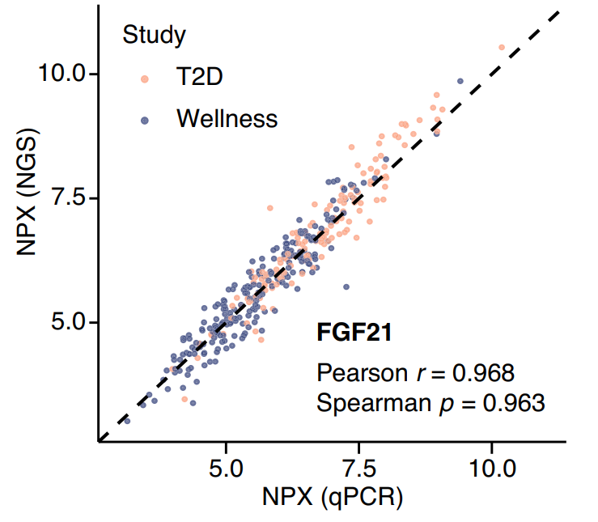
Expected result

Slide 11
Summary
Project: re-analysis of longitudinal plasma proteomics profile
Status: on-time

Slide 12


