Slide 1
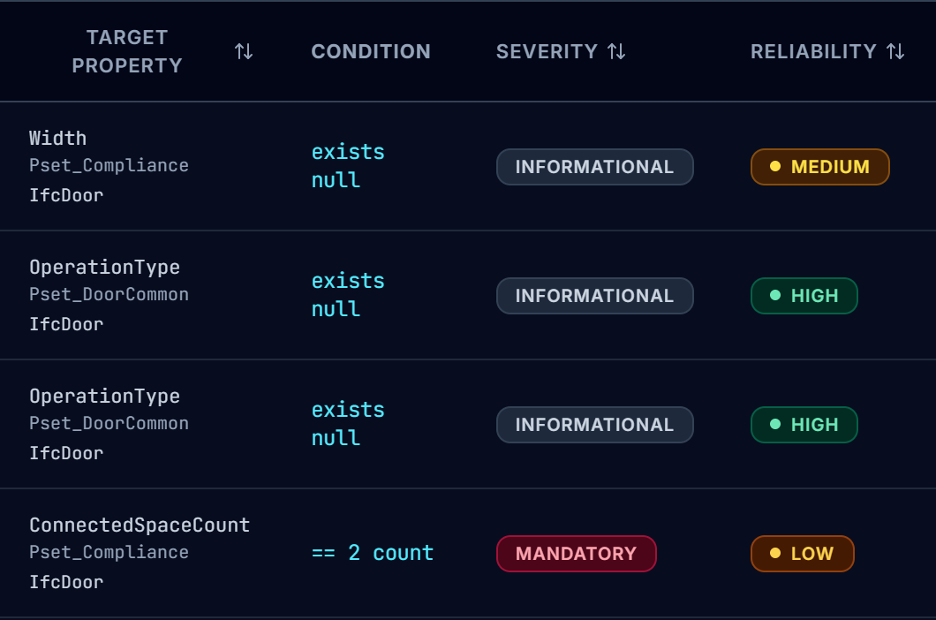
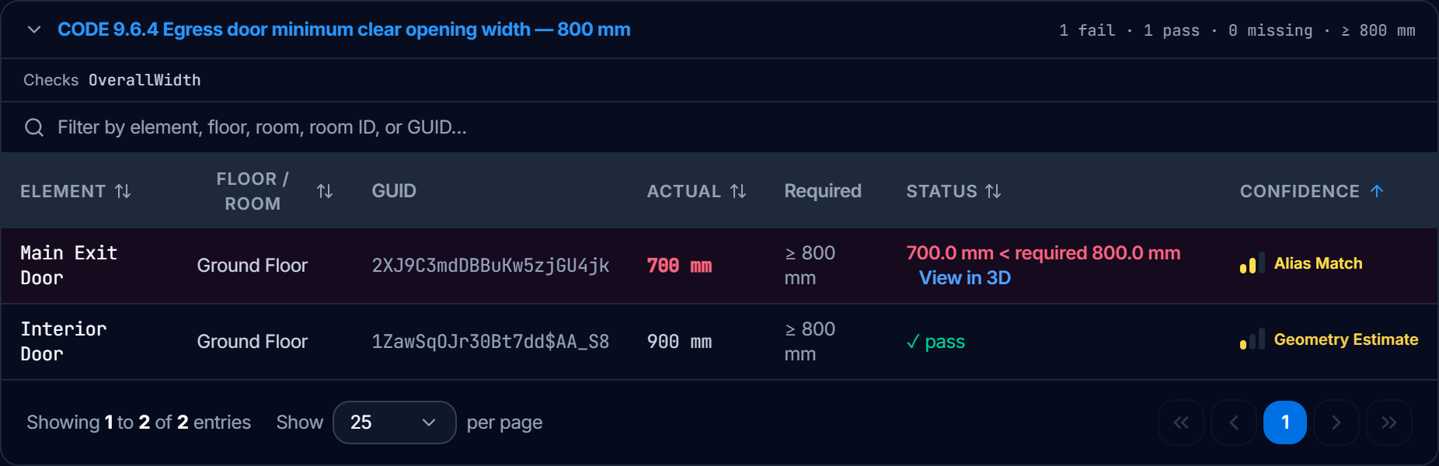
Every finding carries two grades and one verdict
PRESENTER Malak
Pillar A · Rule extraction
Pillar B · Compliance testing
Reliability of the rule · if the value is present, is it true?
Reads the real IFC values · no silent defaults
HIGH
Stored in the file, one source
IFC attribute, element class, stored relationship, Qto quantity
Confidence of the result
Six verdicts
Authored property
PASS
Value found, meets the rule
MEDIUM
Standard property set
True when found, but many models do not export it
Derived from model geometry
FAIL
Value found, breaks the rule
Type-inherited
MISSING
Value not in the model
LOW
Not held in the model
Geometry estimate, custom Pset, manufacturer or user-defined field
Alias match
NOT ASSESSED
No rule or no evidence
Rule fallback property
Geometry estimate
N/A
Outside the rule's scope
Live · Rules Catalog
Every rule shows its grade before any model is loaded.
A rule takes the grade of its weakest property.
Unresolved
UNDETERMINED
Scope cannot be tested
Live · audit result: one door fails, one passes, each with its confidence
Notes:
Pillar A, rule extraction: every rule is graded for reliability from the IFC property it reads. The screenshot is the live Rules Catalog filtered to door rules; OperationType grades High, Pset properties grade Medium, ConnectedSpaceCount grades Low. Pillar B, compliance testing: each element gets one of six verdicts plus a confidence grade that says where the value was found. The screenshot is a live audit of the Broken Twin Model v3 against BUILDING-CODE-PART9: the Main Exit Door fails the 800 mm egress width rule at 700 mm (confidence: Alias Match) and the Interior Door passes at 900 mm (confidence: Geometry Estimate).

