Slide 1








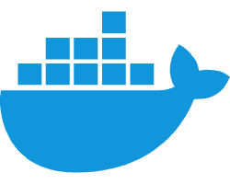
ComercioLocal.com / LocalCommerce.com
.NET
Result
HealthChecks
K8s
Nginx Ingress LoadBalancer
Nginx Ingress container
Logs ? (elastic/Kibana)
APIServiceDiscovery
Shared
Parametricas
Stores
webApp
Interactions
Authorization & Authentication
Products
Api Gateway
Turism
Services
RealState

Slide 2
Tareas
Instalar GUI para paquetes NUGET
Estudiar (DockerCompose?K8s)

