Slide 1
Adaptive Traffic-Signal Control as a Multi-agent MDP
A cooperative MMDP traffic domain and a head-to-head study of value-factorisation MARL
SUMO microsimulation + PettingZoo · IQL · Hysteretic-Q · VDN · QMIX (CTDE)

Slide 2
Motivation & contributions
Urban congestion is a coordination problem: fixed-time signals can't adapt to shifting demand,
and neighbouring junctions must act jointly to move platoons through a corridor.
We cast adaptive traffic-signal control as a cooperative Multi-agent MDP (MMDP):
one agent per junction picks a green phase; all agents share a single team reward.
Contributions
A configurable MMDP traffic domain: 4 purpose-built stress scenarios + 2 real RESCO benchmarks.
A head-to-head evaluation of IQL, Hysteretic-Q, VDN and QMIX (CTDE) on it.
A reproducible 5-seed pipeline reporting mean +/- std, with an open SLURM harness.

Slide 3
Modelling the domain as an MMDP

Slide 4
MMDP formulation
Agents N
One controller per signalised junction (1x4: A0,B0,C0,D0; cologne3: 3; grid4x4: 16).
State S (near-full observability -> MMDP, not Dec-POMDP)
Each agent sees local E-W & N-S queues PLUS the rest-of-network E-W & N-S queues,
discretised into 5 bins per dimension (5^4 = 625 joint-aware states).
Actions A
Joint action = product of each junction's green-phase choice (1x4: 2 phases; RESCO: up to 8).
Transitions T
SUMO microsimulation with stochastic (Poisson) arrivals and platoon injections.
Reward R (cooperative / shared)
Single team reward broadcast to all agents: R = - sum of accumulated waiting time over all lanes.

Slide 5
Why this is an MMDP (and why these algorithms fit)
MMDP = cooperative multi-agent MDP: a shared/observable joint state and a single team reward.
The rest-of-network observation pushes each agent toward the global state -> approximates full observability.
The synchronized global reward makes all agents optimise one cooperative objective.
This is exactly the setting cooperative value-factorisation methods target:
VDN and QMIX (CTDE) learn a joint value and factor it for decentralised execution.
IQL and Hysteretic-Q are decentralised baselines that ignore / partially correct for non-stationarity.

Slide 6
The algorithms we evaluate

Slide 7
Independent & Hysteretic Q-Learning (decentralised baselines)
Independent Q-Learning (IQL)
Every agent runs its own tabular Q-learning, treating other agents as part of the environment.
Simple, but the environment looks non-stationary from each agent's view.
Hysteretic Q-Learning
Optimistic IQL: large LR (alpha) for positive TD errors, small LR (beta) for negative ones.
Reduces mis-penalising an agent for teammates' exploration -> more stable cooperation.

Slide 8
VDN & QMIX (centralised training, decentralised execution)
Value Decomposition Networks (VDN)
Q_tot = sum_i Q_i(s_i, a_i); one shared TD error trains all agents; each acts greedily on its own Q_i.
Captures the team reward while keeping decentralised execution.
QMIX
Q_tot = monotonic mixing network of the Q_i, with weights produced by a hypernetwork on the global state.
Monotonicity keeps argmax_a Q_tot factorisable; strictly more expressive than VDN's sum.
Our QMIX is a deep CTDE method (PyTorch agent nets + mixing net) for the 1x4 domain.

Slide 9
Test scenarios: real-world traffic, MMDP-worthy stress tests

Slide 10
Custom 1x4 corridor scenarios (we designed these)
Scenario | Traffic design | Real-world analog | MMDP property stressed
baseline | 30-veh platoons / 150 s; cross p=0.1 | Arterial green wave, light cross traffic | Basic spatial coordination
dense_wave | 50-veh platoons / 100 s; cross p=0.05 | Heavy commuter arterial at peak | Sequential hand-off (green wave)
cross_surge | 20-veh platoons / 180 s; cross p=0.4 | Event / shopping-district side streets | Collective sacrifice of arterial green
split_rush | 0-1800s E-W heavy -> 1800-3600s N-S heavy | AM inbound -> PM outbound reversal | Non-stationary strategy switch
All four share one 1x4 network; only the demand profile changes, isolating a distinct coordination challenge.

Slide 11
RESCO benchmark scenarios (standard, real-world)
Scenario | Network | Real-world analog | MMDP property stressed
cologne3 | Real 3-junction Cologne arterial (OSM), AM rush | Actual city corridor geometry | Transfer to real, heterogeneous junctions
grid4x4 | Synthetic 16-junction grid, right-on-red | Dense downtown grid (Manhattan-like) | Scalability to many agents
RESCO = Reinforcement-learning Benchmarks for Signal Control. Junctions have 3-8 green phases (vs 2 in the 1x4).

Slide 12
Why these scenarios are MMDP-testing-worthy
Each scenario isolates a different property of the cooperative joint MDP:
Spatial credit assignment (dense_wave) - agents must hand platoons downstream in sequence.
Competing global trade-off (cross_surge) - the team must sacrifice local arterial throughput.
Temporal non-stationarity (split_rush) - the optimal joint policy changes mid-episode.
Realism & heterogeneity (cologne3) - real geometry, unequal junctions and phase counts.
Scale (grid4x4) - 16 interacting agents stress factorisation and exploration.
Together they probe coordination, not just single-intersection control.

Slide 13
Experimental methodology & reproducibility

Slide 14
Setup & reproducibility (the "k-fold" analog for RL)
5 independent seeds x 6 scenarios, run as a SLURM job array (one task per seed x scenario).
Per-run seeding of numpy / torch / SUMO; fixed per-run eval seed for clean, comparable curves.
We report mean +/- std across seeds (learning curves with error bands; bar charts with error bars).
Multi-seed repetition is the RL analog of k-fold cross-validation: it quantifies variance/repro.
Baselines:
1x4: coordinated fixed-time (50/50) controller.
RESCO: BOTH the SUMO-native fixed-time program AND a round-robin all-phases plan.
Metric: evaluation return = - total system waiting time ("delay" = |return|, lower is better).

Slide 15
Results

Slide 16
Performance across seeds: final / late-window / peak (mean +/- std)
Scenario | Algorithm | Final | Late-window | Peak | Seeds
baseline | IQL | -119,144 ± 58,633 | -118,183 ± 27,494 | -45,498 ± 8,251 | 5
baseline | Hysteretic | -150,344 ± 163,663 | -99,644 ± 35,382 | -37,277 ± 2,293 | 5
baseline | VDN | -35,521 ± 11,517 | -40,063 ± 14,959 | -27,531 ± 3,797 | 5
baseline | Fixed-Time | -114,411 ± 1,541 | -114,411 ± 1,541 | -114,411 ± 1,541 | 5
baseline | QMIX | -25,956 ± 3,540 | -24,245 ± 893 | -21,252 ± 285 | 5
dense_wave | IQL | -169,004 ± 29,450 | -249,185 ± 140,002 | -92,991 ± 8,058 | 5
dense_wave | Hysteretic | -117,650 ± 50,216 | -181,539 ± 95,508 | -63,923 ± 10,688 | 5
dense_wave | VDN | -83,614 ± 16,807 | -118,852 ± 41,819 | -57,649 ± 5,746 | 5
dense_wave | Fixed-Time | -141,633 ± 3,216 | -141,633 ± 3,216 | -141,633 ± 3,216 | 5
dense_wave | QMIX | -49,603 ± 9,398 | -50,347 ± 4,573 | -36,240 ± 1,731 | 5
cross_surge | IQL | -305,483 ± 202,940 | -298,661 ± 144,000 | -145,227 ± 12,312 | 5
cross_surge | Hysteretic | -174,940 ± 43,596 | -422,805 ± 133,130 | -128,382 ± 7,705 | 5
cross_surge | VDN | -260,125 ± 119,732 | -205,426 ± 31,761 | -129,448 ± 6,814 | 5
cross_surge | Fixed-Time | -255,587 ± 1,715 | -255,587 ± 1,715 | -255,587 ± 1,715 | 5
cross_surge | QMIX | -91,369 ± 4,246 | -87,819 ± 2,622 | -79,746 ± 1,060 | 5
split_rush | IQL | -318,516 ± 316,965 | -257,179 ± 112,120 | -72,032 ± 12,225 | 5
split_rush | Hysteretic | -169,830 ± 87,539 | -211,530 ± 171,319 | -63,645 ± 6,979 | 5
split_rush | VDN | -109,227 ± 21,811 | -104,294 ± 18,076 | -58,214 ± 5,009 | 5
split_rush | Fixed-Time | -141,341 ± 1,619 | -141,341 ± 1,619 | -141,341 ± 1,619 | 5
split_rush | QMIX | -40,930 ± 8,581 | -44,855 ± 4,433 | -34,349 ± 2,599 | 5
cologne3 | IQL | -10,589 ± 3,693 | -10,729 ± 4,086 | -6,473 ± 825 | 5
cologne3 | Hysteretic | -29,617 ± 44,541 | -96,554 ± 97,862 | -8,256 ± 4,322 | 5
cologne3 | VDN | -5,510 ± 626 | -5,368 ± 371 | -3,882 ± 249 | 5
cologne3 | Fixed (native) | -44,047 ± 2,073 | -44,047 ± 2,073 | -44,047 ± 2,073 | 5
cologne3 | Fixed (round-robin) | -175,498 ± 1,415 | -175,498 ± 1,415 | -175,498 ± 1,415 | 5
cologne3 | QMIX | -11,779 ± 15,624 | -14,429 ± 13,241 | -2,947 ± 266 | 5
grid4x4 | IQL | -416,788 ± 53,524 | -496,058 ± 35,573 | -272,110 ± 29,998 | 5
grid4x4 | Hysteretic | -484,504 ± 90,652 | -462,960 ± 38,059 | -239,863 ± 23,343 | 5
grid4x4 | VDN | -190,620 ± 43,112 | -155,544 ± 23,682 | -93,341 ± 21,451 | 5
grid4x4 | Fixed (native) | -31,498 ± 587 | -31,498 ± 587 | -31,498 ± 587 | 5
grid4x4 | Fixed (round-robin) | -47,571 ± 1,031 | -47,571 ± 1,031 | -47,571 ± 1,031 | 5
grid4x4 | QMIX | -517,038 ± 129,346 | -451,590 ± 87,427 | -307,420 ± 16,159 | 5
From outputs/aggregated/summary.md. Return is negative; closer to 0 is better. Late-window = mean of last 5 evals (fair plateau metric); Peak = best eval per seed.

Slide 17
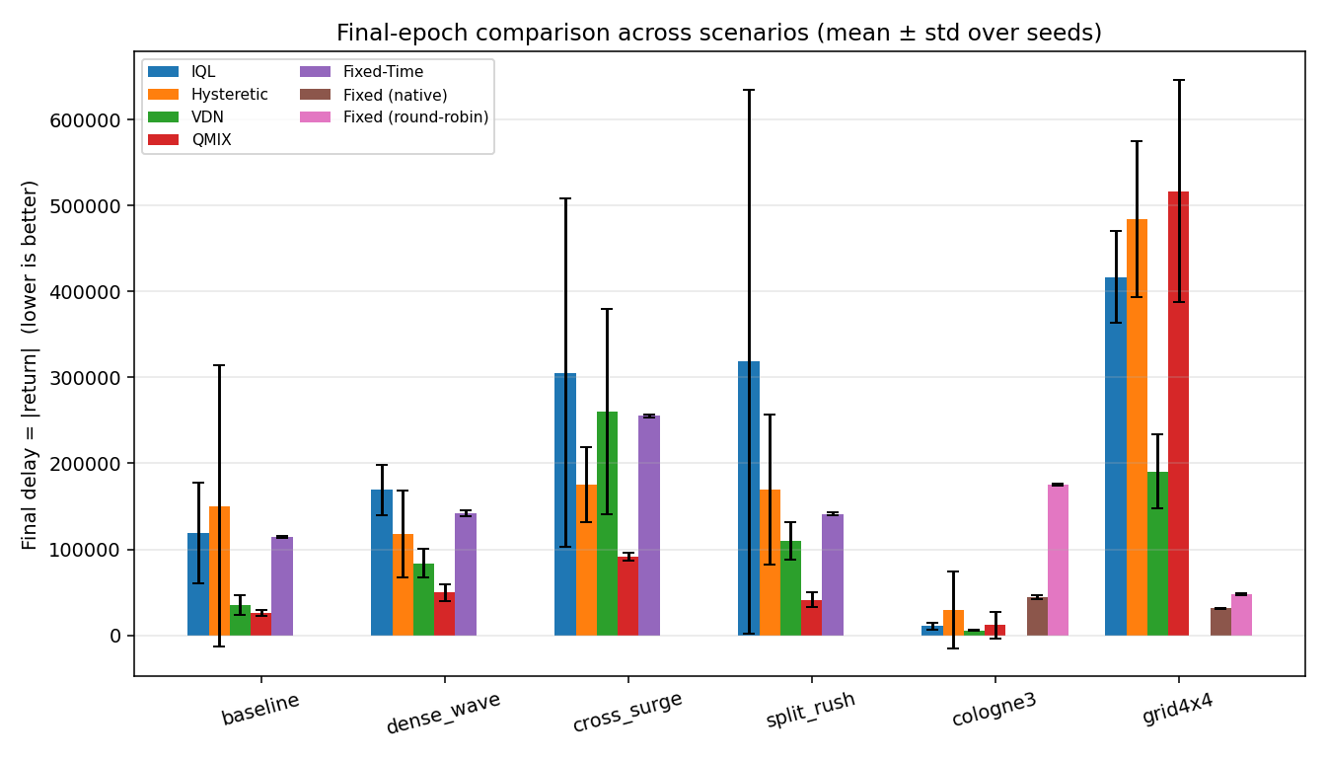
Cross-algorithm comparison: final epoch (mean +/- std over seeds)
Final delay = |return| per scenario/algorithm; error bars = std across seeds.

Slide 18
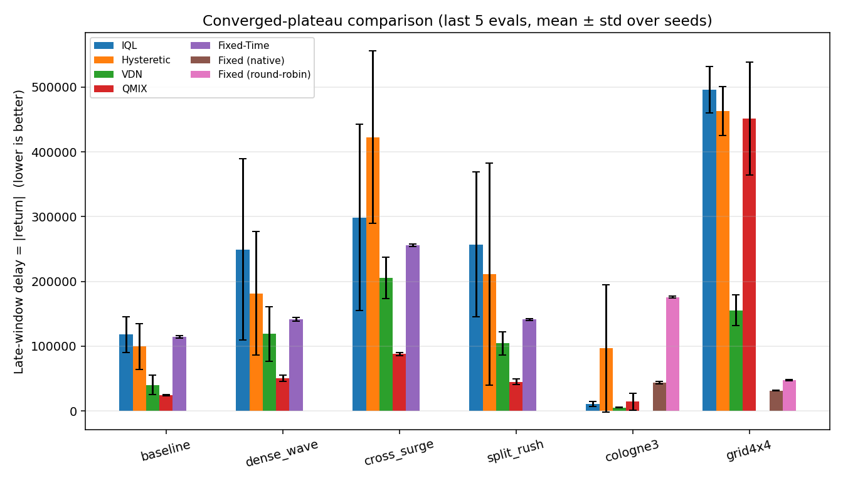
Cross-algorithm comparison: converged plateau (last 5 evals)
Late-window delay = |return|; the fair head-to-head metric, robust to late epsilon-greedy noise in the tabular learners.

Slide 19
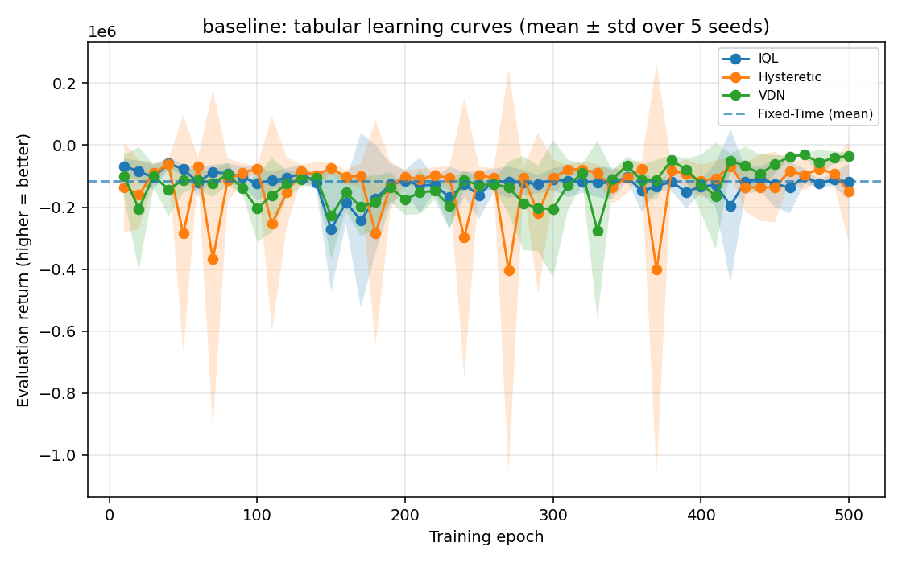
baseline: learning curves (mean +/- std)

Slide 20
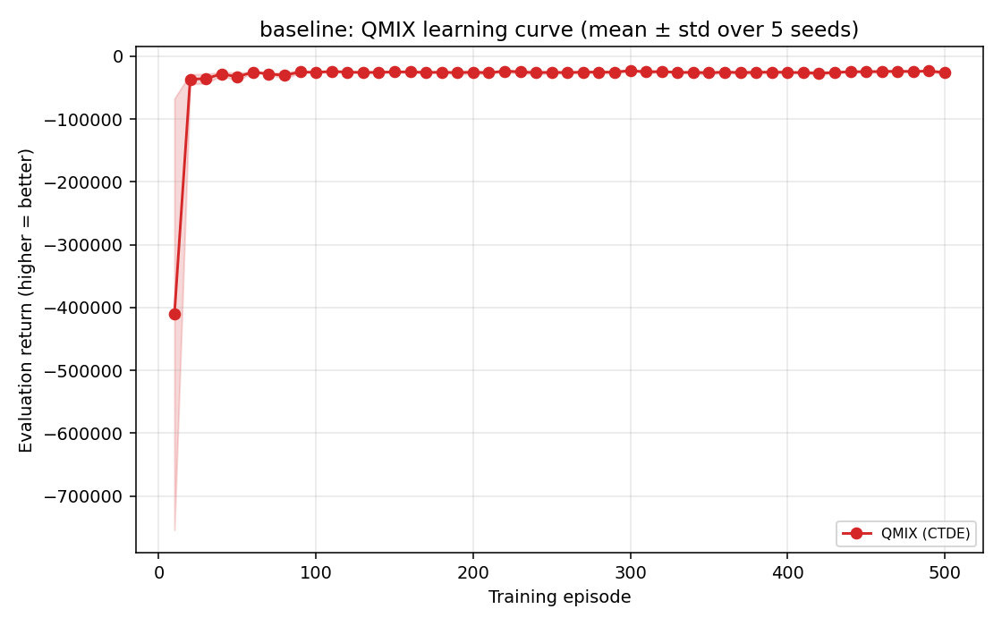
baseline: QMIX (CTDE) learning curve

Slide 21
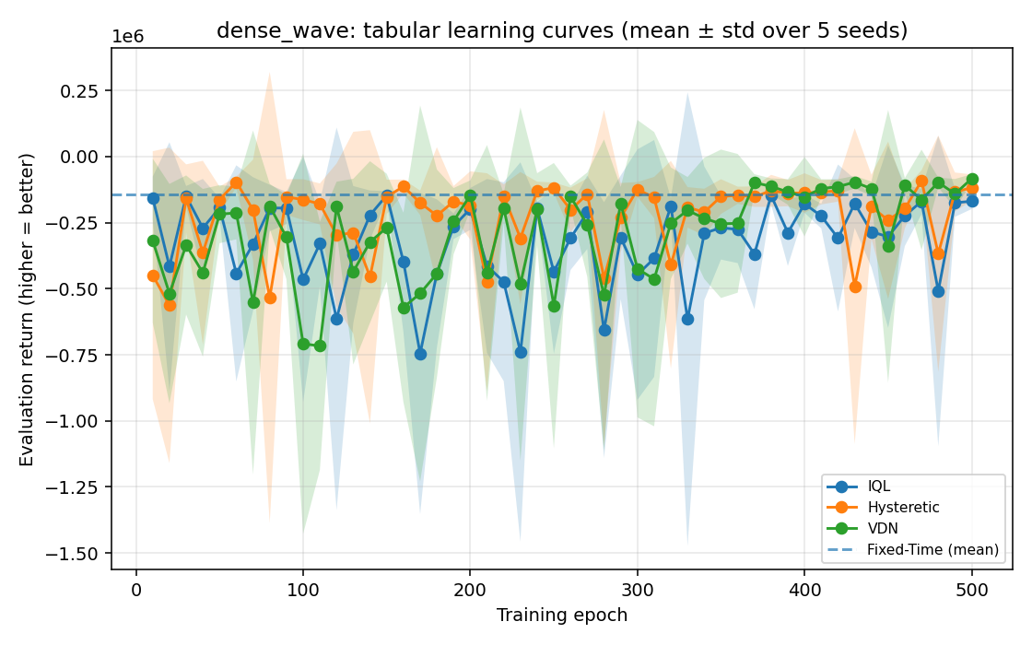
dense_wave: learning curves (mean +/- std)

Slide 22
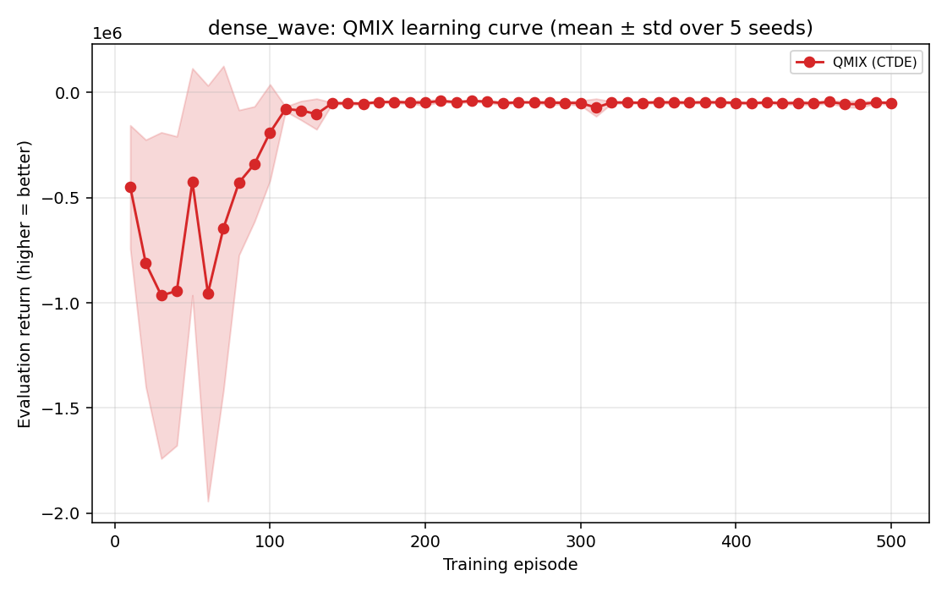
dense_wave: QMIX (CTDE) learning curve

Slide 23
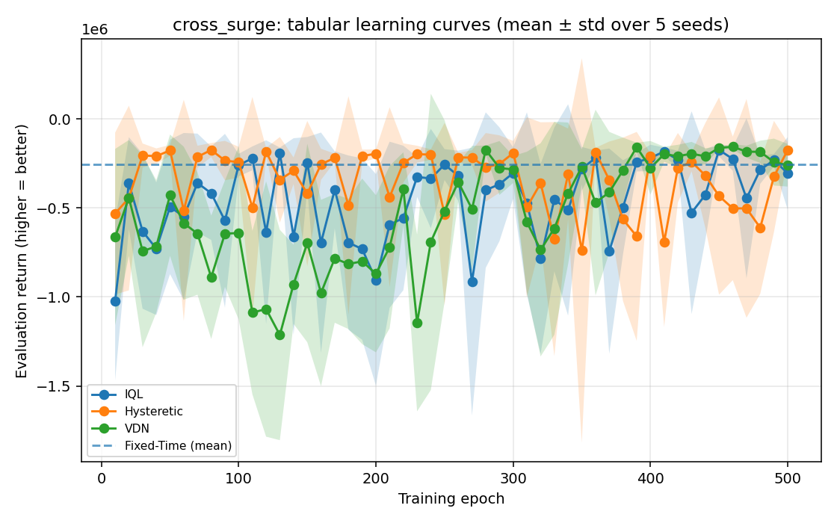
cross_surge: learning curves (mean +/- std)

Slide 24
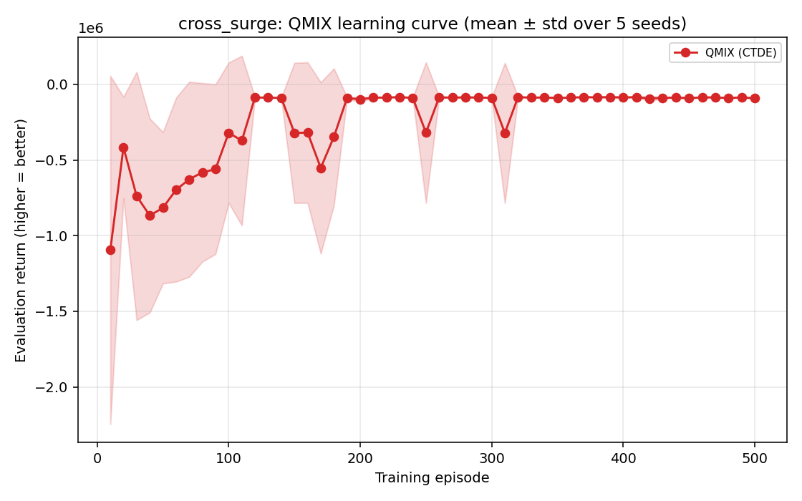
cross_surge: QMIX (CTDE) learning curve

Slide 25
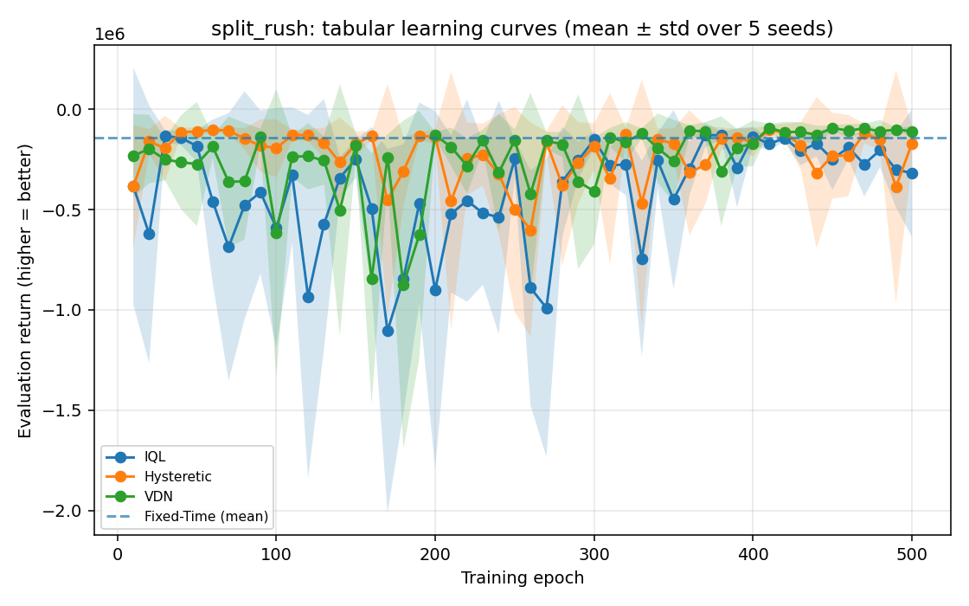
split_rush: learning curves (mean +/- std)

Slide 26
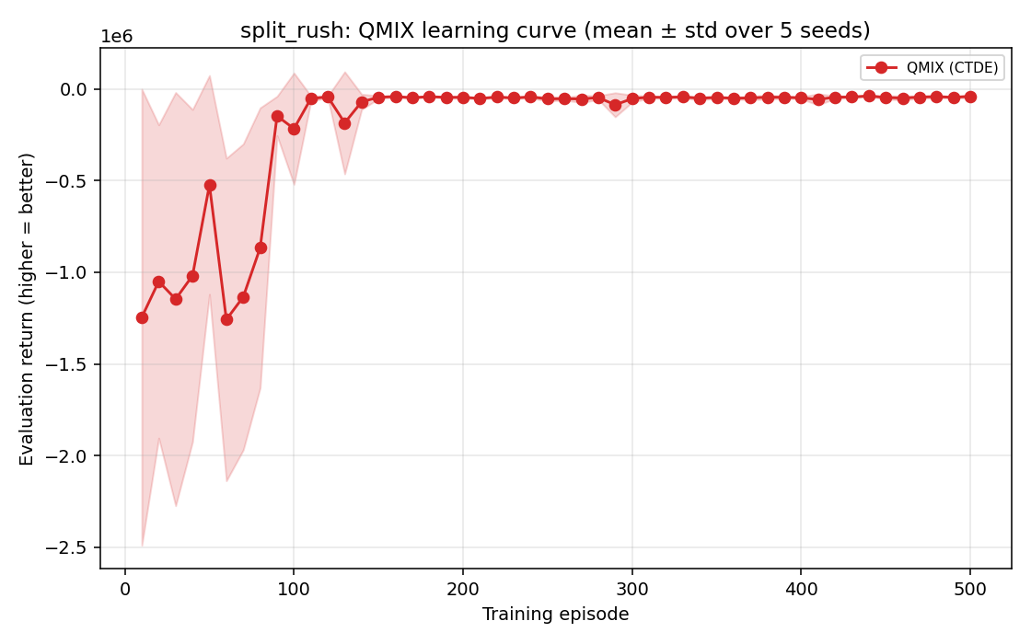
split_rush: QMIX (CTDE) learning curve

Slide 27
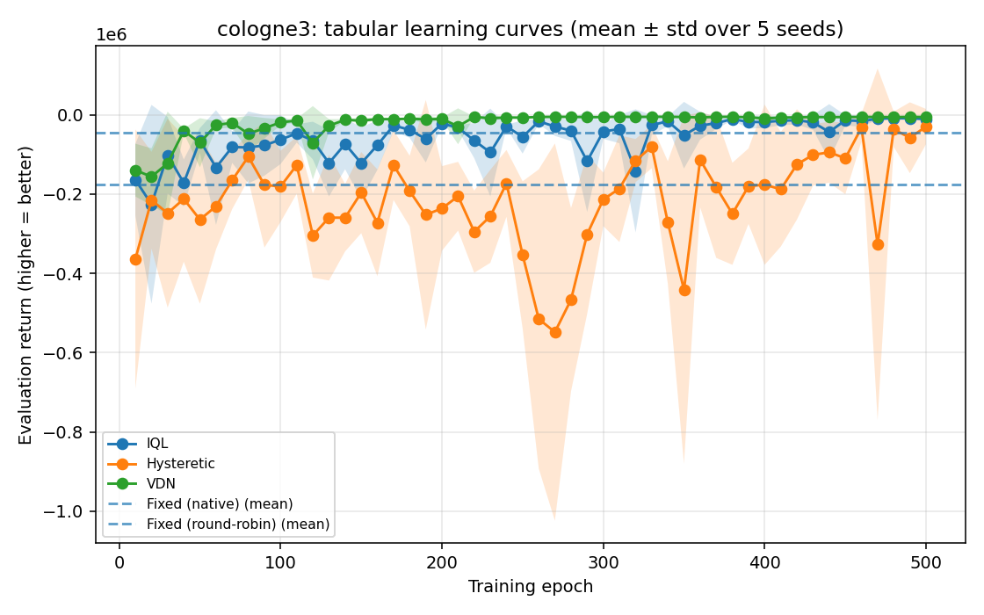
cologne3: learning curves (mean +/- std)

Slide 28
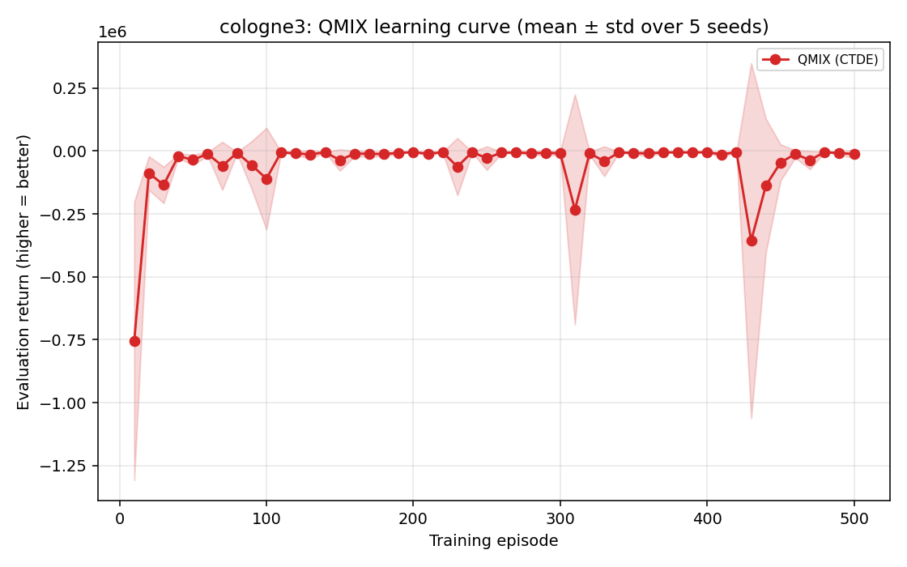
cologne3: QMIX (CTDE) learning curve

Slide 29
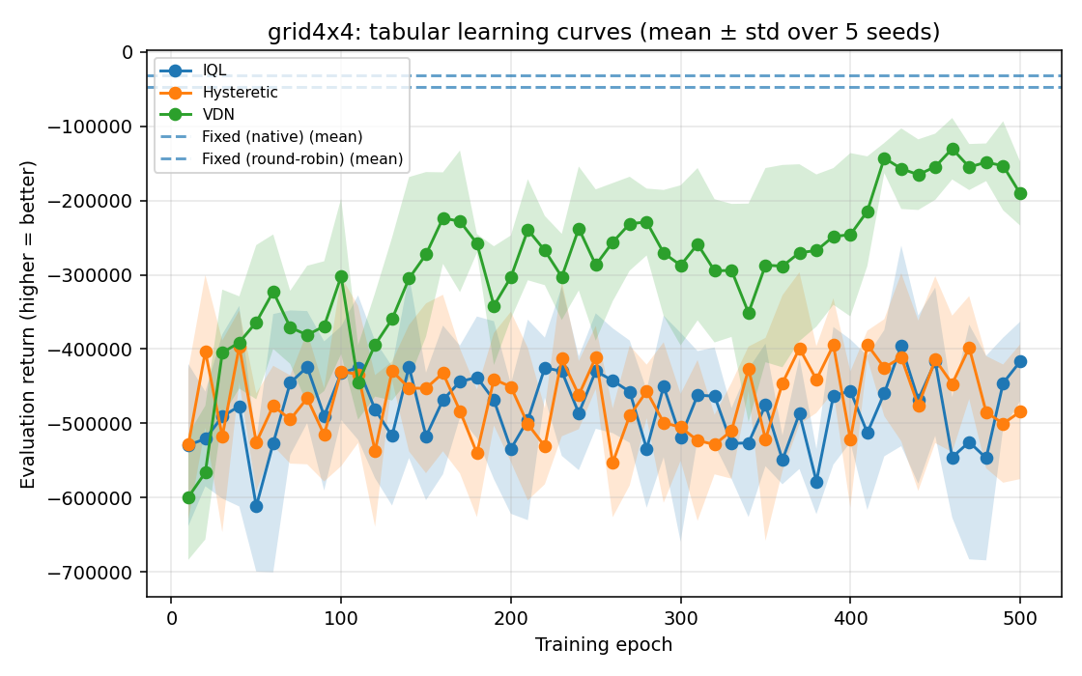
grid4x4: learning curves (mean +/- std)

Slide 30
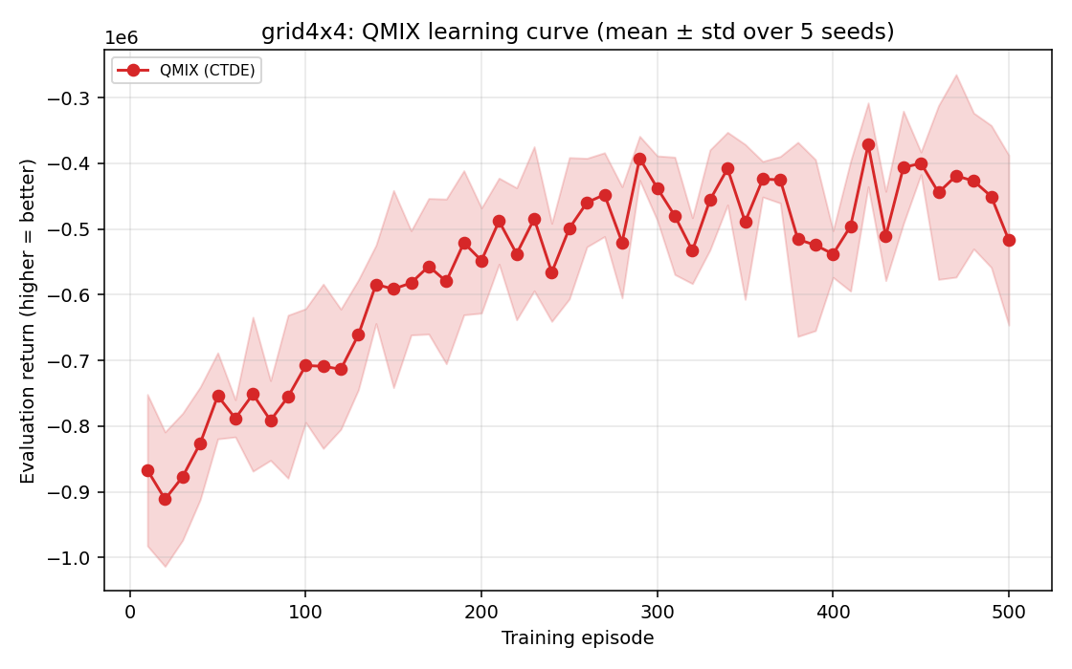
grid4x4: QMIX (CTDE) learning curve

Slide 31
Finding: QMIX (CTDE) extends to real multi-phase junctions
We generalised QMIX from the 1x4 topology to RESCO: agent count, observation dim and per-agent action count are now read from the env (cologne3: 3 agents, 3-4 phases; grid4x4: 16 agents, 8 phases).
cologne3 - value factorisation wins decisively:
All factorised/independent learners beat both fixed-time baselines (native -44k, round-robin -175k).
QMIX reaches the best single-run policy of any method (peak ~ -2.9k); 4 of 5 seeds converge to ~ -3.5k.
But QMIX shows late-training instability: 1 of 5 seeds diverged to -43k, inflating its mean/variance.
VDN is the most RELIABLE winner on cologne3 (-5.4k +/- 0.4k) - near-best and low variance.

Slide 32
Finding: at 16 agents, expressiveness does NOT buy scalability
grid4x4 (16 agents x 8 phases, single global reward): NO learner beats fixed-time (native -31k).
Among learners, simple VDN is best by far (late-window -156k); every other learner is ~3x worse.
QMIX is the most UNSTABLE: worst final epoch (-517k) and the highest variance of any learner; its late-window plateau (-452k) is only mid-pack, and its peak (-307k) is below the tabular learners' best.
Interpretation: the bottleneck at scale is sample-efficiency / credit assignment / exploration,
NOT mixer expressiveness. Under a fixed 500-episode budget, QMIX's heavier deep hypernetwork mixer (over a 64-dim joint state, 16 agents) is harder to train than VDN's simple sum.
More expressive != better at scale when samples are the binding constraint - a clean negative result.

Slide 33
The scalability picture (complete algorithm x problem grid)
Small scale (1x4 corridor, cologne3): value factorisation wins; QMIX/VDN beat fixed-time and the independent learners.
Large scale (grid4x4, 16 agents): cooperative MARL hits a wall - even the most expressive method fails to beat fixed-time, and expressiveness does not rescue it.
Severity scales with agent count and phase count (2 -> ok, 3-4 -> RL wins, 8x16 -> RL loses),
pointing to coordination/credit-assignment at scale as the open problem, not the algorithm class.

Slide 34
Takeaways & outlook

Slide 35
Takeaways
On the 1x4 MMDP, value factorisation wins: QMIX (CTDE) beats coordinated fixed-time on every scenario.
VDN/QMIX (CTDE) consistently outperform independent learners (IQL/Hysteretic) under a shared reward.
Generalised to real RESCO junctions: on cologne3 (3 agents) factorisation beats fixed-time by ~10x; QMIX hits the best peak policy, VDN is the most reliable.
Scalability wall: at grid4x4 (16 agents) NO learner beats fixed-time; simple VDN is best by far while QMIX's heavier mixer is the most unstable (worst final epoch, highest variance) - expressiveness does not buy scale under a fixed sample budget.
Variance matters: we report final / late-window / peak (mean +/- std across 5 seeds), not single runs; deep learners can find a great policy yet fail to hold it (1 cologne3 QMIX seed diverged).
Modelling fidelity is decisive: getting the action space and observation right was the difference between no learning and learning on the real RESCO benchmarks.

Slide 36
Limitations & future work
grid4x4 is unsolved by all methods: the open problem is coordination / credit assignment at 16 agents, not the algorithm class - try a larger sample budget, reward shaping, or per-agent rewards.
Stabilise deep CTDE: early-stopping / Double-Q / target smoothing to prevent the late-training divergence seen on cologne3 QMIX.
Hyperparameter tuning and longer training for both tabular and deep learners on RESCO.
Add per-agent metrics (throughput, average delay) alongside the global reward.
Statistical significance tests across seeds for the headline comparisons.

Slide 37
Thank you
Questions?
Reproduce: bash cluster/setup_env.sh -> bash cluster/submit.sh -> python make_presentation.py

