Slide 1
FlashCard
LE HONG MAI DAO
THI THUY DUYEN TRUONG

Slide 2

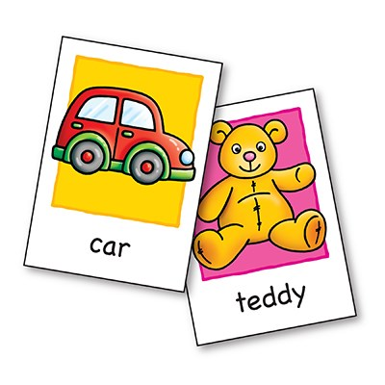
Flashcard
WHAT an application that help users memorize using flashcard method
WHO for anyone who want to apply flashcard method
HOW given a topic, users can learn and challenge their memory through simple quiz. User can play with existing topics or create their own topics
Notes:
So, What is flashcard?
Flashcard is a learning method to memory using small cards with hint in a frontside and the answer in the backside. It's very popular especially in learning vocabulary. With this application, we would like to bring physical cards into digital cards then users can learn everywhere with their mobile.

Slide 3


WHO are OUR COMPETITORS?
A LOT!
Flashcard
BABY Flashcards
Brain flips
studyblue
ANKI
BABBel
CRAM
quizlet
flashdecks
brainscape
TINY CARDS
Notes:
This is a popular method, if you go to google or app store and search for flash card application, it will result many many applications.
Here we list out some top results when searching for flashcard applications. We can see that some of them focus on children, some of them are from big companies, some of them are developed individualy. Very various.
Besides, flashcard is also implemented as a part of larger applications such as Babbel – an application to learn languages. It supports all 4 skills listening – reading- writing- speaking and it uses flashcard as a method to remember vocabulary. However our application focuses on flashcard only, these types of applications are not our directly competiors.

Slide 4
Competitors' overview
- Content created by vendor and users
- Rich features
- In-app purchase for features
Ad-free studing
Studing offline
Rich text formatting
Upload your own images
Scan to create sets
Create an unlimited number of classes
QUIZLET
- Focus on some specific languages such as Kanji, Chinese
Japanese Kanji Flash Cards
- Content created by vendor
- Not good UX
Notes:
We try to examine 3 types of competitors
The first type is old applications which have high downloads such as QUIZLET. It provides a good platform with many features and a nice UI. Content are created by both vendor and users, but most of them come from users. It leads to a problem: users feel confusing when searching for a topic when it resulting many suggestions but their quality is not good: too simple, only few words, boring, etc.
The second type is applications which focus on some specific languages such as Kanji or Chinese like Japanese Kanji Flash Cards
And the last type is applications with some provided-content, many advertises and bad UX
With lots of applications, how can we be different to others?
We think that with these type of application, the most important is the content: users will be happy if what they want to learn are provided already with high quality. Allow users creating their own content is optional. Therefore, we have two objectives for this application: good content and a friendly UI.

Slide 5
strategy
Land Grab
Focus on content provided
Easy-to-use UI
Promote the application
Free
No-ad
In-app purchase for some specific content
War
Provide richer features
Promote the application
Peace
Subscription to open all content
Differentiator
Provide smart features
Users can make money by their owncontent
Notes:
For our application, we don't allow advertise because this is a memoring application, these ads are very noise and impact to the ability to focus of the users. Instead, we will make money from the content: some specific content will be unlock only if users pay for it.

Slide 6

Flashcard FEATURES
View list of topics
Search for topics
Download topics
Learn words in a topic
Memory words through quiz
Manage your own topics
Share your own topics
Evaluate topics

Slide 7
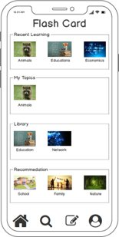
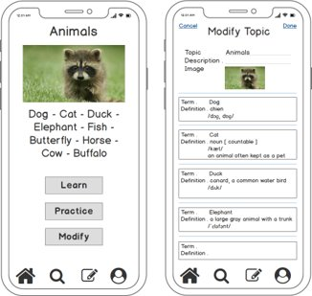
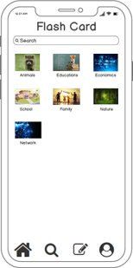
FIRST sketch
Homepage
Topic Details
Search for a topic
Notes:
This is our first sketch to help understanding the workflow of the application. It is not really good and the ui is changed while development.

Slide 8
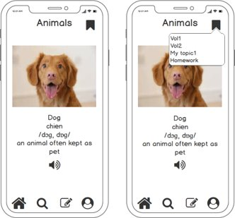
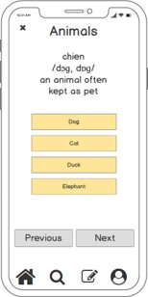
FIRST sketch
Modify a topic
Learn a topic
Quiz

Slide 9
Use cases
Learn languages
Learn captitals of countries all the world
Remember elements in chemistry
Etc.

Slide 10



architecture

Slide 11
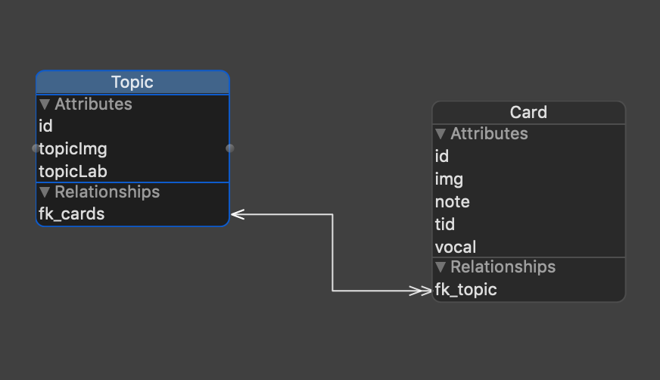
data model

Slide 12
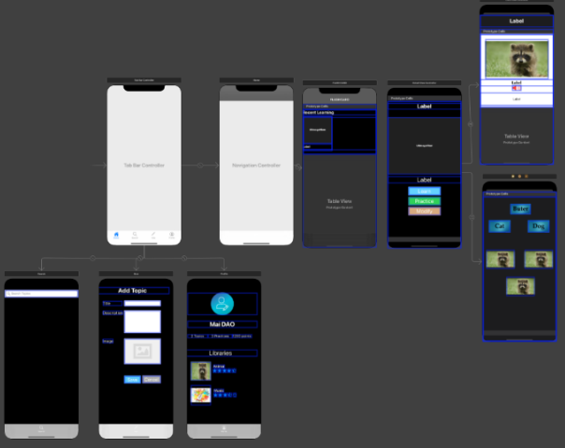
storyboards
Notes:
Uikit: defines the core components of an iOS application, from labels and buttons to table views and navigation controllers
Core data: manage the model layer objects in your application. It provides generalized and automated solutions to common tasks associated with object life cycle and object graph management, including persistence.
AVFoundation: build media functionality

Slide 13
frameworks
UIKIT
CORE DATA
AVFoundation
Notes:
Uikit: defines the core components of an iOS application, from labels and buttons to table views and navigation controllers
Core data: manage the model layer objects in your application. It provides generalized and automated solutions to common tasks associated with object life cycle and object graph management, including persistence.
AVFoundation: build media functionality

Slide 14
Project assignment
Task | Assignee
Design | Duyen
Prepare the content | Duyen
Develop Homepage | Mai
Develop Topic Details | Mai
Develop Topic Learn | Mai
Database | Duyen + Mai
Fix bugs | Duyen
Slide preparation | Duyen
Notes:
Agile development

Slide 15
demo

Slide 16

Thank you!

