Slide 1
CSS
Animesh B

Slide 2
Agenda
What is CSS
CSS Declaration & Basic Rules
CSS selector and box model
CSS Property: Position, Float, Visibility, Opacity & Display inline, Display Block
CSS manipulation from JS
CSS Exercise

Slide 3
Three Ways to Insert CSS
External Style Sheet:
An external style sheet can be written in any text editor. The file should not contain any html tags. Your style sheet should be saved with a .css extension. An example of a style sheet file is shown below:
<head> <link rel="stylesheet" type="text/css" href="mystyle.css"> </head>

Slide 4
Three Ways to Insert CSS
Internal Style Sheet:
An internal style sheet should be used when a single document has a unique style. You define internal styles in the head section of an HTML page, by using the <style> tag, like this:
<head> <style> hr {color:red;} p {margin-left:20px;} body {background-image:url("images/background.gif");} </style> </head>

Slide 5
Three Ways to Insert CSS
Inline Style Sheet:
An internal style sheet should be used when a style attribute is added to
HTML tag:
<p style="color: red;margin-left:20px;">This is a paragraph.</p>

Slide 6

CSS Syntax
A CSS comprises of style rules that are interpreted by the browser and then applied to the corresponding elements in your document. A style rule is made of three parts:
Selector: A selector is an HTML tag at which style will be applied. This could be any tag like <h1> or <div> or any ID or class name etc.
Property: A property is a type of attribute of HTML tag. Put simply, all the HTML attributes are converted into CSS properties. They could be color or border etc.
Value: Values are assigned to properties. For example color property can have value either red or #F1F1F1 etc.
You can put CSS Style Rule Syntax as follows:

Slide 7
CSS Selector
In CSS, pattern matching rules determine which style rules apply to elements in the document tree. These patterns, called selectors:
Universal selector
ID (#) Selector
Class (.) Selector
Type Selector
Group Selector
Child Selector
Descendant selectors
Pseudo selector

Slide 8
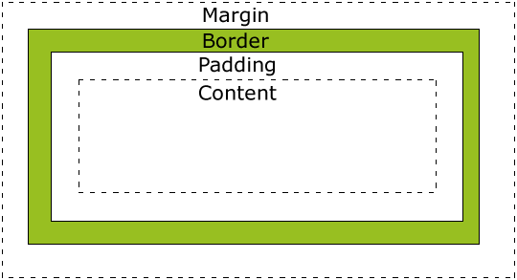
All HTML elements can be considered as boxes. In CSS, the term "box model" is used when talking about design and layout. The CSS box model is essentially a box that wraps around HTML elements, and it consists of: margins, borders, padding, and the actual content.
The box model allows us to place a border around elements and space elements in relation to other elements.
CSS Box Model

Slide 9
CSS - Position Property
A CSS comprises of style rules that are interpreted by the browser and then applied to the corresponding elements in your document. A style rule is made of three parts:
Static positioning is the default positioning model for elements. They are displayed in the page where they rendered as part of normal HTML flow. Statically positioned elements don't obey left, top, right and bottom rules
Relative Position: The position for an element which is relatively positioned is calculated from the original position in the document. That means that you move the element to the right, to the left, up or down. This way, the element still obtains a space in the document after it is positioned. bottom and right property treat as a negative of left and top value.
Absolute Position: To position an element absolutely, the position property is set as absolute. You can subsequently use the properties left, right, top, and bottom to place the box.
Fixed Position: An element with position:fixed is fixed with respect to the viewport. It stays where it is, even if the document is scrolled.

Slide 10
CSS - Float Property
The float property specifies whether or not a box (an element) should float.
Note: Absolutely positioned elements ignores the float property!
none: The element is not floated, and will be displayed just where it occurs in the text. This is default.
left: The element floats to the left.
right: The element floats the right.
initial: Sets this property to its default value.
inherit: Inherits this property from its parent element.

Slide 11
Display
Visibility
Opacity
CSS – Display Property

