Slide 1

Even Faster Web Sites
Flushing the Document Early
Simplifying CSS Selectors
Avoiding @import
Steve Souders
souders@google.com
http://stevesouders.com/docs/web20expo-20090402.ppt
Disclaimer: This content does not necessarily reflect the opinions of my employer.
Notes:
Permission to use photo given by Amnemona: http://www.flickr.com/photos/marinacvinhal/379111290/

Slide 2

the importance of frontend performance
9%
91%
17%
83%
iGoogle, primed cache
iGoogle, empty cache
Notes:
Data source: Steve Souders
Tested on IE6 on Comcast cable modem (~5 mbps) medium powered PC, April 2008.

Slide 3
time spent on the frontend
 | Empty Cache | Primed Cache
www.aol.com | 97% | 97%
www.ebay.com | 95% | 81%
www.facebook.com | 95% | 81%
www.google.com/search | 47% | 0%
search.live.com/results | 67% | 0%
www.msn.com | 98% | 94%
www.myspace.com | 98% | 98%
en.wikipedia.org/wiki | 94% | 91%
www.yahoo.com | 97% | 96%
www.youtube.com | 98% | 97%
April 2008
Notes:
Ten top sites according to Alexa.com.
Data source: Steve Souders
Tested on IE6 on Comcast cable modem (~5 mbps) medium powered PC, April 2008.
http://www.aol.com/
http://www.ebay.com/
http://www.facebook.com/
http://www.google.com/search?hl=en&q=flowers
http://www.myspace.com/
http://www.msn.com/
http://search.live.com/results.aspx?q=flowers&mkt=en-us&scope=&FORM=LIVSOP
http://en.wikipedia.org/wiki/Flowers
http://www.yahoo.com/
http://www.youtube.com/
For Google and Live Search there are so few components (2-4) and they're mostly cacheable so the HTML document is a bigger percentage.

Slide 4

14 RULES
MAKE FEWER HTTP REQUESTS
USE A CDN
ADD AN EXPIRES HEADER
GZIP COMPONENTS
PUT STYLESHEETS AT THE TOP
PUT SCRIPTS AT THE BOTTOM
AVOID CSS EXPRESSIONS
MAKE JS AND CSS EXTERNAL
REDUCE DNS LOOKUPS
MINIFY JS
AVOID REDIRECTS
REMOVE DUPLICATE SCRIPTS
CONFIGURE ETAGS
MAKE AJAX CACHEABLE
Notes:
photo courtesy of Vicki & Chuck Rogers: http://www.flickr.com/photos/two-wrongs/205467442/

Slide 5
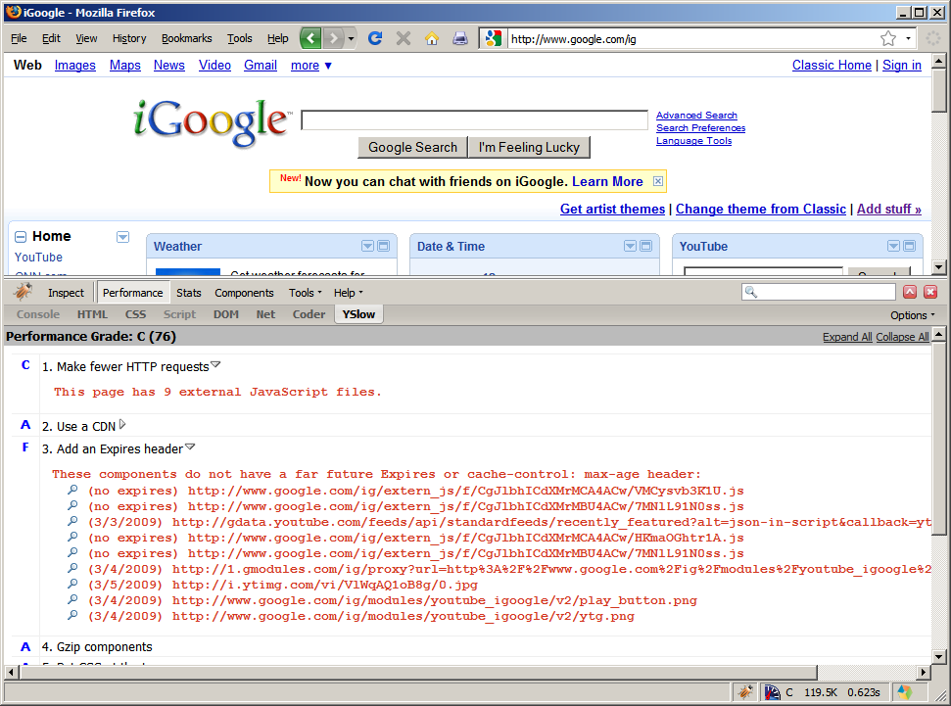

Slide 6


Slide 7


Slide 8

Sept 2007

Slide 9

June 2009

Slide 10
Even Faster Web Sites
Splitting the initial payload
Loading scripts without blocking
Coupling asynchronous scripts
Positioning inline scripts
Sharding dominant domains
Flushing the document early
Using iframes sparingly
Simplifying CSS Selectors
Understanding Ajax performance...Doug Crockford
Creating responsive web apps......Ben Galbraith, Dion Almaer
Writing efficient JavaScript...........Nicholas Zakas
Scaling with Comet......................Dylan Schiemann
Going beyond gzipping...............Tony Gentilcore
Optimizing images.....................Stoyan Stefanov, Nicole Sullivan
Avoiding @import

Slide 11
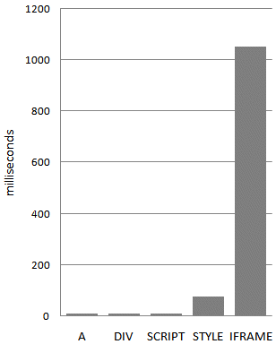
iframes: most expensive DOM element
load 100 empty elements of each type
tested in all major browsers¹
¹IE 6, 7, 8; FF 2, 3.0, 3.1b2; Safari 3.2, 4; Opera 9.63, 10; Chrome 1.0, 2.0

Slide 12
iframes block onload
parent's onload doesn't fire until iframe and all its components are downloaded
workaround for Safari and Chrome: set iframe src in JavaScript
<iframe id=iframe1 src=""></iframe>
<script type="text/javascript">
document.getElementById('iframe1').src="url";
</script>

Slide 13

scripts block iframe
IE
script
Firefox
script
Safari
Chrome
Opera
script
no surprise – scripts in the parent block the iframe from loading

Slide 14
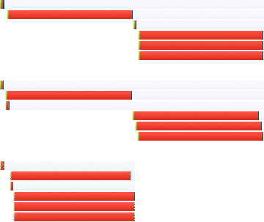
stylesheets block iframe (IE, FF)
IE
stylesheet
Firefox
stylesheet
Safari
Chrome
Opera
stylesheet
surprise – stylesheets in the parent block the iframe or its resources in IE & Firefox

Slide 15
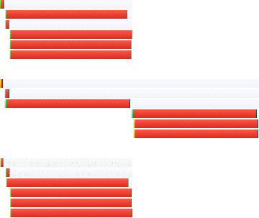
stylesheets after iframe still block (FF)
IE
stylesheet
Firefox
stylesheet
Safari
Chrome
Opera
stylesheet
surprise – even moving the stylesheet after the iframe still causes the iframe's resources to be blocked in Firefox

Slide 16
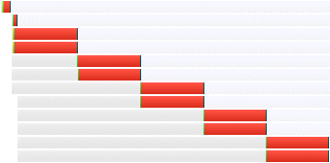
iframes: no free connections
parent
iframe
iframe shares connection pool with parent (here – 2 connections per server in IE 7)

Slide 17


flushing the document early
html
image
image
script
html
image
image
script
call PHP's flush()
gotchas:
  PHP output_buffering – ob_flush()
  Transfer-Encoding: chunked
  gzip – Apache's DeflateBufferSize before 2.2.8
  proxies and anti-virus software
  browsers – Safari (1K), Chrome (2K)
other languages:
  $| or FileHandle autoflush (Perl), flush (Python), ios.flush (Ruby)

Slide 18


flushing and domain blocking
you might need to move flushed resources to a domain different from the HTML doc
html
image
image
script
blocked by HTML document
html
image
image
script
different domains
case study: Google search
google
image
image
script
image
204

Slide 19
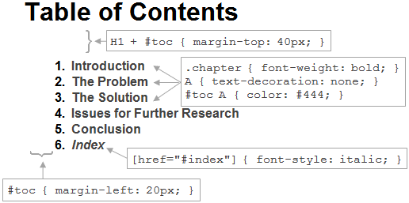
Simplifying CSS Selectors
selector
rule
#toc > LI { font-weight: bold; }
simple selectors
declaration block
combinator

Slide 20
types of CSS selectors
ID selectors
  #toc { margin-left: 20px; }
  element whose ID attribute has the value "toc"
class selectors
  .chapter { font-weight: bold; }
  elements with class=chapter
type selectors
  A { text-decoration: none; }
  all A elements in the document tree
http://www.w3.org/TR/CSS2/selector.html

Slide 21
types of CSS selectors
adjacent sibling selectors
  H1 + #toc { margin-top: 40px; }
  an element with ID=toc that immediately follows an H1
child selectors
  #toc > LI { font-weight: bold; }
  all LI elements whose parent has id="toc"
descendant selectors
  #toc A { color: #444; }
  all A elements that have id="toc" as an ancestor

Slide 22
types of CSS selectors
universal selectors
  * { font-family: Arial; }
  all elements
attribute selectors
  [href="#index"] { font-style: italic; }
  all elements where the href attribute is "#index"
psuedo classes and elements
  A:hover { text-decoration: underline; }
  non-DOM behavior
  others: :visited, :link, :active, :focus, :first-child, :before, :after

Slide 23
writing efficient CSS
https://developer.mozilla.org/en/Writing_Efficient_CSS
  "The style system matches a rule by starting with the rightmost selector and moving to the left through the rule's selectors. As long as your little subtree continues to check out, the style system will continue moving to the left until it either matches the rule or bails out because of a mismatch."
  #toc > LI { font-weight: bold; }
    find every LI whose parent is id="toc"
  #toc A { color: #444; }
    find every A and climb its ancestors until id="toc" or DOM root (!) is found

Slide 24
writing efficient CSS
avoid universal selectors
don't qualify ID selectors
  bad: DIV #navbar {}
  good: #navbar {}
don't qualify class selectors
  bad: LI .tight {}
  good: .li-tight {}
make rules as specific as possible
  bad: #navbar A {}
  good: .a-navbar {}
https://developer.mozilla.org/en/Writing_Efficient_CSS

Slide 25
writing efficient CSS
avoid descendant selectors
  bad: UL LI A {}
  better: UL > LI > A {}
avoid tag-child selectors
  bad: UL > LI > A {}
  best: .li-anchor {}
be wary of child selectors
rely on inheritance
  http://www.w3.org/TR/CSS21/propidx.html
https://developer.mozilla.org/en/Writing_Efficient_CSS
David Hyatt
4/21/2000

Slide 26
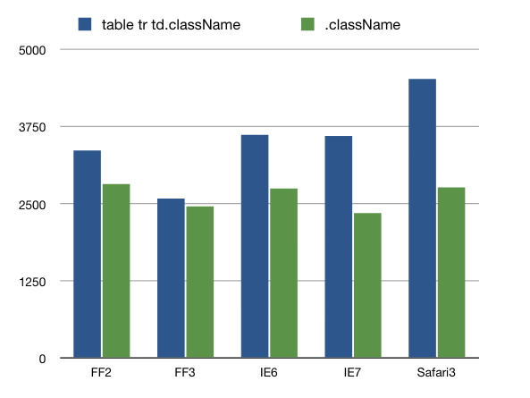
Testing CSS Performance
20K TD elements
http://jon.sykes.me/152/testing-css-performance-pt-2

Slide 27
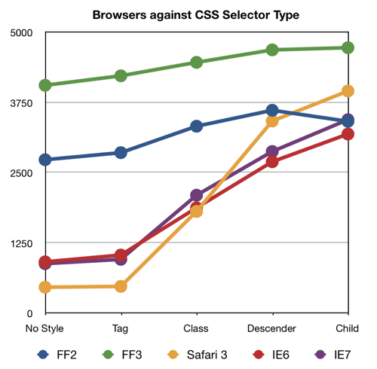
testing massive CSS
20K A elements
no style: control
tag:
  A {}
class:
  .a00001 {}
  .a20000 {}
descender:
  DIV DIV DIV P A.a00001 {}
child:
  DIV > DIV > DIV > P > A.a00001 {}
http://jon.sykes.me/153/more-css-performance-testing-pt-3

Slide 28
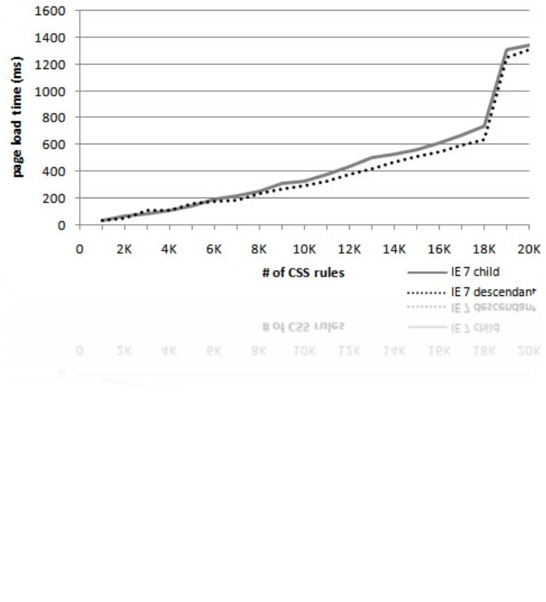
CSS performance isn't linear
IE 7 "cliff" at 18K rules

Slide 29
real world levels of CSS
 | # Rules | # elements | Avg Depth
AOL | 2289 | 1628 | 13
eBay | 305 | 588 | 14
Facebook | 2882 | 1966 | 17
Google Search | 92 | 552 | 8
Live Search | 376 | 449 | 12
MSN.com | 1038 | 886 | 11
MySpace | 932 | 444 | 9
Wikipedia | 795 | 1333 | 10
Yahoo! | 800 | 564 | 13
YouTube | 821 | 817 | 9
average | 1033 | 923 | 12

Slide 30
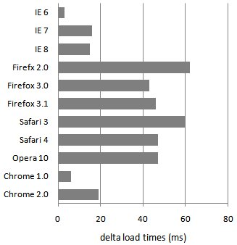
testing typical CSS
1K rules (vs. 20K)
same amount of CSS in all test pages
30 ms avg delta
"costly"selectors aren't always costly (at typical levels)
are these selectors "costly"?
  DIV DIV DIV P A.class0007 { ... }
http://www.stevesouders.com/blog/2009/03/10/performance-impact-of-css-selectors/

Slide 31
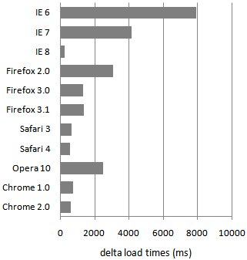
testing expensive selectors
1K rules (vs. 20K)
same amount of CSS in all test pages
2126 ms avg delta!
truly expensive selector
  A.class0007 * { ... }
compare to:
  DIV DIV DIV P A.class0007 { ... }
the key is the key selector – the rightmost argument

Slide 32
CSS3 selectors (bad)
more David Hyatt:
  "The sad truth about CSS3 selectors is that they really shouldn’t be used at all if you care about page performance. Decorating your markup with classes and ids and matching purely on those while avoiding all uses of sibling, descendant and child selectors will actually make a page perform significantly better in all browsers."
http://shauninman.com/archive/2008/05/05/css_qualified_selectors#comment_3942

Slide 33
selectors to avoid
A.class0007 DIV { ... }
#id0007 > A { ... }
.class0007 [href] { ... }
DIV:first-child { ... }

Slide 34
reflow time vs. load time
reflow – time to apply CSS, re-layout elements, and repaint
triggered by DHTML:
  elem.className = "newclass";
  elem.style.cssText = "color: red";
  elem.style.padding = "8px";
  elem.style.display = "";
reflow can happen multiple times for long-lasting Web 2.0 apps

Slide 35
reflow time by browser
DHTML action | Chr1 | Chr2 | FF2 | FF3 | IE6,7 | IE 8 | Op | Saf3 | Saf4
className | 1x | 1x | 1x | 1x | 1x | 1x | 1x | 1x | 1x
display none | - | - | - | - | 1x | - | - | - | -
display default | 1x | 1x | 1x | 2x | 1x | 1x | - | 1x | 1x
visibility hidden | 1x | 1x | 1x | 1x | 1x | 1x | - | 1x | 1x
visibility visible | 1x | 1x | 1x | 1x | 1x | 1x | - | 1x | 1x
padding | - | - | 1x | 2x | 4x | 4x | - | - | -
width length | - | - | 1x | 2x | 1x | 1x | - | 1x | -
width percent | - | - | 1x | 2x | 1x | 1x | - | 1x | -
width default | 1x | - | 1x | 2x | 1x | 1x | - | 1x | -
background | - | - | 1x | 1x | 1x | - | - | - | -
font-size | 1x | 1x | 1x | 2x | 1x | 1x | - | 1x | 1x
reflow performance varies by browser and action
"1x" is 1-6 seconds depending on browser (1K rules)

Slide 36
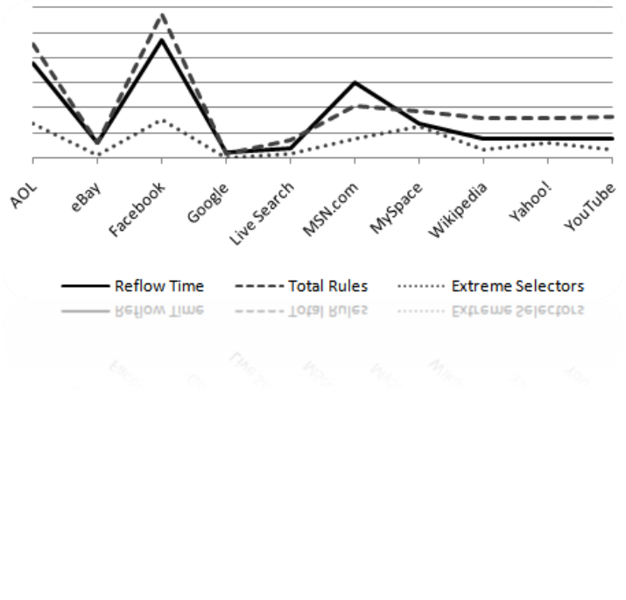
Simplifying CSS Selectors
efficient CSS comes at a cost – page weight
focus optimization on selectors where the key selector matches many elements
reduce the number of selectors
Notes:
reflow times measured in FF 3.0

Slide 37
Avoiding @import – @import @import
<style>
@import url('stylesheet1.css');
@import url('stylesheet2.css');
</style>
no blocking
in fact, improves progressive rendering in IE
http://stevesouders.com/tests/atimport/import-import.php

Slide 38
link @import
<link rel='stylesheet' type='text/css' href='stylesheet1.css'>
<style>
@import url('stylesheet2.css');
</style>
blocks in IE
http://stevesouders.com/tests/atimport/link-import.php

Slide 39
link with @import
<link rel='stylesheet' type='text/css' href='stylesheet1.css'>
blocks in all browsers!
includes
@import url('stylesheet2.css');
http://stevesouders.com/tests/atimport/link-with-import.php

Slide 40

link blocks @import
<link rel='stylesheet' type='text/css' href='stylesheet1.css'>
<link rel='stylesheet' type='text/css' href='proxy.css'>
blocks in IE
includes
@import url('stylesheet2.css');
http://stevesouders.com/tests/atimport/link-blocks-import.php

Slide 41
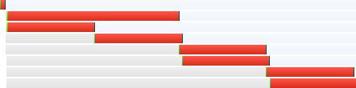
many @imports
<style>
@import url('stylesheet1.css');
...
@import url('stylesheet6.css');
</style>
<script src='script1.js'></script>
loads script before stylesheets in IE
http://stevesouders.com/tests/atimport/many-imports.php

Slide 42
link link
<link rel='stylesheet' type='text/css' href='stylesheet1.css'>
<link rel='stylesheet' type='text/css' href='stylesheet2.css'>
no blocking in all browsers
http://stevesouders.com/tests/atimport/link-link.php

Slide 43
takeaways
focus on the frontend
run YSlow: http://developer.yahoo.com/yslow
speed matters
Notes:
72 years = 2,270,592,000 seconds = 500ms * 4.4B page views

Slide 44
impact on revenue
Google:
Yahoo:
Amazon:
+500 ms → -20% traffic¹
+400 ms → -5-9% full-page traffic²
+100 ms → -1% sales¹
¹ http://home.blarg.net/~glinden/StanfordDataMining.2006-11-29.ppt
² http://www.slideshare.net/stoyan/yslow-20-presentation
Notes:
72 years = 2,270,592,000 seconds = 500ms * 4.4B page views

Slide 45
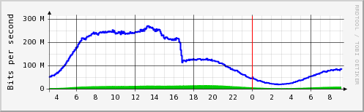
cost savings
hardware – reduced load
bandwidth – reduced response size
http://billwscott.com/share/presentations/2008/stanford/HPWP-RealWorld.pdf
Notes:
72 years = 2,270,592,000 seconds = 500ms * 4.4B page views

Slide 46
if you want
  better user experience
  more revenue
  reduced operating expenses
the strategy is clear
Even Faster Web Sites
Notes:
72 years = 2,270,592,000 seconds = 500ms * 4.4B page views

Slide 47

Steve Souders
souders@google.com
http://stevesouders.com/docs/web20expo-20090402.ppt
Notes:
"thank you" by nj dodge: http://flickr.com/photos/nj_dodge/187190601/

