Slide 1
CSS
Animesh Bhadra
Semester – 1
M.Tech - Adv Information Technology

Slide 2
Agenda
What is CSS?
CSS Declaration & Basic Rules
CSS selector and box model
CSS Property: Position, Visibility, Opacity & Display
CSS manipulation from JS
XML StyleSheet

Slide 3
How to insert CSS in HTML.

Slide 4
External Style Sheet
An external style sheet can be written in any text editor. The file should not contain any HTML tags. Your style sheet should be saved with a .css extension. An example of a style sheet file is shown.
<head> <link rel="stylesheet" type="text/css" href="mystyle.css"> </head>

Slide 5
Internal Style Sheet
An internal style sheet should be used when a single document has a unique style. You define internal styles in the head section of an HTML page, by using the <style> tag, like this.
<head> <style> hr {color:red;} p {margin-left:20px;} body {background-image:url("images/background.gif");} </style> </head>

Slide 6
Inline Style Sheet
An internal style sheet should be used when a style attribute is added to HTML tag directly.
<p style="color: red;margin-left:20px;">This is a paragraph.</p>

Slide 7

CSS Syntax
A CSS comprises of style rules that are interpreted by the browser and then applied to the corresponding elements in your document. A style rule is made of three parts:
Selector: A selector is an HTML tag at which style will be applied. This could be any tag like <h1> or <div> or any ID or class name etc.
Property: A property is a type of attribute of HTML tag. Put simply, all the HTML attributes are converted into CSS properties. They could be color or border etc.
Value: Values are assigned to properties. For example color property can have value either red or #F1F1F1 etc.

Slide 8
Selectors
In CSS, pattern matching rules determine which style rules apply to elements in document tree. These patterns are called selectors.
Universal selector
Element Selector
ID (#) Selector
Class (.) Selector
Group Selector
Child Selector
Descendant selectors
Pseudo selector

Slide 9
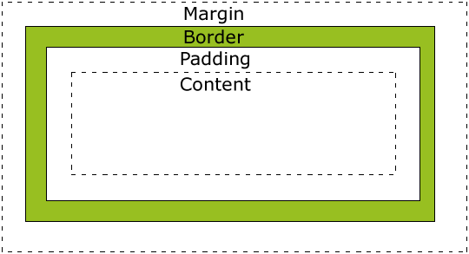
Box Model
All HTML elements can be considered as boxes. In CSS, the term "box model" is used when talking about design and layout. The CSS box model is essentially a box that wraps around HTML elements, and it consists of: margins, borders, padding, and the actual content.
The box model allows us to place a border around elements and space elements in relation to other elements

Slide 10
CSS - Position
A CSS comprises of style rules that are interpreted by the browser and then applied to the corresponding elements in your document. A style rule is made of three parts:
Static positioning is the default positioning model for elements. They are displayed in the page where they rendered as part of normal HTML flow. Statically positioned elements don't obey left, top, right and bottom rules
Relative Position: The position for an element which is relatively positioned is calculated from the original position in the document. That means that you move the element to the right, to the left, up or down. This way, the element still obtains a space in the document after it is positioned. bottom and right property treat as a negative of left and top value.
Absolute Position: To position an element absolutely, the position property is set as absolute. You can subsequently use the properties left, right, top, and bottom to place the box.
Fixed Position: An element with position:fixed is fixed with respect to the viewport. It stays where it is, even if the document is scrolled.

Slide 11
CSS – Display
Display
Visibility
Opacity

Slide 12
Thank You

