Slide 1
₿
Bitcoin Price Forecasting
Comparing a Multi-Layer Perceptron and an LSTM Network
Final Project — Ethical, Responsible & Sustainable AI Practices
Beryl Abi Ouma
Case Study 2 · Time-Series Deep Learning with PyTorch

Slide 2
EXECUTIVE SUMMARY
What this project does
Cryptocurrency prices are highly volatile — forecasting even one day ahead is genuinely useful for traders and exchanges.
We predict Bitcoin's next-day closing price using the previous 30 days of prices (2019–2023 daily data).
Two deep learning models are built and compared: an MLP (feedforward) and an LSTM (sequence-aware).
Result: the LSTM outperformed the MLP on every metric — consistent with the idea that sequence-aware models handle time-dependent data better.
47.19%
LSTM MAPE
(vs 90.58% for MLP)
1,674 days of data
1,644 training windows
10 training epochs
Bitcoin Price Forecasting — MLP vs LSTM
2

Slide 3
PROBLEM FORMULATION
Why is this problem hard?
1
2
3
The Task
The Challenge
The Approach
Predict tomorrow's Bitcoin closing price using the previous 30 days of prices — a time-series regression problem.
Crypto prices are driven by news, sentiment, and large trades — not just historical patterns. Order and recency matter.
Compare a model with no sense of order (MLP) against one built for sequences (LSTM) to see if sequence-awareness helps.
Bitcoin Price Forecasting — MLP vs LSTM
3

Slide 4
DATASET DESCRIPTION
Daily Bitcoin market data
1,674 daily records, Jan 1, 2019 – Aug 1, 2023
No missing values across any column type
Target variable: close (closing price)
Columns: timestamp, open, high, low, close, volume
Column | Description
timestamp | Date (daily)
open | Opening price
high / low | Day's highest / lowest price
close | Closing price — the target
volume | Daily traded volume
Source: historical daily Bitcoin OHLCV market data (Kaggle-style crypto dataset).
Bitcoin Price Forecasting — MLP vs LSTM
4

Slide 5
DATA PREPARATION
From raw prices to model-ready sequences
1
2
3
4
Scale
Window
Split
Reshape
Close price scaled to 0–1 with MinMaxScaler — neural nets train better on small, consistent ranges.
30-day lookback windows built: input = past 30 days, output = next day's price.
Chronological 80/20 train-test split — never shuffled, to avoid leaking future data into training.
Two input shapes prepared: (samples, 30) for MLP, (samples, 30, 1) for LSTM.
Result: 1,644 windows → 1,315 for training, 329 held out for testing.
Bitcoin Price Forecasting — MLP vs LSTM
5

Slide 6
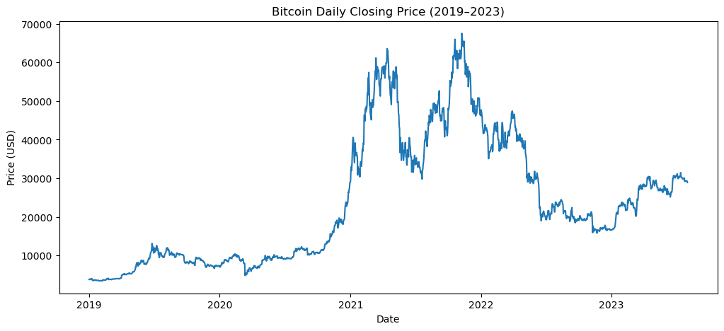
EXPLORATORY ANALYSIS
Bitcoin's price journey, 2019–2023
Key observations
2021 bull run pushed price above $60,000
2022 crash brought it back near $16,000
Gradual recovery through 2023
High volatility throughout — no stable range
Bitcoin Price Forecasting — MLP vs LSTM
6

Slide 7
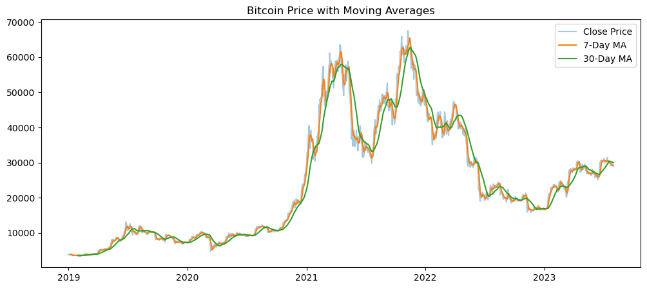
EXPLORATORY ANALYSIS
Smoothing out the noise: moving averages
Reading the lines
7-day MA reacts quickly — short-term momentum.
30-day MA is smoother — longer-term trend.
7-day crossing above 30-day often signals upward momentum ("bullish"); crossing below signals "bearish".
Bitcoin Price Forecasting — MLP vs LSTM
7

Slide 8
MODEL DESIGN
Two architectures, one comparison
MLP
LSTM
Multi-Layer Perceptron
Long Short-Term Memory
Input: 30 days flattened into a list of 30 numbers
64 neurons → ReLU → 32 neurons → ReLU → 1 output
No concept of order — day 1 and day 30 are treated the same way
Input: 30 days processed one day at a time, in order
Hidden size 64, carries a "memory" forward through the sequence
Linear output layer reads the final memory state to predict day 31
Both trained identically: Adam optimizer · MSE loss · 10 epochs · learning rate 0.001
Bitcoin Price Forecasting — MLP vs LSTM
8

Slide 9
EVALUATION
LSTM outperforms MLP on every metric
Metric | MLP | LSTM
MSE | 453,710,662 | 151,892,116
MAE | $21,019.15 | $11,503.85
MAPE | 90.58% | 47.19%
What this means
Lower error on all three metrics means LSTM's predictions land consistently closer to the real price.
This matches expectations: LSTM can use the order of the 30 days, MLP cannot.
Errors are still large in absolute terms — with only 10 training epochs, neither model fully converges. See Limitations.
Bitcoin Price Forecasting — MLP vs LSTM
9

Slide 10
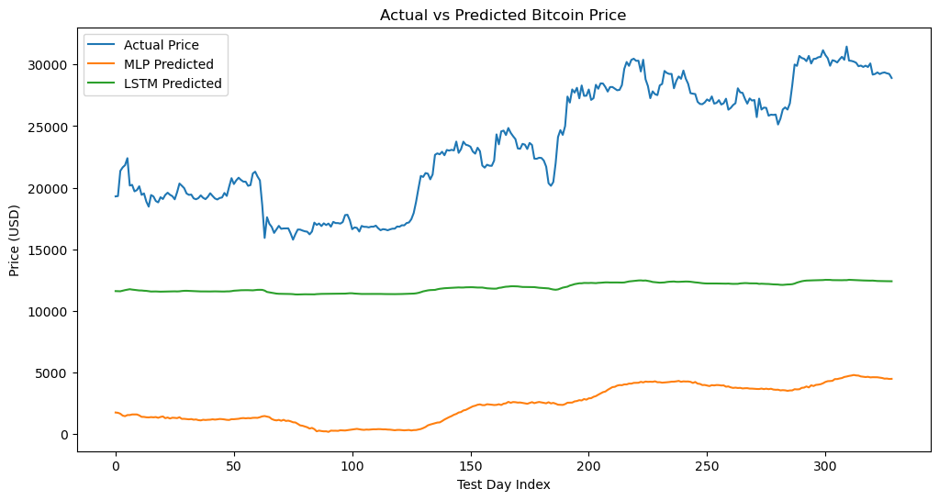
VISUALIZATION
Actual vs. predicted price on test data
Reading the chart
Blue = actual price
Green (LSTM) tracks noticeably closer to actual than orange (MLP)
Both under-predict overall — a sign of undertraining in just 10 epochs, not a coding error
Bitcoin Price Forecasting — MLP vs LSTM
10

Slide 11
BUSINESS INTERPRETATION
Why this matters for traders & exchanges
Risk Reduction
Entry / Exit Timing
Trend Reversal Detection
More accurate forecasts help traders size positions and set stop-losses with more confidence.
Predicting short-term direction can inform when to buy or sell.
Catching a shift from uptrend to downtrend early can help prevent large losses.
Why prediction is hard: our model only sees past prices — not the news, sentiment, or large trades that actually drive sudden price shocks.
Bitcoin Price Forecasting — MLP vs LSTM
11

Slide 12
LIMITATIONS
Honest constraints on these results
Model simplicity | Only 10 training epochs and basic architectures — a real trading system would need far more tuning and data.
Data noise | Crypto prices are naturally noisy and can move unpredictably in the short term.
Unmodeled events | Regulatory crackdowns or exchange collapses (e.g. FTX) can't be predicted from price history alone.
Undertrained models | Both models' predictions sit below actual price levels — a sign neither fully converged in the epoch budget used.
Bitcoin Price Forecasting — MLP vs LSTM
12

Slide 13
ETHICAL, RESPONSIBLE & SUSTAINABLE AI
Transparency, explainability & fairness
LSTM is a "black box"
Is the data "fair" to the problem?
Neural networks like our LSTM offer low transparency — it's hard to see exactly why a given prediction came out the way it did, unlike Linear Regression, where coefficients directly show feature influence.
For a financial forecasting tool, this matters: a trader can't easily verify the model's reasoning before acting on it.
Explainability tools (e.g. SHAP, feature importance) could be added in future work to make the model's behavior more interpretable.
This isn't a demographic-bias case like hiring or lending — but data representativeness still matters here.
Our data spans 2019–2023, covering both bull and bear cycles — but it doesn't include truly extreme shocks (e.g. exchange collapses), so the model may be blind to unprecedented events.
Being upfront about what the training data does and doesn't cover is itself a transparency practice.
Bitcoin Price Forecasting — MLP vs LSTM
13

Slide 14
ETHICAL, RESPONSIBLE & SUSTAINABLE AI
Accountability, robustness & sustainability
Accountability
Robustness
This model is for educational forecasting only — not financial advice. Predictions should never replace human judgment in real trading decisions.
The model wasn't tested against manipulated or adversarial data (e.g. pump-and-dump patterns), and performance may degrade under sudden regime shifts unlike anything in the training data.
Reproducibility
Sustainability
A chronological (never shuffled) split, documented libraries, and a fixed preprocessing pipeline mean someone else could rerun this and get the same result.
Kept deliberately lightweight — small architectures and only 10 epochs — avoiding the heavy energy footprint of large-scale deep learning training.
Bitcoin Price Forecasting — MLP vs LSTM
14

Slide 15
CONCLUSION
Sequence-aware models have the edge
LSTM outperformed MLP across MSE, MAE, and MAPE — confirming that treating price data as an ordered sequence helps forecasting.
Absolute errors remain high, reflecting the limited training budget (10 epochs) rather than a flaw in the approach.
Future work: more epochs, additional features (volume, technical indicators), and larger LSTM/GRU architectures.
Bitcoin Price Forecasting — MLP vs LSTM
15

Slide 16
REFERENCES
Dataset & Tools
Dataset: Bitcoin_Daily.csv — daily Bitcoin OHLCV market data, Jan 2019–Aug 2023
Libraries: pandas, NumPy, Matplotlib, scikit-learn (MinMaxScaler, metrics), PyTorch
Models: Multi-Layer Perceptron (feedforward NN), Long Short-Term Memory (recurrent NN)
Course: GGK-MAIADS — Week 5, Ethical, Responsible, and Sustainable AI Practices
Bitcoin Price Forecasting — MLP vs LSTM
16

