Slide 1
Blocking vs Non-Blocking
Blocking Mode
Printing Thread
Copying Thread
Cooking Thread
more threads
Non-Blocking Mode
Let me know if job is done!
Printer
Copier
Cooker
Others..

Slide 2
Advantages and disadvantages
Blocking:
Use more CPU
Use more Memory
More code
Straightforward
Non-Blocking
Hard to understand the process logics
We can use blocking mode if it helps code logics and costs not so much CPU and memory.

Slide 3
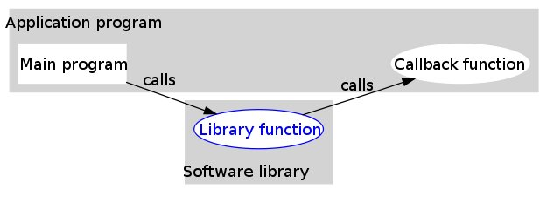
What is callback
A callback is executable code that is passed as an argument to other code. It allows a lower-level software layer to call a subroutine (or function) defined in a higher-level layer.
From Wikipedia

Slide 4
Why Defer
Defer is a callback function and result container.
Maybe it helps improve the code quality.
It is not a must.

Slide 5
How to use defer
An example class with callback functions
class haha {
public:
void test1(dht::entry &result){
std::string key = result["key"].string();
int value = result["value"].integer();
std::cout << "test1: key=" << key << ", value="<<value<< endl;
return;
}
void test2(dht::entry &result){
std::string key = result["key"].string();
int value = result["value"].integer();
std::cout << "test2: key=" << key << ", value="<<value<< endl;
return;
}
static void test1_wrapper(void* pt2Object, dht::entry &result){
haha *myself = (haha*)pt2Object;
myself->test1(result);
}
static void test2_wrapper(void* pt2Object, dht::entry &result){
haha *myself = (haha*)pt2Object;
myself->test2(result);
}
};

Slide 6
How to use defer
dht::Deferred *testDefer(std::string key, int value){
dht::Deferred *df = new dht::Deferred();
dht::entry result;
result["key"] = "abcd";
result["value"] = 8888;
//df->Callback(result);
return df;
}
int main(int c, char **v){
//dht::Deferred *df = new dht::Deferred();
haha *xixi = new haha();
dht::callbackFunc func;
func.pt2Obj = xixi;
func.pt2Func = haha::test2_wrapper;
dht::Deferred *df = testDefer("abcd", 888);
df->AddCallback(func);
dht::entry result;
result["key"] = "abcd";
result["value"] = 8888;
df->Callback(result);
std::cout << "done" << std::endl;
return 0;
}

Slide 7
What is inside Defer
typedef void (*pt2Function)(void* pt2Object, entry &result);
struct callbackFunc{
void *pt2Obj;
pt2Function pt2Func;
};
class Deferred{
public:
Deferred();
~Deferred();
void AddCallback(callbackFunc &cbFunc);
void Callback(entry &result);
private:
callbackFunc callback_;
entry result_;
bool is_callbacked_;
bool is_result_set_;
};

Slide 8
What is inside Defer
void Deferred::AddCallback(callbackFunc &cbFunc){
callback_.pt2Obj = cbFunc.pt2Obj;
callback_.pt2Func = cbFunc.pt2Func;
if (is_result_set_)
Callback(result_);
}
void Deferred::Callback(entry &result){
if ((callback_.pt2Func != NULL)&&(!is_callbacked_)){//can only callback once
callback_.pt2Func(callback_.pt2Obj, result);
is_callbacked_ = true;
}
else{
is_result_set_ = true;
result_ = result;
}
}

