Slide 1
PORTFOLIO PROJECT
Credit-SME Loan Application
& Portfolio Analytics
SQL
Reliable metrics
R
End-to-End Analytics using
PostgreSQL, R & R Shiny
Evidence & statistics
SHINY
From raw lending data to management-level credit insights.
Decision support
[Md. Maidul Hassan Shanto]
SYNTHETIC SME PORTFOLIO • Portfolio demonstration | October 2026
01
Notes:
This is my Credit-SME Loan Application and Portfolio Analytics project. It uses synthetic lending data, so the results demonstrate an analytical workflow rather than a real institution’s performance. I built the workflow around the full lending journey: applications, processing, disbursement and repayment risk. The presentation shows how PostgreSQL provides a reliable foundation, how R supports exploration and statistical reasoning, and how Shiny turns the analysis into management reporting. The emphasis is both technical delivery and careful business interpretation. Predictive credit scoring is a future extension rather than the main outcome of this project.

Slide 2
The Business Problem
Credit teams need one view of demand, operations and portfolio risk.
Raw lending data needs
structure before it can
support decisions.
Demand
Decisions
Application intake
Approval outcomes
Processing
Exposure
Stage delays & TAT
Disbursed & outstanding
Timely, consistent credit intelligence
for operational and risk monitoring.
Delinquency
Concentration
DPD, PAR30 & PAR90
Branch × sector
SYNTHETIC SME PORTFOLIO • Report p. 5
02
Notes:
Imagine a credit management meeting where application volumes, delays and exposure are stored in separate tables. A total application count alone does not explain decision outcomes, and disbursement does not show current risk. The business problem is to bring these measures together with consistent definitions. This project addresses visibility across demand, approvals, stage delays, outstanding exposure and delinquency. Branch and sector views make the information more useful because portfolio averages can hide local differences. The dashboard supports questions and investigation; it does not automatically explain causes or prescribe lending policy.

Slide 3
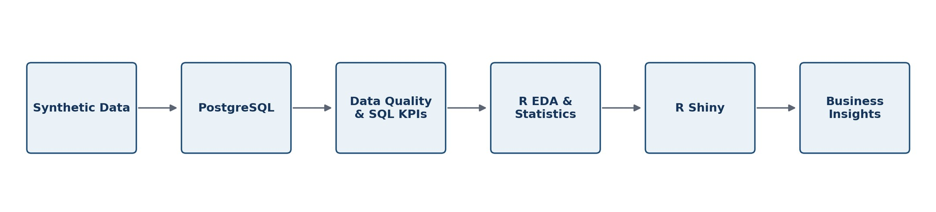
From Raw Data to Decision Support
One workflow connects database engineering, analysis and an interactive product.
01 FOUNDATION
02 INVESTIGATION
03 DELIVERY
Synthetic data → PostgreSQL
Quality checks → SQL KPIs
R exploratory analysis
Statistical evaluation
Reactive R Shiny dashboard
Management insights
SYNTHETIC SME PORTFOLIO • Report pp. 5–7, 13
03
Notes:
The workflow begins with synthetic lending records and places them in PostgreSQL. Validation comes before KPI calculations because an incorrect join or inconsistent record can distort a management result. SQL defines reusable measures, while R supports visual exploration and statistical questions. Shiny then presents the measures through filters, charts and tables. The original workflow diagram is shown above; the detailed stages below describe the same process. This separation of responsibilities is useful for reproducibility and maintenance: the database provides relational logic, R provides analytical flexibility, and the dashboard provides accessible decision support.

Slide 4
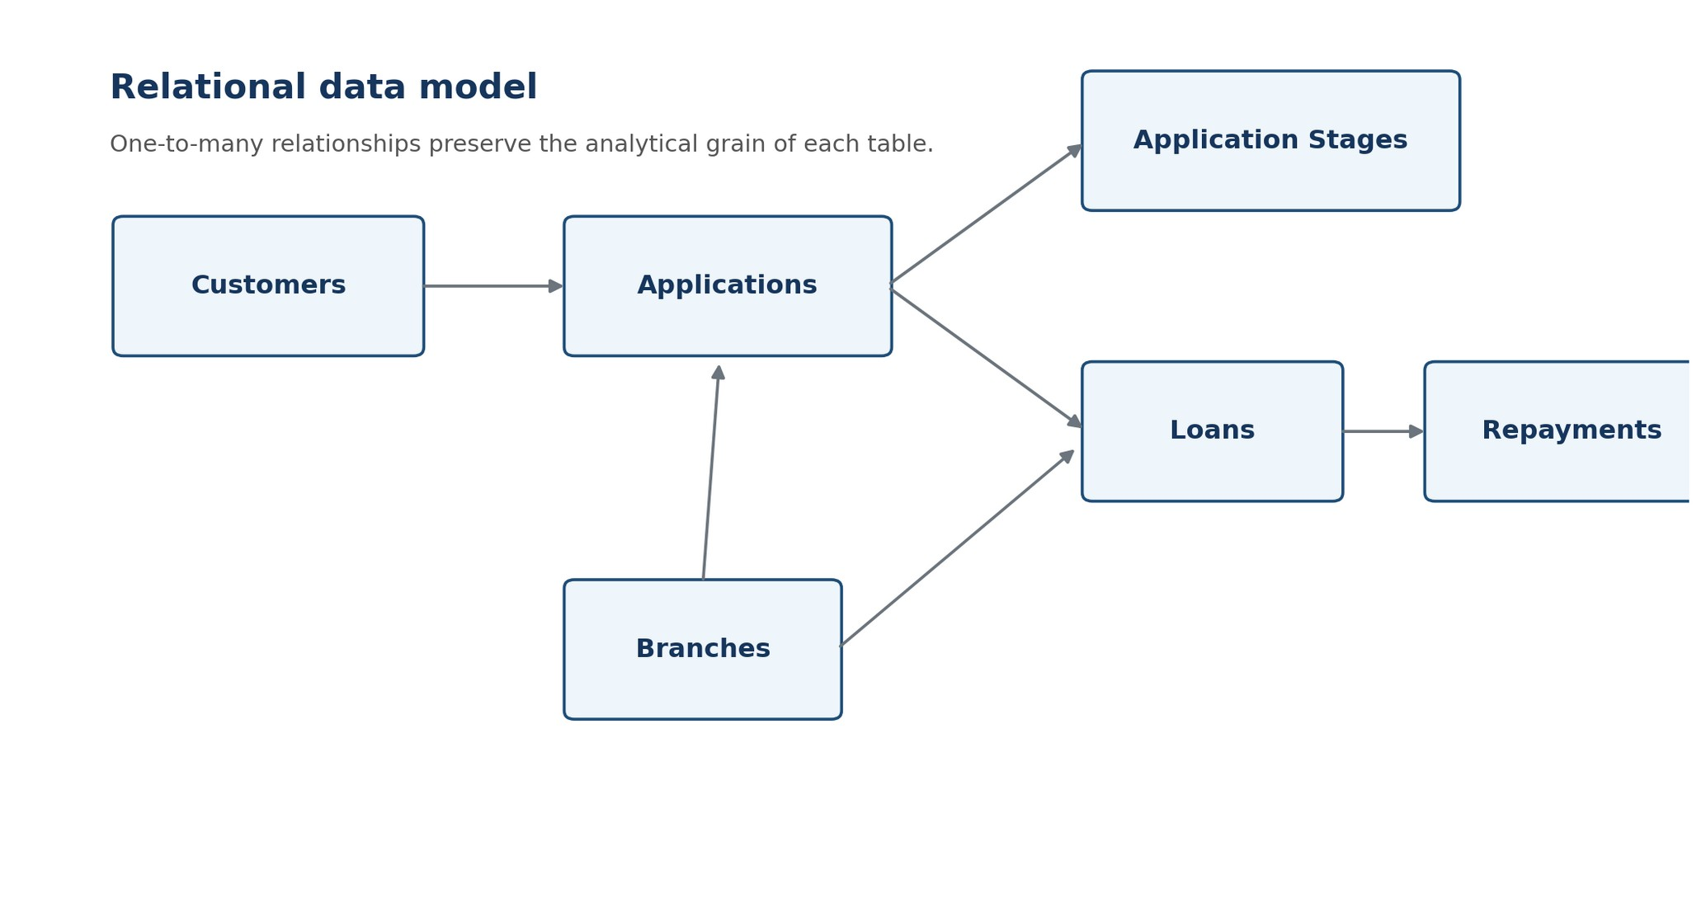
Relational Data Architecture
Six tables preserve the grain of the SME lending journey.
Branches
8
Customers
1,000
Applications
1,500
Application Stages
8,978
Loans
995
Repayments
12,218
Correct grain prevents one-to-many joins from overstating portfolio exposure.
SYNTHETIC SME PORTFOLIO • Report pp. 5–6
04
Notes:
The model links customers to applications, applications to processing-stage events and loans, and loans to repayment installments. Branches provide an operational dimension. Each table has a different grain, which is central to the correctness of the analysis. A loan can have many repayments. If its outstanding balance is summed after a direct join to those installments, the balance can be counted multiple times. Loan-level exposure therefore needs loan-grain calculations or appropriately aggregated repayment results. The row counts shown here are reported counts, not estimates. This design discipline connects database engineering directly to the credibility of portfolio reporting.

Slide 5
Building a Reliable Analytical Foundation
Reliable KPIs require reliable data — and exceptions require business review.
Uniqueness
Completeness
Validity
Consistency
Duplicate customer IDs: 0
Duplicate application IDs: 0
Missing core profiles: 0
Approved, no decision date: 0
Negative balances: 0
Invalid decision chronology: 0
Rejected with loan: 0
Outstanding > disbursed: 0
9 approved applications without a loan
Flag for follow-up; do not automatically treat as an error.
PostgreSQL • JOINs • CTEs • CASE WHEN • Window Functions
LAG(): month-on-month comparisons | ROW_NUMBER(): latest stage
SYNTHETIC SME PORTFOLIO • Report pp. 7–9
05
Notes:
The validation covered uniqueness, completeness, valid financial values and cross-table consistency. The report records no duplicate customer or application IDs, no missing core customer fields, no negative balances and no rejected applications with loans. One exception is particularly useful: nine approved applications did not have a loan. That is a review flag, not proof of an error, because approval and disbursement are different events. The SQL techniques listed below supported KPI calculation and operational monitoring, including rolling comparisons and latest-stage identification. These checks help distinguish data errors from legitimate business states before a result reaches management.

Slide 6
Portfolio at a Glance
Six management KPIs connect financing demand, processing and financial risk.
1,500
71.8%
15 days
Applications
Approval rate
Median TAT
BDT 4.108B
BDT 1.341B
45.1%
Total disbursement
Active outstanding
PAR30
Approval rate = Approved / (Approved + Rejected)
SYNTHETIC SME PORTFOLIO • Report pp. 3, 8–9, 20
06
Notes:
These are the six headline metrics from the report. Approval rate uses only approved and rejected applications in its denominator; it is not the approved share of all applications. Median turnaround time is fifteen days. Disbursement is the total value of originated facilities, while active outstanding is the remaining balance on loans not marked Closed. PAR30 is exposure-weighted under the project definition, so it should not be read as a percentage of loan accounts. All values describe the synthetic portfolio and do not establish a banking benchmark. Consistent definitions are what make these measures comparable across SQL, R and Shiny.

Slide 7
Application Demand & Decision Outcomes
Approved applications dominate the decided portfolio; volume is a separate question.
Application status · count
71.8% approval rate
1,004 / (1,004 + 394)
Gulshan: 316 applications
Highest branch application volume
Retail: 345 applications
Highest sector application volume
Volume and approval rates describe different dimensions of demand and decision-making.
SYNTHETIC SME PORTFOLIO • Report pp. 8, 17
07
Notes:
The chart shows the full application status mix, including withdrawn and pending records. There are 1,004 approvals and 394 rejections, producing a 71.8 percent approval rate among decided applications. That differs from the 66.93 percent approved share of all 1,500 applications. The right panel adds two concentration observations: Gulshan has the highest branch application volume, and Retail the highest sector volume. These describe demand, not superior performance. We would need capacity, mix and benchmark information to evaluate whether a volume or approval rate is desirable. Monthly values are not reconstructed because the available screenshot does not show complete axis information.

Slide 8
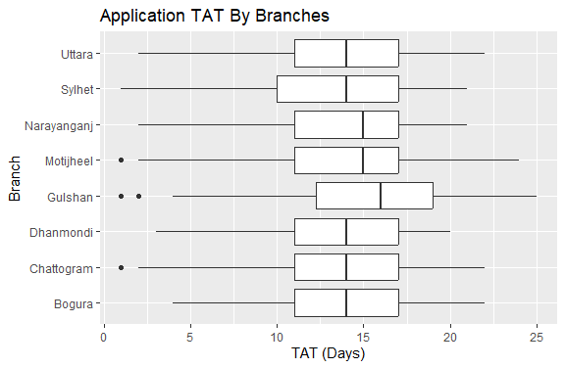
Where Does the Application Process Slow Down?
Stage-level analysis gives a more actionable starting point than overall TAT alone.
Average stage duration · days
Median TAT 15 days | Mean TAT 14.07 days | P90 19 days
SYNTHETIC SME PORTFOLIO • Report pp. 8, 10
08
Notes:
The branch boxplots show both typical decision time and variation. Gulshan has the highest reported median at sixteen days, while most branches are around fourteen to fifteen days. The stage chart identifies Credit Assessment as the longest average stage, at 4.45 days, followed by Documentation at 3.53 days. This makes Credit Assessment a logical first area for investigation, but it does not establish inefficiency. A longer stage could reflect required review depth or case complexity. The next analysis should examine workload, queues and branch-level delays, using distributions and percentiles as well as averages. Stage durations should not simply be added to infer end-to-end TAT.

Slide 9
Monitoring Portfolio Deterioration
Assess delinquency severity together with the money at risk.
45.1% PAR30
Outstanding exposure by DPD bucket · BDT million
Active exposure with DPD ≥ 30
12.35% PAR90
Active exposure with DPD ≥ 90
995 disbursed loans
BDT 4.13M average loan size
Bucket labels follow the report; PAR thresholds use ≥30 / ≥90 and cannot be inferred from these bands.
SYNTHETIC SME PORTFOLIO • Report pp. 9, 20
09
Notes:
The headline measures are exposure-weighted PAR30 and PAR90 for the active portfolio. The chart shows outstanding balances in the report’s displayed DPD buckets. These balances sum to approximately BDT 1.341 billion after rounding. The larger PAR30 relative to PAR90 suggests a need to monitor whether earlier delinquency cures or progresses, but a single snapshot cannot establish migration. An important definition detail is that project PAR30 uses DPD greater than or equal to thirty, while the displayed bands are labelled one to thirty and thirty-one to sixty. PAR90 has a similar boundary issue. Therefore the chart is not used to recompute the headline PAR values.

Slide 10
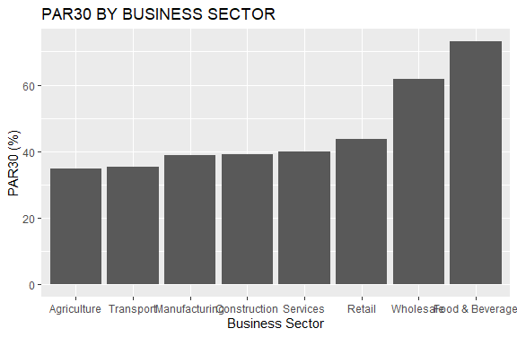
Exposure and Risk Are Not the Same Thing
Compare the amount outstanding with the proportion delinquent.
Largest reported sector exposures
BDT million · selected sectors only
Retail: 23.8% of active exposure
PAR30 ≈ 43.7%
Compare amount with risk rate.
Highest PAR30: Food & Beverage ≈ 73.2% • Wholesale ≈ 61.7%
SYNTHETIC SME PORTFOLIO • Report pp. 11, 18
10
Notes:
The original R chart presents sector PAR30 across all sectors. Food and Beverage is highest at approximately 73.2 percent, followed by Wholesale at 61.7 percent. The exposure panel is intentionally limited to the two largest reported sectors: Retail at BDT 318.8 million and Services at BDT 295.8 million. It is not a complete sector exposure ranking. Retail illustrates the distinction well: it has the largest exposure but a PAR30 of approximately 43.7 percent. Management should examine both rate and financial weight, and then investigate borrower concentration. A high sector rate alone does not justify labelling a sector bad or changing credit policy.

Slide 11
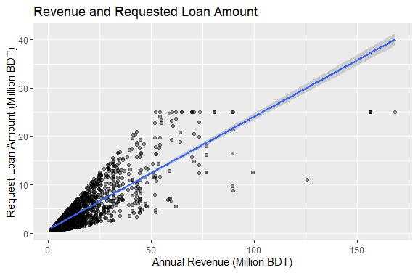
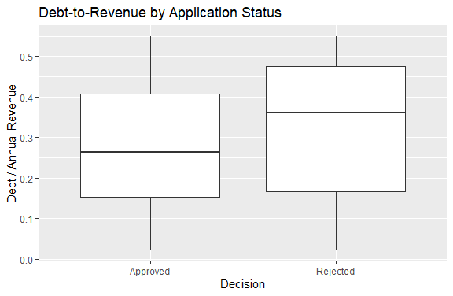
Moving Beyond Descriptive Reporting
Borrower relationships are investigated with charts and statistical tests.
Revenue × loan request
r ≈ 0.822; p < 0.001
Mean debt-to-revenue: 27.5% vs 32.4%
Welch t-test: p < 0.001
CI • Welch t-test • Chi-square • Correlation • Regression preview | Association ≠ causation
SYNTHETIC SME PORTFOLIO • Report pp. 11–13
11
Notes:
The two original R plots investigate borrower financial characteristics. The revenue plot shows a strong positive association with requested loan size, with Pearson correlation around 0.822. The debt-to-revenue plot shows distributions for approved and rejected applications. Their mean ratios are 27.5 and 32.4 percent respectively, and the Welch test detects a difference with p below 0.001. These are associations in synthetic data. The sector decision chi-square test, in contrast, has p around 0.415 and does not provide strong overall evidence of association. The tests are primarily univariate, and repeated applications may weaken independence assumptions. The logistic regression is only an exploratory preview, without predictive validation.

Slide 12
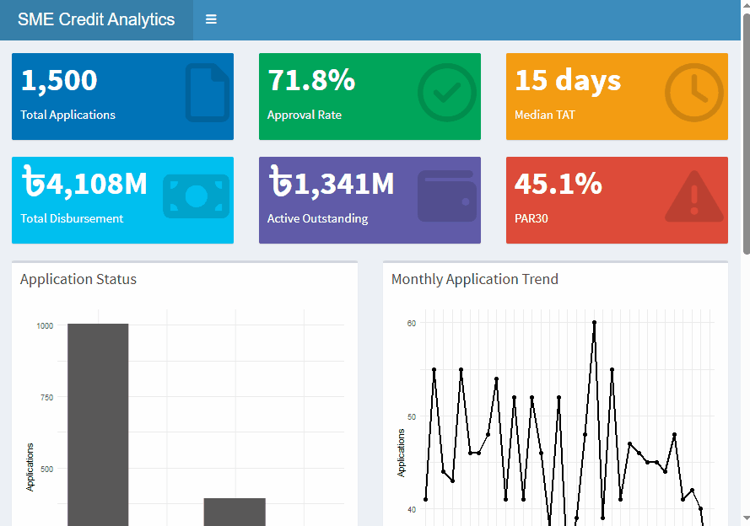
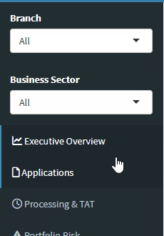
Turning Analysis into Interactive Decision Support
Interactive filters: Branch × Business Sector
Four dashboard sections
Executive Overview
Applications
Processing & TAT
Portfolio Risk
User selection → Reactive data → KPIs → Charts & tables
SYNTHETIC SME PORTFOLIO • Report pp. 13–17
12
Notes:
This is the actual Shiny application from the project report. The main screenshot shows the six headline KPI cards, with application charts beneath them. The smaller filter panel comes from the Applications page and confirms the branch and business-sector controls. Those global selections feed reactive datasets, which recalculate KPIs and update charts and tables. The four pages cover the executive overview, applications, processing and turnaround time, and portfolio risk. The screenshots are static evidence of the product; the report also describes a recording demonstrating changing results when a filter is selected. The dashboard is useful because managers can investigate a segment without manually rerunning the R script.

Slide 13
From Analytics to Action
Use evidence to prioritize investigation, without inventing causal explanations.
FINDING
RECOMMENDED INVESTIGATION / ACTION
Credit Assessment is longest: 4.45 days
→
Examine workload, queue size and branch-level delays.
PAR30 materially exceeds PAR90
→
Track DPD migration: cure versus deterioration.
PAR30 differs across sectors
→
Compare rates with exposure and borrower concentration.
Filters reveal segment-level differences
→
Use drill-down monitoring alongside portfolio averages.
SYNTHETIC SME PORTFOLIO • Report pp. 18–19; actions framed as investigations
13
Notes:
The recommendations follow directly from the evidence. For the longest processing stage, the action is to investigate workload and queues rather than assume the team is inefficient. For the gap between PAR30 and PAR90, the next step is migration analysis to see which loans cure and which deteriorate. For sector differences, compare delinquency rates with exposure and borrower concentration before drawing policy conclusions. Finally, use branch and sector drill-downs to supplement portfolio-wide averages. These are monitoring and investigation priorities, not causal findings. They also show how the project can evolve toward early warning while retaining clear KPI definitions and transparent assumptions.

Slide 14
What This Project Demonstrates
Database discipline, analytical reasoning, credit knowledge and product delivery.
DATA
ANALYTICS
CREDIT DOMAIN
PRODUCT
PostgreSQL
Relational modeling
Data quality
SQL & R
EDA
Statistics
TAT & DPD
PAR30 / PAR90
Exposure
R Shiny
Interactive dashboard
Decision support
A structured analytical workflow — from database design and statistical
analysis to interactive management reporting.
FUTURE EXTENSION · SME Credit Risk Scoring & Default Prediction
Logistic regression • Probability of default • Scorecard • ROC-AUC • KS / Gini • Model monitoring
SYNTHETIC SME PORTFOLIO • Report pp. 19–20
14
Notes:
The value of this project is the connection between its parts. Relational modeling and quality checks make the data trustworthy. SQL and R turn those records into metrics and evidence. Credit-domain definitions help explain what exposure, turnaround time and delinquency actually mean. Shiny makes the results accessible through a usable reporting product. The work demonstrates a foundation for a junior data scientist or credit analytics role, including responsible communication of limitations. A future extension would build a validated default-prediction workflow with a defined target, logistic regression, probability of default, scorecard concepts and model monitoring. Those capabilities remain planned; this deck does not claim a production scoring model.

