Slide 1

Customer Shopping Behavior Analysis
Uncovering insights from 3,900 transactions across product categories — spending patterns, customer segments, and strategic opportunities.

Slide 2

Dataset at a Glance
3,900
Transactions
Rows in the dataset
18
Columns
Features per record
37
Missing Values
In Review Rating only
$59.76
Avg. Purchase
Mean transaction value
Key features: demographics (Age, Gender, Location), purchase details (Category, Amount, Season), and behavior signals (Discount, Subscription, Review Rating).

Slide 3


Data Preparation in Python
Cleaning
Imputed missing Review Ratings using median by product category; standardized columns to snake_case.
Feature Engineering
Created age_group (binned ages) and purchase_frequency_days; dropped redundant promo_code_used.
Database Integration
Loaded cleaned DataFrame into PostgreSQL for SQL-based analysis.

Slide 4
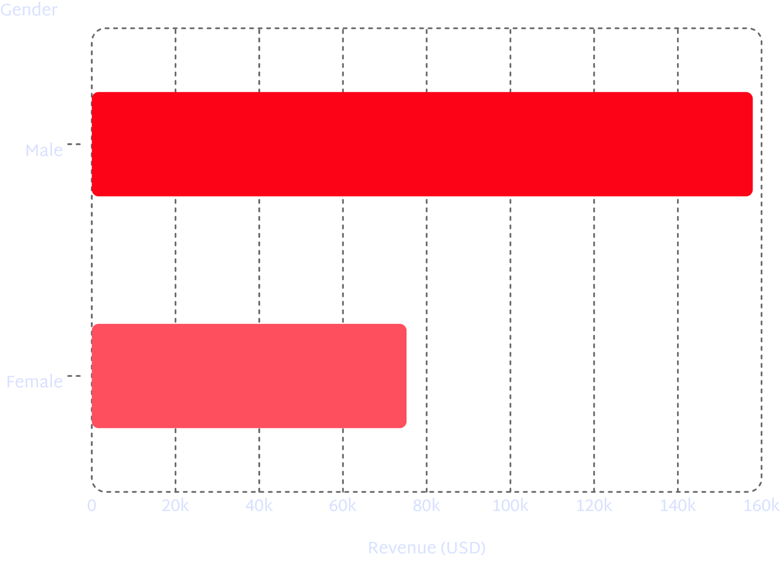
Revenue & Spending Insights
Gender Revenue Gap
Male customers generated 2.1× more revenue than female customers ($157,890 vs. $75,191).
Discount Users Still Spend More
839 customers used discounts yet spent above the average purchase amount — indicating high-value, deal-seeking buyers.

Slide 5
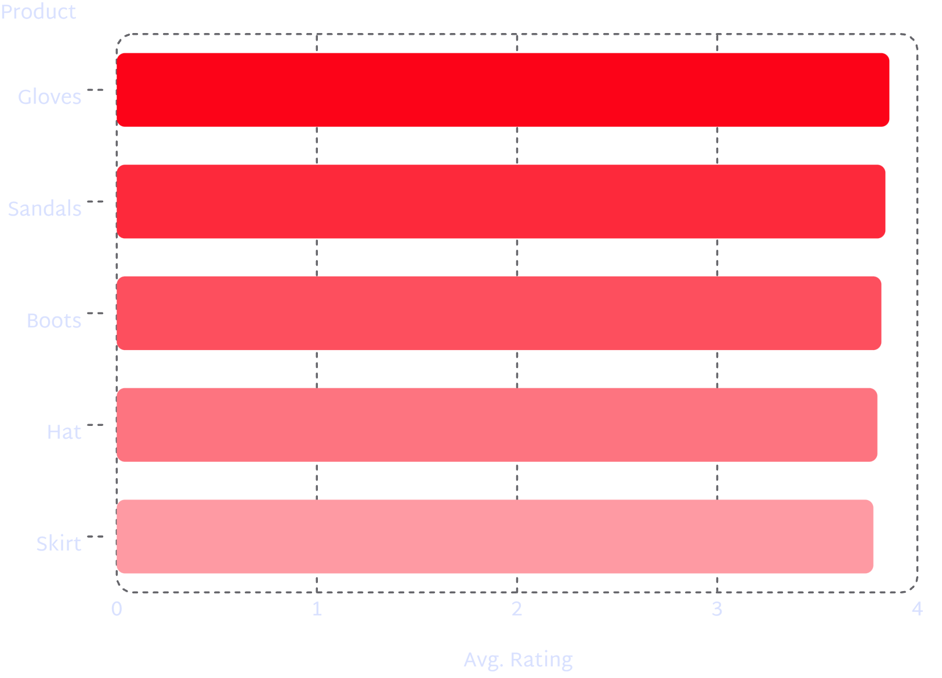
Top Products & Shipping Behavior
Express Shipping Premium
Express shipping averages $60.48 vs. $58.46 for Standard — a $2.02 uplift per order.
Most Discounted Products
Jacket (39%), Skirt (38%), Sandals (36%), Blouse (33%), Socks (32%) — highest discount rates in the catalog.

Slide 6
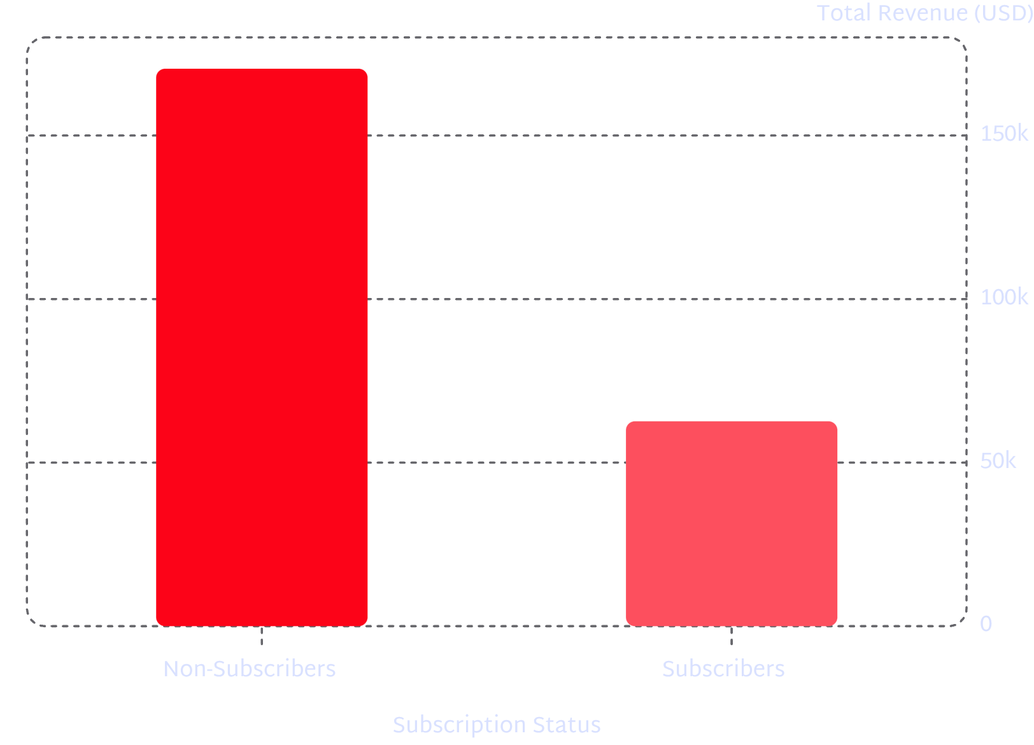

Subscribers vs. Non-Subscribers
Key Findings
2,847 non-subscribers vs. 1,053 subscribers — a 73% / 27% split.
Average spend is nearly identical: $59.87 (non-subscribers) vs. $59.49 (subscribers).
Of customers with >5 purchases, 958 are subscribers vs. 2,518 non-subscribers.

Slide 7
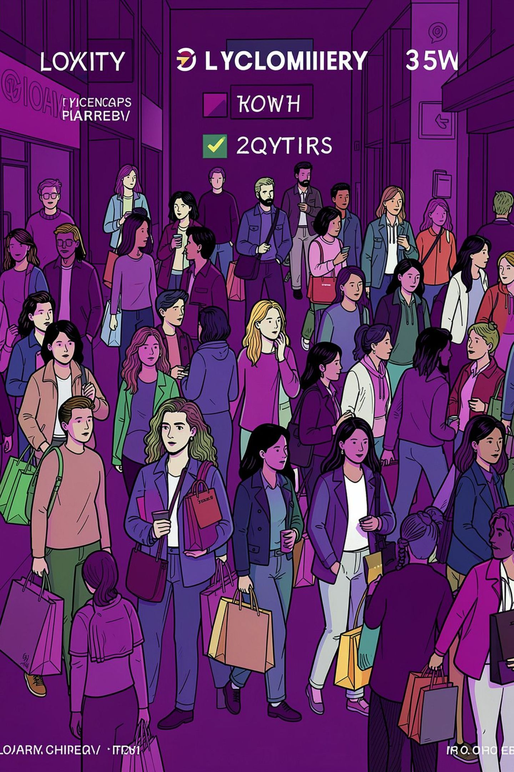
Customer Segmentation
🏆 Loyal
🔄 Returning
3,116 customers — the dominant segment, representing 80% of the base.
701 customers — repeat buyers with potential to convert to Loyal.
🆕 New
83 customers — smallest segment; prime target for onboarding campaigns.

Slide 8
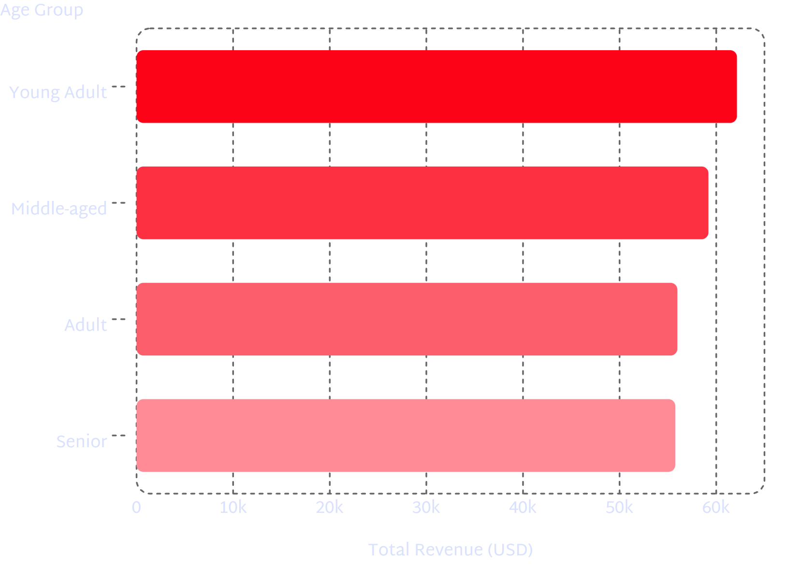
Revenue by Age Group & Top Products per Category
Top 3 Products per Category
Accessories: Jewelry (171), Sunglasses (161), Belt (161)
Clothing: Blouse (171), Pants (171), Shirt (169)
Footwear: Sandals (160), Shoes (150), Sneakers (145)
Outerwear: Jacket (163), Coat (161)
Young Adults lead revenue; Clothing and Accessories dominate order volume across all groups.

Slide 9
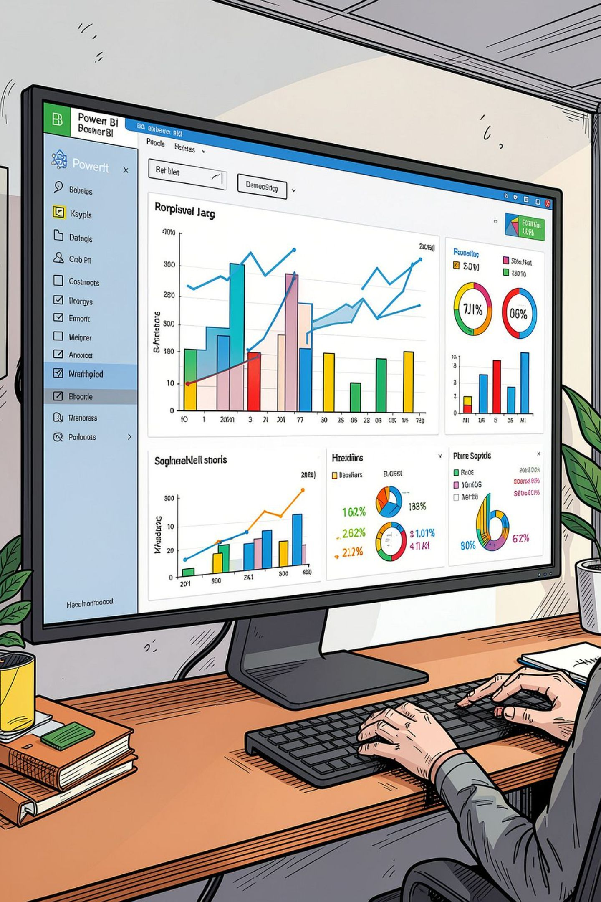



Power BI Dashboard
Key KPIs
3.9K customers · 3.75 avg. rating · $59.76 avg. purchase amount
Subscription Distribution
~75% subscribed vs. ~25% non-subscribed, visualized as a donut chart
Revenue by Category
Clothing (~$100K) leads, followed by Accessories (~$75K), Footwear (~$40K), Outerwear (~$15K)

Slide 10

Business Recommendations
1
2
Boost Subscriptions
Loyalty Programs
Promote exclusive subscriber benefits to grow the 27% base.
Reward repeat buyers to convert the 701 Returning customers into Loyal.
3
4
Review Discount Policy
Product & Marketing Focus
Balance discount-driven sales with margin control — 839 high-spend discount users show opportunity.
Highlight top-rated products; target Young Adults and express-shipping users for campaigns.

