Slide 1
PORTFOLIO CASE STUDY / MARKETING ANALYTICS
Marketing Effectiveness &
Media Budget Optimisation
An End-to-End Marketing Mix Modelling
and Econometric Analysis
PostgreSQL | Python | Econometrics | Marketing Mix Modelling | Optimisation
Synthetic but business-realistic dataset created for portfolio and learning purposes.
Illustrative consumer-business setting; no real company data.
Notes:
Open with the business decision: can a fixed media budget work harder? All analysis uses synthetic data created for portfolio and learning purposes. No company ownership is implied.

Slide 2
MARKETING ANALYTICS / 02
Can the existing marketing budget generate more sales?
The decision: understand effectiveness before changing the media mix.
TV
Search
Meta
YouTube
OOH
01
02
03
04
Drivers
Incrementality
Efficiency
Allocation
What actually drives weekly sales?
How many sales units does each channel add?
Which channels deliver better returns?
Where does the next unit of spend work hardest?
Measure marketing effectiveness and identify a more efficient media allocation without increasing total spend.
SYNTHETIC PORTFOLIO DATA • Project scope & media variables
02
Notes:
Frame a hypothetical consumer business investing across TV, Search, Meta, YouTube and out-of-home. The objective is model-supported allocation, not a causal claim from observational data.

Slide 3
MARKETING ANALYTICS / 03
One decision, connected across the analytical workflow
Sales Units is the primary KPI; business controls separate media from underlying demand.
OBSERVATIONS
TIME SPAN
MEDIA COVERAGE
156 weeks
≈3 years
5 channels
Controls: Price • Promotion • Distribution • Holiday activity • Competitor activity
Raw data
PostgreSQL
validation
Cleaning
EDA
Econometrics
Adstock
Saturation
MMM
Attribution
ROAS
Response
curves
Optimisation
SYNTHETIC PORTFOLIO DATA • EDA & modelling notebooks
03
Notes:
Read the workflow left to right on each row. The clean analytical data contains 156 observations from January 2023 through December 2025. SQL provides validation and an audit trail; Pandas supports EDA; statsmodels provides econometric models; SciPy solves constrained allocation.

Slide 4
MARKETING ANALYTICS / 04
Reliable modelling starts with reliable data
Raw records were preserved; repairs were documented in a data-quality audit log.
Row count & duplicates
Six documented issues
1 duplicate week → remove identical record
2 missing media values → local interpolation
1 missing distribution → local interpolation
1 negative OOH spend → invalidate & interpolate
1 implausible promotion → local pattern review
Missing values & ranges
Business rules & categories
Weekly continuity & revenue checks
Raw table
Validation
Audit log
Clean table
PostgreSQL techniques: CTEs, ROW_NUMBER, LAG / LEAD, COALESCE, constraints and an explicit audit trail.
SYNTHETIC PORTFOLIO DATA • SQL validation & cleaning scripts
04
Notes:
Sources: data_quality_check.sql and data_cleaning.sql. Repairs: W023 Search 2.56; W068 distribution 88.25; W119 Meta 3.15; W045 OOH -0.80 to 3.01; W092 promotion 75 to 0; W030 exact duplicate removed. Local interpolation uses adjacent weeks. These are project-specific judgements, not universal cleaning rules. The archive has scripts, not a database execution log; do not claim independent PostgreSQL re-execution.

Slide 5
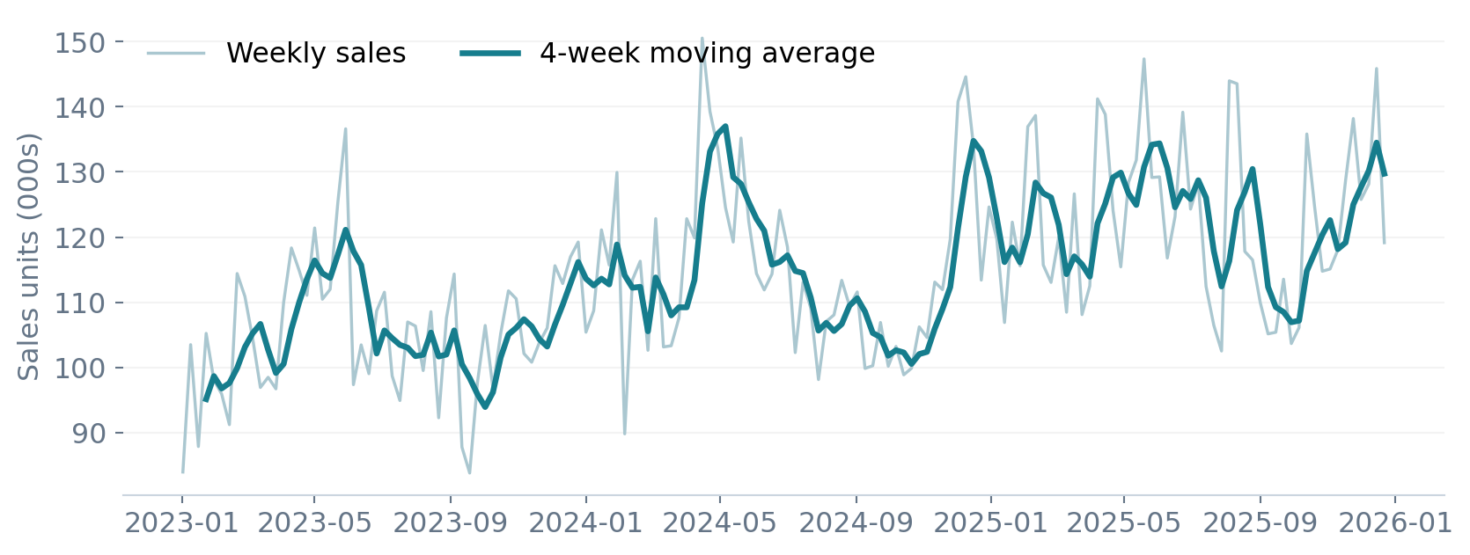
MARKETING ANALYTICS / 05
Sales grew, but media spend alone cannot explain the trend
Long-term growth and seasonal fluctuations make business controls essential.
2023 AVG. WEEKLY SALES
≈105k
2024 AVG. WEEKLY SALES
≈115k
2025 AVG. WEEKLY SALES
≈122k
Explore price, promotion, distribution, holidays and competition. Correlation is exploratory evidence, not causal proof.
SYNTHETIC PORTFOLIO DATA • EDA notebook; values rounded
05
Notes:
EDA annual averages: 105292.00 in 2023; 114815.66 in 2024; 122414.27 in 2025. The chart is redrawn from raw sales after exact duplicate removal; sales values are unchanged by the cleaning script. Promotion, distribution and holidays show positive exploratory associations; price is negatively associated. Promotion and price are strongly related, so standalone correlations can mislead.

Slide 6
MARKETING ANALYTICS / 06
Separate marketing effects from other sales drivers
A business-led regression establishes a baseline before adding transformed media.
Sales = Base demand + Price + Promotion + Distribution + Holiday
+ Competition + Trend + Seasonality + Media + Error
BASE MODEL R²
ADJUSTED R²
Positive: distribution, holiday demand
Negative: price, competitor activity
Trend and seasonality provide time controls
≈0.816
≈0.804
Diagnostics: coefficient plausibility, uncertainty, VIF, residuals, heteroscedasticity and autocorrelation.
SYNTHETIC PORTFOLIO DATA • Econometrics notebook; rounded fit
06
Notes:
Base model excludes media and includes price, promotion, distribution, holidays, competitor activity, trend and two sine/cosine seasonal harmonics. Fit is in-sample. In the base model price and promotion VIFs are approximately 32.5 and 32.6; promotion effects should not be interpreted in isolation. Trend and seasonality are important controls but not every seasonal coefficient is statistically significant.

Slide 7
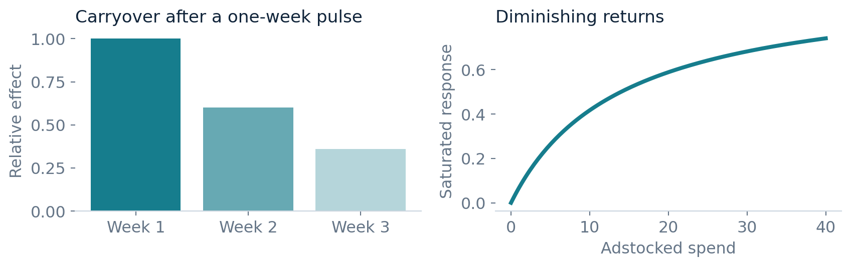
MARKETING ANALYTICS / 07
Advertising carries over—and eventually saturates
Raw weekly spend misses both delayed effects and diminishing returns.
ADSTOCK
Spend(t) + λ × Adstock(t−1)
SATURATION
Adstock / (Adstock + θ)
SYNTHETIC PORTFOLIO DATA • MMM notebook; illustrative diagrams
07
Notes:
Adstock models persistence after a campaign. The illustrative pulse uses TV decay 0.60: relative effects 1, 0.60, 0.36. Saturation is x/(x+theta), using TV theta 14 for the diagram. Notebook channel decay values: TV .60, Search .20, Meta .35, YouTube .45, OOH .50. Theta: 14, 5.5, 7.5, 5, 6.5. These settings are specified in the notebook; no parameter search or uncertainty range is demonstrated.

Slide 8
MARKETING ANALYTICS / 08
Transformed media improved fit; uncertainty still matters
Compare like-for-like in-sample models, then examine the limits of interpretation.
MODEL
R²
ADJ. R²
RMSE (units)
Diagnostic findings
Base controls
0.816
0.804
5,896
Raw-media diagnostics:
DW ≈1.84; BP p ≈0.981
HAC standard errors examined
Price / promotion VIF >32
No holdout evaluation shown
Raw media
0.833
0.815
5,627
Adstock
0.846
0.830
5,391
Adstock + saturation
0.849
0.833
5,339
Non-negative media attribution fit: R² ≈0.849; RMSE ≈5,341 units. Fit alone does not establish causal validity.
SYNTHETIC PORTFOLIO DATA • MMM & econometrics notebooks; rounded
08
Notes:
OLS comparison values are from MMM notebook outputs. Attribution is a separate constrained least-squares fit: R2 .8492183603150396 and RMSE 5341.161832338219. Breusch-Pagan and Durbin-Watson diagnostics quoted here apply to the raw-media full model in the econometrics notebook, not automatically to the constrained fit. BP does not reject homoscedasticity; DW is near two. No held-out or rolling temporal validation is in the supplied outputs. Unconstrained transformed-media coefficients: TV p=.447, Search p=.455, Meta p=.725, YouTube p=.030, OOH p=.005. Wide media uncertainty should temper decisions.

Slide 9
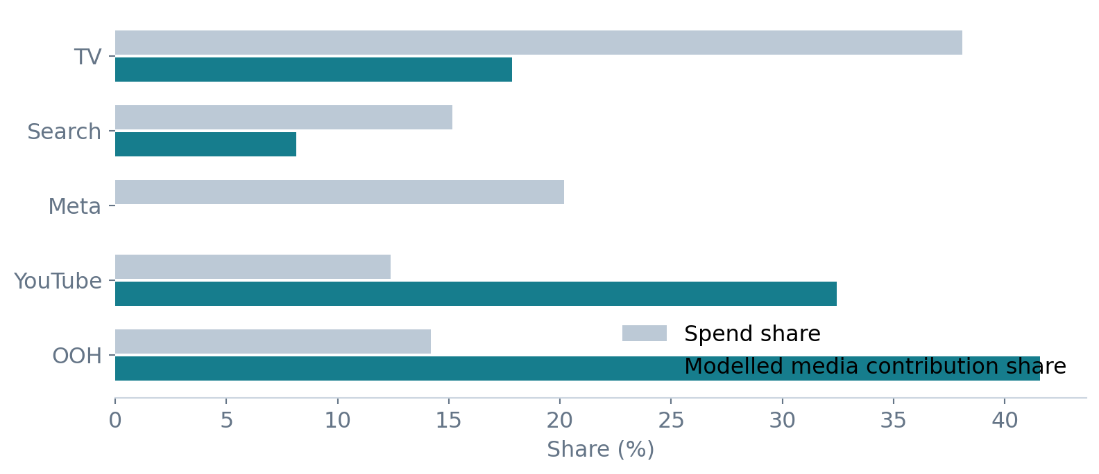
MARKETING ANALYTICS / 09
OOH and YouTube account for most modelled media sales
Counterfactual attribution removes each transformed channel while holding other inputs fixed.
MODELLED MEDIA UNITS
≈5.23m
OOH + YOUTUBE SHARE
≈74%
Share of modelled media contribution, not total sales.
Meta’s fitted effect is approximately zero under the non-negative constraint; this is not proof of no effectiveness.
SYNTHETIC PORTFOLIO DATA • MMM notebook; shares rounded
09
Notes:
Contribution is full predicted sales minus channel-zero counterfactual predicted sales. Total modelled media incremental units approximately 5.234 million over 156 weeks. Channels: TV .934m, Search .425m, Meta zero, YouTube 1.698m, OOH 2.177m. OOH+YouTube shares 41.586%+32.441%=74.027%. Attribution uses transformed media set to zero, not observed experimental removal. Baseline includes intercept and all non-media predictors. No causal or experimental validation is claimed.

Slide 10
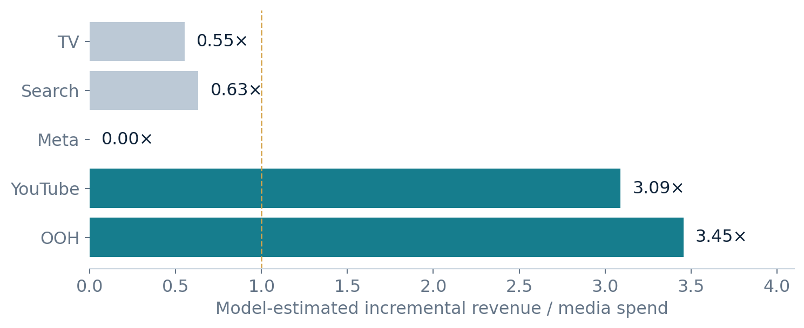
MARKETING ANALYTICS / 10
OOH and YouTube show the strongest revenue efficiency
ROAS measures incremental revenue per unit of media spend—not profit.
Revenue ROAS
Incremental units
× weekly average price
÷ channel spend
Aggregated over 156 weeks
OOH ≈3.45× and YouTube ≈3.09×. TV ≈0.55×, Search ≈0.63×, Meta ≈0.00× in this fitted model.
SYNTHETIC PORTFOLIO DATA • MMM notebook; ROAS rounded
10
Notes:
Revenue is computed week by week using channel contribution times avg_price_bdt divided by one million, then summed and divided by total channel spend in BDT million. Exact ROAS: TV .553042; Search .632929; Meta 0; YouTube 3.089985; OOH 3.454851. Dashed line marks 1x revenue/spend, not profit breakeven. The notebook separately assumes a 35% contribution margin; no margin or profit claim is required here.

Slide 11
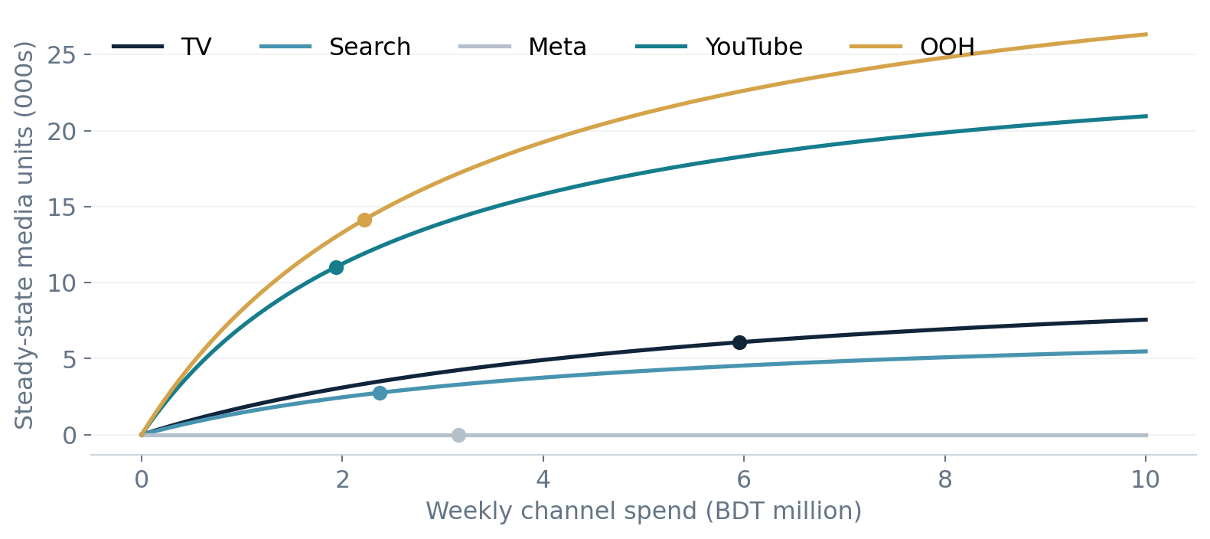
MARKETING ANALYTICS / 11
Allocate the next unit of budget using marginal response
Average ROAS describes the past mix; response curves guide incremental allocation.
Marginal units per
BDT 1m weekly spend
OOH
≈3,790
YouTube
≈3,344
Search
≈758
TV
≈495
Meta
≈0
Dots mark current average weekly spend. Curves assume sustained spend and a steady-state adstock response.
SYNTHETIC PORTFOLIO DATA • MMM response functions; rounded
11
Notes:
Steady-state response = coefficient * spend / (spend + theta*(1-decay)). Derivative = coefficient*a/(spend+a)^2, where a=theta*(1-decay). Current marginal units: TV 495.2941, Search 758.2976, Meta effectively zero, YouTube 3344.294, OOH 3789.717. These are local derivatives, not guaranteed effects of a full BDT million shift. Curves hold model parameters fixed and do not model changing creative, price, competition or execution.

Slide 12
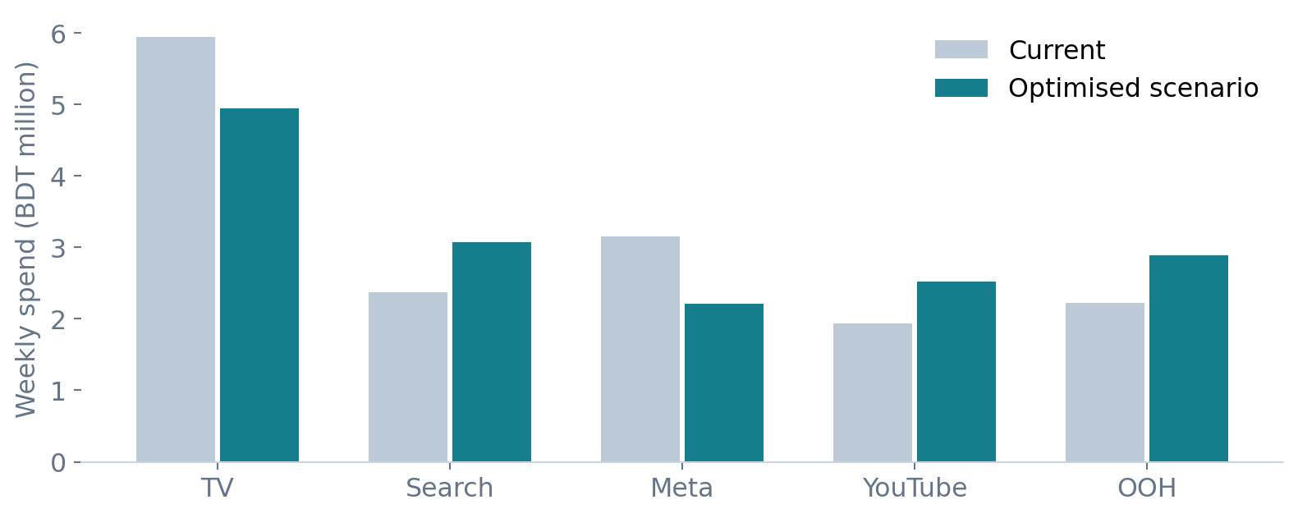
MARKETING ANALYTICS / 12
The fixed-budget scenario reallocates toward stronger response
Optimisation maximises steady-state media response with each channel limited to ±30%.
UNCHANGED WEEKLY BUDGET
BDT 15.63m
TV −17.0%
Meta −30.0%
Search +30.0%
YouTube +30.0%
OOH +30.0%
SLSQP solver • Fixed total budget • Non-negative spend • ±30% channel movement bounds
SYNTHETIC PORTFOLIO DATA • Allocation CSV & MMM notebook; rounded
12
Notes:
Source allocation_summary.csv. Current→optimised weekly spend BDT million: TV 5.950769→4.941212; Search 2.366987→3.077083; Meta 3.156282→2.209397; YouTube 1.935705→2.516417; OOH 2.218782→2.884417. Total 15.628525641. Search rises despite lower marginal return because higher-return YouTube and OOH hit +30% bounds while Meta falls to -30%; the remaining budget is redistributed under the fixed-total constraint. Scenario applies to average weekly steady-state spend, not an optimised week-by-week flighting schedule.

Slide 13
MARKETING ANALYTICS / 13
The model estimates 11.5% more media-driven sales units
Same budget, different mix: scenario uplift applies to the media component, not total sales.
CURRENT MEDIA UNITS
OPTIMISED MEDIA UNITS
ESTIMATED WEEKLY INCREASE
≈34.0k
≈37.9k
≈3.9k
Budget movement limit
Estimated uplift
±15%
≈6.2%
±30%
≈11.5%
±50%
≈17.6%
Model-estimated scenarios—not guaranteed future outcomes. Results depend on fitted coefficients and fixed response assumptions.
SYNTHETIC PORTFOLIO DATA • MMM optimisation outputs; rounded
13
Notes:
Exact main scenario: current media response 34019.178810841615; optimised 37935.360114602445; difference 3916.18130376083; uplift 11.511686762153051%. Sensitivity outputs: ±15% 6.1661511%; ±30% 11.5116868%; ±50% 17.6262713%. These are steady-state weekly media response estimates. Do not describe as 11.5% total sales growth or multiply by 156 to claim a realised gain. Parameters are not re-estimated across scenarios and confidence intervals are not supplied.

Slide 14
MARKETING ANALYTICS / 14
Use the scenario to design a measured allocation test
Translate model evidence into a controlled learning plan before broad deployment.
01
Prioritise OOH and YouTube
Test phased increases where the model indicates stronger marginal response.
02
Review TV and Meta
Reduce cautiously; investigate creative, audience quality and attribution uncertainty.
03
Validate before scaling
Add temporal holdouts, parameter sensitivity and channel or geo experiments.
Portfolio capability: SQL governance → Python analysis → econometric controls → MMM → a testable budget decision.
SYNTHETIC PORTFOLIO DATA • Recommendations based on project findings
14
Notes:
Recommendations are proposed next steps, not completed experiments. The project demonstrates PostgreSQL SQL, Pandas EDA, statsmodels OLS/HAC diagnostics, adstock, saturation, constrained least-squares attribution, ROAS, analytic response derivatives and SciPy SLSQP optimisation. Important limitations: synthetic data; 156 observations; price/promotion collinearity; weak identification for some channels; fixed transformation settings; no out-of-sample validation; no uncertainty interval for optimisation. Source inventory: three notebooks, two SQL scripts, raw CSV/XLSX, chart outputs and allocation CSV. No standalone project report was present in the supplied archive. Presentation charts have been redrawn from source data or notebook outputs for consistent design.

