Slide 1
ARROWSTACK • TASK 1
Customer Churn
Investigation
Comprehensive Exploratory Data Analysis
Arrowstack Data Science Internship — Batch 2026
Presenter: Md. Maidul Hassan Shanto
Python | Pandas | Seaborn | Data Visualization
ARROWSTACK / DATA SCIENCE INTERNSHIP / BATCH 2026
01
Notes:
Opening — 25 seconds. Introduce the descriptive EDA project and its business purpose. Presenter: Md. Maidul Hassan Shanto, supplied by the user.

Slide 2
BUSINESS CONTEXT
Understanding the Customer Retention Challenge
Churn means a customer stops using a service or subscription.
Understanding who leaves can help subscription businesses focus retention research.
Understand patterns
Identify priority groups
Guide retention tests
Explore how churn differs across customer characteristics.
Find segments with higher observed churn for further investigation.
Translate descriptive findings into testable business actions.
ARROWSTACK / DATA SCIENCE INTERNSHIP / BATCH 2026
02
Notes:
35 seconds. Define churn and explain the three goals. No predictive model or causal estimate was developed.

Slide 3
DATASET & METHOD
From Raw Data to Business Insights
7,043
21
Yes / No
Customer records
Variables
Churn outcome
Data
Understanding
›
Data
Cleaning
›
Univariate
EDA
›
Bivariate
EDA
›
Segmentation
›
Validation
›
Business
Recommendations
Python • Pandas • NumPy • Matplotlib • Seaborn • Google Colab
Source: Telco Customer Churn (IBM sample data via Kaggle); project EDA.
ARROWSTACK / DATA SCIENCE INTERNSHIP / BATCH 2026
03
Notes:
35 seconds. Explain dataset scope and the workflow from inspection to recommendations.

Slide 4
DATA QUALITY
Building a Reliable Analytical Foundation
Before cleaning
After cleaning
TotalCharges stored as text; 11 blank entries, all among zero-tenure customers.
Converted to float64; assigned the 11 entries zero under a documented assumption.
7,043
0
0
Passed
Records retained
Missing cells
Exact duplicates
Implemented checks
Assumption not independently checked against billing records. Passed checks do not prove every assumption is correct.
ARROWSTACK / DATA SCIENCE INTERNSHIP / BATCH 2026
04
Notes:
40 seconds. Explain the 11 zero-tenure blanks and the assumption. Validation reports consistency, not the truth of the billing assumption.

Slide 5
OVERALL CHURN
One in Four Customers Was Classified as Churned
26.54%
Churned: 1,869 customers
7,043
73.46% retained
5,174 customers
Retention is an important area for investigation.
This is a dataset proportion; the churn observation period is not confirmed.
ARROWSTACK / DATA SCIENCE INTERNSHIP / BATCH 2026
05
Notes:
35 seconds. Approximately 26.54% of records are classified as churned. Do not characterize this as monthly or annual churn.

Slide 6
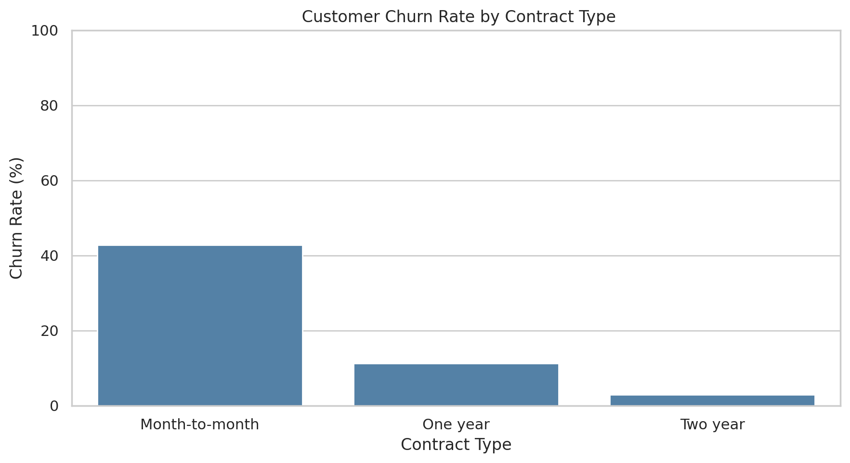
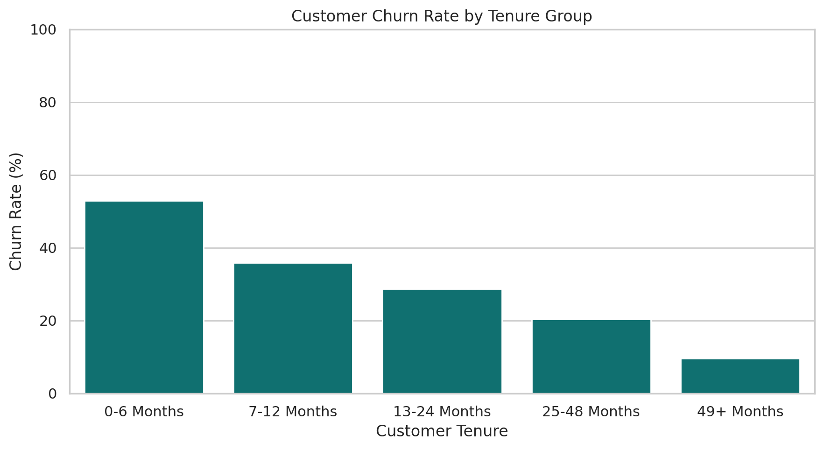
CONTRACT & TENURE
Contract Structure and Tenure Reveal Churn Patterns
Contract type
Customer tenure
Month-to-month customers show approximately 42% observed churn.
Shorter-tenured customers generally show higher observed churn.
Source: Telco Customer Churn (IBM sample data via Kaggle); project EDA.
ARROWSTACK / DATA SCIENCE INTERNSHIP / BATCH 2026
06
Notes:
40 seconds. Distinguish separate contract and tenure comparisons. Explain the general tenure trend without asserting exact tenure-group rates.

Slide 7
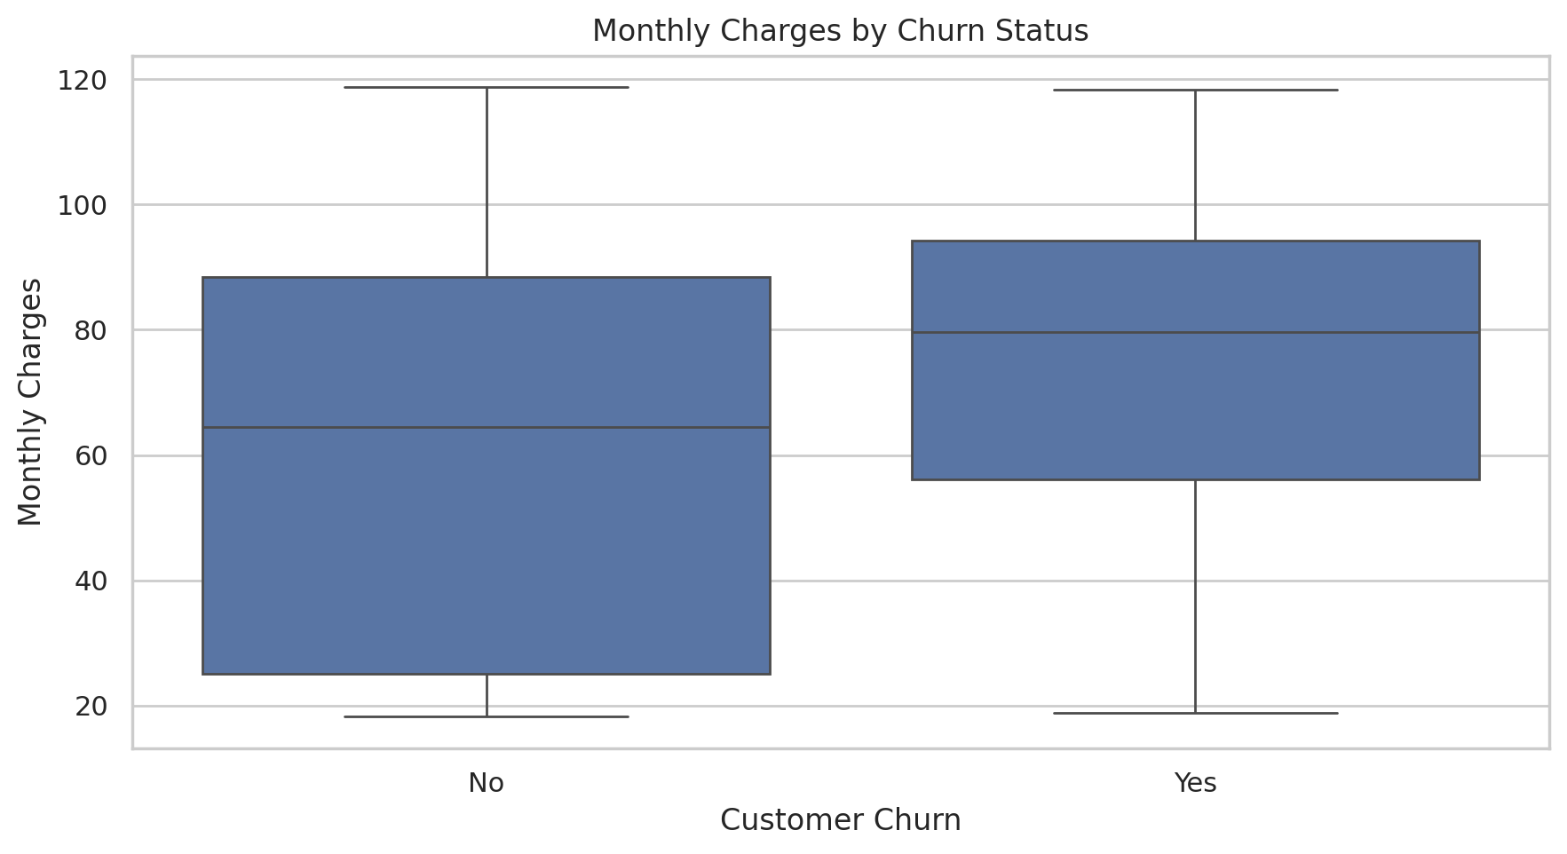
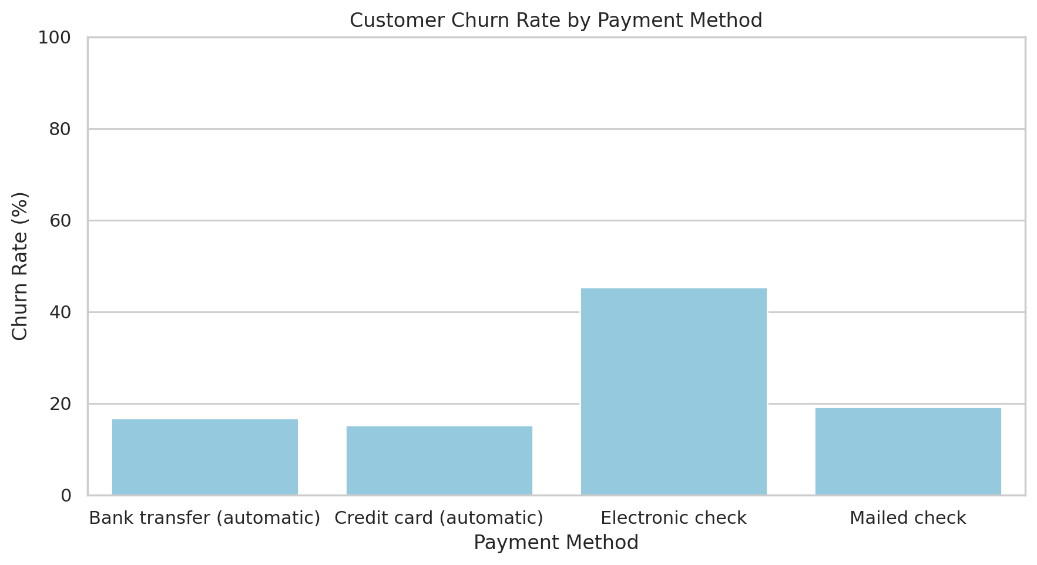
CHARGES & PAYMENT
Billing Characteristics Differ Across Churn Groups
Monthly charges by churn status
Churn by payment method
Churned customers have higher median charges; distributions overlap.
Electronic-check customers show comparatively high observed churn.
Source: Telco Customer Churn (IBM sample data via Kaggle); project EDA.
ARROWSTACK / DATA SCIENCE INTERNSHIP / BATCH 2026
07
Notes:
45 seconds. Compare monthly-charge distributions by churn status and churn proportions by payment method. Charge distributions overlap. No exact electronic-check percentage is asserted pending verification. Associations do not establish billing dissatisfaction as a cause.

Slide 8
CUSTOMER SEGMENTATION
Combining Tenure and Contract Reveals Detailed Patterns
Month-to-month
One year
Two year
Within month-to-month
0–6 months
55.2%
10.3%
Masked
55.2% at 0–6 months
26.0% at 49+ months
7–12 months
42.0%
10.6%
0.0%
13–24 months
37.7%
8.1%
0.0%
25–48 months
32.9%
10.6%
2.2%
Internet-service comparison
49+ months
26.0%
12.9%
3.3%
Fiber ≈42% | DSL ≈19% | None ≈8%
Groups with fewer than 30 customers are masked; masked cells are not zero. Small-group estimates may be unstable.
Source: Telco Customer Churn (IBM sample data via Kaggle); project EDA.
ARROWSTACK / DATA SCIENCE INTERNSHIP / BATCH 2026
08
Notes:
50 seconds. Emphasize the 55.2% early-tenure month-to-month segment. Explain the masked two-year cell and small sample uncertainty. The heatmap reports observed subgroup churn percentages.

Slide 9
BUSINESS RECOMMENDATIONS
Turning Findings into Testable Retention Strategies
01 Improve onboarding
02 Evaluate contract incentives
Evidence: higher churn among newer customers.
Action: investigate early support and onboarding.
Evaluate: pilot changes with a comparison group.
Evidence: month-to-month churn ≈42%.
Action: test suitable offers and loyalty benefits.
Evaluate: retention and offer uptake.
03 Investigate fiber-optic experience
04 Review payment experiences
Evidence: observed churn ≈42%.
Action: review pricing, service and feedback.
Evaluate: pilot a response to verified issues.
Evidence: electronic-check users stand out.
Action: examine payment convenience and billing.
Evaluate: controlled test of verified improvements.
Test interventions and measure outcomes before implementing them at scale.
ARROWSTACK / DATA SCIENCE INTERNSHIP / BATCH 2026
09
Notes:
45 seconds. All recommendations are hypotheses to evaluate. No projected financial savings or churn reduction are claimed. Establish an outcome window, eligibility and comparison group before testing.

Slide 10
CONCLUSION
Key Takeaways and Next Steps
Churn differs across customer groups.
Newer month-to-month customers deserve further investigation.
Use segmentation to guide targeted research and controlled tests.
LIMITATIONS
Associations do not prove causation.
Observation period is unconfirmed.
Some subgroups are small.
Satisfaction and cancellation reasons were not measured.
Thank You
Customer Churn Investigation | Arrowstack Data Science Internship
ARROWSTACK / DATA SCIENCE INTERNSHIP / BATCH 2026
10
Notes:
30 seconds. Close by distinguishing patterns from proven mechanisms and proposed actions from demonstrated outcomes. Total planned narration: about 6 minutes 20 seconds.

