Slide 1
Python Tutorial
Haitham El-Ghareeb, Ph.D.
May 2012
Twitter: @helghareeb

Slide 2
Session One - Agenda
Whetting Your Appetite
Using Python Interpreter
Informal Introduction to Python
More Control Flows

Slide 3
Session Two - Agenda
Data Structures
Modules
Input and Output
Errors and Exceptions
Classes

Slide 4
Bonus Session - Agenda
Unit Testing
Hopefully!

Slide 5
Python
easy to learn, powerful programming language.
has efficient high-level data structures and a simple but effective approach to object-oriented programming.
elegant syntax
dynamic typing
interpreted nature,

Slide 6
Whetting Your Appetite
You could write a Unix shell script or Windows batch files for some tasks, but:
Shell scripts are best at moving around files and changing text data, not well-suited for GUI applications or games.
You could write a C/C++/Java program, but:
It can take a lot of development time to get even a first-draft program.

Slide 7
Python
Simpler to use
Available on Windows, Mac OS X, and Unix
Help you get the job done more quickly
Split your program into modules that can be reused
Python is an interpreted language:
Save you considerable time during program development because no compilation and linking is necessary.
Interpreter can be used interactively
Notes:
Interpreter can be used interactively, which makes it easy to experiment with features of the language, to write throw-away programs, or to test functions during bottom-up program development. It is also a handy desk calculator.

Slide 8
Python
Python is extensible: if you know how to program in C it is easy to add a new built-in function or module to the interpreter,
Named after the BBC show “Monty Python’s Flying Circus” and has nothing to do with reptiles.

Slide 9

Using the Python Interpreter
Python interpreter is usually installed as /usr/local/bin/python
Invoking the Interpreter
A second way of starting the interpreter is python -c command [arg] ..., which executes the statement(s) in command
Some Python modules are also useful as scripts. These can be invoked using python -m module [arg] ..., which executes the source file for module

Slide 10

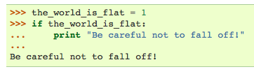
Using Python Interpreter
Argument Passing
Interactive Mode
Error Handling

Slide 11


Executable Python Scripts

Slide 12

Source Code Encoding
It is possible to use encodings different than ASCII in Python source files.
The best way to do it is to put one more special comment line right after the #! line to define the source file encoding:

Slide 13

Informal Introduction

Slide 14
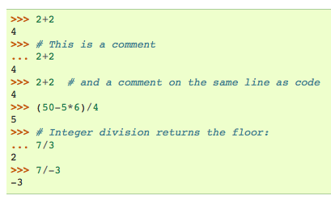
Using Python as a Calculator

Slide 15

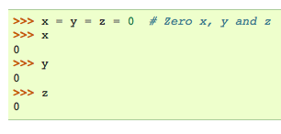
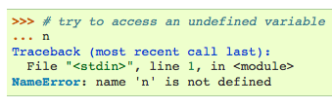

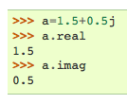
Numbers

Slide 16
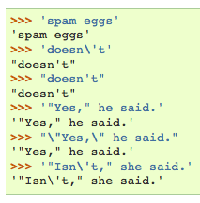
Strings

Slide 17
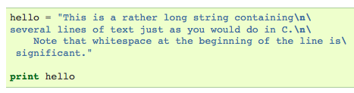
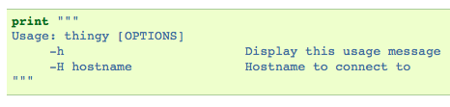

Strings
Notes:
Using r in front of string means: Raw String – string will not be processed

Slide 18
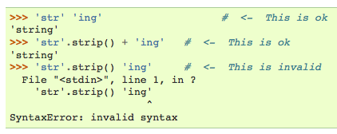
String Concatenation

Slide 19
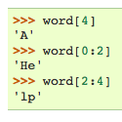
String Indexing

Slide 20

String Slicing

Slide 21
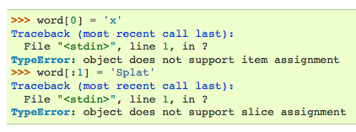
Strings are Immutable!

Slide 22
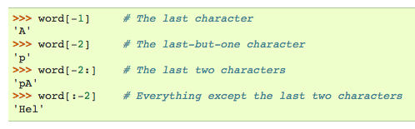
Indices May be Negative

Slide 23
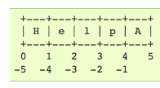
How Come?!

Slide 24
Lists
compound data type
used to group together other values
The most versatile
can be written as a list of comma-separated values (items) between square brackets.
List items need not all have the same type.

Slide 25


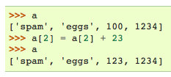
Shallow Copy
Notes:
Unlike Strings, Lists are Mutable
We can Apply len() on lists
It is possible to Nest Lists

Slide 26
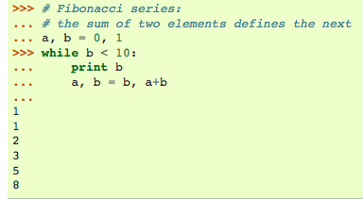
First Steps toward Programming

Slide 27
More Control Flow Tools

Slide 28
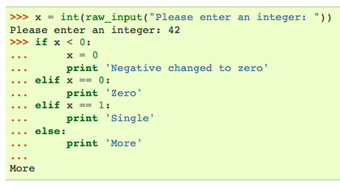
If Statement

Slide 29
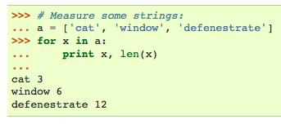
For Statement

Slide 30
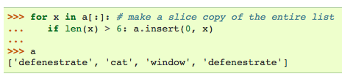
For Statement with Shallow Copy

Slide 31
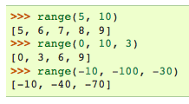
Range Function

Slide 32
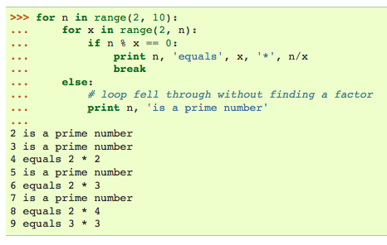
Break, Continue, Else
Notes:
The break statement, like in C, breaks out of the smallest enclosing for or while loop.
The continue statement, also borrowed from C, continues with the next iteration of the loop.
Loop statements may have an else clause; it is executed when the loop terminates through exhaustion of the list (with for) or when the condition becomes false (with while), but not when the loop is terminated by a break statement.

Slide 33



Pass
Does Nothing!

Slide 34
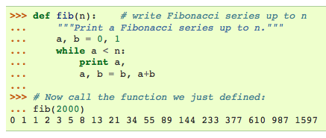
Functions

Slide 35
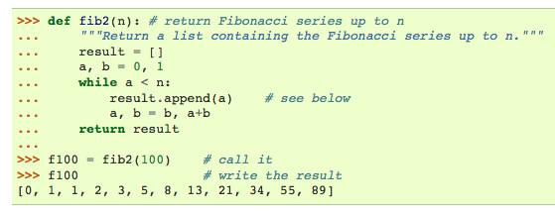
Return Statement

Slide 36
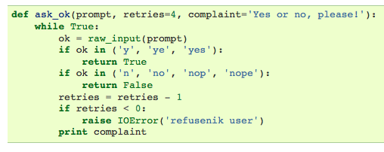
Default Argument Value

Slide 37
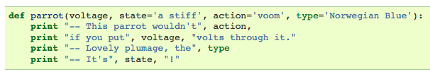
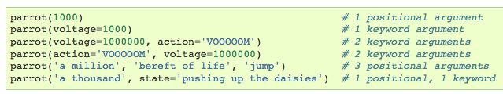

Keyword Arguments
Notes:
First Block: Function Declaration
Second Block: Valid
Third Block: Non-Valid

Slide 38
Keyword Arguments
When a final formal parameter of the form **name is present, it receives a dictionary containing all keyword arguments except for those corresponding to a formal parameter.
This may be combined with a formal parameter of the form *name which receives a tuple containing the positional arguments beyond the formal parameter list.
(*name must occur before **name.)

Slide 39
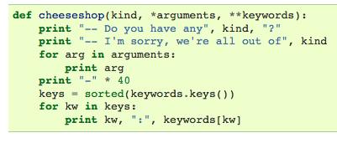
Declaration

Slide 40
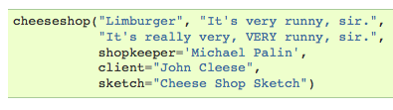
Calling

Slide 41
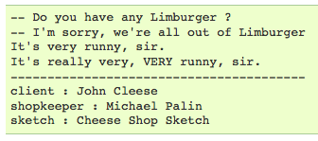
Output

Slide 42
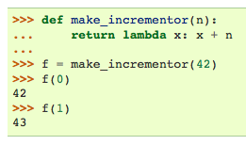
Lambda Strings
Notes:
By popular demand, a few features commonly found in functional programming languages like Lisp have been added to Python. With the lambda keyword, small anonymous functions can be created. Here’s a function that returns the sum of its two arguments: lambda a, b: a+b. Lambda forms can be used wherever function objects are required. They are syntactically restricted to a single expression. Semantically, they are just syntactic sugar for a normal function definition. Like nested function definitions, lambda forms can reference variables from the containing scope:

Slide 43
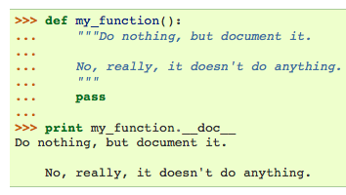
Documentation String

Slide 44
Coding Style - PEP8
Use 4-space indentation, and no tabs.
4 spaces are a good compromise between small indentation (allows greater nesting depth) and large indentation (easier to read). Tabs introduce confusion, and are best left out.
Wrap lines so that they don’t exceed 79 characters.
This helps users with small displays and makes it possible to have several code files side-by-side on larger displays.
Use blank lines to separate functions and classes, and larger blocks of code inside functions.

Slide 45
Coding Style - PEP8
When possible, put comments on a line of their own.
Use docstrings.
Use spaces around operators and after commas, but not directly inside bracketing constructs: a = f(1, 2) + g(3, 4).
Name your classes and functions consistently; the convention is to use CamelCase for classes and lower_case_with_underscores for functions and methods. Always use self as the name for the first method argument.
Don’t use fancy encodings if your code is meant to be used in international environments. Plain ASCII works best in any case.

Slide 46
Data Structures - Lists
list.append(x) Add an item to the end of the list.
list.extend(L) Extend the list by appending all the items in the given list.
list.insert(i, x) Insert an item at a given position. The first argument is the index of the element before which to insert, so a.insert(0, x) inserts at the front of the list, and a.insert(len(a), x) is equivalent to a.append(x).
list.remove(x) Remove the first item from the list whose value is x. It is an error if there is no such item.

Slide 47
Data Structures - Lists
list.pop([i]) Remove the item at the given position in the list, and return it. If no index is specified, a.pop() removes and returns the last item in the list.
list.index(x) Return the index in the list of the first item whose value is x. It is an error if there is no such item.
list.count(x) Return the number of times x appears in the list.
list.sort() Sort the items of the list, in place.
list.reverse() Reverse the elements of the list, in place.

Slide 48
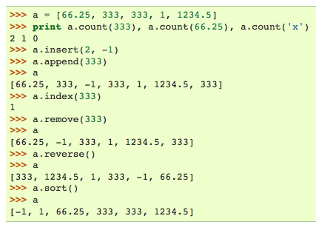
Lists Example

Slide 49
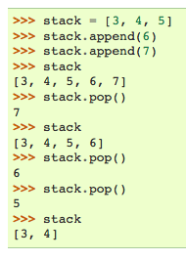
Using Lists as Stack
Notes:
First in Last Out, The list methods make it very easy to use a list as a stack, where the last element added is the first element retrieved (“last-in, first-out”). To add an item to the top of the stack, use append(). To retrieve an item from the top of the stack, use pop() without an explicit index.

Slide 50
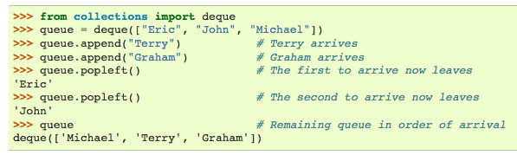
Using List as a Queue
Notes:
It is also possible to use a list as a queue, where the first element added is the first element retrieved (“first-in, first-out”); however, lists are not efficient for this purpose. While appends and pops from the end of list are fast, doing inserts or pops from the beginning of a list is slow (because all of the other elements have to be shifted by one).

Slide 51
Functional Programming Tools
There are three built-in functions that are very useful when used with lists: filter(), map(), and reduce().

Slide 52
Filter()
filter(function, sequence) returns a sequence consisting of those items from the sequence for which function(item) is true.
If sequence is a string or tuple, the result will be of the same type; otherwise, it is always a list.
For example, to compute a sequence of numbers not divisible by 2 and 3:

Slide 53

Filter()

Slide 54

Map()
map(function, sequence) calls function(item) for each of the sequence’s items and returns a list of the return values.
For example, to compute some cubes:

Slide 55
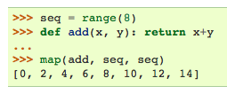
Map()
More than one sequence may be passed; the function must then have as many arguments as there are sequences and is called with the corresponding item from each sequence (or None if some sequence is shorter than another). For example:

Slide 56

Reduce()
reduce(function, sequence) returns a single value constructed by calling the binary function function on the first two items of the sequence, then on the result and the next item, and so on.
For example, to compute the sum of the numbers 1 through 10:

Slide 57
List Comprehension
List comprehensions provide a concise way to create lists.
Common applications are to make new lists where each element is the result of some operations applied to each member of another sequence or iterable, or to create a subsequence of those elements that satisfy a certain condition.

Slide 58
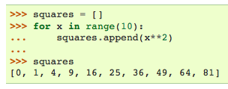

List of Squares
Notes:
Pythonic Style
Another way: squares = map(lambda x: x**2, range(10))

Slide 59
List Comprehension
A list comprehension consists of brackets containing an expression followed by a for clause, then zero or more for or if clauses. The result will be a new list resulting from evaluating the expression in the context of the for and if clauses which follow it.
For example, this listcomp combines the elements of two lists if they are not equal:

Slide 60
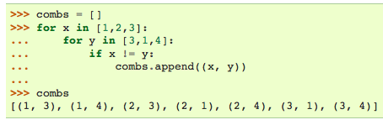
Notes:
How can this be Pythonic?

Slide 61


Slide 62
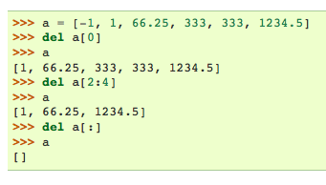
Del()
Notes:
We can del a

Slide 63
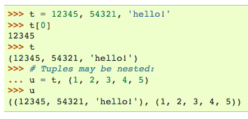
Tuples and Sequences

Slide 64
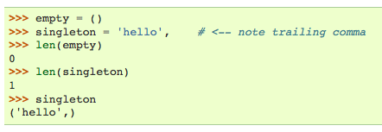
Comma at the end!

Slide 65
Sets
A set is an unordered collection with no duplicate elements.
Basic uses include membership testing and eliminating duplicate entries.
Set objects also support mathematical operations like union, intersection, difference, and symmetric difference.

Slide 66
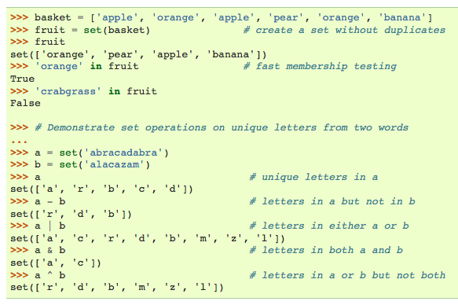

Slide 67
Dictionaries
Dictionaries are sometimes found in other languages as “associative memories” or “associative arrays”.
Unlike sequences, which are indexed by a range of numbers, dictionaries are indexed by keys, which can be any immutable type; strings and numbers can always be keys.
Tuples can be used as keys if they contain only strings, numbers, or tuples; if a tuple contains any mutable object either directly or indirectly, it cannot be used as a key.

Slide 68
Dictionaries
You can’t use lists as keys, since lists can be modified in place using index assignments, slice assignments, or methods like append() and extend().
It is best to think of a dictionary as an unordered set of key: value pairs, with the requirement that the keys are unique (within one dictionary).
A pair of braces creates an empty dictionary: {}. Placing a comma-separated list of key:value pairs within the braces adds initial key:value pairs to the dictionary; this is also the way dictionaries are written on output.

Slide 69
Dictionaries
The main operations on a dictionary are storing a value with some key and extracting the value given the key.
It is also possible to delete a key:value pair with del. If you store using a key that is already in use, the old value associated with that key is forgotten. It is an error to extract a value using a non-existent key.
The keys() method of a dictionary object returns a list of all the keys used in the dictionary, in arbitrary order (if you want it sorted, just apply the sorted() function to it).
To check whether a single key is in the dictionary, use the in keyword.

Slide 70
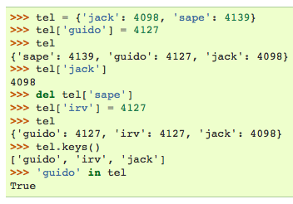

Slide 71

Dict() Constructor

Slide 72
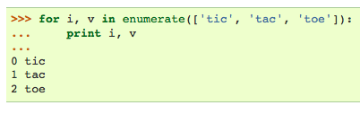
Looping Techniques

Slide 73
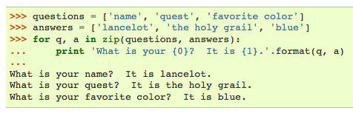
Looping over Two Sequences
Notes:
A = [1,2,3]
B = [4,5,6]
C = zip(A,B)
F,G = zip(*C) #this is unzipping

Slide 74
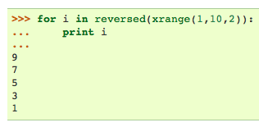
Loop in Reverse

Slide 75

More on Conditions
Include and, or

Slide 76
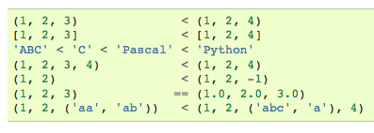
Comparing Objects of Different Types
Notes:
Note that comparing objects of different types is legal. The outcome is deterministic but arbitrary: the types are ordered by their name. Thus, a list is always smaller than a string, a string is always smaller than a tuple, etc. [1] Mixed numeric types are compared according to their numeric value, so 0 equals 0.0, etc.

