Slide 1
Explainable Longitudinal Digital Twin for Glioma Progression: A Real-Data Multimodal MRI and Clinical Approach
Shahla Newas
Maiesa Siddika
0182320012101393
0182320012101319
Fahmida Iqbal Yesha
Tuli Rani Das
0182320012101329
0182320012101337
Rahma Ferdous Lima
Samiya Akhter Anika
0182320012101341
0182320012101355
01

Slide 2
Project Progress: What We Completed
Review focus: implementation status—not a repeat of the proposal.
01
02
03
04
05
06
Data
MRI
Models
XAI
Evaluation
Digital Twin
Verified
Prepared
Trained
Tested
Completed
Prototype
MAIN REVIEW MESSAGE
We moved from a proposed framework to a complete experimental pipeline.
02

Slide 3
Dataset Verification
Before modeling, we checked whether the longitudinal data were complete and geometrically consistent.
298
1,788
0
TIME 1 ↔ TIME 2
PATIENTS
MRI FILES
MISSING FILES
MATCHED
LONGITUDINAL CHECK
TIME 1
GEOMETRY
TIME 2
MRI + segmentation
Registration check
MRI + segmentation
NO REGISTRATION MISMATCH FOUND
03

Slide 4
MRI Preprocessing
The goal was to make every patient comparable before model training.
STANDARDIZED LONGITUDINAL INPUT
Same spatial format • same image scale • consistent slices
04
Resize
03
224 × 224
Pad
02
Common geometry
Crop
04
01
Relevant region
Normalize
Intensity
04

Slide 5
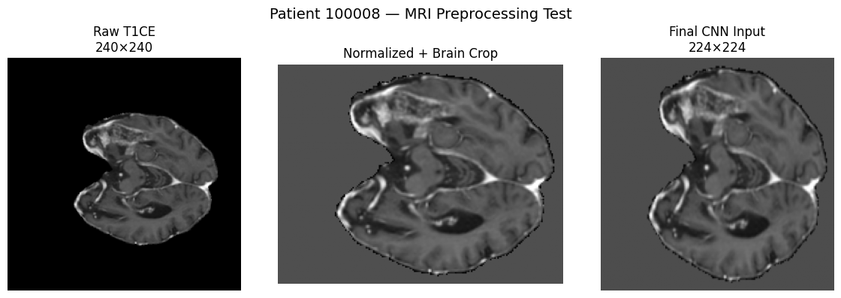
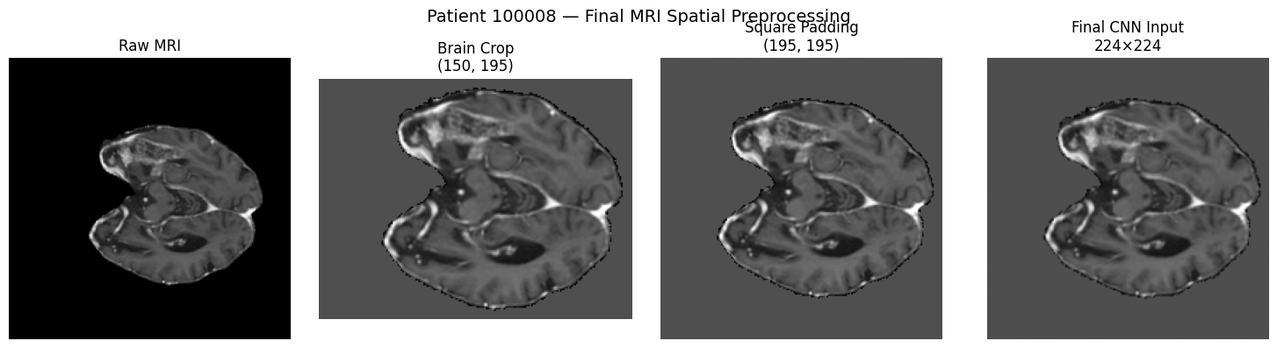
05

Slide 6
Input Construction
Each patient was converted into a matched two-timepoint representation.
TIME 1
TIME 2
FINAL MRI INPUT
48 matched slices
FLAIR + T1CE
48 matched slices
FLAIR + T1CE
48 matched
slices
FLAIR
T1CE
WHY MATCHED SLICES MATTER
The model can compare corresponding anatomy across Time 1 and Time 2 instead of treating the scans as unrelated images.
2 channels
224 × 224
06

Slide 7
Baseline & Ablation Results
Validation performance - concise comparison
Validation Accuracy
Clinical-only
Time 1 CNN
Time 2 CNN
Improved Siamese + Clinical
44.44%
53.33%
53.33%
60.00%
Baseline
Single timepoint
Single timepoint
Best result
Key Takeaway
Combining longitudinal MRI features with clinical context gives the strongest validation result.
07

Slide 8
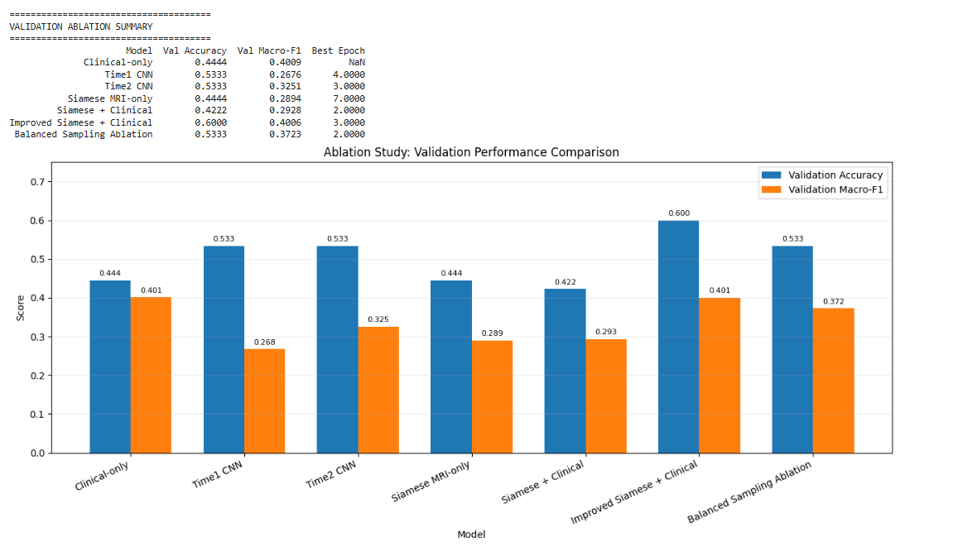
Ablation Study Comparison
Validation performance across model configurations
08
Validation Accuracy and Macro-F1 across the ablation settings.

Slide 9
Longitudinal Siamese Architecture & Case Study
Shared CNN weights learn temporal feature changes
Two MRI time points → shared feature extractor
Time 1
Patient 100183
MRI → shared CNN → F₁
Temporal Difference
True: Increased
Predicted: Increased
Probability: 0.671
ΔF = F₂ − F₁
Time 2
captures feature change over time
MRI → shared CNN → F₂
Explainability
Grad-CAM shows which spatial regions support the temporal prediction.
09

Slide 10
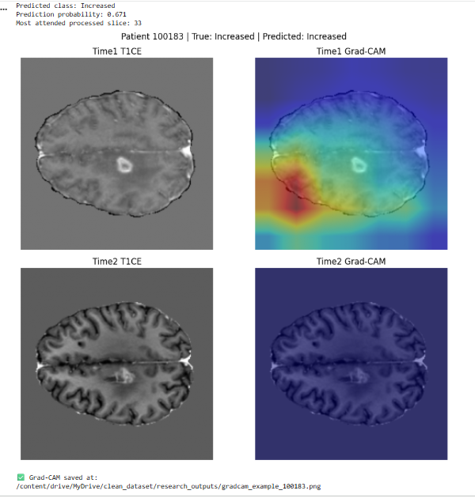
Patient 100183 Attention Visualization
MRI inputs and Grad-CAM explanations at Time 1 and Time 2
10
True: Increased • Predicted: Increased • Probability: 0.671

Slide 11
Explainability Innovation — Solving the Zero-Map Problem
Standard Grad-CAM versus Signed Grad-CAM
The Problem
Standard Grad-CAM
Signed Grad-CAM
• Discards negative evidence through ReLU.
• Can produce empty / zero maps in subtraction networks.
• Preserves positive and negative contributions.
• Keeps informative attribution in subtraction networks.
Max = 0.0000
Max = 1.0000 / 0.5622
Negative attribution is lost.
Richer spatial evidence is preserved.
Value: more complete and clinically trustworthy spatial attribution.
11

Slide 12
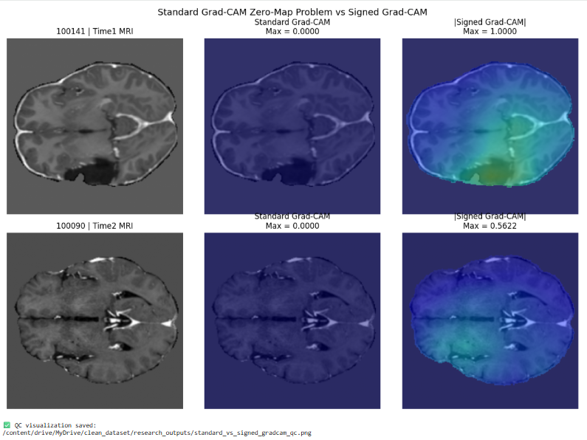
Signed Grad-CAM QC Comparison
Standard Grad-CAM zero maps versus informative signed attributions
Signed Grad-CAM preserves informative attribution where standard Grad-CAM can collapse to zero.
12

Slide 13
Attention-Based Improvement
Mean slice pooling was replaced so informative MRI slices could receive more weight.
BEFORE
AFTER
Mean Slice Pooling
Attention Slice Pooling
→
All slices contribute
approximately equally.
Important slices receive
higher learned weights.
IMPROVED SIAMESE + CLINICAL MODEL
13

Slide 14
Model Comparison & Final Selection
Validation performance determined which MRI-based model moved forward.
Clinical-only
44.44%
SELECTED
Time1 CNN
53.33%
60.00%
Val. Acc.
Time2 CNN
53.33%
Siamese MRI-only
44.44%
Macro-F1
0.4006
Siamese + Clinical
42.22%
Improved Siamese + Clinical
60.00%
BALANCED SAMPLING: NOT SELECTED
14

Slide 15
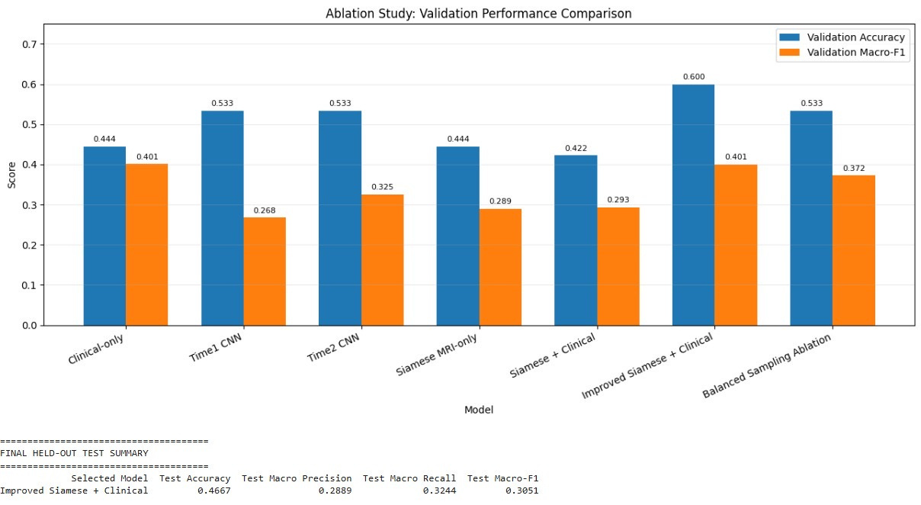
15

Slide 16
Explainability Analysis
We tested whether the model's attention aligned with expert enhancing-tumor regions.
1
2
3
Standard Grad-CAM
Signed Grad-CAM
Multi-layer Grad-CAM
Zero maps observed
in some patients
Used to address
zero-CAM behavior
Small Dice improvement
but still very low
0.0110
0.0119
≈ 0.01
16
TIME 1 DICE
TIME 2 DICE
OVERLAP LEVEL

Slide 17
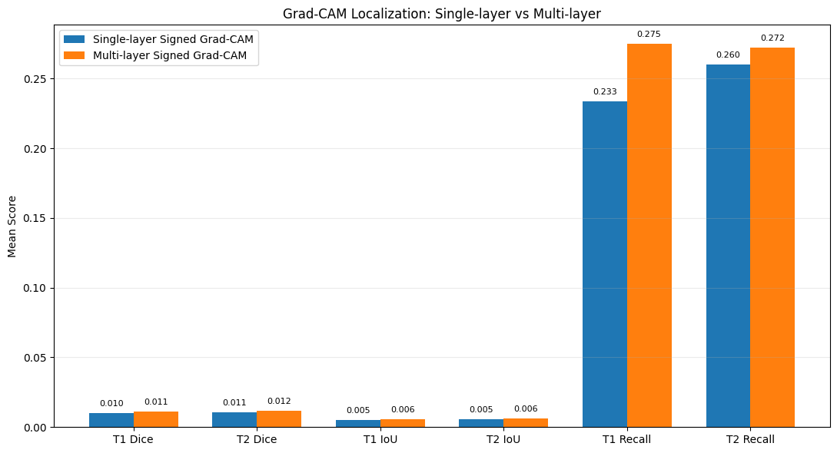
17

Slide 18
Temporal Attention Validation
The key research test: does model attention actually move with tumor evolution?
WILCOXON TESTS
TEMPORAL ALIGNMENT
p > 0.05
No significant temporal alignment.
INTERPRETATION
Attention change
vs. tumor change
The expected hypothesis that model attention would reliably follow actual tumor evolution was not supported.
Single-layer: 0.0039
Multi-layer: −0.0012
CENTROID MOVEMENT
Pearson r = 0.0549
p = 0.777
ALIGNMENT ≈ ZERO
18

Slide 19
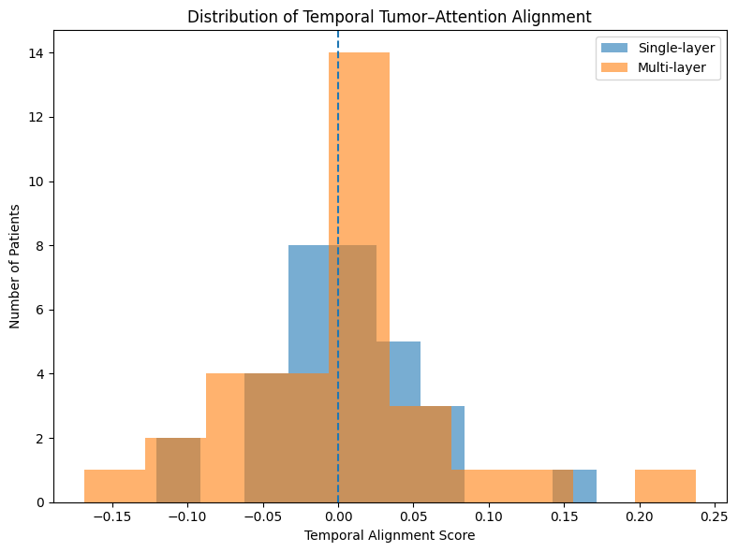
19

Slide 20
Final Test Results & Key Findings
The untouched 45-patient test set revealed the final comparative result.
CLINICAL-ONLY BASELINE
FINAL MRI MODEL
73.33%
46.67%
TEST ACCURACY
TEST ACCURACY
Macro-F1 • 0.6616
Macro-F1 • 0.3051
McNEMAR EXACT TEST • p = 0.028959
20

Slide 21
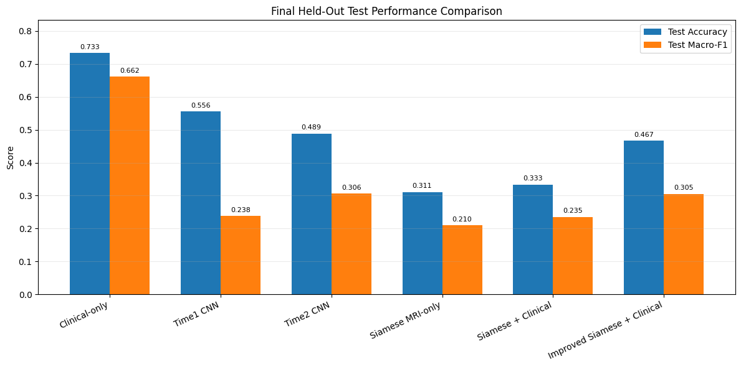
21

Slide 22
Digital Twin, Contribution & Future Work
The research outcome is broader than the final accuracy number.
CONTRIBUTION
WHAT WE LEARNED
DIGITAL TWIN PROTOTYPE
Attention was quantitatively tested against actual tumor evolution.
The MRI longitudinal model did not outperform the clinical-only baseline.
MRI
CLINICAL
FUTURE WORK
1
More longitudinal timepoints
Capture richer temporal dynamics.
TEMPORAL
2
Larger / external cohorts
Improve robustness and generalization.
128-D LATENT REPRESENTATION
3
Stronger localization & modeling
Improve attention–tumor correspondence.
22

Slide 23
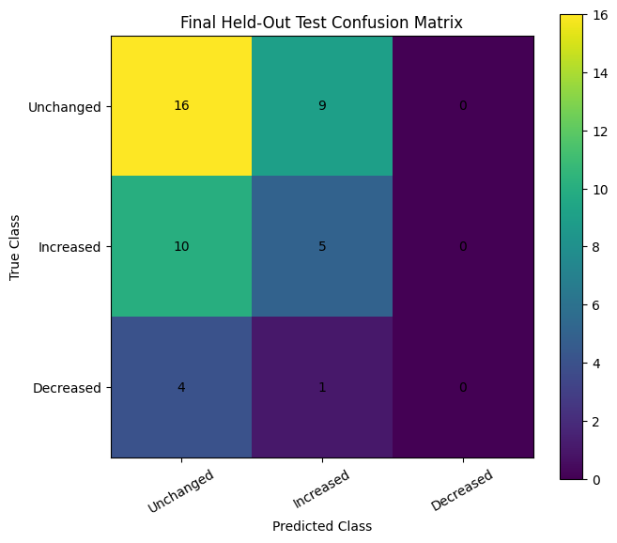
23

Slide 24
THANK YOU
Explainable Longitudinal Digital Twin for Glioma Progression
24

