Slide 1
Bio 201
Lab 5

Slide 2
Announcements
Background reading
R Cookbook, Chapter 9
News & review articles for Friday lecture
Exam 1 Friday
Review session Wednesday 6pm
Friday lecture material only

Slide 3
Notes:
Lets sell some drugs and figure out how different that they are.

Slide 7
Notes:
Knowing
• when to use t test paired and not paired t test,
• how to interpret a p value
• what are the assumptions that are being made
Keeping in mind that everyone comes in with some fixed level of butyrate, and that isn’t necessarily helpful for comparison purposes.
We don’t want to measure whether how much butyrate someone has, instead what is the result of feeding them a supplement. What someone’s x1 of butyrate might be somone’s x0 and one might be higher than the other. Again, we’re measuring change as a result of the supplement, not just the level of butyrate, which varied in the the incoming individuals.

Slide 9
Null Hypothesis (H₀)
Written as an equation
Hypothesis which is tested
Values on each side of equation are commonly equal
Research Question
Study Design
Prediction: The concentration of butyrate is not different between individuals consuming one dose and individuals consuming two doses of starch
Identify Hypothesis
Identify & Conduct
Statistical Test
Butyrate_{1x40}: fecal butyrate of individuals one done
Butyrate_{2x20}: fecal butyrate of individuals two doses
Conclusion
H₀: [Butyrate_{1x40}] = [Butyrate_{2x40}]

Slide 10
Alternative Hypothesis (H_{A})
Research Question
Written as an equation
Inverse of null hypothesis
Values commonly not equal
Study Design
Identify Hypothesis
Identify & Conduct
Statistical Test
H₀: Butyrate_{1x40} = Butyrate_{2x40}
Conclusion
H_{A}: Butyrate_{1x40} ≠ Butyrate_{2x40}

Slide 11
Statistical test: t-tests
Research Question
Identify difference in means between groups
Paired vs. unpaired
Related groups
Repeated measures
Study Design
Identify Hypothesis
Identify & Conduct
Statistical Test
Conclusion
Notes:
Paired – repeat measurements, sample same individual over time
Unpaired – compare groups of individuals
Only works on normal data because we’re comparing means

Slide 12
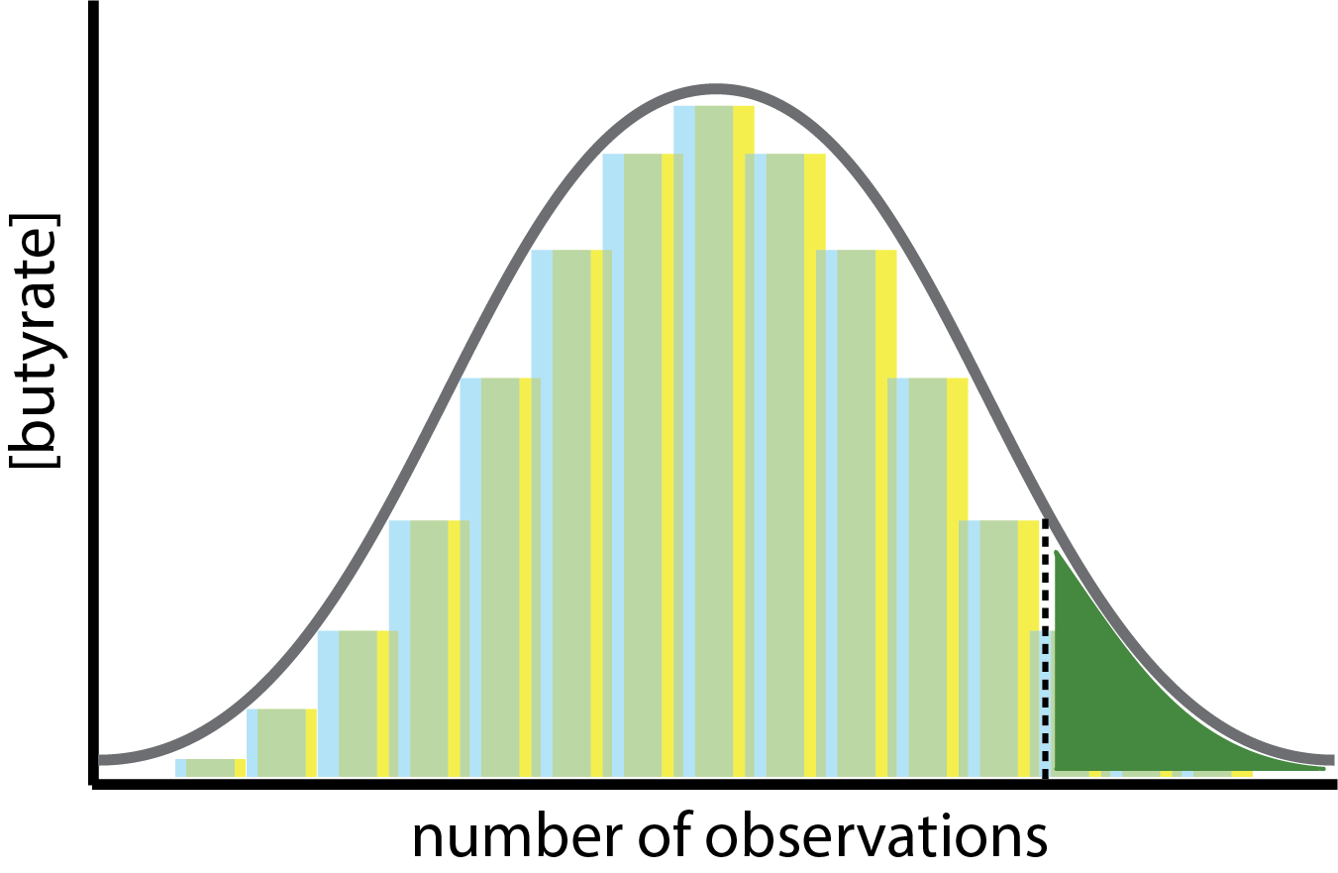
Interpreting p-values
Probability of obtaining a result equal to or more extreme than what was actually observed if the null hypothesis is true.
p-value < 0.05: reject null, support the alternate
p-value > 0.05: fail to reject null
H_{A}: Butyrate_{1x40} ≠ Butyrate_{2x40}
We often use a cutoff
of 0.05 for 95%
H₀: Butyrate_{1x40} = Butyrate_{2x40}
Notes:
• Use a mathematical approach to determine the confidence it is at LEAST THAT different

Slide 13
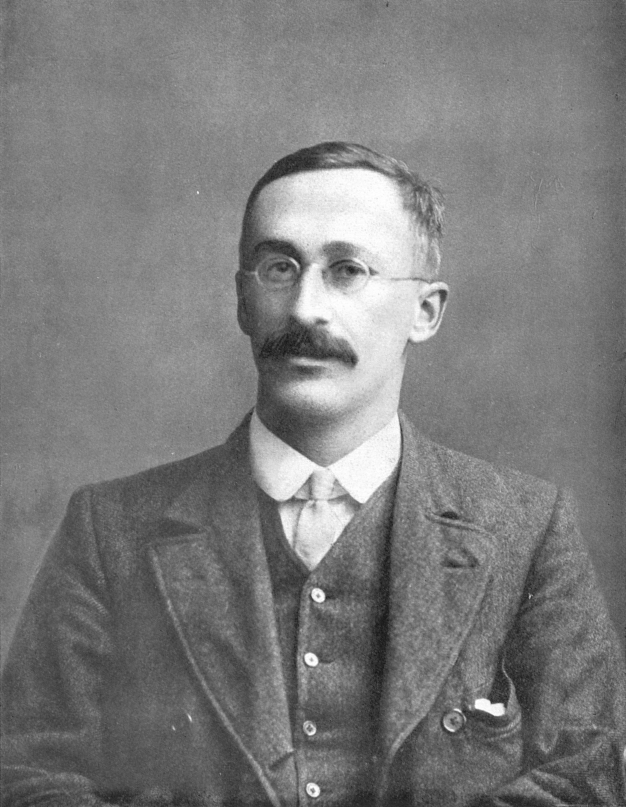

William Gosset (chemist for Guiness) 1908

