Slide 1
CROPS HARVEST
PROBLEM
GROUP 16
128517 - IT3052E

Slide 2
PRESENTATION INDEX
01
02
03
PROBLEM
MIP SOLVER
CP MODEL
04
05
06
HEURISTIC
BRANCH & BOUND
CONCLUSION

Slide 3
01
PROBLEM
What do we need to solve here?

Slide 4


CROPS HARVEST
PROBLEM
There are $N$fields with the same crops
Field $i$ need to be harvested from day $s_{i}$ to $e_{i}$with the yield of $d_{i}$
Each days, the factory processes the harvested crops
However, the factory has the minimum capacity of $m$
and the maximum capacity of $M$
Our objective is making a harvest plan that the processed crops per day is smallest

Slide 5







Data Generation
The Algorithm will take four input:
- $N$: number of fields
- $J$: number of days
- $lb$: lower bound of crops yield across all fields
An algorithm that will randomly generate our data $N, d, s, e, M, m$
- $ub$: upper bound of crops yield across all fields
Then, we will build 3 vectors of size $N$, which is $d, s, e$
Each are filled with random integer such that for $i$ from 1 to $N$:
$$ub≥d_{i}≥lb$$
$$J≥e_{i}≥s_{i}≥0$$
To make sure there is an available solution, we randomly sum up some sub-vectors of $d$, we will call those as $D$. Then we choose $M$, $m$:
$$M=max⁡(D)$$
$$m=min⁡(D)$$

Slide 6
02
MIP SOLVER
Using Ortools to solve this mixed integer problem

Slide 7






$$for i from 1 to N, j from 1 to J$$
$$x_{ij}=\left\{\begin{aligned}1, if field i can be harvest in day j \\ &0, otherwise\end{aligned}\right.$$
$$y_{j}=the capacity used for day j$$
$$M≥y_{j}≥0$$
$$z=max⁡(y_{j})$$
$$inf≥z≥0$$
$$c_{j}=\left\{\begin{aligned}1, if the factory run in day j \\ &0, otherwise\end{aligned}\right.$$
Variables

Slide 8

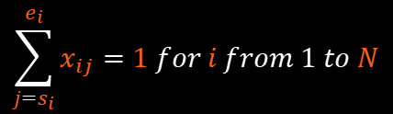
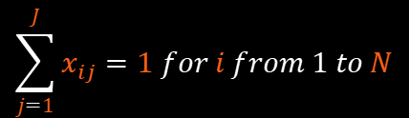
Creating Constraint
Each field need to be harvested once and only once
$$\sum_{j=1}^{J}{x_{ij}}=1 for i from 1 to N$$
Specifically, field $i$ can only be harvest once from day $e_{i}$ to day $s_{i}$
$$\sum_{j=s_{i}}^{e_{i}}{x_{ij}}=1 for i from 1 to N$$
$t$ must be smaller than min($y_{j}$)
$$y_{j} + (1−c_{j})∗L ≥ t for j from 1 to J$$

Slide 9


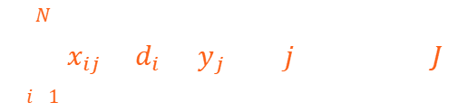

Creating Constraint
If there is no harvest, there will be no capacity used that day, otherwise, it must be greater than $m$
$$y_{j}≤c_{j}×L for i from 1 to N, with L is a large number$$
$$y_{j}≥c_{j}×m for i from 1 to N$$
Then, $y_{j}$ must be the capacity used in day $j$
$$\sum_{i=1}^{N}{x_{ij}×d_{i}}=y_{j} for j from 1 to J$$
Finally, $z$ must be bigger than $max⁡(y_{j})$
$$z≥y_{j} for j from 1 to J$$

Slide 10

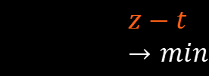
Objective
Our objective function is simple
$$z−t→min$$
$$z→$$

Slide 11
03
CP MODEL
Using Ortools to solve this constraint problem

Slide 12

$$for i from 1 to N, j from 1 to J$$
$$x_{i}=the day to harvest field i$$
$$x_{j}≥0$$
$$y_{j}=the capacity used for day j$$
$$M≥y_{j}≥0$$
$$z=max⁡(y_{j})$$
$$inf≥z≥0$$
$$c_{j}=\left\{\begin{aligned}1, if the factory run in day j \\ &0, otherwise\end{aligned}\right.$$
Variables

Slide 13
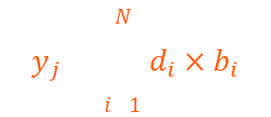


Creating Constraint
Field $i$ can only be harvest once from day $s_{i}$to day $e_{i}$
$$e_{i}≥x_{i}≥s_{i} for i from 1 to N$$
For each day $j$, if field $i$ is harvested ,then its yield $d_{i}$ will be added to total capacity used that day
$$x_{i}=j↔b_{i}=1 for i from 1 to N$$
$$y_{j}=\sum_{i=1}^{N}{d_{i}×b_{i}}$$
$$x_{i}≠j↔b_{i}=0 for i from 1 to N$$
$$b_{j}=intermiediate binary variable$$
Finally, $z$ must be bigger than $max⁡(y_{j})$
$$z≥y_{j} for j from 1 to J$$

Slide 14

Objective
Our objective function is simple
$$z→min$$
$$z→$$

Slide 15
04
HEURISTIC
Using creative ways to solve this problem

Slide 16
05
BRANCH & BOUND
A solution with less precise

Slide 17






IDEA & ALGORITHM
Fist, call 2 global zeros vectors
$$f of size J$$
$$x of size N$$
Our idea is to count almost all possible solution with two easy to understand bounds
Then, run algorithm for the first field
For each field, search from day $1$ to day $J$
If in day $j$, field $i$ can be harvested
We will call them $b_{up}$ = M and $b_{down}=m$
$$f_{j}+=d_{i}$$
$$x_{i}=j$$
If it is the last field, if $\max\left(f\right) ≤ b_{up}$ and $\min\left(f:(f>0)\right)≥b_{down}$
Record $x$ and $f$
$$b_{up}=\max\left(f\right)$$
$$b_{down}=\min\left(f:(f>0)\right)$$
If $\max\left(f\right) ≤ b_{up}$ and $\min\left(f:(f>0)\right)+remaining yield ≥b_{down}$
Run algorithm for the next field
$$f_{j}−=d_{i}$$

Slide 18
06
CONCLUSION
What did we learn?

Slide 19

For the case that $N≈J$
There seem to be an exponential growth for MIP and CP

Slide 20

For the case that $5N≈J$

Slide 21

For the case that $N≈5J$

Slide 22
Thanks for your
listening
GROUP 16
Trần Hoàng Quốc Anh - 20200044
Mai Hà Đạt - 20200135
Dương Tùng Giang - 20204908
Lý Nhật Nam - 20204886
128517 - IT3052E

