Slide 1
Mini Project Presentation
Melanie Duong – DATA 400

Slide 2

OUTLINE
01
04
02
05
Project Overview
Exploratory Data
Data & Methodology
Implications & Conclusion

Slide 3

01
PROJECT OVERVIEW

Slide 4
Project Overview
Research Topic
Traffic Crashes in Pennsylvania (2014–2024): trends, locations, and vehicle involvement.
Measure crash severity statewide (injuries + fatalities) from 2014–2024.
Identify hotspots by municipality to see where people are most affected.
Track trends over time to spot increases, declines, or COVID-era shifts.
Compare vehicle involvement (automobiles, trucks, buses, motorcycles, bicycles) and their shares.
Purpose

Slide 5
02
DATA & METHODOLOGY

Slide 6
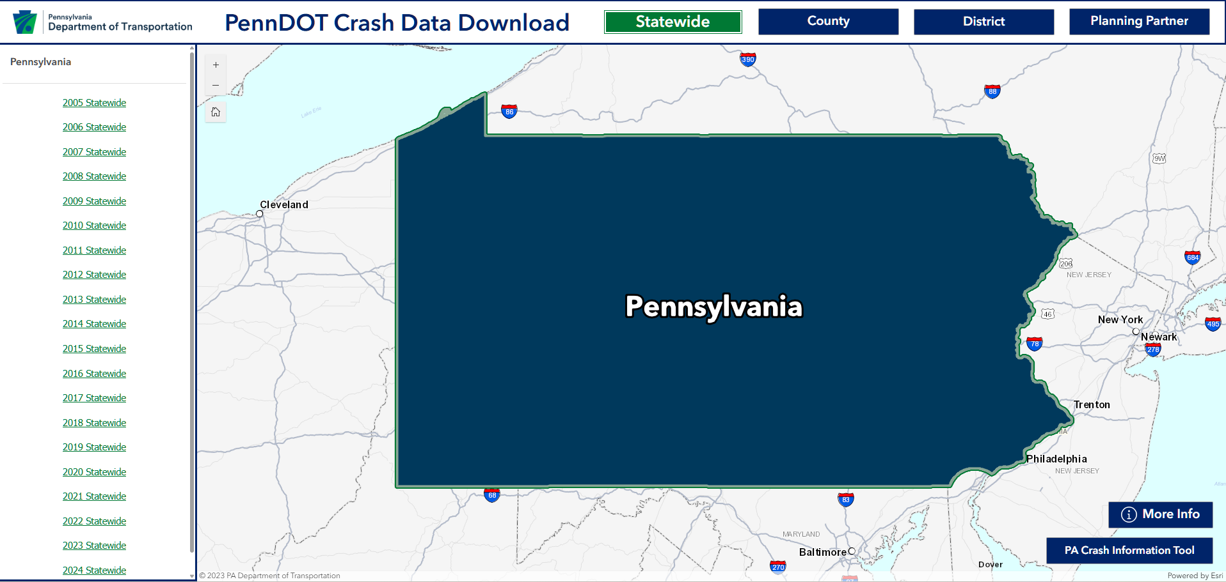
Data Source: PennDOT
Data Source

Slide 7
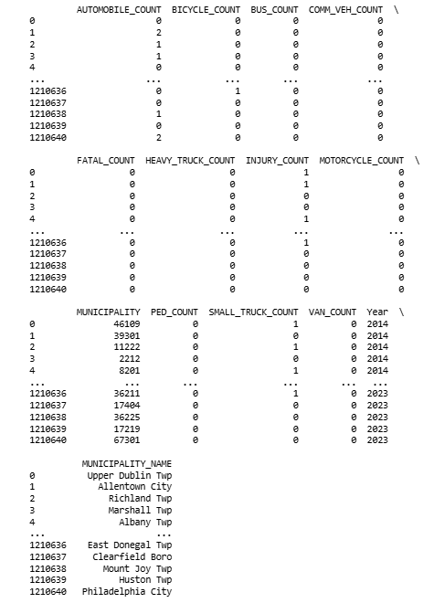
Dataset
Timeframe: 2014–2023.
Geography: All Pennsylvania municipalities.
Unit = crash.
Measures:
AUTOMOBILE_COUNT
BICYCLE_COUNT
BUS_COUNT
COMM_VEH_COUNT
FATAL_COUNT
HEAVY_TRUCK_COUNT
INJURY_COUNT
MOTORCYCLE_COUNT
MUNICIPALITY
PED_COUNT
SMALL_TRUCK_COUNT
VAN_COUNT
YEAR
MUNICIPALITY_NAME

Slide 8
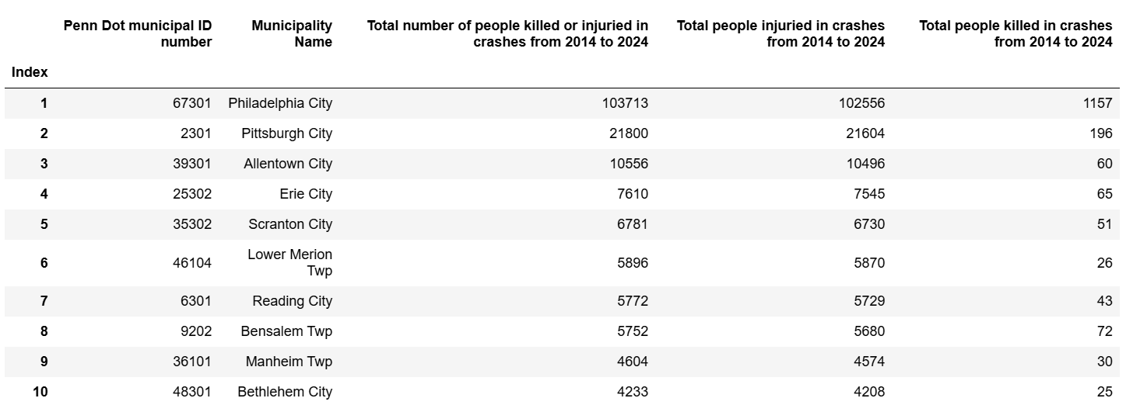
Dataset

Slide 9
03
EXLPORATORY DATA ANALYSIS

Slide 10
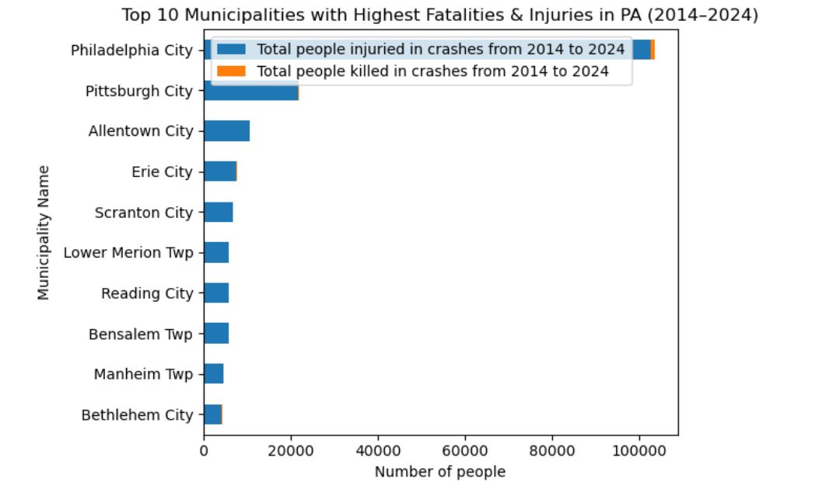
Top Municipalities with Most Crashes

Slide 11
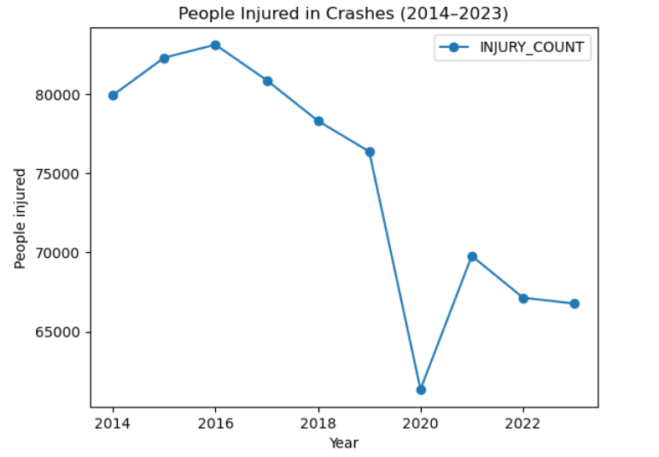
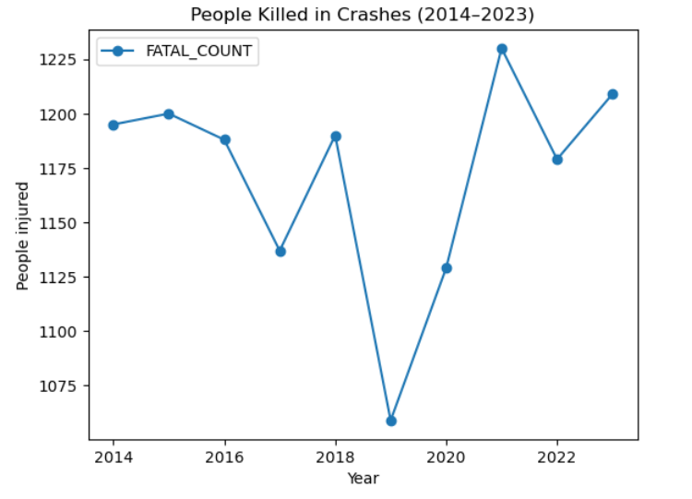
CRASHES TREND OVER TIME

Slide 12
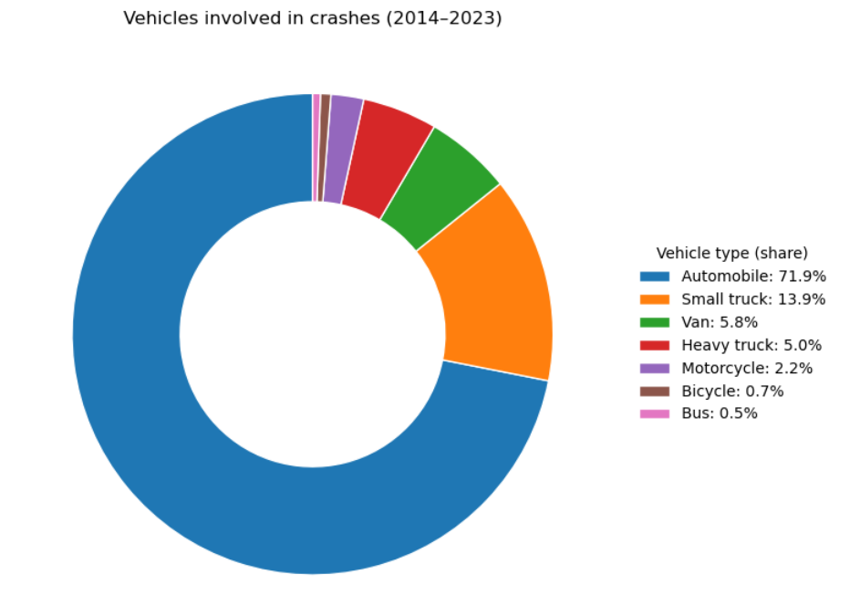
Vehicles Involvement

Slide 13
IMPLICATIONS
Stakeholders
Ethical & Societal
Legal & Governance
Prioritize high-injury corridors and peak times
Fund engineering fixes first: speed management, protected turns, lighting, road diets
Design for safety first
Payment plans for low-income residents, language access, and reinvest any revenue into safety projects in the same neighborhoods
Follow state/local laws on cameras and speed setting
Ensure accessibility and civil-rights compliance

Slide 14
Thank you for listening!

