Slide 1
EMF Query processing Engine
By Yunxiang Fu & Zhili Yu

Slide 2
Standard SQL query flaw
Ad-hoc OLAP queries (also known as multi-dimensional queries) expressed in standard SQL, even the simplest types, often lead to complex relational algebraic expressions with multiple joins, group by, and sub queries. When faced with the challenges of processing such queries, traditional query optimizers do not consider the “big picture”. Rather, they try to optimize a series of joins and group by, leading to poor performance.

Slide 3
Project PURPOSE
Build a query processing engine for Ad-Hoc OLAP queries. The query construction is based on an extended SQL syntax known EMF queries(Extended Multi-Feature queries). It reads in a query in the specified format, then generates a file called “Query.java”. By compiling and running “Query.java”, the result of Ad-Hoc OLAP query is presented

Slide 4
ROUGH Structure
EMF Query
Translate_SQL.java
TranslateEmf.java
Main.java
Query.java
Result.xlsx

Slide 5
The input of processing engine
select prod, month, count(z.quant)
from sales
group by prod, month; x, y, z
such that x.prod = prod and x.month = month - 1, y.prod = prod and y.month = month + 1, z.prod = prod and z.month = month and z.quant > avg(x.quant) and z.quant < avg(y.quant)

Slide 6
After Translation
// SELECT ATTRIBUTE(S):
prod,month, avg(z.quant), max(y.quant)
// NUMBER OF GROUPING VARIABLES(n):
3
// GROUPING ATTRIBUTES(V):
prod,month
// F-VECT([F]):
avg(x.quant),avg(y.quant),count(z.quant)
// SELECT CONDITION-VECT([Sigma]):
x.prod = prod and x.month = month - 1, y.prod = prod and y.month = month + 1, z.prod = prod and z.month = month and z.quant>x_avg_quant and y_avg_quant
// HAVING CONDITION(G):

Slide 7
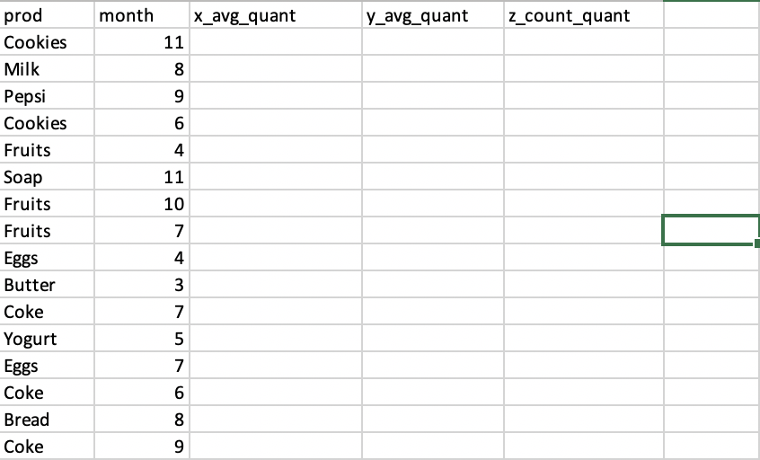
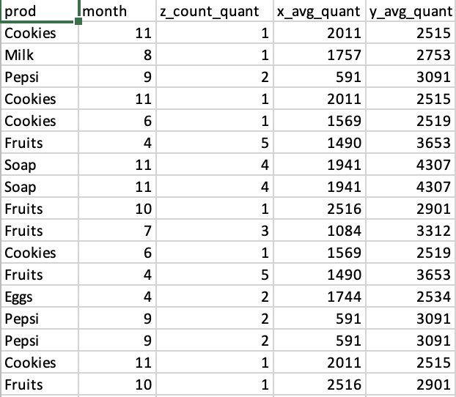
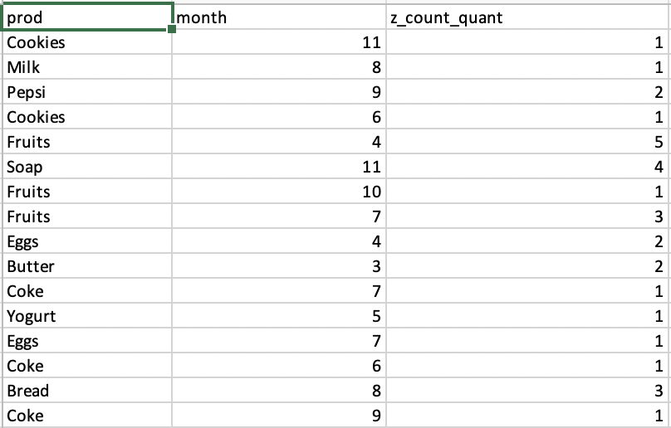
How to process the query 1.Generate EMF-structure
1.Genreate EMF Structure
2.Scan the table to generate the aggregate value
3.Generate the output

Slide 8
The description of the technology
Regular Expression
Java
Apache POI library
PostgreSQL JDBC Driver Version 42.2.12

Slide 9
Technical limitations
Where clause is not supported.
No optimization
Result will be sorted in excel not in program
No error checking for the SQL input

Slide 10
Summary
To express complex OLAP queries in Standard SQL, a high degree of redundancy (multiple self-joins, correlated subqueries, and repeated group-bys) is required. This leads to complicated queries, difficult to write, understand and optimize.
Make queries to be expressed in a succinct and simple manner
Run queries faster by using efficient algorithms with less memory cost

