Slide 1
The Discrete Kalman Filter
Final project – Fall 2015
Scientific Computing
Daniel Hallman and Maike Scherer

Slide 2
Overview
Rudolf Emil Kalman
Use of the Kalman Filter
Theory behind the Kalman Filter
Application
Works Cited

Slide 3
Rudolf Emil Kalman
Born in 1930
Electrical Engineer (undergrad) and Mathematician (graduate, PhD)
Papers in physics, differential equations, prediction theory (statistics)
→ Kalman filter, 1960
Received a prize for his work from the AMS
Notes:
Did not show to pick up steel medal since he didn’t consider it his work

Slide 4
Use of the Kalman Filter
Signal processing
GPS data
Computer Vision
Object Tracking
Image Processing
De-noise i.e. filter images
…anything that has numbers that needs to be filtered
Note: there is a lot of MATLAB documentation
Notes:
Original idea: noisy sensor measurements and we have data and we are pretty much “curve fitting”
GPS data noisy due to long distances, weather, etc
Object tracking: security systems (track a moving object), object in blood vessels, ball flying through air, self driving cars
Kalmanfilter for tracking

Slide 5
Idea and Assumptions
Discrete
measurements taken with equal distances, use as unity to “keep the Math rigorous yet elementary” (Kalman)
Educated guess (Prediction)
Actual (noisy) data updates prediction (Correction)
Only need to keep track of one prior step (fast)
Everything is related to a certain degree
Minimize Estimated Error Covariance (trial and error, update educated guess)
Assume Gaussian noise (white noise) i.e. the noise has a normal distribution
Notes:
Uncertain information vs educated guess (combine theory and real world)
Velocity and position or anything else you want to keep track of plus noise (e.g. wind, distance from remote…)
Actual is linear comb of guess and

Slide 6
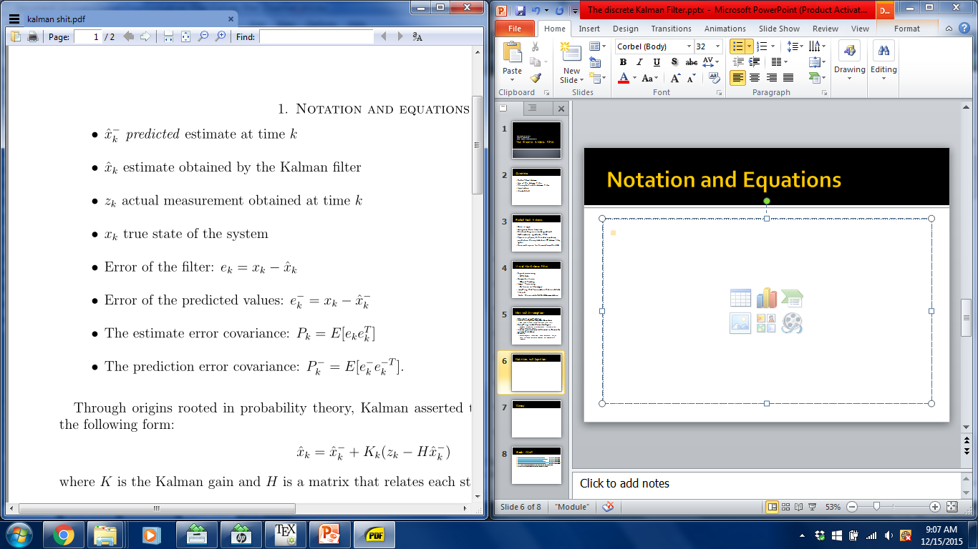
Notation and Equations

Slide 7

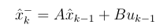
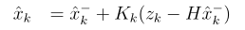
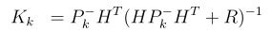
Theory
True answer:
Prediction (also: Time Update)
Correction (also: Measurement update)
K – Kalman gain
Notes:
A – matrix that realtes previous est to predition, control signal
P – prediction error coariance, P error cov
H – relates them
K is there to
R measurement noise covariance

Slide 8
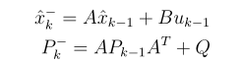
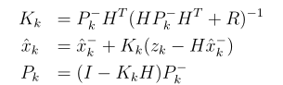
Theory
Time Update
Measurement update

Slide 9

Application I
Tracking an object under constant acceleration
Equations of motion are used as the prediction model

Slide 10



Discretize model
Matrix-vector notation

Slide 11
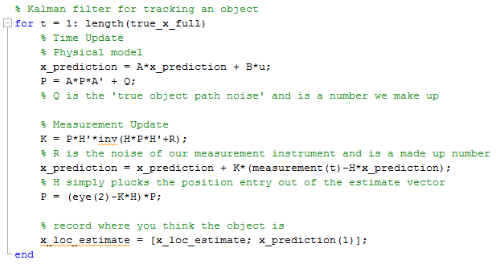
MATLAB excerpt

Slide 12
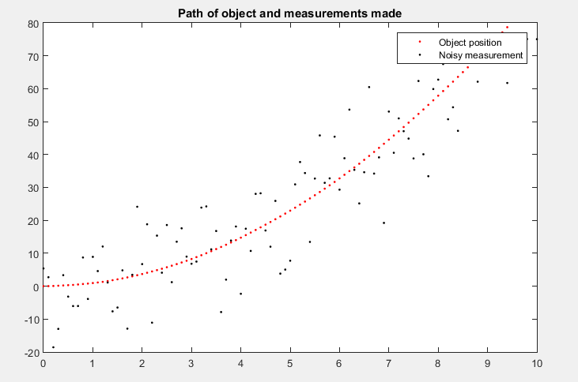
Result

Slide 13
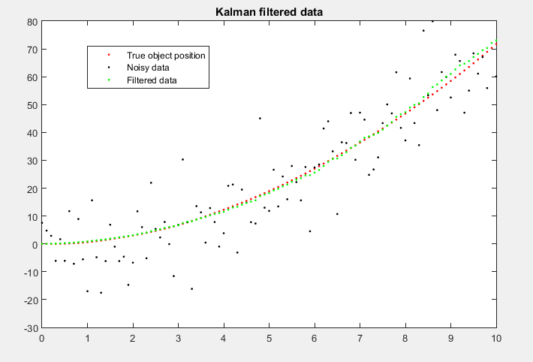
Result

Slide 14
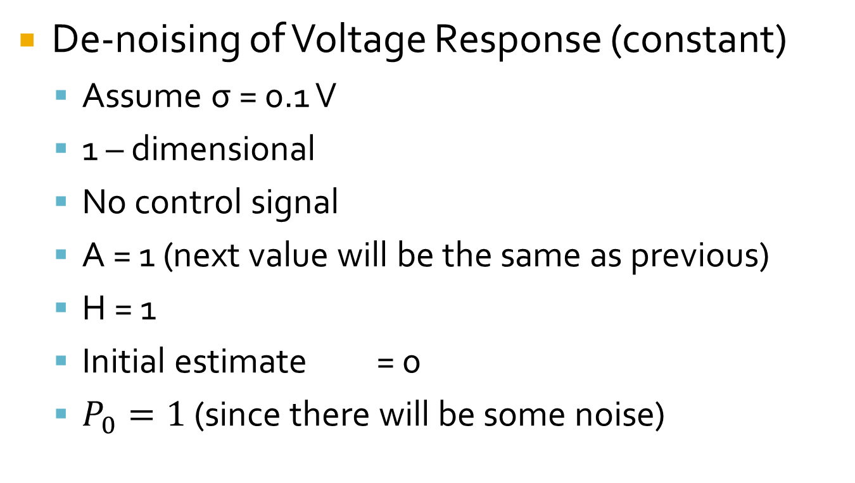
Application II
De-noising of Voltage Response (constant)
Assume σ = 0.1 V
1 – dimensional
No control signal
A = 1 (next value will be the same as previous)
H = 1
Initial estimate = 0
$P_{0}=1$ (since there will be some noise)
Notes:
Random scalar constant, normal means 68% within 1 stand dev
H – state value and some noise (hardly not 1)

Slide 15
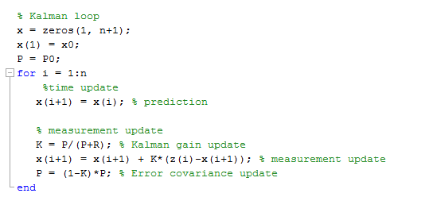
MATLAB excerpt

Slide 16
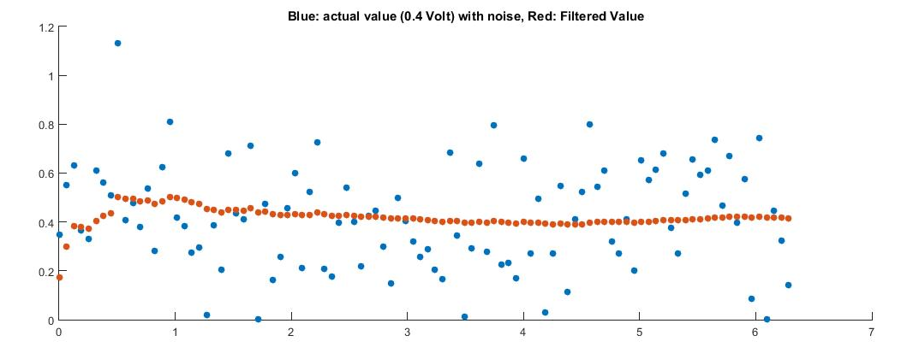
Results

Slide 17
Works Cited
http://www.genealogy.math.ndsu.nodak.edu/id.php?id=13021 last accessed 12/12/15
http://www-history.mcs.st-andrews.ac.uk/Biographies/Kalman.html last accessed 12/12/15
http://www.mathworks.com/discovery/kalman-filter.html last accessed 12/14/15
http://bilgin.esme.org/BitsBytes/KalmanFilterforDummies.aspx last accessed 12/15/15
http://www.cs.unc.edu/~tracker/media/pdf/SIGGRAPH2001_CoursePack_08.pdf last accessed 12/15/15
http://www.bzarg.com/p/how-a-kalman-filter-works-in-pictures/ last accessed 12/15/15
R. E. Kalman – A New Approach to Linear Filtering and Prediction Problems (1960)
Greg Welch and Gary Bishop – An Introduction to Kalman Filter (2006)
https://www.youtube.com/watch?v=rUgKnoiRoY0 last accessed 12/12/15

